Slide 1
Evaluating scientific software

Slide 2
Choosing appropriate software. Options.
Create your own from scratch.
Create your own with key bits from well-developed, professionally written libraries (e.g. LINPACK).
Use or modify somebody else’s – in-house.
Use professionally developed packages. Great for what it is designed for, hard to modify.
Use UNIX tools (e.g. shell scripting) to create a pipeline that executes existing pieces, including some of the above.
Each option has its pros and cons.
Different stages of the project may require different approaches. E.g. make no sense to spend a lot of time on #1 just to test out various algorithms.

Slide 3
Two key properties of scientific software/algorithm
speed
accuracy

Slide 4
Two key properties of scientific software/algorithm
Genius
speed
typical
accuracy

Slide 5
Assessing accuracy
Generally hard.
Best – against experimental observations. Example: protein folding prediction against experimentally determined protein structures. RMS deviation from experiment. Often hard: multivariable. Not every method predicts experimental outcome directly.
By proxy, against “industry standard” methods of known quality. The reference methods are often slower, but more accurate. Example: coarse-grained methods against full calculations. Monte Carlo against exhaustive search.

Slide 6
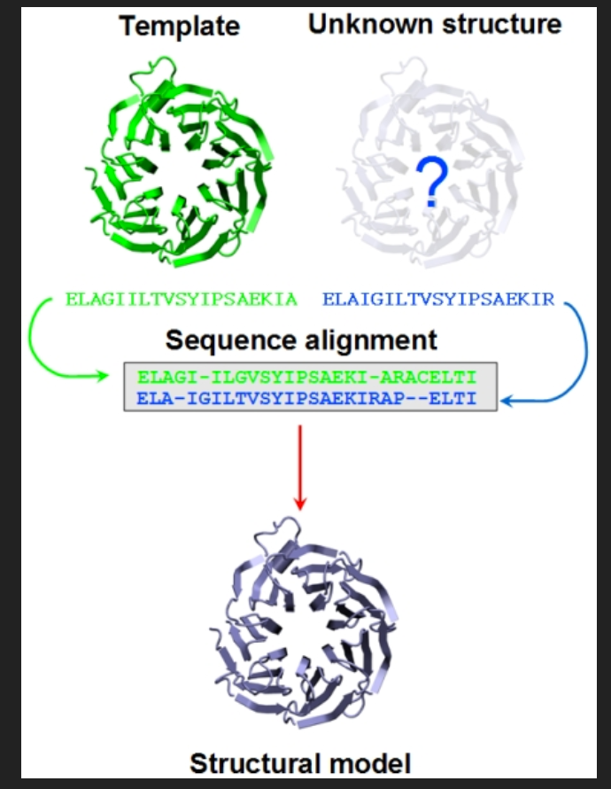
Example: protein prediction by homology modeling to known proteins
accuracy
Similarity to a known protein

Slide 7
Comparing speeds
Obviously, the new and the reference method must compute the same quantity.
Ideally, compare at fixed accuracy. Hard. Sophisticated methods have complex accuracy/speed trade-offs, controlled by multiple parameters. Example: solve PDE via finite difference. Lattice spacing and order of the method control both accuracy and speed. Have to be an expert, ideally the developer.
Relatively easy: compare two methods by setting parameters to their recommended defaults.
A set of benchmarks that everyone recognizes. For example: LINPACK benchmarks for testing supercomputers.

Slide 8
Testing supercomputers:
Solve Ax = b using a version of Gaussian elimination
A = random, non-sparse NxN matrix, entries between [-1, 1]. So is b.
Expected compute time = O(N^3). Obviously, need to test various n, usually spanning at least an order of magnitude.
Test speed as a function of # of CPUs used AND the size of the problem n.
Maintain fixed accuracy

Slide 9
Testing supercomputers: scaling
Speed (appropriate units)
realistic, larger problem
Ideal linear scaling
realistic
# of compute units
1 2 4 8 16 32 64 128

Slide 10
Problem scaling with # of processors.
Time to perform the task on single CPU: t0
Assume the task can be equally divided between N CPUs, the time is cut by N: t0/N
Time to communicate between CPUs: τ << t0
Total compute time T = t0/N + τ
Speed-up relative to 1 CPU = t0/T = t0/(t0/N + τ ).

Slide 11
Parallel scaling of common molecular dynamics software
From Antti-Pekka Hynninen and Michael F. Crowley, JCC 2014

Slide 12
Parallel scaling of common molecular dynamics software
From Antti-Pekka Hynninen and Michael F. Crowley, JCC 2014

Slide 13
Example of professional (speed) benchmarking
AMBER 12 NVIDIA GPU ACCELERATION SUPPORT
http://ambermd.org/gpus/benchmarks.htm

Slide 14
Benchmarking scientific software that are not based on exactly the same algorithm
Not meaningful to compare speeds within a factor of 2, only ballpark comparisons make sense. Usually can get a factor of two by tweaks to compiler options, etc. Example:
B. Aguilar and A.V. Onufriev, Efficient Computation of the Total Solvation Energy
of Small Molecules via the R6 Generalized Born Model J. Chem. Theory and Comput., 8 (7) (2012), 2404-2411

