Slide 1

The Graphics Processing Unit (GPU) revolution
Lecture: Vartan Kesiz-Abnousi
CS/Math 4414: Issues in Scientific Computing
Alexey onufriev

Slide 2
Outline
The need for parallel processing
Basic parallel processing concepts
The GPU – a massively parallel processor
Overview of GPU hardware architecture
Introduction to GPU programming
Performance considerations

Slide 3
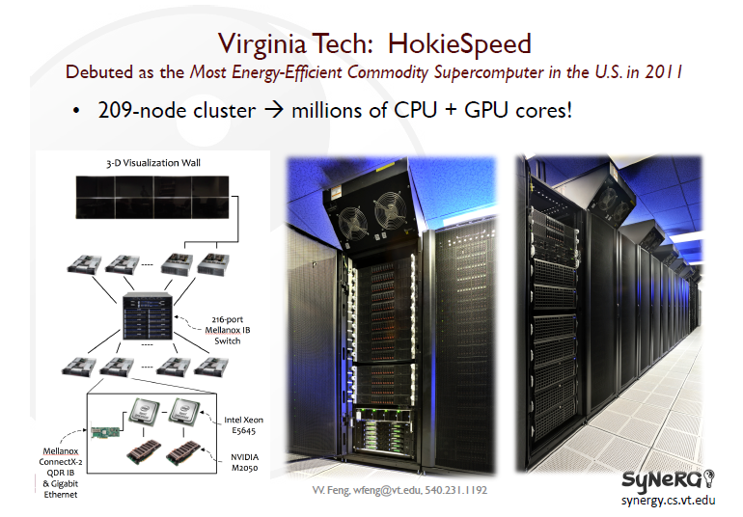

Slide 4
Why Parallel Computation?
The answer 10-15 years ago?
  To realize performance improvements that exceeded what CPU performance improvements could provide
  Otherwise, just wait 18-24 months, your code automatically runs faster on the next-generation CPU.
The answer today?
  It is the primary way to achieve significantly higher application performance for the foreseeable future.

Slide 5
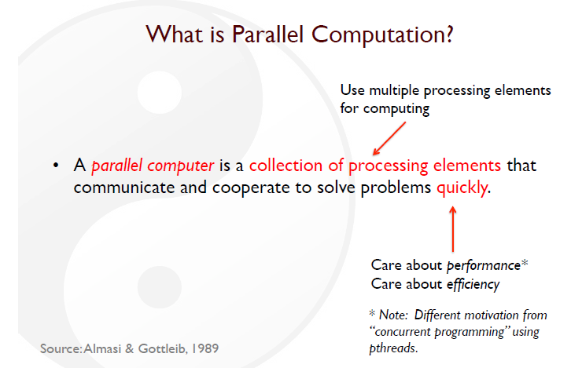

Slide 6
Two Major Reasons for Improved Processor
Performance (until 2006)
Increasing the clock frequency
  At what cost?
Exploiting instruction-level parallelism (ILP)
  How?

Slide 7
Increasing the clock frequency
More transistors => Increase the clock frequency (Flops)
Moore’s Law: the number of transistors on a reasonably priced integrated circuit tends to double every 2 years.
Not quite
More Transistors -> More heat -> Lower Frequency

Slide 8
Increasing the clock frequency ☹
Power Draw as a Function of Frequency
Dynamic power α capacitive load x voltage2 x frequency
Static power: Transistors burn power even when inactive due to leakage
Maximum allowed frequency determined by processor’s core voltage

Slide 9
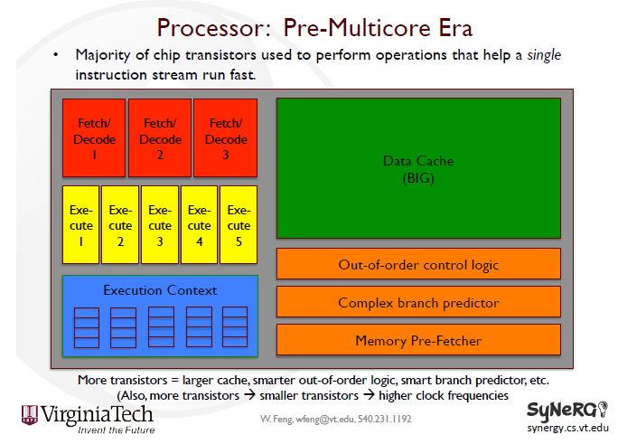

Slide 10
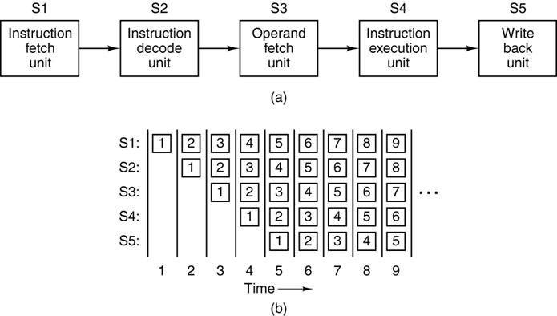
Instruction level parallelism (ILP)
10

Slide 11
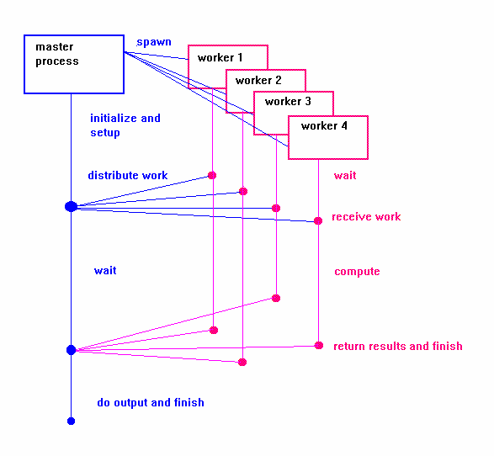
Application level parallelism
11

Slide 12
Limitations of instruction level parallelism
12
The Pentium 4 has a 20 stage pipeline
Typically every 5th or 6th instruction is a branch instruction – longer pipelines have a larger branch mis-prediction penalty
Different instructions require different number of clock cycles which occur at different frequencies

Slide 13
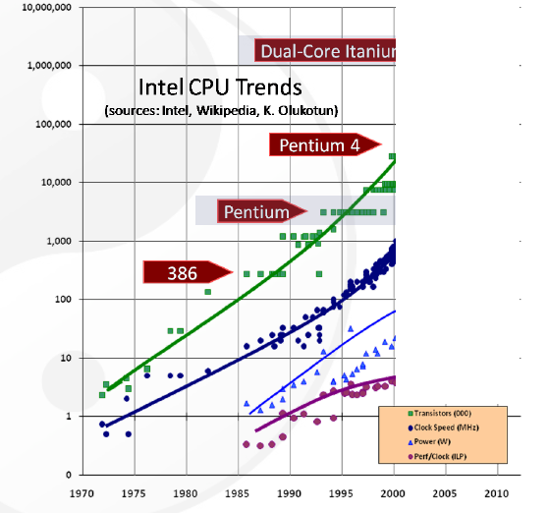

Slide 14
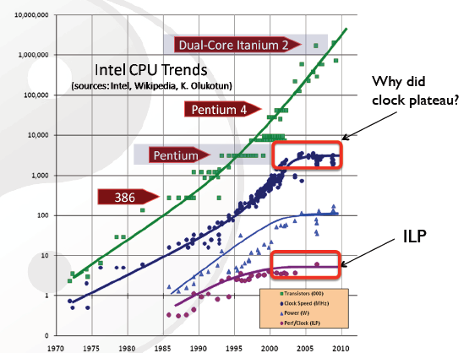

Slide 15
Software must be written to be
parallel to see performance gains.
No more free lunch for software
developers.

Slide 16
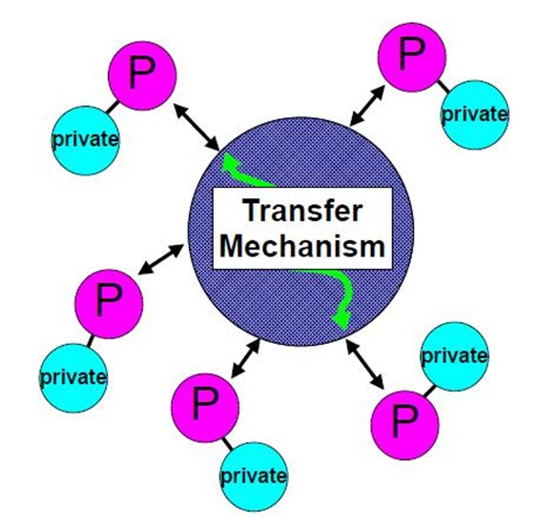
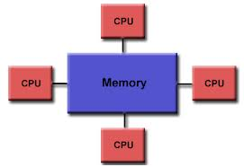
Application level parallelism - implementation models
16
Shared address space
(OpenMP)
HokieOne: 492 cores
Message Passing
(MPI)
HokieSpeed: 2448 cores (204 nodes)

Slide 17
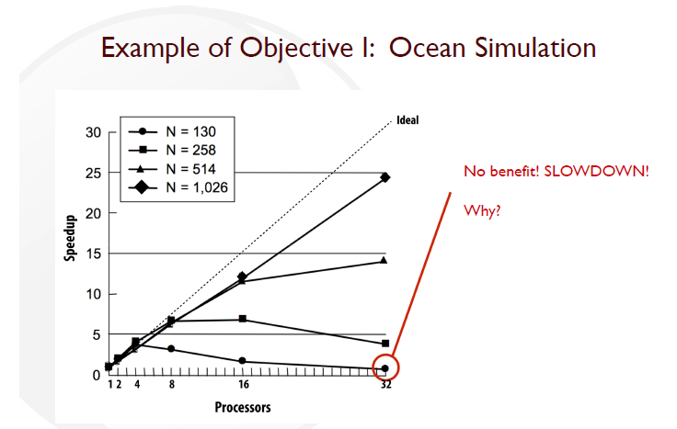
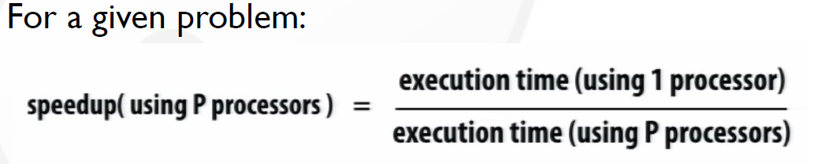
When Parallel Computing Fails

Slide 18
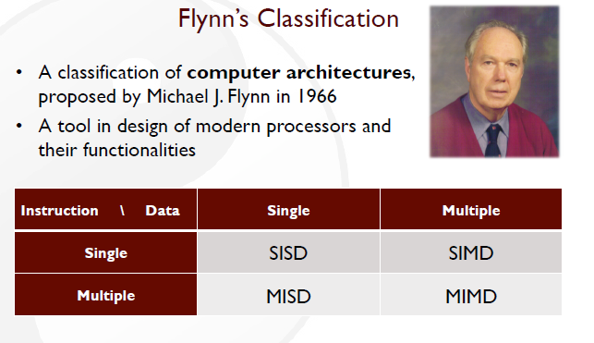

Slide 19
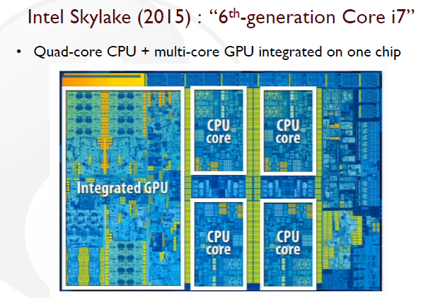

Slide 20
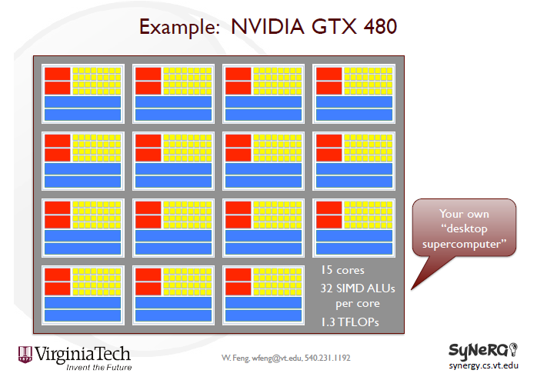
GPU
(ALU):
Arithmetic Logic Unit
GPUs Massively parallel processors

Slide 21
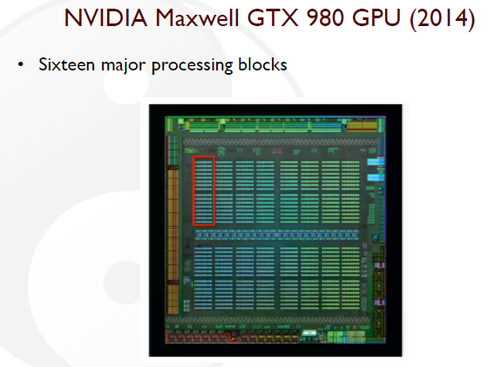
GPUs Massively parallel processors

Slide 22
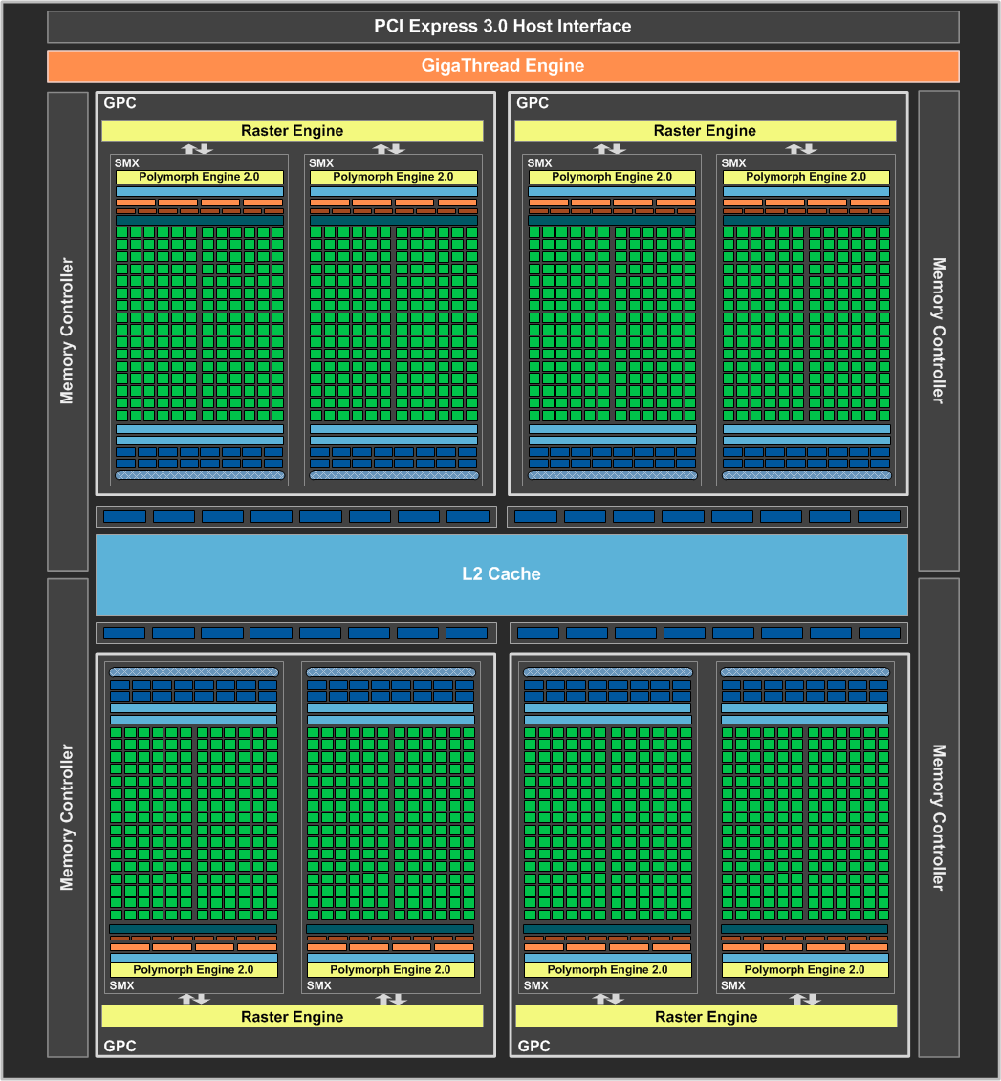
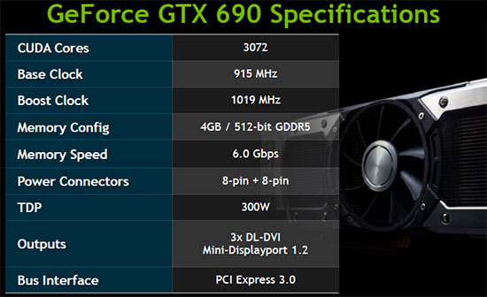
GPUs – Massively parallel processors
22
(www.nvidia.com)

Slide 23

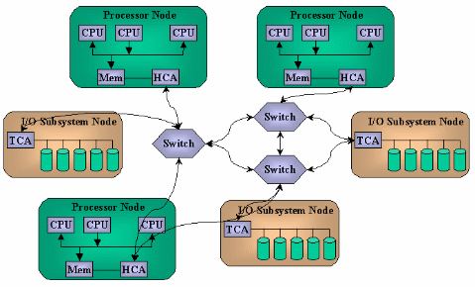
A key limitation of supercomputer architecture – inter node communication
23
(extremetech.com)
Master Process

Slide 24
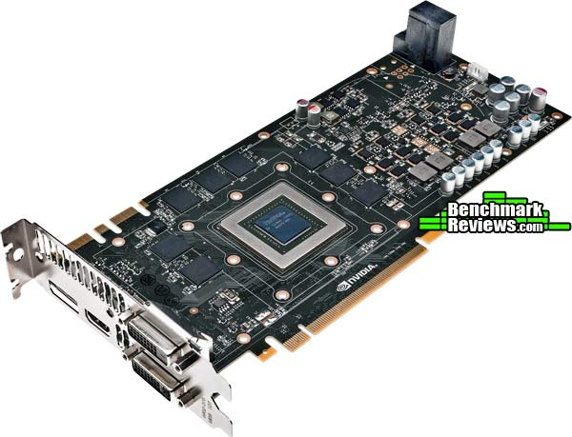
GPUs – thousands of processors on a single node
24
(www.nvidia.com)

Slide 25
The need for speed
Add an example from your filed???

Slide 26
Examples
Computational finance
Data science and analytics
Deep learning and machine learning
Media and entertainment
Manufacturing/AEC (Architecture, Engineering, and Construction)
Safety and security
Medical imaging

Slide 27
Example: Vector addition
27
Ai + Bi = Ci
A0
B0
C0
Thread 0
A1
B1
C1
Thread 1
A2
B2
C2
Thread 2
+
=
.
.
.
.
.
.
.
.
.
An
Bn
Cn
Thread n

Slide 28
The need for speed:
Best protein folding predictions using conventional (but most powerful)
supercomputer “Anton”. Takes months.
Simulation (prediction)
Experiment (reality)
Science 28 Oct 2011:
Vol. 334, Issue 6055, pp. 517-520

Slide 29
The need for speed:
Best protein folding predictions using GPU-enabled ”supercomputer on the desk”,
the type you will use in this class (Takes days. ).
J. Am. Chem. Soc., 2014, 136 (40), pp 13959–13962

Slide 30
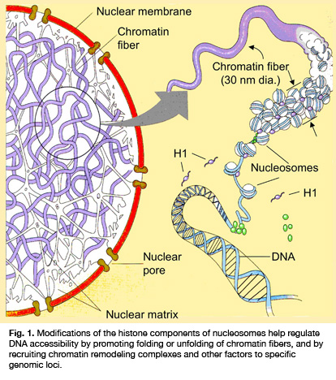
A typical scientific computing problem
30
The DNA in the human genome is made up of ~300 billion atoms.
How is this 3 m long DNA strand packed into the 3 µm nucleus of a cell?
In this tightly packed environment how is a specific gene transcribed, as and when needed?
Experimental tools are not yet sophisticated enough to answer such questions.
mcb.illinois.edu

Slide 31
Molecular dynamics simulations can be used to study these systems
31
N = 3 x 10⁶ atoms
T = 10⁻¹⁵ sec per step (simulation time)
F = 10¹² FLOPS (teraflop)
Time simulated / year =
(T / N²) x F x 3600 x 8 x 365
~ 1 nanosecond
Not long enough to “observe” meaningful activity

Slide 32
How to Parallelize on GPUs
The “hard” way to parallelize an application for running on a GPU:
  NVIDIA CUDA (for NVIDIA GPUs)
  OpenCL (for both NVIDIA and AMD GPUs)
The “easy” way is to use the OpenMP/OpenACC for GPUs:
  A directive-based approach for exploiting parallelism on GPUs
  But oftentimes, you cannot directly get satisfactory performance

Slide 33
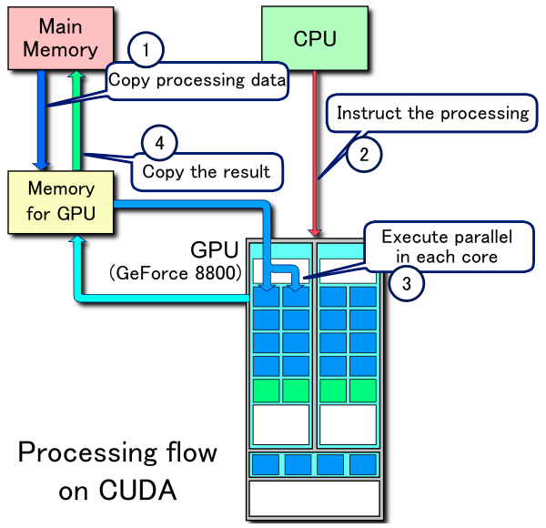
CUDA – for running code on the GPU
33
Example of CUDA process flow
  Copy data from main mem to GPU mem
  CPU initiates threads on the GPU
  GPU execute parallel code
  Copy the result from GPU mem to main memory
http://en.wikipedia.org/wiki/CUDA

Slide 34
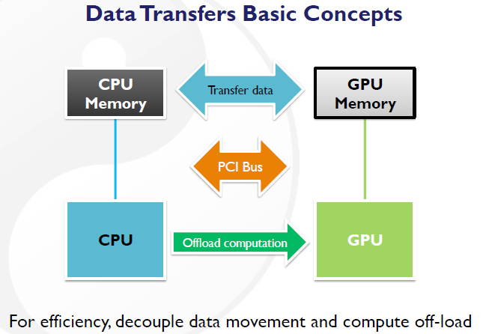

Slide 35
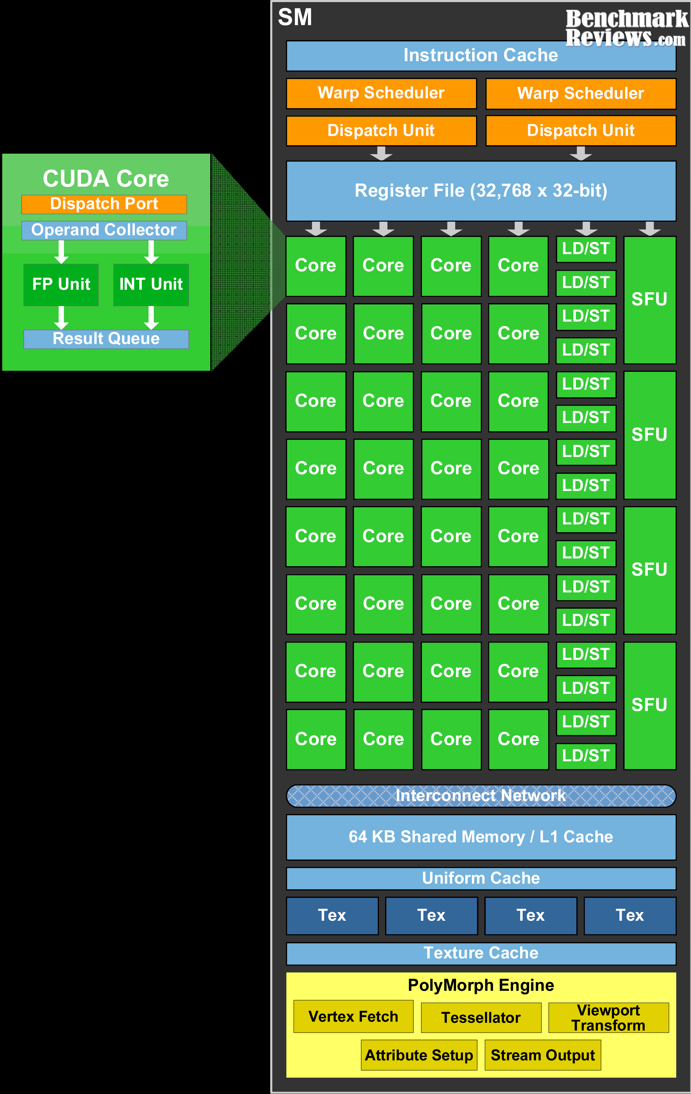
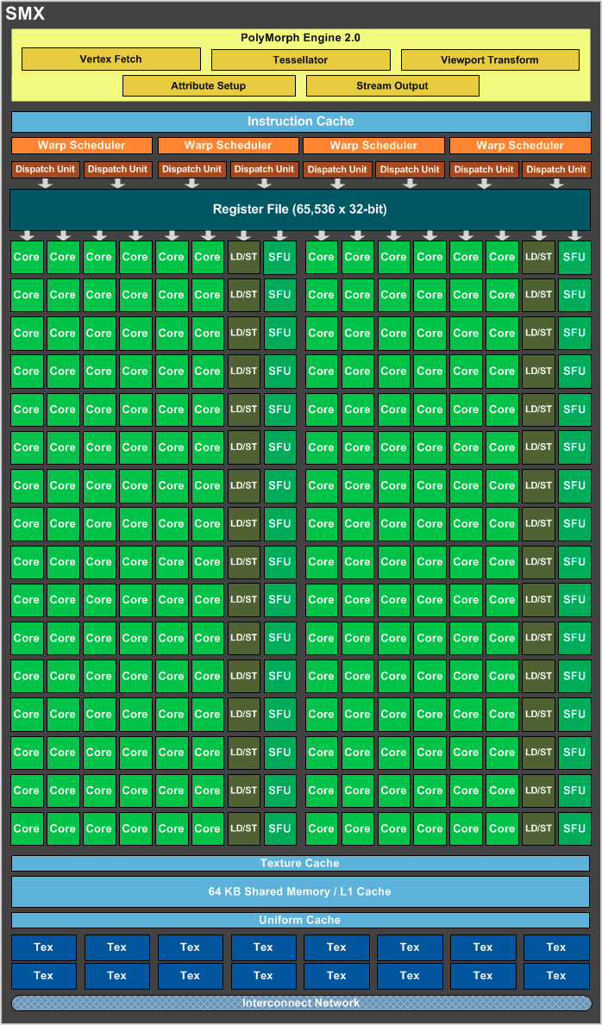
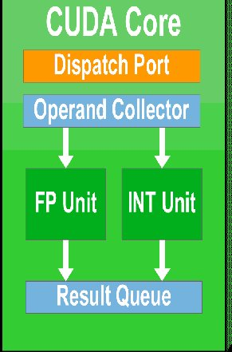
nvidia – hardware architecture
35
(neoseeker.com)

Slide 36
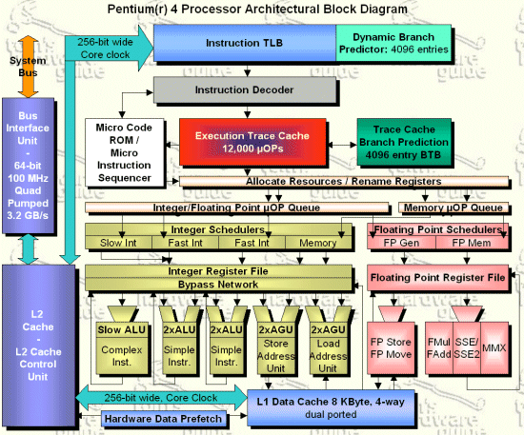
Tradeoffs between the CPU and GPU
36
(neoseeker.com)

Slide 37
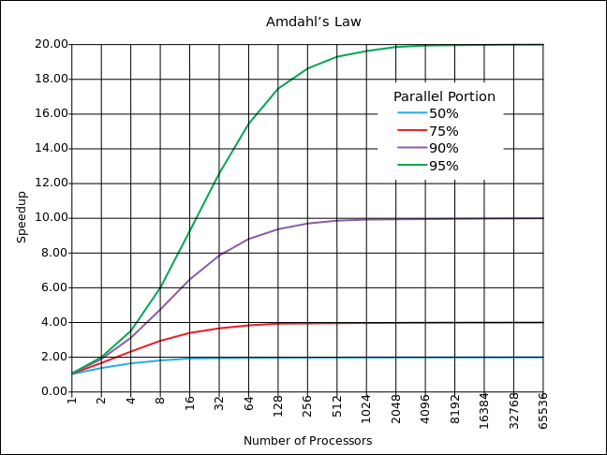
GPU limitations and performance considerations
Not all code is highly parallelizable – Amdahl’s law
Severe penalty for branching (if-then-else)
Limited GPU memory – increases code complexity
Complex operations not available or much slower
Communication between GPU and CPU is relatively slow
Writing efficient code for the GPU is not easy
37
Notes:
Despite tremendous advances in technology we still don’t fully understand many biological processes – at the most fundamental atomic level.
As a result, even after spending billions of dollars and decades of research,
we still don’t have a cure or even satisfactory treatments for many diseases,
37

Slide 38
GPU limitations and performance considerations
38
GPUs are great for performing the same operation on thousands of pieces of data.
  SIMD architecture
CPU: an architecture that includes a lot of cache memory, which enables the CPU to handle just a few threads at a time.
A GPU will have a much smaller amount of cache memory: dedicated to making up for a higher latency from a computer’s system RAM.
Notes:
Despite tremendous advances in technology we still don’t fully understand many biological processes – at the most fundamental atomic level.
As a result, even after spending billions of dollars and decades of research,
we still don’t have a cure or even satisfactory treatments for many diseases,
38

Slide 39
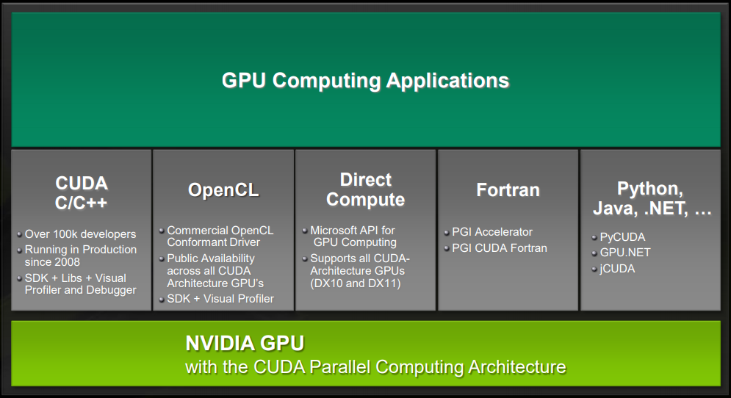
GPU Computing Applications

Slide 40
1. Host: Copy data from main memory to GPU memory
40
// Host code
int main()
{
int N = ...;
size_t size = N * sizeof(float);
// Allocate input vectors h_A and h_B in host memory
float* h_A = (float*)malloc(size);
float* h_B = (float*)malloc(size);
// Initialize input vectors
...
// Allocate vectors in device memory
float* d_A;
cudaMalloc(&d_A, size);
float* d_B;
cudaMalloc(&d_B, size);
float* d_C;
cudaMalloc(&d_C, size);
// Copy vectors from host memory to device memory
cudaMemcpy(d_A, h_A, size, cudaMemcpyHostToDevice);
cudaMemcpy(d_B, h_B, size, cudaMemcpyHostToDevice);
...
}

Slide 41
2. Host: Initiate parallel threads (device kernels) on the GPU
41
// Device code
__global__ void VecAdd(float* A, float* B, float* C, int N)
{
...
}
// Host code
int main()
{
int N = ...;
size_t size = N * sizeof(float);
// Allocate input vectors h_A and h_B in host memory
float* h_A = (float*)malloc(size);
float* h_B = (float*)malloc(size);
// Initialize input vectors
...
// Allocate vectors in device memory
float* d_A;
cudaMalloc(&d_A, size);
float* d_B;
cudaMalloc(&d_B, size);
float* d_C;
cudaMalloc(&d_C, size);
// Copy vectors from host memory to device memory
cudaMemcpy(d_A, h_A, size, cudaMemcpyHostToDevice);
cudaMemcpy(d_B, h_B, size, cudaMemcpyHostToDevice);
// Invoke kernel
int threadsPerBlock = 256;
int blocksPerGrid =
(N + threadsPerBlock – 1) / threadsPerBlock;
VecAdd<<<blocksPerGrid, threadsPerBlock>>>(d_A, d_B, d_C, N);
...
}
Number of threads =
blocksPerGrid *
threadsPerBlock

Slide 42
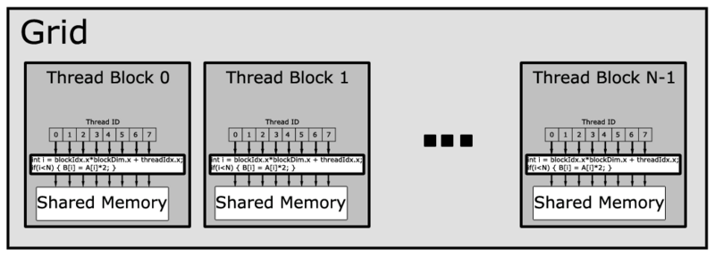
3. Device: Execute parallel code
42
// Host code
int main()
{
int N = ...;
size_t size = N * sizeof(float);
// Allocate input vectors h_A and h_B in host memory
float* h_A = (float*)malloc(size);
float* h_B = (float*)malloc(size);
// Initialize input vectors
...
// Allocate vectors in device memory
float* d_A;
cudaMalloc(&d_A, size);
float* d_B;
cudaMalloc(&d_B, size);
float* d_C;
cudaMalloc(&d_C, size);
// Copy vectors from host memory to device memory
cudaMemcpy(d_A, h_A, size, cudaMemcpyHostToDevice);
cudaMemcpy(d_B, h_B, size, cudaMemcpyHostToDevice);
// Invoke kernel
int threadsPerBlock = 256;
int blocksPerGrid =
(N + threadsPerBlock – 1) / threadsPerBlock;
VecAdd<<<blocksPerGrid, threadsPerBlock>>>(d_A, d_B, d_C, N);
...
}
// Device code
__global__ void VecAdd(float* A, float* B,
float* C, int N)
{
int i = blockDim.x * blockIdx.x + threadIdx.x;
if (i < N)
C[i] = A[i] + B[i];
}

Slide 43
4. Host: Copy results from GPU memory back to main memory
// Host code
int main()
{
int N = ...;
size_t size = N * sizeof(float);
// Allocate input vectors h_A and h_B in host memory
float* h_A = (float*)malloc(size);
float* h_B = (float*)malloc(size);
// Initialize input vectors
...
// Allocate vectors in device memory
float* d_A;
cudaMalloc(&d_A, size);
float* d_B;
cudaMalloc(&d_B, size);
float* d_C;
cudaMalloc(&d_C, size);
// Copy vectors from host memory to device memory
cudaMemcpy(d_A, h_A, size, cudaMemcpyHostToDevice);
cudaMemcpy(d_B, h_B, size, cudaMemcpyHostToDevice);
// Invoke kernel
int threadsPerBlock = 256;
int blocksPerGrid =
(N + threadsPerBlock – 1) / threadsPerBlock;
VecAdd<<<blocksPerGrid, threadsPerBlock>>>(d_A, d_B, d_C, N);
// Copy result from device memory to host memory
// h_C contains the result in host memory
cudaMemcpy(h_C, d_C, size, cudaMemcpyDeviceToHost);
// Free device memory
cudaFree(d_A); cudaFree(d_B); cudaFree(d_C);
// Free host memory
....
}
43
// Device code
__global__ void VecAdd(float* A, float* B,
float* C, int N)
{
int i = blockDim.x * blockIdx.x + threadIdx.x;
if (i < N)
C[i] = A[i] + B[i];
}

Slide 44
Compiling and executing GPU code
44
cudaSetDevice(1) – first statement in program
nvcc -o vectorAdd vectorAdd.cu
./vectorAdd

Slide 45
Useful Links
  https://devblogs.nvidia.com/even-easier-introduction-cuda/
  https://digitalerr0r.wordpress.com/2010/12/03/parallel-computing-using-the-gpu-tutorial-1-getting-started/
  https://developer.nvidia.com/cuda-zone

