Slide 1
Scientific Visualization

Slide 2
Why visualization helps?
A seashore is a better place than the street. At first it is better to run than to walk. You may have to try several times. It takes some skill but it’s easy to learn. Even young children can have fun.
Once successful, complications are minimal. Birds seldom get too close. Too many people doing the same thing, however, can cause problems. One needs lots of room. Beware of rain; it ruins everything. If there are no complications, it can be very peaceful. A rock will serve as an anchor. If things break loose from it, however, you will not get a second chance.

Slide 3
The Purpose and Types
Mapping numbers to pictures
Helps understand algorithms
Helps understand concepts
Cover Art

Slide 4
The Purpose and Types
Mapping numbers to pictures
Help understand algorithms
Help understand concepts
Cover Art

Slide 5
Example: vector field

Slide 6
Example: tensor field

Slide 7
Mapping a property onto complex surface

Slide 8
Example: scatter plot
Immediately tells:
How good the over-all agreement is
Are there serious outliers
Is the agreement uniform?
Where disagreement is strongest/weakest

Slide 9
Elements of a good graph:
Clear legends
Large
enough
font, thick lines.
Symbols differ in more than one way (color, shape)
Graph not cluttered, space well utilized
All axes labeled, units shown

Slide 10
An ideal scientific paper…
Can be understood by reading the text ONLY
OR by looking and figures ONLY (with figure captions)

Slide 11
Contour Plot

Slide 12
2D contours (“heat map plot”)
Always show scale!

Slide 13
The Purpose and Types
Mapping numbers to pictures
Help understand algorithms
Help understand concepts
Cover Art

Slide 14
An algorithm flowchart:

Slide 15
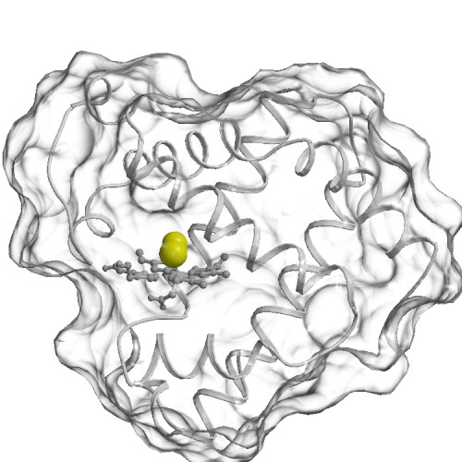
Scientific Animation (power point) to help understand computational approach:
Simulation type #1. Model photo-detachement of carbon monoxyde (CO) ligand. 20 trajectories , 90 ns each. The ligand starts at the docking site (Fe) and comes out, sometimes.
2. Simulation type #2. Model diffusion of the ligand from the outside. The ligand starts in the solvent, and sometimes diffuses all the way to the docking site inside. 48 trajectories, each 90 ns long.

Slide 16
The Purpose and Types
Mapping numbers to pictures
Help understand algorithms
Help understand concepts
Cover Art

Slide 17
Multi-scale concept:

Slide 18
Surface triangulation concept:

Slide 19
An animation (defines key degrees of freedom in amino-acids)

Slide 20
The Purpose and Types
Mapping numbers to pictures
Help understand algorithms
Help understand concepts
Cover Art

Slide 21
Cover art:
Stunning graphics to impress the viewer
Helps draw attention
Presumably, helps explain the concept (not always…)
Must be generally correct, but not precise in every detail
High resolution is key.

Slide 22
Cover art example
Savin, A. V., Kikot, I. P., Mazo, M. A. and Onufriev, A. V. PNAS (2013)
Visualization courtesy of Andrew Woods, Nicholas Polys

Slide 23
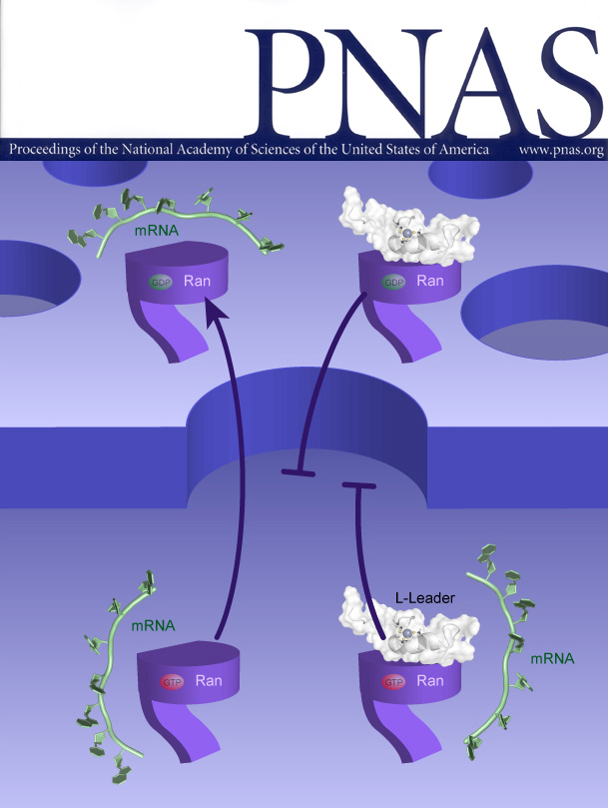
Cover art example
Savin, A. V., Kikot, I. P., Mazo, M. A. and Onufriev, A. V. PNAS (2013)
Visualization courtesy of Andrew Woods, Nicholas Polys

Slide 24
Cover art example (mostly art…)
Savin, A. V., Kikot, I. P., Mazo, M. A. and Onufriev, A. V. PNAS (2013)
Visualization courtesy of Andrew Woods, Nicholas Polys

Slide 25
Software (General)
Plots: Xmgrace, Mathematica
Image Manipulation: Gimp
Image Generation: InkScape, xfig (vector graphics)
Presentations: power point, beamer (latex friendly).

Slide 26
The undeniable advantage of vector graphics: scales to ANY resolution
.eps, .svg
.tiff, .jpeg, etc.

Slide 27
Software (special purpose)
Area specific
Example: Structure Visualization. VMD, Rasmol.
Mapping properties onto structures: GEM

Slide 28
The Monk’s climb problem:
A monk climbs a mountain. He starts at 8 am and reaches the summit at noon. He spends the night on the summit. The next morning, he leaves the summit at 8 am and descends by the route he took the day before, reaching the bottom at noon. Prove that there is a time between 8 am and noon at which the monk was at exactly the same spot on the mountain on both days. (Notice that we do not specify anything about the speed at which the monk travels. The monk does not have to walk at constant speed, or the same speed going up and down)

