Slide 1
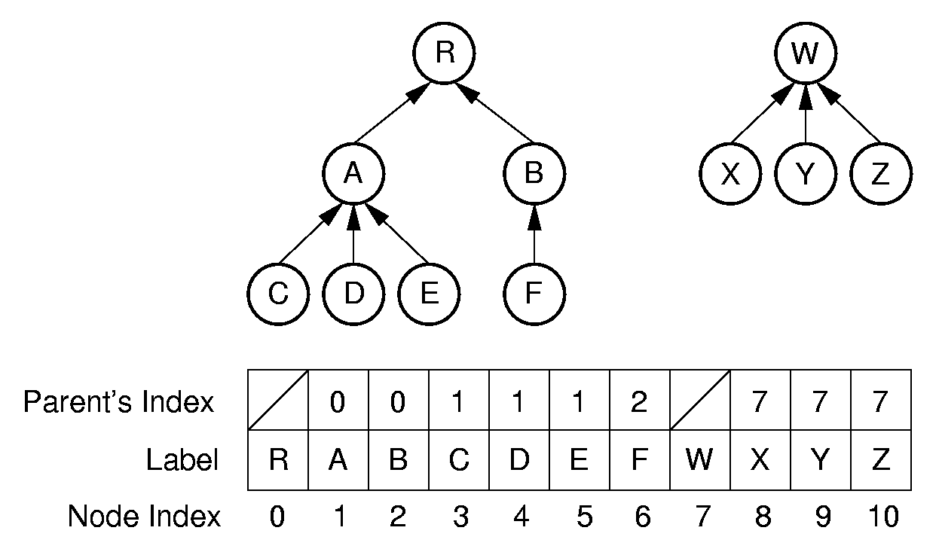
Parent Pointer Implementation

Slide 2
Equivalence Class Problem
The parent pointer representation is good for answering:
Are two elements in the same tree?
/** Determine if nodes in different trees */
public boolean differ(int a, int b) {
Integer root1 = FIND(array[a]);
Integer root2 = FIND(array[b]);
return root1 != root2;
}
Notes:
Examples of equivalence classes:
Connected components in graphs
Point clustering

Slide 3
Union/Find
/** Merge two subtrees */
public void UNION(int a, int b) {
Integer root1 = FIND(a); // Find a’s root
Integer root2 = FIND(b); // Find b’s root
if (root1 != root2) array[root2] = root1;
}
public Integer FIND(Integer curr) {
if (array[curr] == null) return curr;
while (array[curr] != null)
curr = array[curr];
return curr;
}
Want to keep the depth small.
Weighted union rule: Join the tree with fewer nodes to the tree with more nodes.

Slide 4
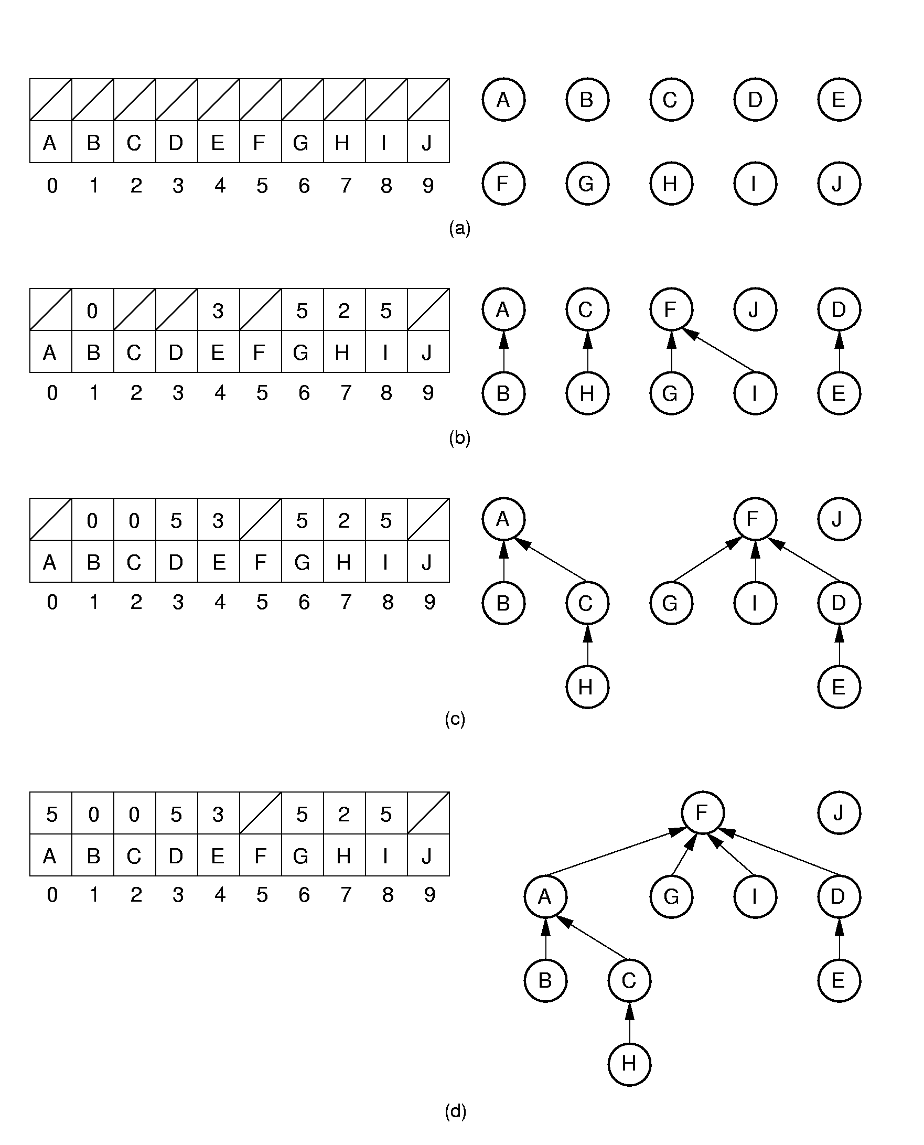
Equiv Class Processing (1)
Notes:
Initially, all objects are in separate sets (equivalence classes).
(b) shows the result of processing equivalences (A, B), (C, H), (F, G), (D, E), and (I, F).
(c) shows the result of processing equivalences (A, H) and (E, G). Note that weighted union is used.

Slide 5
Equiv Class Processing (2)
Notes:
(d) shows the result of processing equivalence (H, E).

Slide 6
Path Compression
public Integer FIND(Integer curr) {
if (array[curr] == null) return curr;
array[curr] = FIND(array[curr]);
return array[curr];
}
Notes:
Path compression is used to process equivalence (H, E).

