Slide 1
B⁺-Trees
The most commonly implemented form of the B-Tree is the B⁺-Tree.
Internal nodes of the B⁺-Tree do not store record -- only key values to guild the search.
Leaf nodes store records or pointers to records.
A leaf node may store more or less records than an internal node stores keys.

Slide 2
B⁺-Tree Example

Slide 3
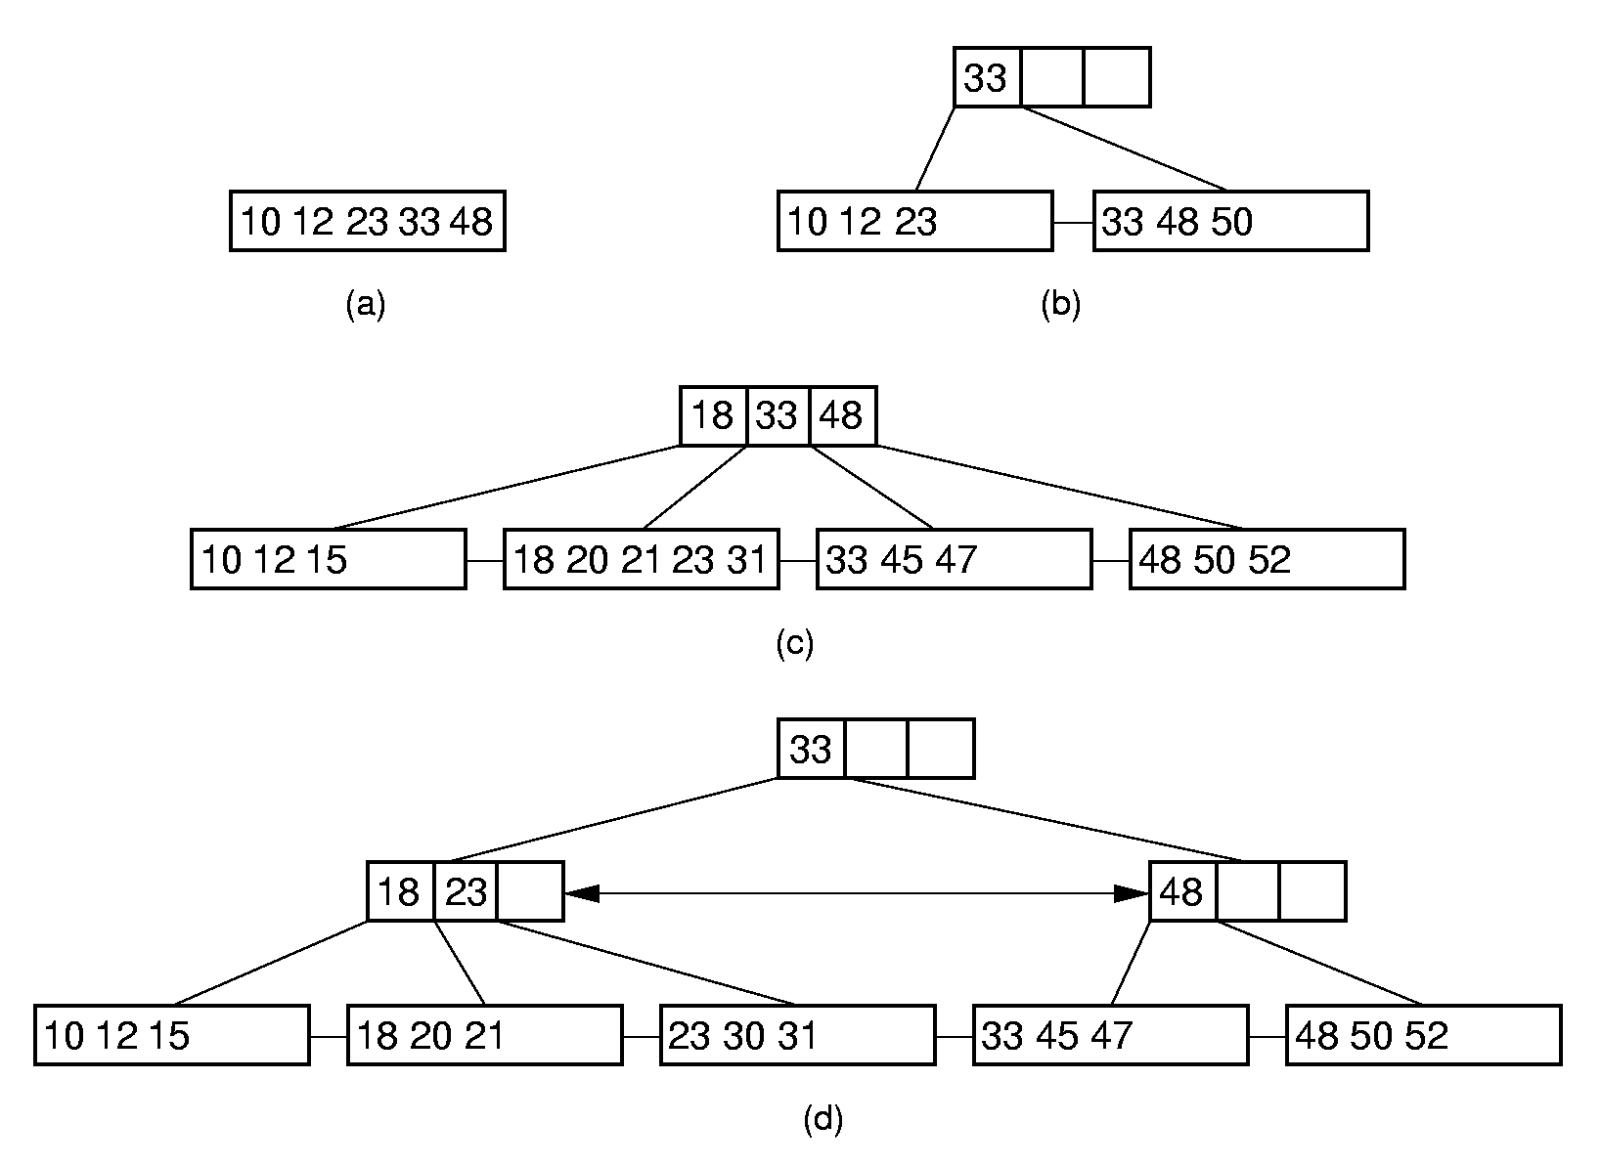
B⁺-Tree Insertion

Slide 4
B⁺-Tree Deletion (1)
Notes:
Delete 18

Slide 5
B⁺-Tree Deletion (2)
Notes:
Delete 12. Borrow 18 from the second child.

Slide 6
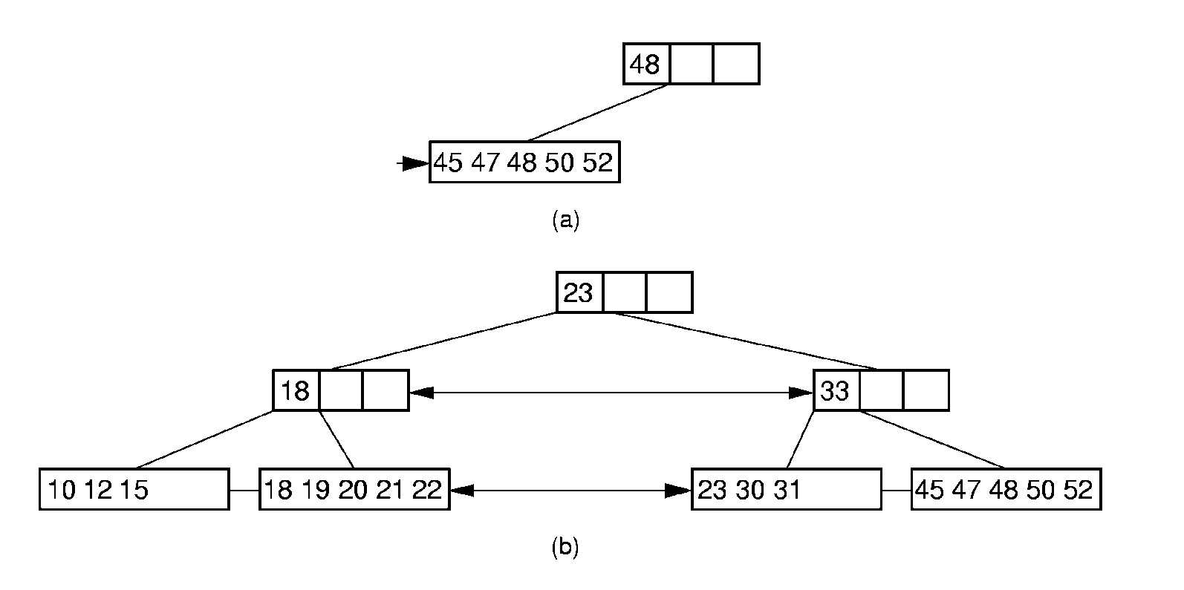
B⁺-Tree Deletion (3)
Notes:
Delete 12. Borrow 18 from the second child.

Slide 7
B-Tree Space Analysis (1)
B⁺-Trees nodes are always at least half full.
The B*-Tree splits two pages for three, and combines three pages into two. In this way, nodes are always 2/3 full.
Asymptotic cost of search, insertion, and deletion of nodes from B-Trees is Θ(log n).
Base of the log is the (average) branching factor of the tree.

Slide 8
B-Tree Space Analysis (2)
Example: Consider a B+-Tree of order 100 with leaf nodes containing 100 records.
1 level B+-tree:
2 level B+-tree:
3 level B+-tree:
4 level B+-tree:
Ways to reduce the number of disk fetches:
Keep the upper levels in memory.
Manage B+-Tree pages with a buffer pool.
Notes:
1 level: Min 0, Max 100
2 level: Min: 2 leaves of 50 for 100 records. Max: 100 leaves with 100 for 10,000 records.
3 level: Min 2 x 50 nodes of leaves, for 5000 records. Max: 100³ = 1,000,000 records.
4 level: Min: 250,00 records (2 * 50 * 50 * 50). Max: 100⁴ = 100 million records.

