Slide 1
Childcare Study
Edgardo & Zalia
Usable Security – CS 6204 – Fall, 2009 – Dennis Kafura – Virginia Tech

Slide 2
Overview
Introduction
Method
Demographics
Codes
Design Implications for Security
Summary
Q & A

Slide 3
Introduction
Pilot studies conducted this summer
Keeping and maintaining records is a growing concern
Current system is paper
We are studying how information is shared, documented, and evaluated in child-cares.
Usable Security – CS 6204 – Fall, 2009 – Dennis Kafura – Virginia Tech

Slide 4
Method
Collect Data
Code
Categories
Theories
Concepts
Grounded theory
Interview lasting about 30 minutes

Slide 5
Demographics
Interview 21 parents (7/14/2009 - 9/30/2009)
18 Female 3 Males
2 in after school only rest in full time
1.29 average number of children
13 months in current childcare on average
Two were single parent
All other had partners

Slide 6
Codes
Ambient Information
Attitudes about sharing sensitive information
Breakdowns
Child Provided Information
Communication method
Enrolling Information
Expiration
Face-to-face
Happy or Unhappy with childcare
Leaving a childcare
Light-bulb moments
Ownership
Partner
Policy Violations
Pre-enrolling practices
Reassurances
Reports
Security
Social-service intervention
Trust
Unusual Occurrence
Want to provide more information

Slide 7
Codes
Ambient Information
Attitudes about sharing sensitive information
Breakdowns
Child Provided Information
Communication method
Enrolling Information
Expiration
Face-to-face
Happy or Unhappy with childcare
Leaving a childcare
Light-bulb moments
Ownership
Partner
Policy Violations
Pre-enrolling practices
Reassurances
Reports
Security
Social-service intervention
Trust
Unusual Occurrence
Want to provide more information

Slide 8
Enrollment
General
Name, Birth date/Certificate, Emergency contact, SSN, Child’s like and dislike
Family Information
Parents’ contact, Employment,
Background, Siblings
Health Information
Immunization record,
Health insurance info,
Medical conditions, Allergies
Sensitive Information

Slide 9
Additional Information
Special needs (Speech disability, handicap)
Language and cultural information (Bi-lingual)
Psychological family condition ( Other child’s death, parents’ divorce)

Slide 10
Security
Physical safety
of children
Information Security
Security

Slide 11
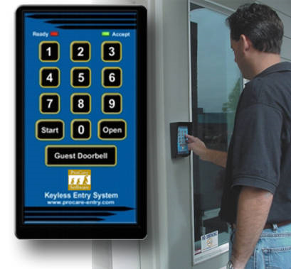
Physical Safety of the Children
Buzzer/bell at entrance
Door lock: Pin / card
Web-camera
Central monitoring System
Signature sheet for
drop in and pick up
Emergency list

Slide 12
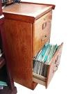
Information Security
Storage
Locked file cabinet
No one sure if the information are stored digitally
Access
Only two parents are informed about access (Emergency listed people)
Others believe daycare officials have
Share
Parents believe daycares will ask them before sharing their information
Expiration
Parents
Want to keep only name,
contact and enrollment time in file after leaving the childcare
Believe their information will eventually be disposed.

Slide 13
Trust
Parents generally trust daycares.
Personal relationship rather than information practice is the basis of their trust.
Security system of daycares has impact in their trust
None but participant 13 and 14 faced information security breach.
Single incident of security breach leads to unrecoverable bad impact on trust

Slide 14
Communication
Face-to-face
Physical reports
Ambient Information

Slide 15
Face-to-face
Main communication method by all 21 participants
Preferred method
Expect verbal report of the status of their child

Slide 16
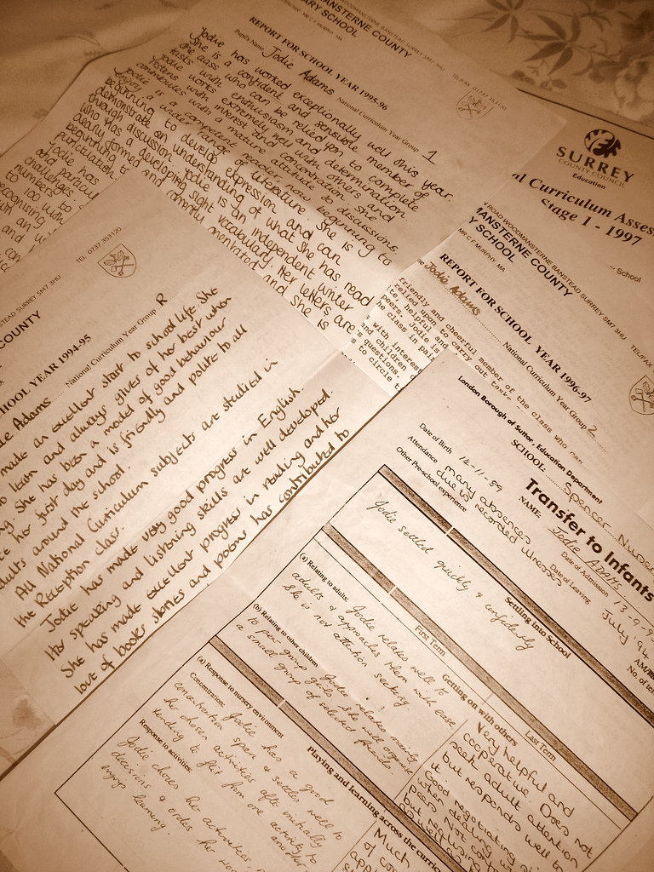
Physical Reports
Mentioned by all
Specific Child Information
Information About the Childcare
Secondary Information

Slide 17
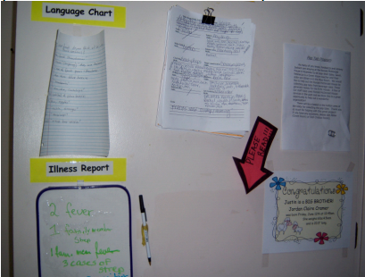
Ambient Information
15 participant mention receiving information this way
“[the] majority of their information is all posted. Cork boards
display boards all
through the
entrance way”

Slide 18
Breakdowns
Whenever a communication, interaction, or a critical incident has occurred
14 participants mention this
5 participant left
childcare after
a breakdown

Slide 19
Light Bulb Moments
Just over half of participants
"You know, I've never really thought about it."

Slide 20
Design Implications for Security
Supporting rich communication and reporting in both directions
Take the information the parents have and explain how and why this information is needed
Provide access logs to all parties’ information

Slide 21
Summary
Technology continues to fill our lives, it is becoming more ubiquitous
Parent have a large amount of trust in the childcares information security practices
Large emphasis on the ability to communicate with the childcare effectively

Slide 22
Q & A

