Slide 1
Virtual-Time Round-Robin: An O(1) Proportional Share Scheduler
Jason Nieh, Chris Vaill, Hua Zhong
Columbia University
Presented by Adam Binford

Slide 2
About the Paper
Jason Nieh
77 publications
870 citations
Columbia University
17 Citations
Group ratio round-robin: O(1) proportional share scheduling for uniprocessor and multiprocessor systems

Slide 3
Overview
Scheduling Background
WRR and WFQ
Core VTRR Algorithm
Implementation
Experimental Results
Conclusions

Slide 4
History
Linux 2.4 released 2001
Authors compared against Linux 2.2
Released 1999
Scheduling classes
Varied time quantum
Dynamic priorities

Slide 5
Proportional Fairness
Perfect fairness
$W_{A}\left(t_{1},t_{2}\right)=\left(t_{2}−t_{1}\right)\frac{S_{A}}{\sum_{i}{S_{i}}}$
Service time error
$E_{A}\left(t_{1},t_{2}\right)=W_{A}\left(t_{1},t_{2}\right)−\left(t_{2}−t_{1}\right)\frac{S_{A}}{\sum_{i}{S_{i}}}$

Slide 6
Weighted Round Robin
O(1)
Each process gets all its shares at once
Service time error depends on magnitude of shares
3, 2, and 1 shares has error range [-1 tu, +1.5 tu]
3000, 2000, and 1000 shares has error range [-1000 tu, +1500 tu]

Slide 7
Weighted Fair Queueing
Tasks sorted by Virtual Finishing Time
Task with lowest VFT executes
VFT get’s updated, reinserted in Queue
O(N) for simple design
Service time error not dependent on magnitude
3000, 2000, and 1000 share allocation same as 3, 2, and 1

Slide 8
Virtual Time
Concept still used in current Linux kernel
Virtual time of client A:
${VT}_{A}\left(t\right)=\frac{W_{A}(t)}{S_{A}}$
Virtual finishing time of client A:
${VFT}_{A}\left(t\right)={VT}_{A}\left(t\right)+\frac{Q}{S_{A}}$

Slide 9
VTRR State
Client
Shares
VFT
Time counter
ID
Run state
Scheduler
Time quantum
Run queue
Total shares
Queue virtual time

Slide 10
Further Definitions
Queue virtual time
$QVT\left(t+Q\right)=QVT\left(t\right)+\frac{Q}{\sum_{i}{S_{i}}}$
VFT inequality
${VFT}_{C}\left(t\right)−QVT\left(t+Q\right)<\frac{Q}{S_{C}}$
Time counter
Equal to number of shares
Time counter invariant
${TC}_{A}≥{TC}_{B}$ for consecutive clients in queue, A, B

Slide 11
The Process
$$t=0,QVT\left(t+Q\right)=1/6$$
A
VFT: 1/3
Time Counter: 3
B
VFT: 1/2
C
VFT: 1
Time Counter: 1
Time Counter: 2

Slide 12
The Process
$$t=1,QVT\left(t+Q\right)=1/3$$
A
VFT: 2/3
Time Counter: 2
B
VFT: 1/2
C
VFT: 1
Time Counter: 1
Time Counter: 2

Slide 13
The Process
$$t=2,QVT\left(t+Q\right)=1/2$$
A
VFT: 2/3
Time Counter: 2
B
VFT: 1
C
VFT: 1
Time Counter: 1
Time Counter: 1

Slide 14
The Process
$$t=3,QVT\left(t+Q\right)=2/3$$
A
VFT: 2/3
Time Counter: 2
B
VFT: 1
C
VFT: 2
Time Counter: 0
Time Counter: 1

Slide 15
The Process
$$t=4,QVT\left(t+Q\right)=5/6$$
A
VFT: 1
Time Counter: 1
B
VFT: 1
C
VFT: 2
Time Counter: 0
Time Counter: 1

Slide 16
The Process
$$t=5,QVT\left(t+Q\right)=1$$
A
VFT: 1
Time Counter: 1
B
VFT: 3/2
C
VFT: 2
Time Counter: 0
Time Counter: 0

Slide 17
The Process
$$t=6,QVT\left(t+Q\right)=7/6$$
A
VFT: 4/3
Time Counter: 3
B
VFT: 3/2
C
VFT: 2
Time Counter: 1
Time Counter: 2

Slide 18
Dynamic Operations
New task
${VFT}_{A}\left(t\right)=QVT\left(t\right)+\frac{Q}{S_{A}}$
Old task
Last-previous and last-next references
${VFT}_{A}\left(t\right)=\text{MAX}\text{\{}QVT\left(t\right)+\frac{Q}{S_{A}},{VFT}_{A}(t^{′})\}$
Time counter proportional to others in queue
Changing shares is a removal and insertion

Slide 19
Complexity
Insertion in worst case is O(N)
O(1) with valid last-previous and last-next references
Naïve time counter reset takes O(N) time
Can be reduced to O(1)
All other operations O(1)

Slide 20
Implementation
Built on Linux 2.2 kernel
Single CPU
Reused existing scheduling code
Statically allocated kernel memory

Slide 21
Simulation Studies

Slide 22
Scheduling Overhead

Slide 23
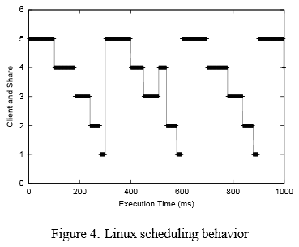
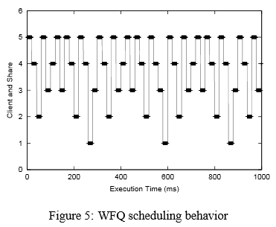
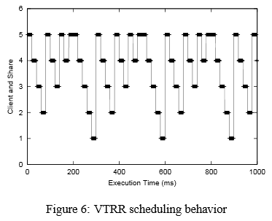
Scheduling Granularity

Slide 24
Schedulers Today
Linux default scheduler is the Completely Fair Scheduler
Red-black tree ordered by virtual time
Additional scheduling classes
SCHED_RR strictly priority based round robin
SCHED_FIFO non-preemptive scheduling
Both supersede default
SCHED_FIFO supersedes SCHED_RR

Slide 25
Conclusions
Majority of operations O(1)
Effective for large-scale servers
Strong proportional fairness
Virtual time still used today
Single processor design

Slide 26
Questions

