Slide 1
Application performance and flexibility on Exokernel systems
M. Frans Kaashoek, Dawson R. Engler, Gregory R. Ganger, Hector M. Bricefio, Russell Hunt, David Mazikres, Thomas Pinckney, Robert Grimm, John Jannotti and Kenneth Mackenzie
SOSP 1997
Presented by
Carol Pinto

Slide 2
The Problem!
Performance
  Fixed general purpose implementations
Flexibility
  High level abstractions hide information
Functionality
  Changes to abstractions rarely happen

Slide 3
The Solution
Why should the OS do anything that the user program can do itself?
Separate resource management from protection
Give applications flexible, extensible access to OS primitives
Notes:
Lesson descriptions should be brief.

Slide 4
Overview
New kernel interfaces
The disk subsystem, XN
Overview of Xok, ExOS
Performance evaluation of unaltered UNIX applications
Global performance of exokernel

Slide 5
Previous work
Concept of exokernel was introduced by Engler, Kaashoek and O’Toole in 1995
Aegis and ExOS
Other techniques
  Better microkernel
  Virtual machines
  Downloading the code

Slide 6
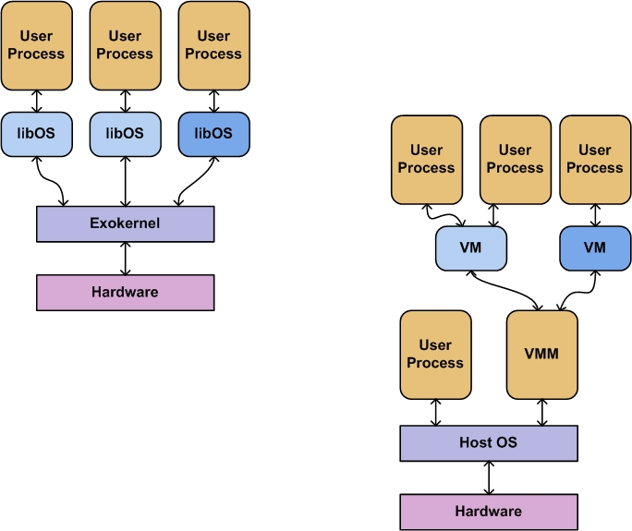
Exokernel Architecture
Kaashoek et al.
Notes:
Example objectives
At the end of this lesson, you will be able to:
Save files to the team Web server.
Move files to different locations on the team Web server.
Share files on the team Web server.

Slide 7
Techniques involved
Secure Bindings
  Library OS bind to resources
Visible Resource Revocation
  Reclaiming and breaking the secure bindings
Abort Protocol
  To handle library OSes that fail to respond

Slide 8
Exokernel Design principles
Securely expose hardware
Expose allocation
Expose Names
Expose Revocation

Slide 9
Protected sharing
Levels of Trust
  Mutual trust
  Unidirectional trust
  Mutual distrust

Slide 10
Multiplexing Stable Storage
Failures:
  Disk-block-level multiplexing
  Self-descriptive metadata
  Template-based description

Slide 11
XN
Guarded operation on disk data – Secure bindings
Determination of Access rights – UDF mechanism
Ordered disk updates
Coherent caching of disk blocks – in-kernel cache registry
Atomic metadata updates – locks
Well formed updates – satisfying metadata invariants

Slide 12
C-FFS: a library file system
UNIX-like library file system
Methods are downloaded into kernel
Adds to XN’s protection mechanism

Slide 13
Xok
Similar to Aegis Exokernel
Exokernel for Intel x86-based computers
  TLB refills are not handled
  Wakeup predicates – injected into the kernel
  Access control – hierarchically named capabilities

Slide 14
ExOS 1.0
Runs unmodified UNIX applications
Missing functions
  – paging, process swapping, process groups and windowing system
Research based system
Shared global states for a few abstractions

Slide 15
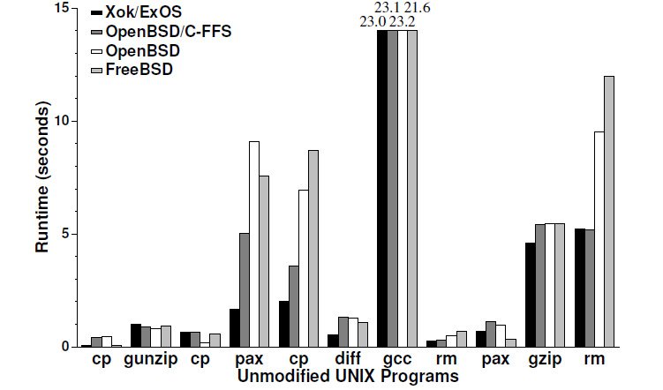
Performance of unmodified UNIX applications
Xok/ExOS – 41 seconds
OpenBSD/C-FFS – 51 seconds
OpenBSD/FreeBSD - 60 seconds

Slide 16
Performance on MAB:
Modified Andrew Benchmark:
  Xok/ExOS - 11.5 seconds
  OpenBSD/CFFS - 12.5 seconds
  OpenBSD - 14.2 seconds
  FreeBSD - 11.5 seconds

Slide 17
The Cheetah HTTP/1.0 Server
XIO library for fast servers
Sample application - Cheetah Server
Optimizations:
  Merged File Cache and Retransmission Pool.
  Knowledge-based Packet Merging
  HTML-based FileGrouping

Slide 18
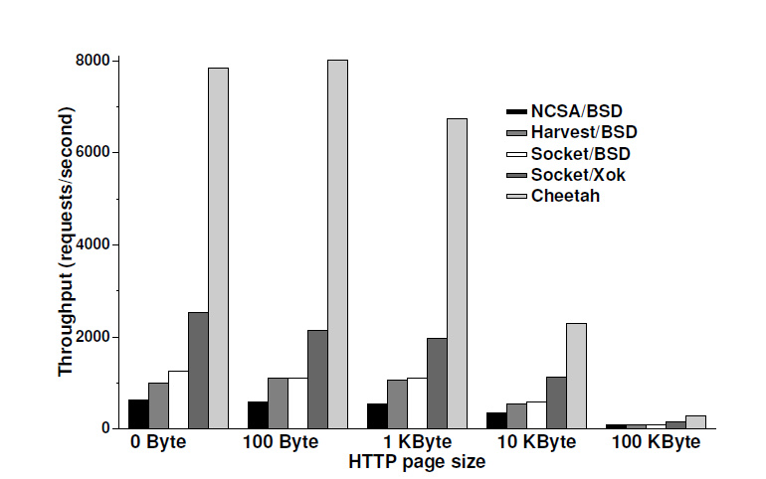
HTTP document throughput performance

Slide 19
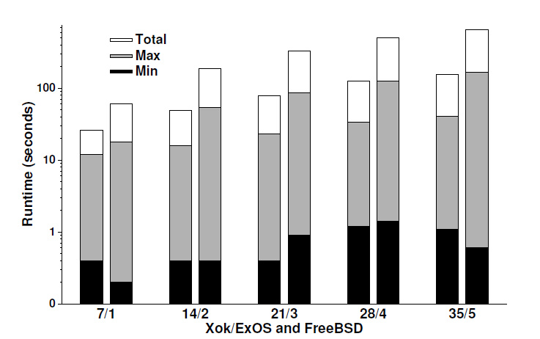
Global performance

Slide 20
Exokernel Experience
Exposing kernel data structures
Libraries are simpler
`Reboot’ is replaced by `relink’
Design is not simple
Loss of information by implementing OS abstractions at user level

Slide 21
What about now!
Exopc Exokernel Distribution
  Under active development by PDOS at MIT, Greg Ganger's group at CMU, and Exotec
  Still many bugs and features that have not yet been implemented.
Recent work:
  Fast and flexible application-level networking on exokernel systems
      Gregory R. Ganger, Dawson R. Engler, M. Frans Kaashoek, Hector M. Briceno, Russell Hunt, and Thomas Pinckney. ACM Transactions on Computer Systems 20(1), February 2002.
  Multiprocessing with the Exokernel operating system
      Benjie Chen. Master's thesis, Massachusetts Institute of Technology, February 2000.

Slide 22
Exokernels and Microkernels today!
Exokernel
Corey, Barrelfish multikernel and many other libraryOS systems.
Influenced hypervisors like Xen
Microkernels
L4 microkernels such as Pistachio(University of Karlsruhe in collaboration with the DiSy group at the University of New South Wales, Australia), NICTA::Pistachio-embedded, L4 on MIPS and many more.

Slide 23
Questions ?

