Slide 1
Eraser: A Dynamic Data Race Detector for Multithreaded Programs STEFAN SAVAGE, MICHAEL BURROWS, GREG NELSON, PATRICK SOBALVARRO, and THOMAS ANDERSON Ethan Holder 2014
Notes:
SOSP 1997 (Symposium on Operating Systems Principles)
TOCS 1997 (Transactions on Computer Systems)

Slide 2
Presentation Outline
About the Authors
What is Eraser?
Why is Eraser Important?
Background & Related Work
Happens-Before
Eraser Algorithm
Eraser Implementation
Experiences
Evaluation

Slide 3
About the Authors
Savage and Anderson (UCB) were at U. Washington. Burrows, Nelson, and Sobalvarro were at Digital Equipment Corporation.
Cited by 387 (according to ACM DL) including RaceMob and PARROT.
Each averages over 35 cites per article.
Eraser their most or second most cited article.
Notes:
Savage and Anderson were able to work easily with the professors to get measurements from undergraduates given they were at U Washington.
First to differ from happens-before really.
Burrows, Nelson did something cited more than this earlier actually, also worked on BigTable at Google.

Slide 4
What is Eraser?
Detects data races in a multithreaded program dynamically.
Allows developers to easily find and correct concurrency bugs.
Works by monitoring data accesses at a very low level and observing locking patterns.

Slide 5
Why is Eraser Important?
Basically the first to use lock set idea instead of Happens-Before.
Lock set is relatively low overhead compared to Happens-Before, albeit less accurate.
Leads to future work combining the two approaches for both speed and reliability (FastTrack by Flanagan and Freund in PLDI 2009).
Notes:
Happens-Before was very prevalent but slow. Time overhead of lock sets is about 10x regular execution, whereas happens-before is 20x or more based on implementations.
FastTrack has comparable overhead to Eraser running against Eclipse with no false positives!

Slide 6
Background
What’s a data race?
One (or more) thread(s) writes as another thread tries to read or write at the same time.
No synchronization mechanism (lock).
Unclear who executes first and what final value is read/written.
Very hard to debug!

Slide 7
Related Work
Largely compared to Happens-Before relationships by Lamport in 1978.
Monitors by Hoare in 1974.
Lock covers by Dinning and Schonberg in 1991.
NOT Eraser by Mellon and Crummey in 1993.
Notes:
Monitors are for static data. Anonymous lock for each procedure modifying static shared data. Think private fields with synchronized methods in java. Can’t handle dynamic data.
Lock covers use happens-before with some improvements.
Eraser by Mellon is for fortran programs.

Slide 8
Happens-Before
Within a thread, execution order generates event order.
Between threads, synchronization events generate a partial order based on shared resource access.
Notes:
t1 before t2 … before tn within a thread.
Your thread’s t10 might be before my thread’s t2 if we share a synchronization event after your t10 and before my t2.

Slide 9
Happens-Before
Thread X Thread Y Thread Z
Time 0
…
Time n
Lock(a)
Modify
Unlock(a)
Lock(a)
Modify
Unlock(a)
Lock(b)
Modify
Unlock(b)
Lock(b)
Modify
Unlock(b)
Lock(a)
Modify
Unlock(a)
Lock(a)
Modify
Unlock(a)

Slide 10
Eraser Algorithm
Initialize set of candidate locks to all locks for each shared variable and held locks to empty set.
On an access, change the set of candidate locks to be the former set’s intersection with the currently held locks.

Slide 11
Example
Thread X Thread Y Held Locks | Candidates
Time 0
…
Time n
{} | U
a | U^a = a
b | a^b = {}
Lock(a)
Modify(var1)
Unlock(a)
Lock(b)
Modify(var1)
Unlock(b)

Slide 12
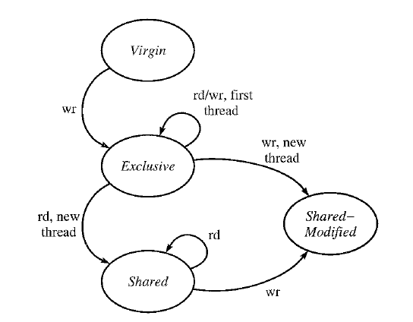
Improvement
Ignore initialization.
Allow read sharing.
Only remove read locks on the second thread write.

Slide 13
Failure
Thread X Thread Y Held Locks | Candidates
Time 0
…
Time n
Allocate(var1)
Set thread Y
to modify var1
Start thread Y
Modify(var1)
{} | U
Potential for race regardless.
Modify(var1)
If this mod is 1st, no race detected.
If this mod is 1st, race detected and output.
Notes:
Suppose that a thread allocates and initializes a shared variable without a lock and erroneously makes the variable accessible to a second thread before it has completed the initialization.
Then Eraser will detect the error if any of the second thread’s accesses occur before the first thread’s final initialization actions, but otherwise Eraser will miss the error.

Slide 14
Eraser Implementation
Instruments loads and stores for checking the set of candidate locks.
Instruments lock acquire and release and thread initialization and finalization for checking locks held.
Instruments storage allocator calls for dynamic data.

Slide 15
Output
On a race detection (no locks held during access) the following is reported:
File and line number.
Backtrace of stack frames.
Thread ID
Memory Address and Access Type
Program Counter and Stack Pointer

Slide 16
Shadow Words
Correspond to real data words in stack and heap.
Contain lockset index (30-bit) or thread ID and state condition (2-bit).
Lockset index points to hash table entry for the distinct set of locks held.

Slide 17
False Alarm Annotations
EraserIgnoreOn/Off for disabling benign race output.
EraserReuse for resetting shadow memory when using internal memory allocators.
EraserReadLock/Unlock and EraserWriteLock/Unlock for communicating private lock usage.

Slide 18
AltaVista Experience
Programs Tested
Ni2 (9) and ft (5)
Mhttpd (10)
False Positives
Avoid locking overhead
Finalization checks
Global Statistics

Slide 19
Vesta Cache Server Experience
Valid Fingerprint Boolean
False Positives (10)
CacheS Free List Flush
TCP_sock and SRPC Objects

Slide 20
Petal Experience
Server Running State Checks
False Positives (several)
Private Reader-Writer Locks
Global Statistics
Stack Memory Reuse on Forking

Slide 21
Undergraduate Assignments Experience
10% data races detected across runnable assignments.
False Positives (1)
Locked Head and Tail in Queue

Slide 22
Experiences
Dependent on test runs versus absolute relationships.
“Easy to use”
Promising results with deadlock-checking.

Slide 23
Evaluation
Novelty
Lock sets instead of Happens-Before.
Importance
Much faster.
Handles dynamic data.
Works on large and small scale code bases.

Slide 24
Evaluation
Negatives
Still not that fast.
Doesn’t specify how to fix the problem (later papers actually tell how or do it themselves).
Measurements aren’t similar and are arbitrarily ran.
LOTS of false positives.

Slide 25
Questions

