Slide 1
Fuzzy Identity Based Encryption based on the paper of Amit Sahai and Brent Waters by: Guido Simon
Seminar biometrics and cryptography
Introduction

Slide 2
Seminar biometrics and cryptography
Content
Motivation / Abstract
  Identity based encryption
  Fuzzyfying identities
  Fuzzy Identity based encryption
  Overview
Preliminaries
  Shamir’s Secret Sharing
  Bilinear Maps
  Lagrange coefficient
Key Generation
Encryption / Decryption
  Encryption
  Decryption
  Explanation
  Extension of the scheme
  Encryption
  Decryption
Security
  Security model
  Definitions
  Proof
Conclusion

Slide 3
Seminar biometrics and cryptography
Content
Part 1:
Motivation / Abstract

Slide 4
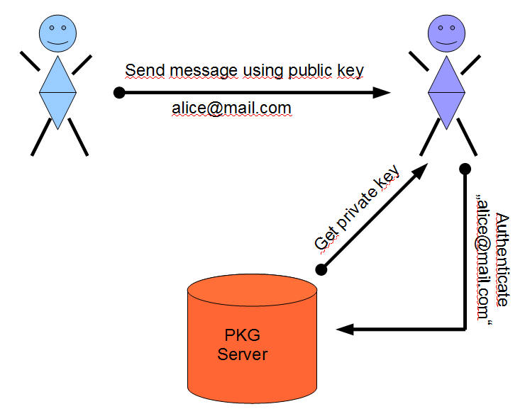
Seminar biometrics and cryptography
1.1 IBE Scheme

Slide 5
Seminar biometrics and cryptography
1.1 IBE Scheme
No key exchange in advance

Slide 6
Seminar biometrics and cryptography
1.1 IBE Scheme
No key exchange in advance
Use the identity of recipient as key

Slide 7
Seminar biometrics and cryptography
IBE Scheme
No key exchange in advance
Use the identity of recipient as key
Decrypt by fetching a key from PKG

Slide 8
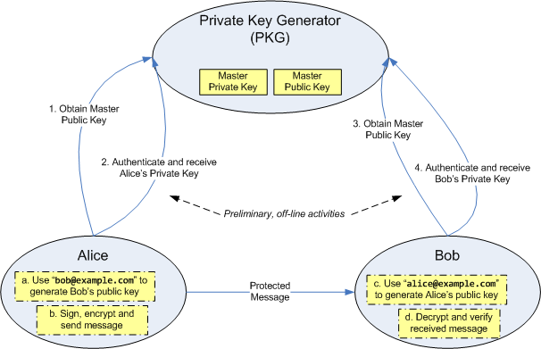
Seminar biometrics and cryptography
1.1 IBE Scheme

Slide 9
Seminar biometrics and cryptography
1.1 IBE Scheme

Slide 10
Seminar biometrics and cryptography
1.2 Fuzzyfying Identitys
Identities become sets of Attributes
Example: IDenc={Student,ComputerScience,Crypto}

Slide 11
Seminar biometrics and cryptography
1.2 Fuzzyfying Identitys
Identities become sets of Attributes
Example: IDenc={Student,ComputerScience,Crypto}
IDdec = {Student,Male,ComputerScience,Crypto,Graphics}

Slide 12
Seminar biometrics and cryptography
1.2 Fuzzyfying Identitys
One can encrypt for some public identity ⍵
Decryption with an identity ⍵‘ ⧧ ⍵ possible
If ⍵ and ⍵‘ are „close enough“

Slide 13
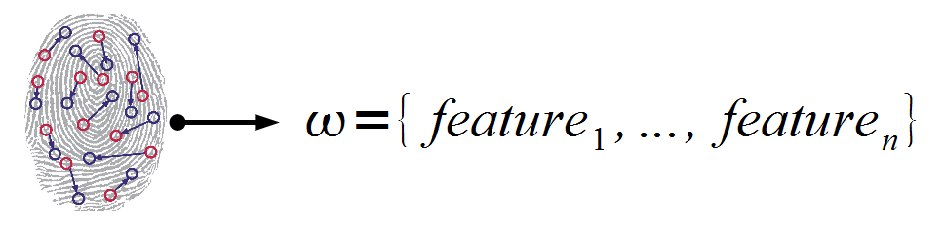
Seminar biometrics and cryptography
1.2 Fuzzyfying Identitys
One can encrypt for some public identity ⍵
Decryption with an identity ⍵‘ ⧧ ⍵ possible
If ⍵ and ⍵‘ are „close enough“
So there must be error tolerance
Error tolerance makes it suitable for biometrics
Use biometric details as attributes

Slide 14
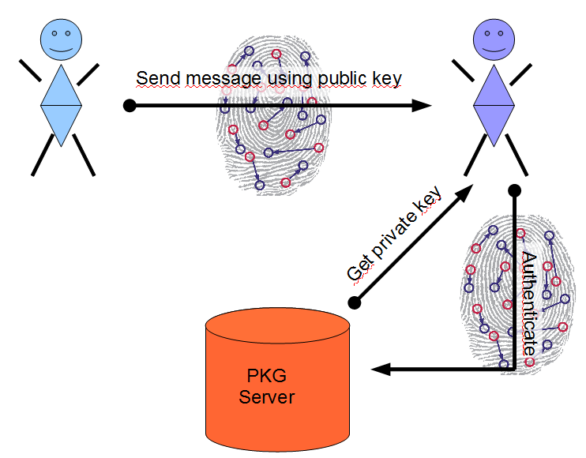
Seminar biometrics and cryptography
1.3 Fuzzy IBE Scheme

Slide 15
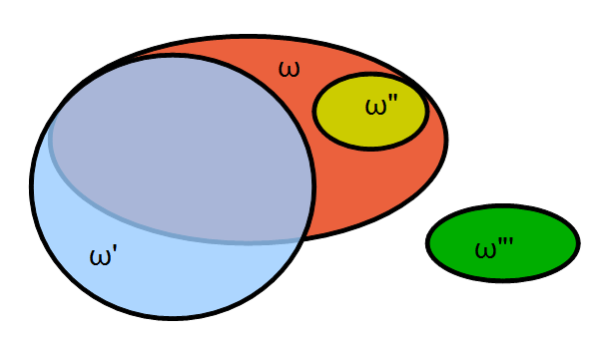
Key Attribute Comparison
Seminar biometrics and cryptography
1.3 Fuzzy IBE Scheme

Slide 16
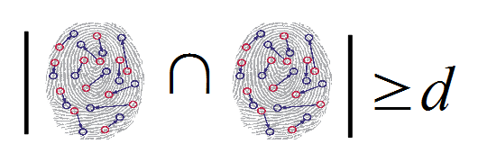
Key Attribute Comparison
Seminar biometrics and cryptography
1.3 Fuzzy IBE Scheme

Slide 17
Seminar biometrics and cryptography
1.4 Overview
A short overview:
Biometric identities are PUBLIC, used for encryption
But also I use my biometric for decryption – How that?
As in IBE scheme above, the Server generates a private
Key for me – to get it, i have to authenticate with my
biometric identity.
Because this ID is public, the scheme relies on a „well
trained operator“ to detect imitations of identites.

Slide 18
Seminar biometrics and cryptography
Content
Part 2:
Preliminaries

Slide 19
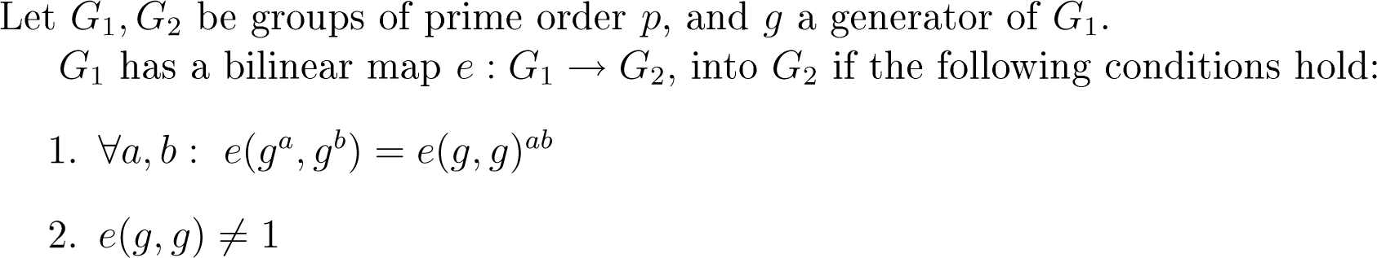
Seminar biometrics and cryptography
2.1 Bilinear Maps
Definition from the paper:
The first condition will be used in the further steps

Slide 20
Seminar biometrics and cryptography
2.2 Shamir‘s secret sharing
Proposed by Shamir in 1979
Allows to share ONE secret among N paricipants
Of which D many have to collude in order to decrypt
Uses Lagrange polynomial interpolation
HOW?
The „dealer“ chooses a random polynomial p of
degree D-1
The absolute part of p is the secret
He computes N random points p(x) and distributes
D of them are needed for interpolation

Slide 21
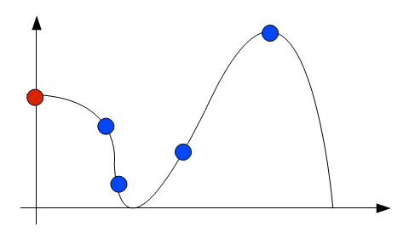
Seminar biometrics and cryptography
2.2 Shamir‘s secret sharing
The „dealer“ chooses a random polynomial p of
degree D-1
The absolute part of p is the secret
He computes N random points p(x) and distributes
D of them are needed for interpolation

Slide 22
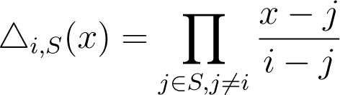
Seminar biometrics and cryptography
2.3 Lagrange coefficient

Slide 23
Seminar biometrics and cryptography
Content
Part 3:
Key generation (Server-side)

Slide 24
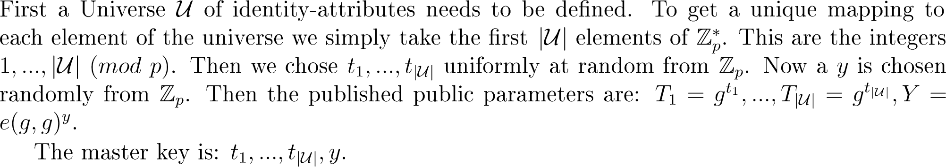
Seminar biometrics and cryptography
3 Key generation
Key Generation (Server side)
Universe of identity-attributes must be defined
To get a unique mapping, take the first
Now a y is chosen randomly from
Then the public parameters are:

Slide 25
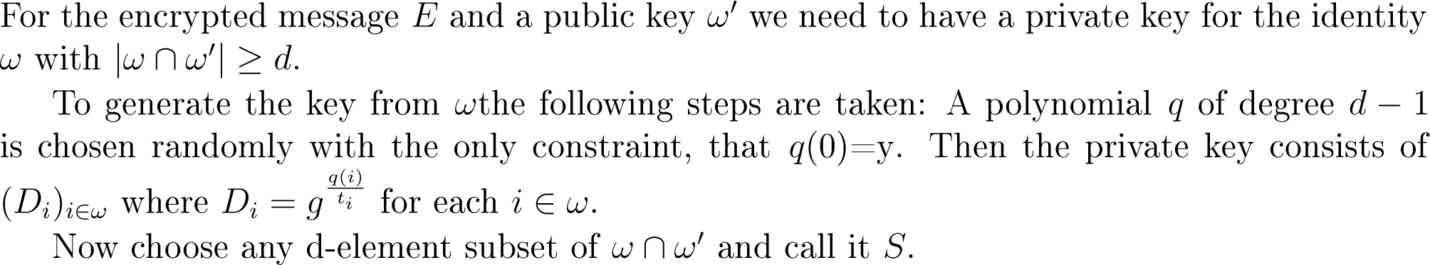
Seminar biometrics and cryptography
3 Key generation
To generate the key for ⍵ a polynomial q of degree d-1
is chosen randomly. Then the private key is:
q(0) must be equal to y

Slide 26
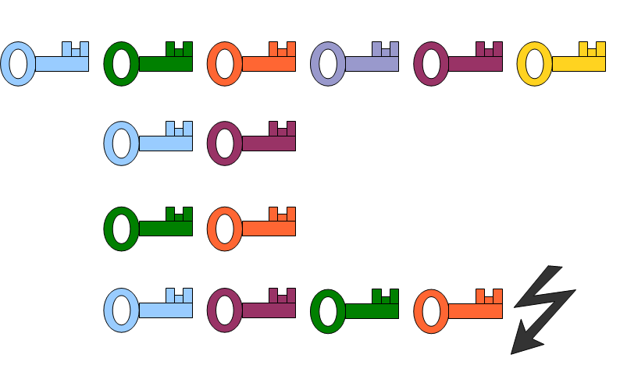
Seminar biometrics and cryptography
3 Key generation
To generate the key for ⍵ a polynomial q of degree d-1
is chosen randomly. Then the private key is:
This is one key for each attribute
D1 D2 D3 D4 D5 D6

Slide 27
Seminar biometrics and cryptography
3 Key generation
Danger: Collusion attacks
Message is encrypted for d>=4
Attributes used for ENC
User 1
User 2
User 1 & User 2, d>=4

Slide 28
Seminar biometrics and cryptography
3 Key generation
Danger: Collusion attacks
Message is encrypted for d>=4
Attributes used for ENC
User 1
User 2
User 1 & User 2, d>=4
To prevent collusion attacks, choose a
different polynomial q for each identity

Slide 29
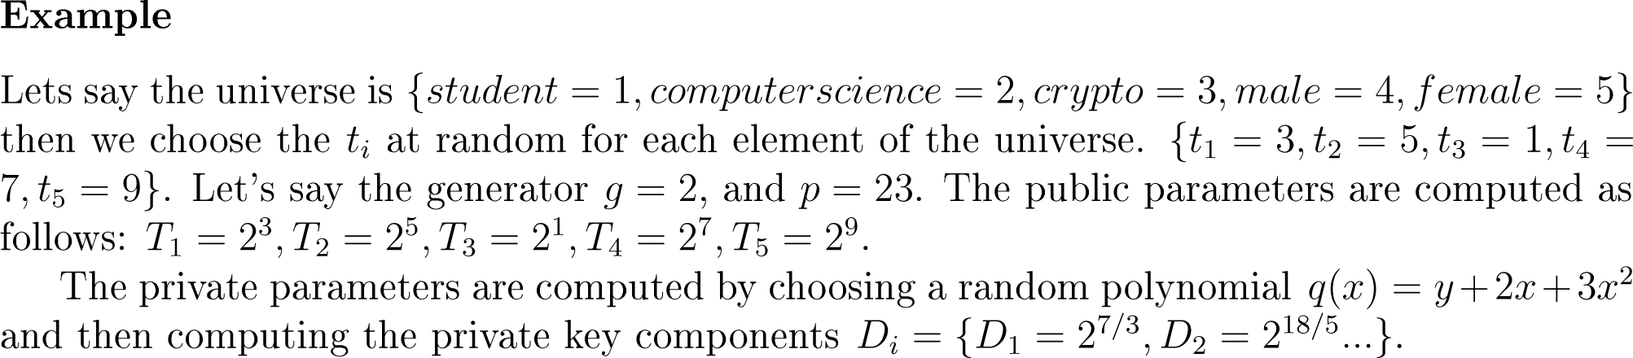
Seminar biometrics and cryptography
Toy example

Slide 30
Seminar biometrics and cryptography
Content
Part 4:
Encryption / Decryption
(client side)

Slide 31
Seminar biometrics and cryptography
4.1 Encryption (small universe)
Remember the public Key:

Slide 32
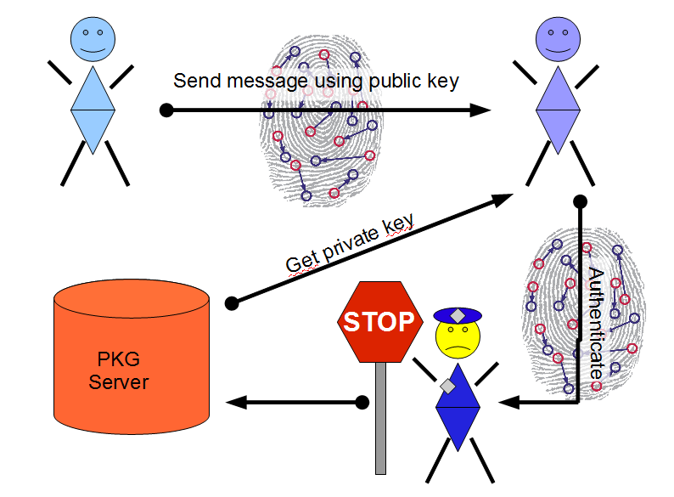
Seminar biometrics and cryptography
4.2 Decryption (client side)

Slide 33
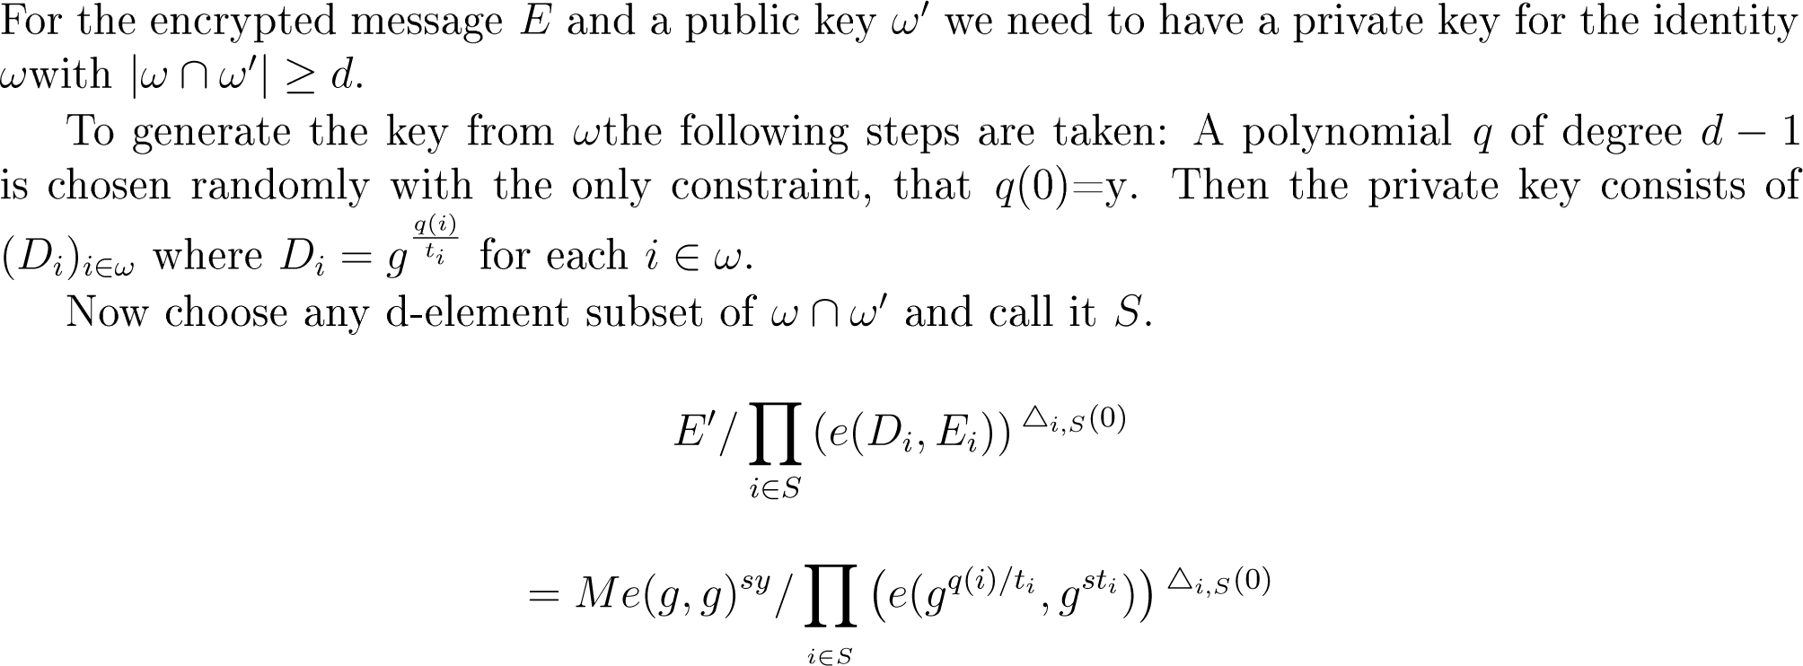
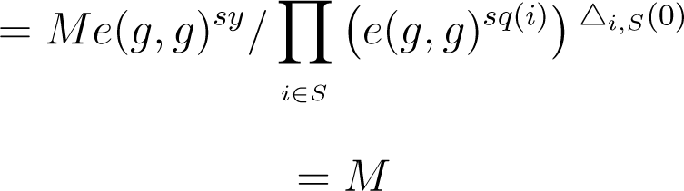
Seminar biometrics and cryptography
4.2 Decryption (client side)
Notation spy:
E‘=MY^{s}
E_{i}=T_{i}^{s}
i= Attr. index
S=subset of ID
q()=rnd. Poly.
D_{i}=priv. keys
s random fixed
y random fixed
M message
Δ: lagrange coeff.

Slide 34
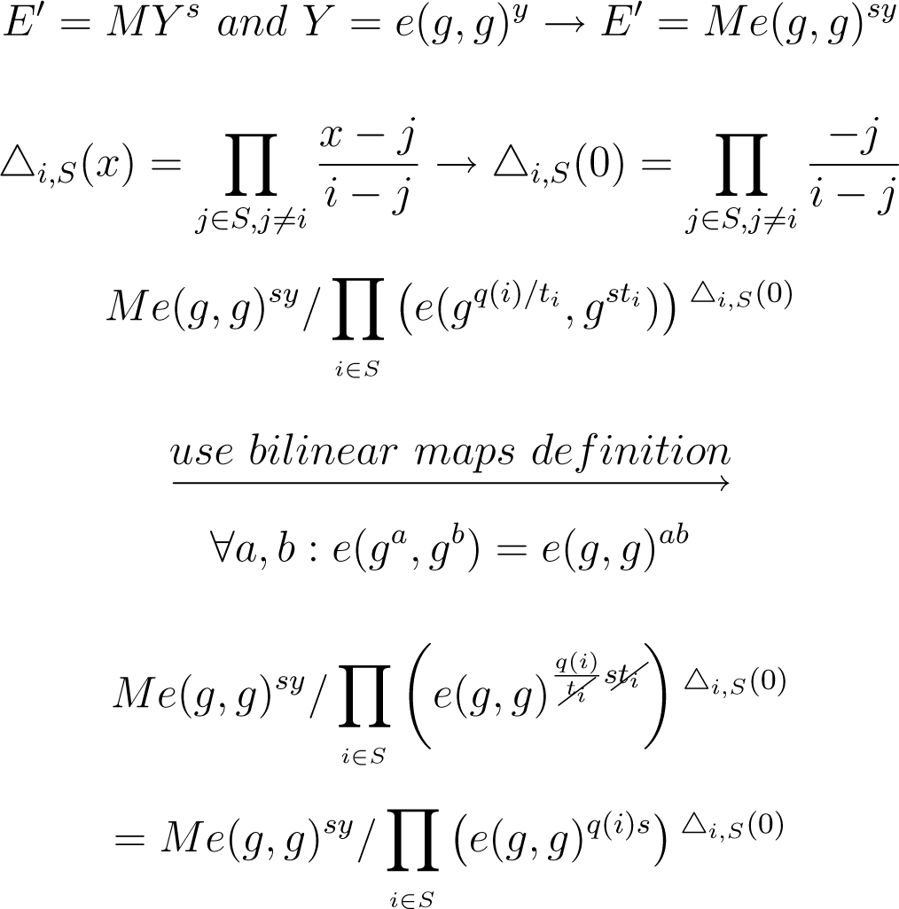
Seminar biometrics and cryptography
4.3 Explanation
Notation spy:
E‘=MY^{s}
E_{i}=T_{i}^{s}
i= Attr. index
S=subset of ID
q()=rnd. Poly.
D_{i}=priv. keys
s random fixed
y random fixed
M message
Δ: lagrange coeff.

Slide 35
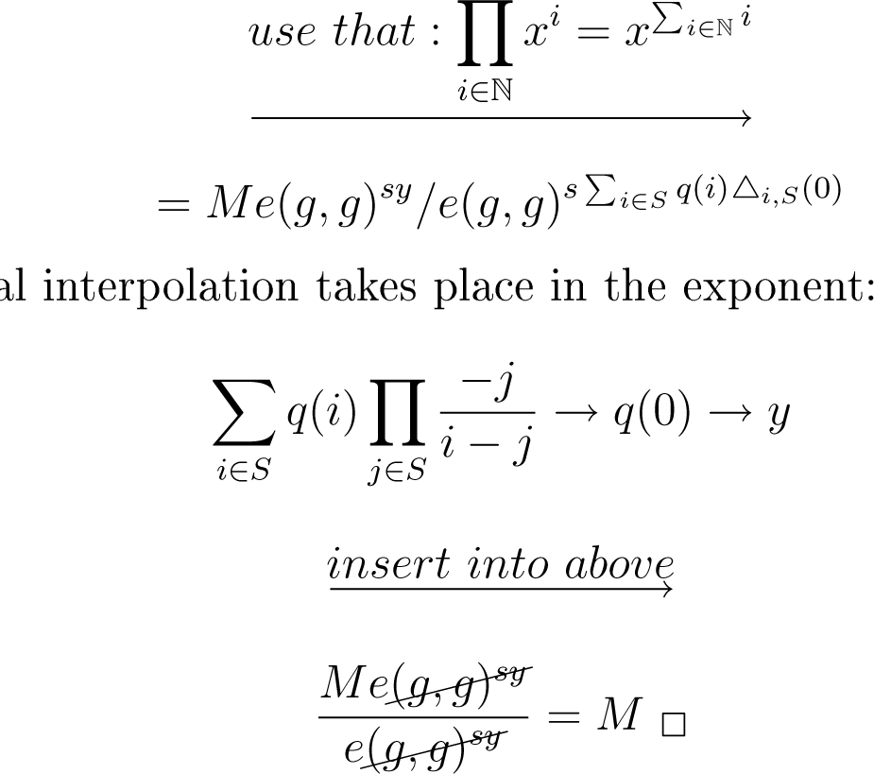
Seminar biometrics and cryptography
4.3 Explanation
Now the polynomial interpolation takes place in the exponent:
Notation spy:
E‘=MY^{s}
E_{i}=T_{i}^{s}
i= Attr. index
S=subset of ID
q()=rnd. Poly.
D_{i}=priv. keys
s random fixed
y random fixed
M message
Δ: lagrange coeff.

Slide 36
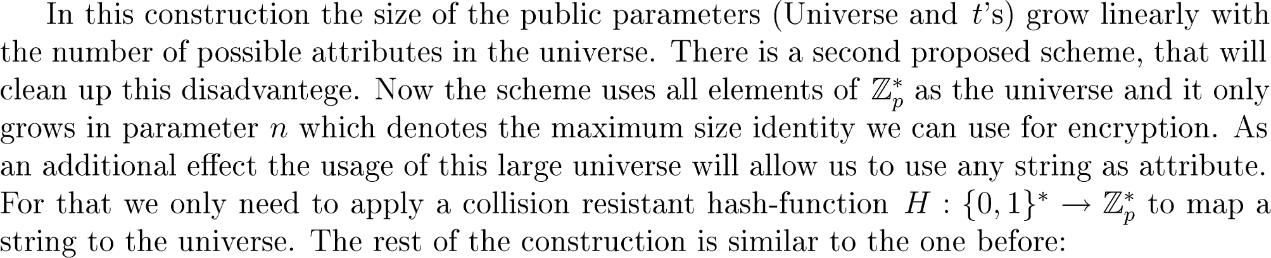
Seminar biometrics and cryptography
4.4 Extension of the scheme
In prior construction size of public parameters (Universe and t‘s)
grow linearly with the number of attributes in the universe
Modification of the scheme that uses all elements of as universe,
and only grows in parameter n, which denotes the max. size
Identity we can use
Usefull side effect: One can use any string as attribute
For that we only need a hash-function to map a string to the universe:
The construction is similar to the construction before

Slide 37
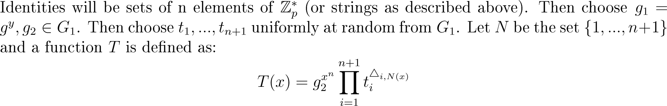
Seminar biometrics and cryptography
4.4 Extension of the Scheme

Slide 38

Seminar biometrics and cryptography
4.4 Extension of the Scheme
The private key consists of two sets

Slide 39

Seminar biometrics and cryptography
4.5 Encryption
is chosen randomly

Slide 40
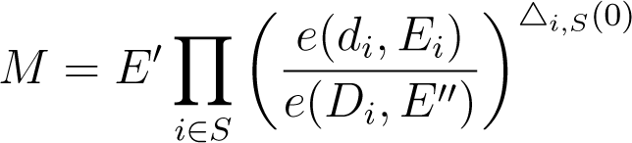
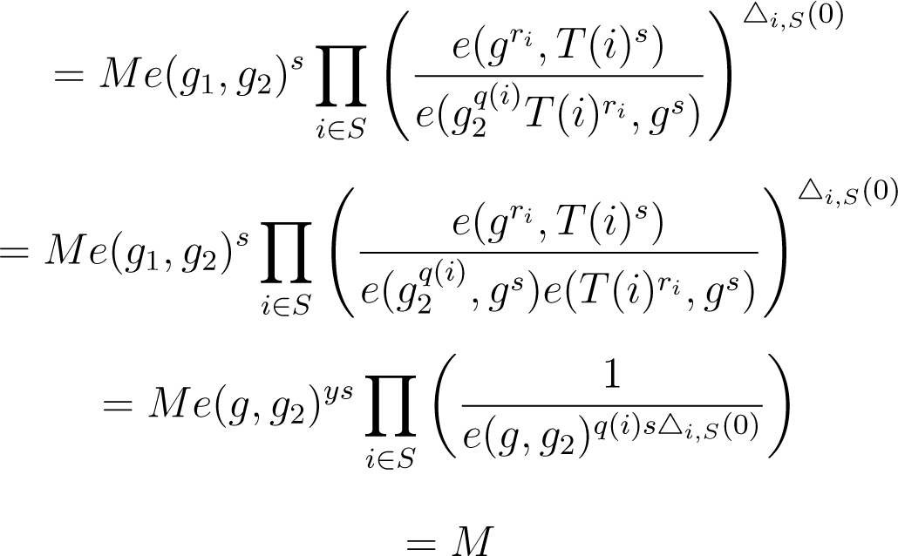
Seminar biometrics and cryptography
4.6 Decryption

Slide 41
Seminar biometrics and cryptography
Content
Part 5:
Security

Slide 42
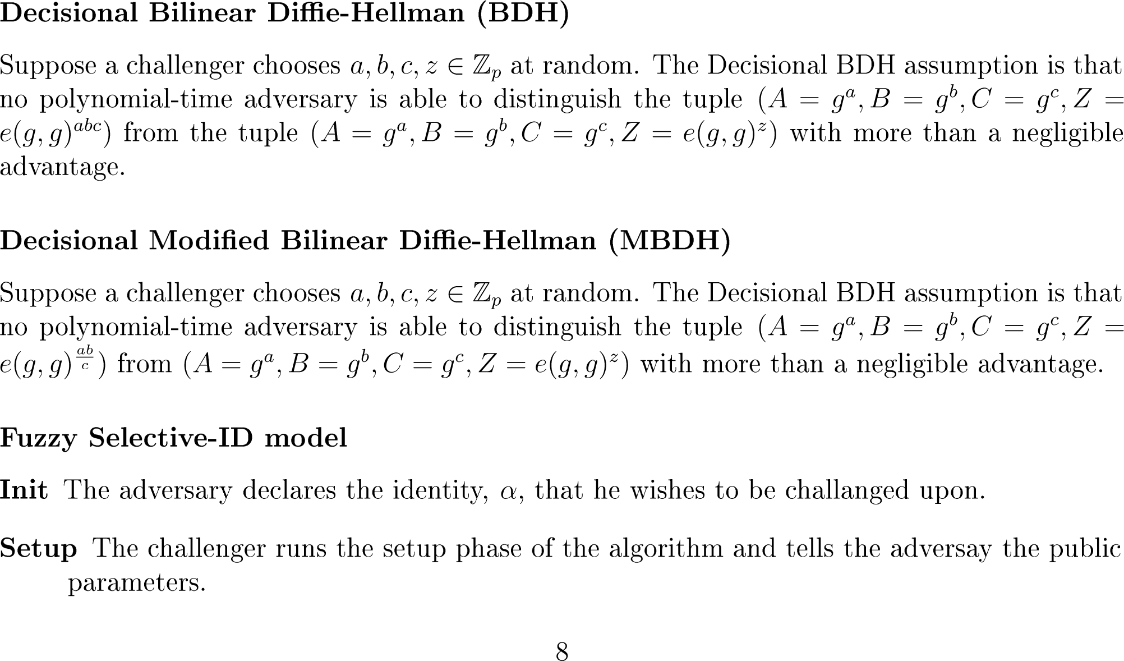
Seminar biometrics and cryptography
5.1 Definitions
sdfsdfsd

Slide 43
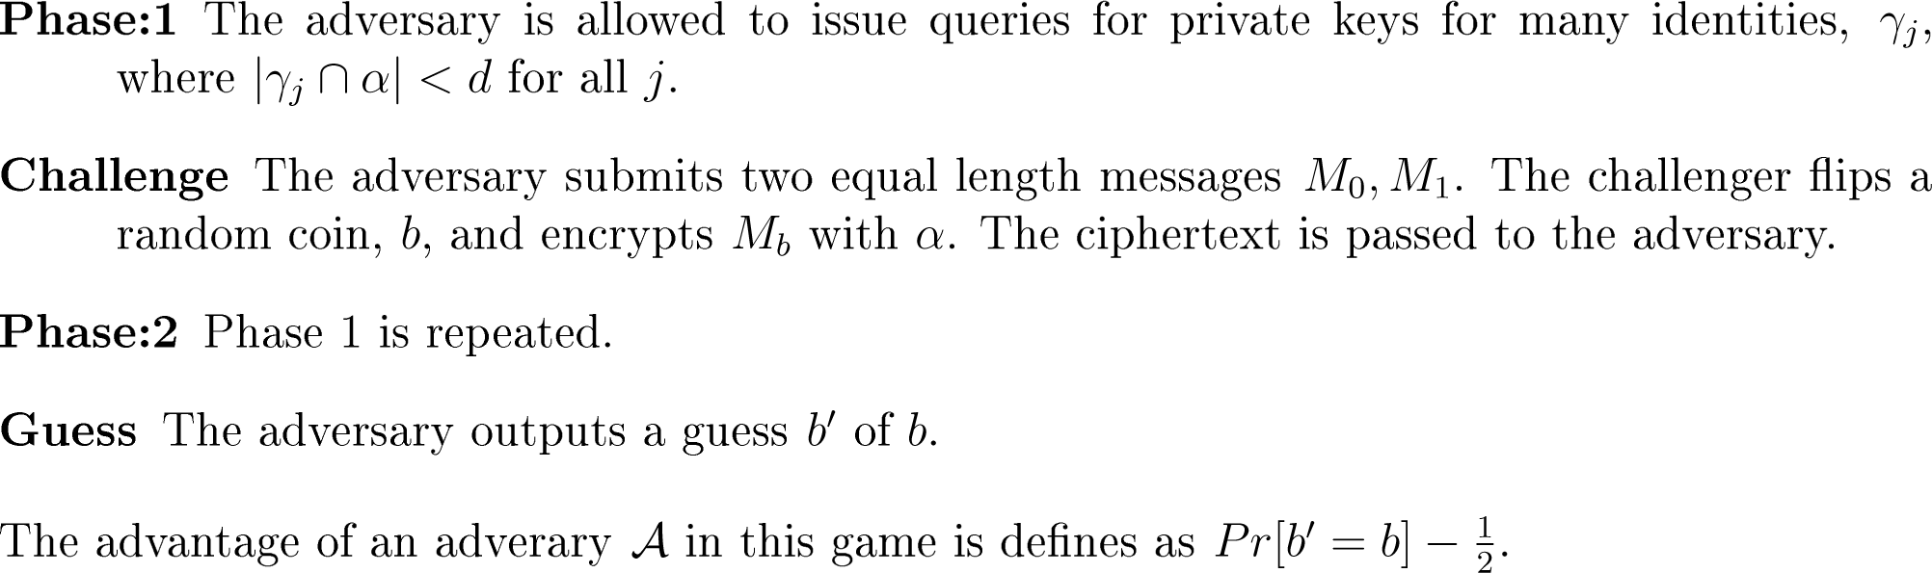
Seminar biometrics and cryptography
5.2 Security Model
sdfsdfsd

Slide 44
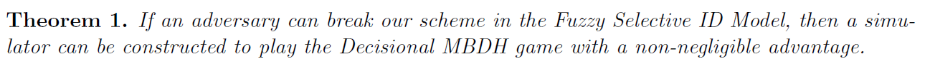
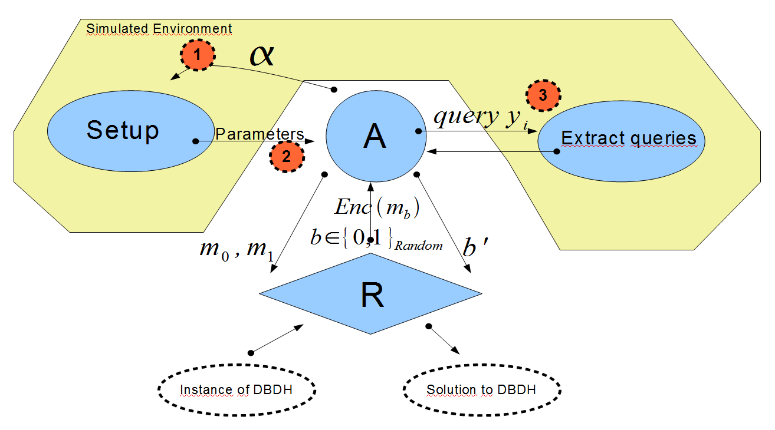
Seminar biometrics and cryptography
5.3 Proof

Slide 45
Seminar biometrics and cryptography
Content
Part 6:
Conclusion

Slide 46
Seminar biometrics and cryptography
6 Conclusion
Public key encryption without prior key exchange
Only users identity is needed
Identities must be unique
Identities consist of attributes – which may be arbitrary strings, but also biometrics are possible

Slide 47
Seminar biometrics and cryptography
6 Conclusion
Public key encryption without prior key exchange
Only users identity is needed
Identities must be unique
Identities consist of attributes – which may be arbitrary strings, but also biometrics are possible
Relies on a PKG, which must be a fully trusted server
Biometric authentication to obtain the private keys

Slide 48
Seminar biometrics and cryptography
6 Conclusion
Public key encryption without prior key exchange
Only users identity is needed
Identities must be unique
Identities consist of attributes – which may be arbitrary strings, but also biometrics are possible
Relies on a PKG, which must be a fully trusted server
Biometric authentication to obtain the private keys
Relies on a well trained officer to detect imitations
Theoretical security is proven
Scheme could be broken by attacking the officer

Slide 49

Seminar biometrics and cryptography
2.1 Standard Identity based Encryption

