Slide 1
Transactional Memory
Part 1: Concepts and Hardware- Based Approaches

Slide 2
Introduction
Provide support for concurrent activity using transaction-style semantics without explicit locking
Avoids problems with explicit locking
Software engineering problems
Priority inversion
Convoying
Deadlock
Approaches
Hardware (faster, size-limitations, platform dependent)
Software (slower, unlimited size, platform independent)
Word-based (fine-grain, complex data structures)
Object-based ( course-grain, higher-level structures)

Slide 3
History
Lomet* proposed the construct:
<identifier>: action( <parameter-list> );
<statement-list>
end;
where the statement-list is executed as an atomic action. The statement-list can include:
await <test> then <statement-list>;
so that execution of the process/thread does not proceed until test is true.
*
D.B. Lomet, “Process structuring, synchronization, and recovery using atomic actions,”
In Proc. ACM Conf. on Language Design for Reliable Software, Raleigh, NC, 1977,
pp. 128–137.

Slide 4
Transaction Pattern
repeat {
BeginTransaction(); /* initialize transaction */
<read input values>
success = Validate(); /* test if inputs consistent */
if (success) {
<generate updates>
success = Commit(); /* attempt permanent update */
if (!success)
Abort(); /* terminate if unable to commit */
}
EndTransaction(); /* close transaction */
} until (success);

Slide 5
Guarantees
Wait-freedom
All processes make progress in a finite number of their individual steps
Avoid deadlocks and starvation
Strongest guarantee but difficult to provide in practice
Lock-freedom
At least one process makes progress in a finite number of steps
Avoids deadlock but not starvation
Obstruction-freedom
At least one process makes progress in a finite number of its own steps in the absence of contention
Avoids deadlock but not livelock
Livelock controlled by:
Exponential back-off
Contention management

Slide 6
Hardware Instructions
Compare-and-Swap (CAS):
word CAS (word* addr, word test, word new) {
atomic {
if (*addr == test) {
*addr = new;
return test;
}
else return *addr;
}
}
Usage: a spin-lock
inuse = false;
…
while (CAS(&inuse, false, true);
Examples:
CMPXCHNG instruction on the x86 and Itaninium architectures

Slide 7
Hardware Instructions
LL/SC: load-linked/store-conditional
word LL(word* address) {
return *address;
}
boolean SC(word* address, word value){
atomic { if (address updated since LL)
return false;
else { address = value;
return true;
}
}
}
Usage:
repeat { while (LL(inuse));
done = SC(inuse, 1);
} until (done);
Examples:
ldl_l/stl_c and ldq_l/stq_c (Alpha), lwarx/stwcx (PowerPC), ll/sc (MIPS), and ldrex/strex (ARM version 6 and above).

Slide 8
Hardware-based Approach
Replace short critical sections
Instructions
Memory
Load-transactional (LT)
Load-transactional-exclusive (LTX)
Store-transactional (ST)
Transaction state
Commit
Abort
Validate
Usage pattern
Use LT or LTX to read from a set of locations
Use Validate to ensure consistency of read values
Use ST to update memory locations
Use Commit to make changes permanent
Definitions
Read set: locations read by LT
Write set: locations accessed by LTX or ST
Data set: union of Read set and Write set

Slide 9
Example
typedef struct list_elem { struct list_elem *next; /* next to dequeue */
struct list_elem *prev; /* previously enqueued */
int value; } entry;
shared entry *Head, *Tail;
void list_enq(entry* new) {
entry *old_tail;
unsigned backoff = BACKOFF_MIN;
unsigned wait;
new->next = new->prev = NULL;
while (TRUE) {
old_tail = (entry*) LTX(&Tail);
if (VALIDATE()) {
ST(&new->prev, old_tail);
if (old_tail == NULL) {ST(&Head, new); }
else {ST(&old_tail->next, new); }
ST(&Tail, new);
if (COMMIT()) return;
}
wait = random() % (01 << backoff); /* exponential backoff */
while (wait--);
if (backoff < BACKOFF_MAX) backoff++;
}
}

Slide 10
Hardware-based Approach

Slide 11
Cache Implementation
. . .
address
value
state
tag
cache
Bus
Shared Memory
Processor caches and shared memory connected via shared bus.
Caches and shared memory “snoop” on the bus and react (by updating their contents) based on observed bus traffic.
Each cache contains an (address, value) pair and a state; transactional memory adds a tag.
Cache coherence: the (address, value) pairs must be consistent across the set of caches.
Basic idea: “any protocol capable of detecting accessibility conflicts can also detect transaction conflict at no extra cost.”

Slide 12
Line States
Name | Access | Shared? | Modified?
invalid | none | --- | ---
valid | R | yes | no
dirty | R, W | no | yes
reserved | R, W | no | no
. . .
address
value
state
tags
cache
Bus
Shared Memory

Slide 13
Transactional Tags
Name | Meaning
EMPTY | contains no data
NORMAL | contains committed data
XCOMMIT | discard on commit
XABORT | discard on abort
. . .
address
value
state
tags
cache
Bus
Shared Memory

Slide 14
Bus cycles
. . .
address
value
state
tags
cache
Bus
Shared Memory
Name | Kind | Meaning | New access
READ | regular | read value | shared
RFO | regular | read value | exclusive
WRITE | both | write back | exclusive
T_READ | transaction | read value | shared
T_WRITE | transaction | read value | exclusive
BUSY | transaction | refuse access | unchanged

Slide 15
Scenarios
LT instruction
If XABORT entry in transactional cache: return value
If NORMAL entry
Change NORMAL to XABORT
Allocate second entry with XCOMMIT (same data)
Return value
Otherwise
Issue T_READ bus cycle
Successful: set up XABORT/XCOMMIT entries
BUSY: abort transaction
LTX instruction
Same as LT instruction except that T_RFO bus cycle is used instead and cache line state is RESERVED
ST instruction
Same as LTX except that the XABORT value is updated

Slide 16
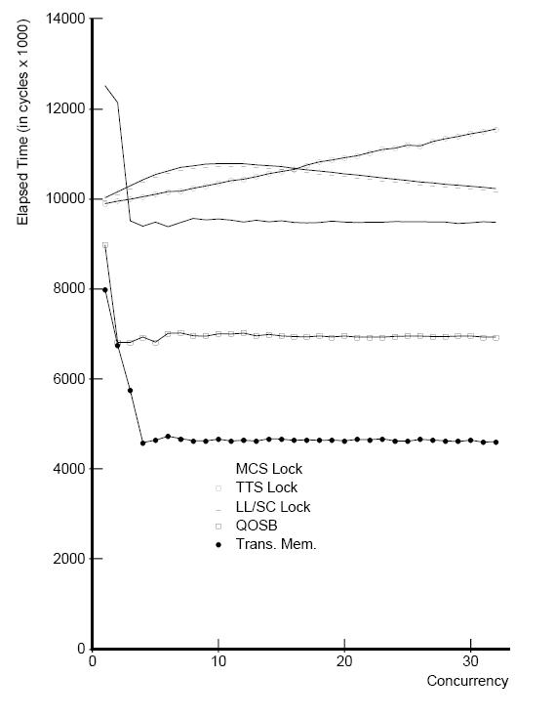
Performance Simulations
TTS
LL/SC
comparison methods
TTS – test/test-and-set (to implement a spin lock)
LL/SC – load-linked/store-conditional (to implement a spin lock)
MCS – software queueing
QOSB – hardware queueing
Transactional Memory
MCS
QOSB
TM

