Slide 1
Threads Redux
Changing thread semantics

Slide 2
Grace: Overview
Goal
Eliminate classes of concurrency errors
For applications using fork-join parallelism
Not appropriate for
Reactive systems (servers)
Systems with condition-based synchronization
Approach
Fully isolated threads (turning threads into processes)
Leveraging virtual memory protections
No need for locks (turn locks into no-ops)
Sequential commit protocol
Threads commit in program order
Guarantees execution equivalent to serial execution
Speculative thread execution

Slide 3
Grace: Overview
Features
Overhead amortized over lifetime of thread
Supports threads with irrevocable operations (e.g., I/O operations)
Less memory overhead than comparable transactional memory techniques
Concurrency error | Cause | Grace Prevention
Deadlock | Cyclic lock acquisition | No locking
Race condition | Unguarded updates | Updates committed deterministically
Atomicity violation | Interleaved updates | Threads run atomically
Order violation | Threads scheduled in unexpected order | Threads execute in program order

Slide 4
Fork-Join Parallelism
A
B
C
D
E
Serial elision used in Grace
In Grace, fork-join parallelism is behaviorally equivalent to its sequential counterpart

Slide 5
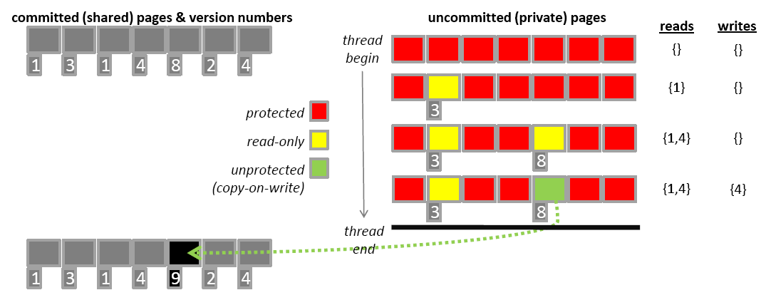
Thread Execution
Each thread has private copies of changed pages (guarantees thread isolation)
Page protection mechanisms used to detect reads/writes
Access tracking and conflict detection at page granularity
Page version numbers allow detection of conflicts
In case of conflict, thread aborts/restarts

Slide 6
Commit order
Rules
Parent waits for
youngest (most recently created) child
Child waits for
youngest (most recently created) elder sibling, if it exists, or
the parent’s youngest (most recently created) elder sibling
Equivalent to post-order traversal of execution tree
Guarantees equivalence to sequential execution

Slide 7
Handling irrevocable I/O operations
Each thread
buffers I/O operations
commits I/O operations with memory updates
Thread attempting irrevocable I/O operation
Waits for its immediate predecessor to commit
Checks for consistency with committed state
If consistent, perform irrevocable I/O operation
Else, restart and perform irrevocable I/O operation as part of new execution

Slide 8
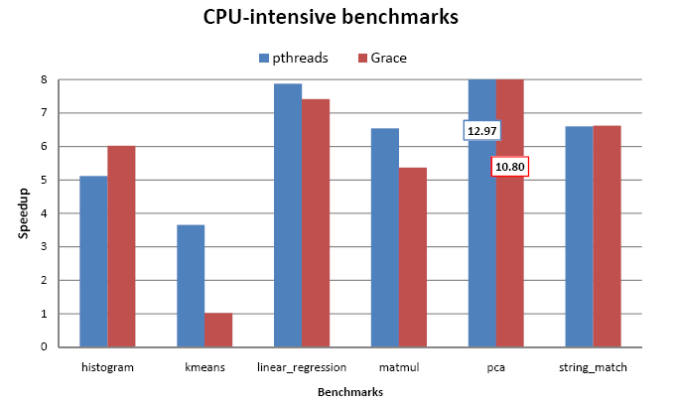
Performance
On 8 core system
Minimal (1-16 lines) changes for Grace version
Speedup for Grace comparable to pthreads but with guarantees of absence of concurrency errors

Slide 9
Sammati
Goals
Eliminates deadlock in threaded codes
Transparent to application (no code changes)
Allows arbitrary use of locks for concurrency control
Achieves composability of lock based codes
Works for weakly typed languages (e.g., C/C++)
Approach
Containment
Identify memory accesses associated with a lock
Keep updates private while lock is held
Make updates visible when lock is released
Deadlock handling
Automatic detection on lock acquisition
Resolves deadlock by restarting one thread

Slide 10
Sammati
Key mechanisms
Transparent mechanism for privatizing memory updates within a critical section
Visibility rules that
preserve lock semantics
allow containment
Deadlock detection and recovery

Slide 11
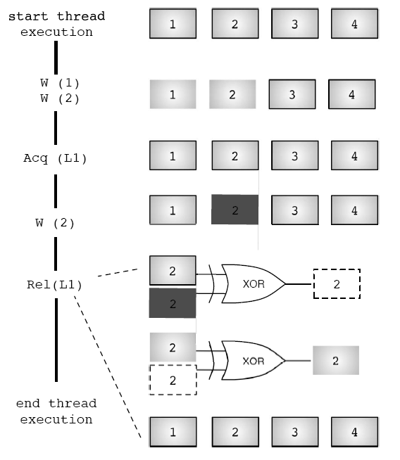
Privatizing memory

Slide 12
Visibility rules
Locks not nested
Begin privatizing changes to x when lock is acquired.
x=y=0;
acquire (L1);
x++;
release (L1);
Allow changes to x to become (globally) visible when lock is released.

Slide 13
Visibility rules
Nested locks
Cannot allow changes to x to become (globally) visible when L2 is released because of possible rollback to L1.
x=y=0;
acquire (L1);
acquire(L2);
x++;
release(L2);
acquire(L3);
x++;
y++;
release(L3);
release (L1);
Cannot allow changes to x or y to become (globally) visible when L3 is released because of possible rollback to L1.
Rule: make changes visible when all locks released.

Slide 14
Visibility rules
Overlapping (unstructured) locks
x=y=0;
acquire (L1);
x++;
acquire(L2);
y++;
release(L1);
release (L2);
Cannot determine transparently with which lock(s) the data should be associated.
Rule: make changes visible when all locks released.

Slide 15
Deadlock detection
A thread may only wait for (be blocked trying to acquire) one lock at a time
Because thread state is privatized, deadlock can be resolved by rolling back and restarting one thread.
L3
T2
T1
L4
L1
L2
T3
L5

Slide 16
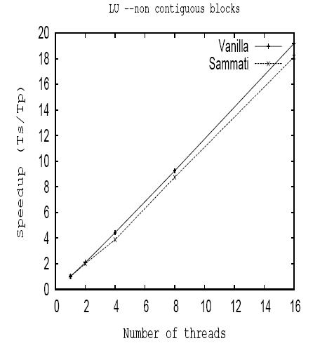
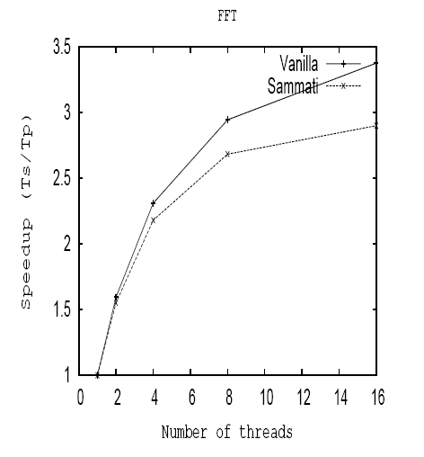
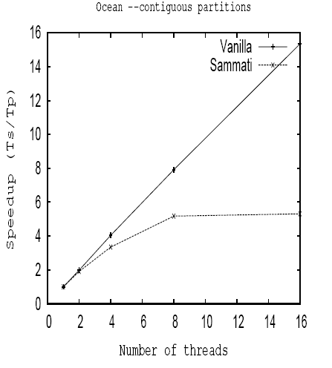
Performance
SPLASH benchmark
Summati performance generally comparable to pthreads (one notable exception)

Slide 17
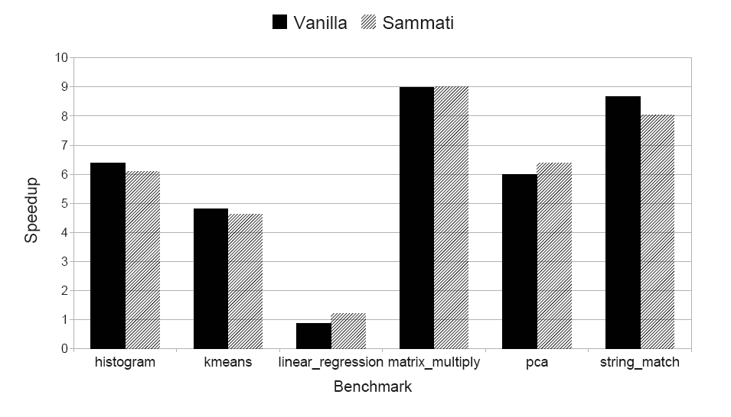
Performance
Phoenix benchmark
Summati performance generally comparable to pthreads

