Slide 1
The Design and Implementation of a Log-Structured File System
Mendel Rosenblum and John K. Ousterhout
Presented by Travis Bale

Slide 2
Overview
Considerations for File Systems
Problems with Existing File Systems
Log-Structured File System
Sprite LFS Implementation Details
Sprite LFS Evaluation
Solid State and Log-Structured File Systems
Questions / Discussion

Slide 3
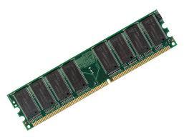
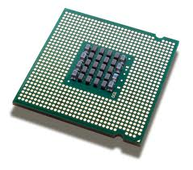
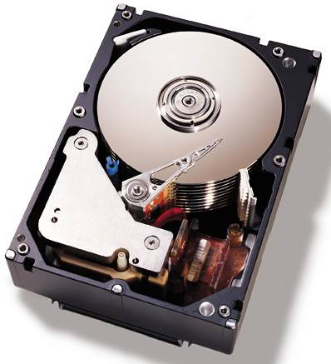
Considerations for File Systems
Technology
Processors
Disks
Main Memory
Workloads
Office
Engineering Environments

Slide 4
Technology Considerations
Processors
Getting exponential faster
Unbalanced Systems
Disk
Components of Disk Access
Transfer Bandwidth
Access Time
Main Memory
Increasing at exponential rate
Caches
Reduces read operations to disk
Write buffers

Slide 5
Workload Considerations
Files tend to be small
Small random disk I/Os
Creation and deletion dominated by updates to metadata

Slide 6
Problems with Existing File Systems
Information Spreading
Synchronous Writes

Slide 7
Information Spreading
Information is spread around the disk so small accesses are frequent
Unix FFS: separates files, file attributes, and directory entries
Unix FFS: takes five disk I/Os with seeks to create a new file

Slide 8
Synchronous Writes
Defeats the use of cache as write buffer
Unix FFS: writes file attributes and metadata structures synchronously
NFS: has synchronous operations that improve crash recovery at cost of write performance

Slide 9
Log-Structured File Systems
Goal: Improve write performance
Buffer file system changes in a cache
Write changes sequential in a single disk operation
Two issues in obtaining goal
Retrieving Information from the log
Managing free space

Slide 10
Sprite LFS Data Structures

Slide 11
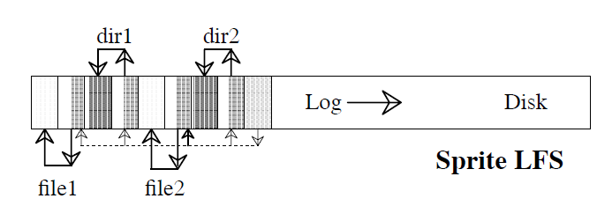
Sprite LFS structure compared to Unix FFS

Slide 12
Reading File from Sprite LFS
Checkpoint Region
Inode
Data Block
Cache
Inode Map

Slide 13
Free Space Management
Fragmentation from deleted and overwritten files
Two approaches to reduce fragmentation
Threading
Leave live data in place and thread through the free extents
Reduces ability of sequential writes
Copying
Copy live data an append to the front of the log
Leaves larger free extents for use
Copying is very expensive on long-lived files
Sprite LFS uses a combination of both threading and copying

Slide 14
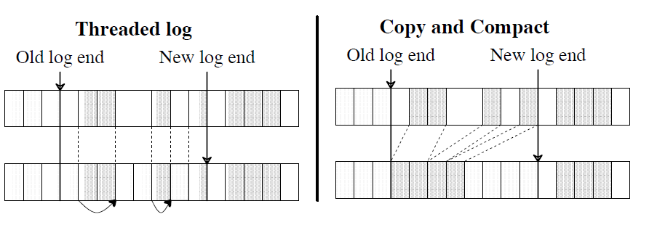
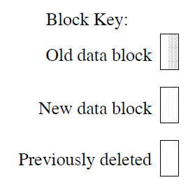
Threading vs Copying

Slide 15
Sprite LFS Segments
The disk is divided into large fixed-sized segments
Either 512 kilobytes or 1 megabyte
Live data on segments is copied if segments need to be rewritten
System collects long-lived data together
These segments can be skipped during the copy procedure
The log is threaded segment-by-segment

Slide 16
Sprite LFS Segment Cleaning
Refers to copying of live data in segments
Read segments into memory
Identify the live data
Segment Summary Block
Uid in inode maps
Write live data to smaller number of clean segments
No free list

Slide 17
Segment Cleaning Policy Questions
When should the segment cleaner execute?
How many segments should it clean at a time?
Which segments should be cleaned?
How should the live blocks be grouped when they are written out?

Slide 18
Write Cost
Used to compare cleaning policies
Average amount of time the disk is busy per byte of new data written, including all the cleaning overheads
1.0 is perfect while higher means fractions of disk bandwidth are being utilized

Slide 19
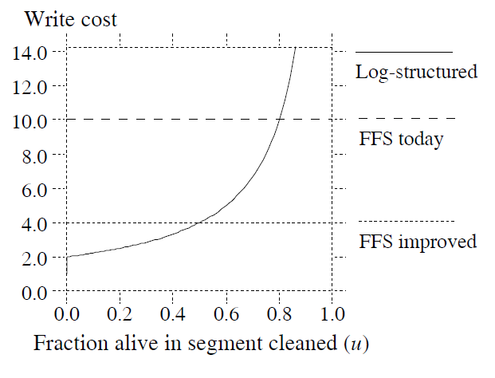
Write Cost of Sprite LFS

Slide 20
Cleaning policy simulation
Models file system as a fixed number of 4-kbyte files
Simulator overrides data by using different access patterns
Uniform
Hot-and-Cold

Slide 21
Greedy Cleaning Policy
Cleaner chooses the least utilized segments to clean
In the case of the Hot-and-Cold distribution the cleaner also sorts the live data by age
Cold blocks tended to be in different segments from Hot blocks

Slide 22
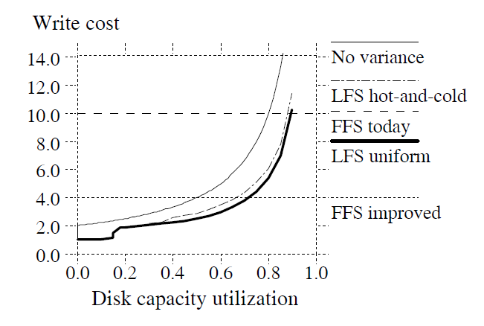
Greedy Cleaning Policy Problems
In Hot-and-Cold performance was worse than random distribution
Cold Segments were not dropping to cleaning utilization thresholds quickly enough

Slide 23
Cost-Benefit Policy
Greedy Policy data shows that hot and cold segments should be treated differently
Cold segments should be cleaned at high utilization
Hot segments should be cleaned at low utilization
Cost-Benefit policy rates each segment with the benefit of cleaning the segment and the cost of cleaning the segment

Slide 24
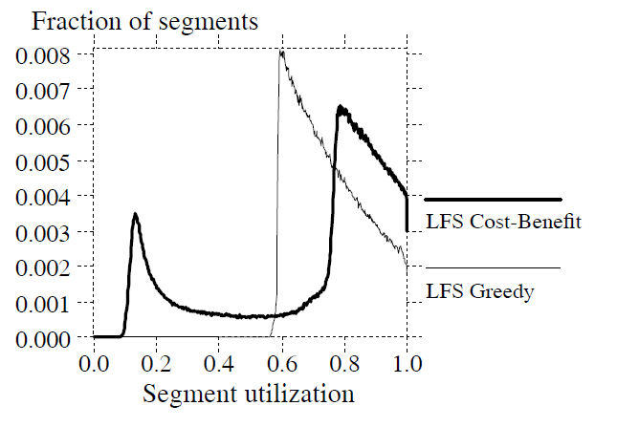
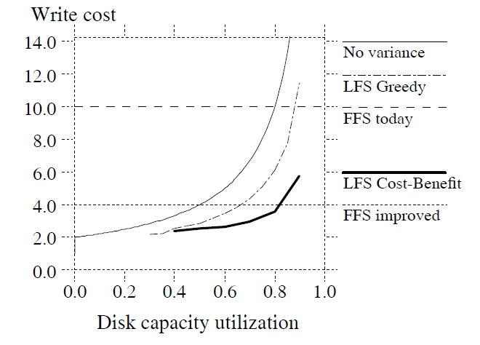
Cost-Benefit Policy Evaluation

Slide 25
Segment Cleaning Policy
Segment Cleaning kicks in when the number of clean segments drops below a threshold
Cleans segments until number of clean segments passes a threshold
Threshold values do not seem to effect performance greatly
Cost-Benefit Policy is used in cleaning the segments
Segment Usage table used to support the Cost-Benefit Policy
Contains number of live blocks and time of the most recently accessed block
Information used to compute the cost benefit to see if segment should be cleaned

Slide 26
Crash Recovery
Checkpoint Region
Contains the addresses of all the blocks in the inode map and segment usage table, plus the current time and a pointer to the last segment written
Performed at periodic intervals
System uses the checkpoint region to return log to this state
Roll-Forward
Uses data after the check point to recover as many files as possible

Slide 27
Micro Benchmarks
File systems: Sprite LFS and Unix FFS
Machine specs: Sun-4/260, with 32 megabytes of memory, a Sun SCSI3 HBA, and a Wren IV disk (1.3 MBytes/sec maximum transfer bandwidth, 17.5 milliseconds average seek time)
Disk Specs: 300 megabytes of usable storage
SunOS (Unix FFS) using 8 kilobyte blocks
Sprite FFS using 4 kilobyte blocks and 1 megabyte segment size

Slide 28
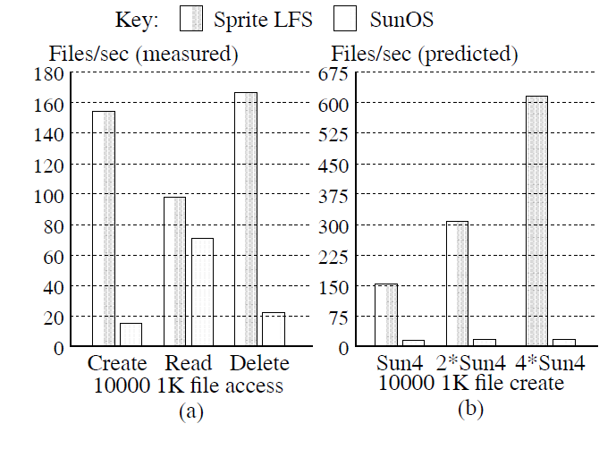
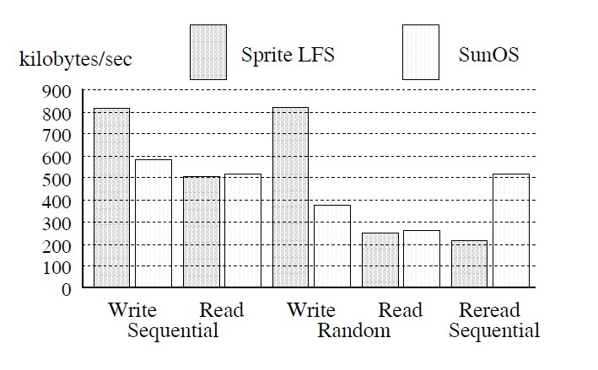
Micro Benchmark Results
Large File Benchmark
Small File Benchmark

Slide 29
Cleaning Overhead
Tested on 5 different file systems over 4 month period
Waited several months to allow file system to balance
Write cost smaller than simulated
This was due to block sizes used in simulation

Slide 30
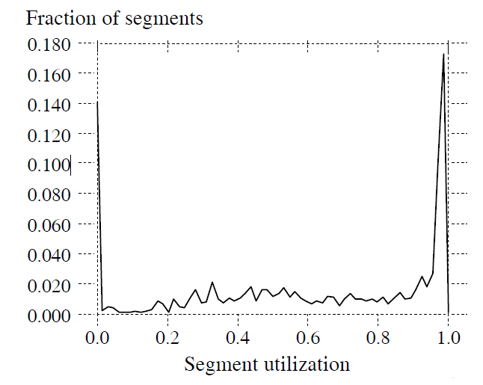
Segment Utilization for /user6

Slide 31
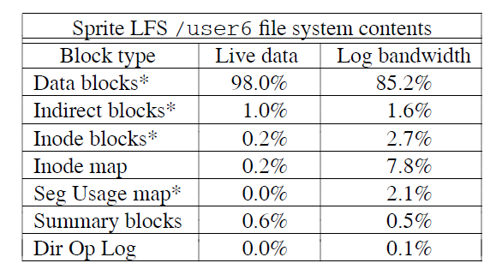
Other Overheads

Slide 32
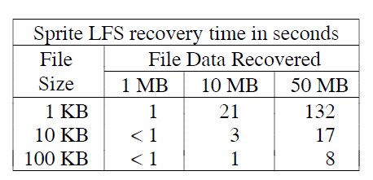
Crash Recovery Times

Slide 33
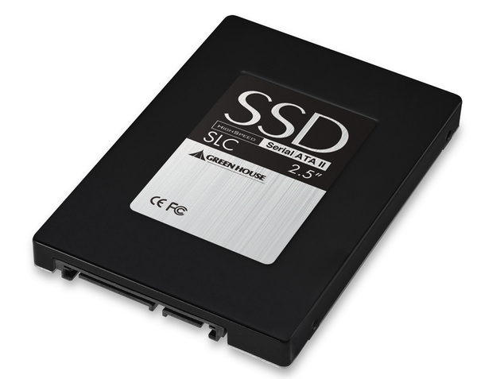
Log Structured File Systems and SSDs
Log Structured File Systems write files sequentially on disk
Segment Cleaning

Slide 34
Questions

