Slide 1
Virtual-Time Round-Robin: An O(1) Proportional Share Scheduler
Jason Nieh; Chris Vaill; & Hua Zhong
Columbia University
Presented By: Parang Saraf

Slide 2
Proportional Share Scheduling

Slide 3
Proportional Share Scheduling
Given a set of clients with associated weights, a proportional share scheduler should allocate resources to each client in proportion to its respective weight.
Two types of proportional sharing:
Varying Frequency
Varying Time quantum

Slide 4
Perfect Fairness
An ideal state in which each client receives service exactly proportional to its share.
where
WA(t1, t2) is the amount of service received by client A during the time interval (t1, t2).
SA is the proportional share of client A
∑i Si is the sum of shares of all the clients.

Slide 5
Service Time Error (EA)
The error is the difference between the amount of time allocated to the client during interval (t1, t2) under the given algorithm, and the amount of time what would have been allocated under an ideal scheme that maintains perfect fairness for all clients over all intervals.
Measured in time units (tu).

Slide 6
Background Art
Weighted Round-Robin Scheduling
Fair-Share Scheduling
Lottery Scheduling
Weighted Fair Queuing Scheduling

Slide 7
Weighted Round-Robin (WRR)

Slide 8
Weighted Round-Robin (WRR)
Clients are placed in a queue and allowed to execute in turn.
WRR provides proportional sharing by running all clients with the same frequency but adjusting the size of their time quanta.
Scheduling overhead: O(1)

Slide 9
WRR Example
3 clients A, B, and C having shares 3, 2, and 1 respectively.
(3 tu) (2 tu) (1 tu)
A B C
The error range is -1 tu to +1.5 tu.

Slide 10
Fair-Share Scheduling
Fair-Share provides proportional sharing among users by adjusting the priorities of a user’s clients in a suitable way.
Proportional sharing is achieved by running the clients at different frequencies.
Scheduling overhead: O(1) – O(N)
Where N is the number of clients

Slide 11
Lottery Scheduling

Slide 12
Lottery Scheduling
Each client is given a number of tickets proportional to its share.
A ticket is randomly selected by the scheduler and the client that owns the selected ticket is scheduled to run for a time quantum.
Scheduling Overhead: O(log N) – O(N).
Scheduling accuracy is random, because it relies on the law of randomness.

Slide 13
Weighted Fair Queuing (WFQ)
Virtual Time VTi(t)
is a measure of the degree to which a client has received its proportional allocation relative to other clients.
advances at the rate inversely proportional to the client’s share.
Where
WA(t) is the amount of service received by client A
SA is the share of client A
Virtual Finish Time (VFT)
is the virtual time after running the client for one time quantum.

Slide 14
Weighted Fair Queuing (WFQ)
Clients are ordered in a queue sorted from smallest to largest VFT.
The first client in the queue is selected for execution.
After the client is executed, its VFT is updated and the client is inserted back into the queue.
Its position in the queue is determined by its updated VFT.

Slide 15
WFQ Example
3 clients A, B, and C having shares 3, 2, and 1 respectively.
Initial VFTs are 1/3, 1/2 and 1/1 respectively.
A | B | C
1/3 | 1/2 | 1/1

Slide 16
WFQ Example
3 clients A, B, and C having shares 3, 2, and 1 respectively.
Initial VFTs are 1/3, 1/2 and 1/1 respectively.
B | A | C
1/2 | 2/3 | 1/1
A

Slide 17
WFQ Example
3 clients A, B, and C having shares 3, 2, and 1 respectively.
Initial VFTs are 1/3, 1/2 and 1/1 respectively.
A | C | B
2/3 | 1/1 | 2/2
A | B

Slide 18
WFQ Example
3 clients A, B, and C having shares 3, 2, and 1 respectively.
Initial VFTs are 1/3, 1/2 and 1/1 respectively.
C | B | A
1/1 | 2/2 | 3/3
A | B | A

Slide 19
WFQ Example
3 clients A, B, and C having shares 3, 2, and 1 respectively.
Initial VFTs are 1/3, 1/2 and 1/1 respectively.
B | A | C
2/2 | 3/3 | 2/1
A | B | A | C

Slide 20
WFQ Example
3 clients A, B, and C having shares 3, 2, and 1 respectively.
Initial VFTs are 1/3, 1/2 and 1/1 respectively.
A | B | C
3/3 | 3/2 | 2/1
A | B | A | C | B

Slide 21
WFQ Example
3 clients A, B, and C having shares 3, 2, and 1 respectively.
Initial VFTs are 1/3, 1/2 and 1/1 respectively.
A | B | C
4/3 | 3/2 | 2/1
A | B | A | C | B | A

Slide 22
WFQ Performance
For last example, service time error ranges from -5/6 to +1 tu.
It never gets below -1 tu. This means that a client can never fall behind its ideal allocation by more than a single time quantum.
Scheduling Overhead: O(log N) – O(N).
Most closest to proportional sharing.

Slide 23
Virtual-Time Round-Robin (VTRR)
Algorithm:
Order the clients in the run queue from largest to smallest share. Unlike fair queue, the client's position in the run queue only changes when its share changes.
Starting from the beginning of the queue, run each client for one time quantum in a round-robin manner.
In step 2, if a client has received more than its proportional allocation, skip the remaining clients in the run queue and start from the beginning. Since, the clients with larger share values are placed first in the queue, this allows them to get more service than the lower-share clients at the end of the queue.

Slide 24
Basic VTRR Algorithm
For each client, VTRR associates the following:
Share: the resource rights of a client.
Virtual Finish Time (VFT): Number of time quanta executed divided by the share of the client.
Time Counter: tracks the number of quanta the client must receive before a period is over.
ID Number: uniquely identifies a client.
Run State: whether the client can be executed or not.

Slide 25
Basic VTRR Algorithm
VTRR maintains a scheduler state, having following:
Time Quantum: How long is one time quantum
Run Queue: sorted queue of all runnable clients ordered from largest to smallest share client.
Total Shares: Sum of the shares of all the clients.
Queue virtual time (QVT): is the measure of what a client's VFT should be if it has received exactly its proportional share allocation.

Slide 26
Basic VTRR Algorithm
Queue Virtual Time (QVT)
QVT advances whenever any client executes at a rate inversely proportional to the total shares (same for every client):
Where,
Q is the system time quantum
Si is the share of client i
The difference between the QVT and a client's virtual time is a measure of whether the respective client has consumed its proportional allocation of resources or not.

Slide 27
Basic VTRR Algorithm
Role of Time Counters
Scheduling Cycle: a sequence of allocations whose length is equal to the sum of all client shares. In our example its 6 (3+2+1).
Time counter for each client is reset at the beginning of each scheduling cycle to the client's share value, and is decremented every time a client receives a time quantum.
At the end of a scheduling cycle, the time counter of every client should be equal to zero.

Slide 28
Basic VTRR Algorithm
Role of Time Counters
Time Counter Invariant: for any two consecutive clients in the queue A and B,
TCA ≥ TCB
Preserving Time Counter Invariant: If the counter value of the next client is greater than the counter of the current client, the scheduler makes the next client the current client and executes it for a quantum, without question.

Slide 29
Basic VTRR Algorithm
VFT Inequality
Where,
Q is the time quantum
SC is the share of client C
Only if the VFT inequality is true, the scheduler selects and executes the next client in the run queue.
If at any point, the VFT inequality is not true, the scheduler returns to the beginning of the run queue and selects the first client to execute.

Slide 30
VTRR Example
3 clients A, B, and C having shares 3, 2, and 1 respectively.
Time Counter | 3 | 2 | 1
Client | A | B | C
VFT | 1/3 | 1/2 | 1/1
Execution
QVT | 1/6 | 2/6 | 3/6 | 4/6 | 5/6 | 6/6

Slide 31
VTRR Example
3 clients A, B, and C having shares 3, 2, and 1 respectively.
Time Counter | 3 | 2 | 1
Client | A | B | C
VFT | 1/3 | 1/2 | 1/1
Execution
QVT | 1/6 | 2/6 | 3/6 | 4/6 | 5/6 | 6/6
:: 1/3 – 2/6 < 1/3

Slide 32
VTRR Example
3 clients A, B, and C having shares 3, 2, and 1 respectively.
Time Counter | 2 | 2 | 1
Client | A | B | C
VFT | 2/3 | 1/2 | 1/1
Execution | A
QVT | 1/6 | 2/6 | 3/6 | 4/6 | 5/6 | 6/6
:: 1/2 – 3/6 < 1/2

Slide 33
VTRR Example
3 clients A, B, and C having shares 3, 2, and 1 respectively.
Time Counter | 2 | 1 | 1
Client | A | B | C
VFT | 2/3 | 2/2 | 1/1
Execution | A | B
QVT | 1/6 | 2/6 | 3/6 | 4/6 | 5/6 | 6/6
:: 1/1 – 4/6 < 1/1

Slide 34
VTRR Example
3 clients A, B, and C having shares 3, 2, and 1 respectively.
Time Counter | 2 | 1 | 0
Client | A | B | C
VFT | 2/3 | 2/2 | 2/1
Execution | A | B | C
QVT | 1/6 | 2/6 | 3/6 | 4/6 | 5/6 | 6/6
:: 2/3 – 5/6 < 1/3

Slide 35
VTRR Example
3 clients A, B, and C having shares 3, 2, and 1 respectively.
Time Counter | 1 | 1 | 0
Client | A | B | C
VFT | 3/3 | 2/2 | 2/1
Execution | A | B | C | A
QVT | 1/6 | 2/6 | 3/6 | 4/6 | 5/6 | 6/6
:: 2/2 – 6/6 < 1/2

Slide 36
VTRR Example
3 clients A, B, and C having shares 3, 2, and 1 respectively.
Time Counter | 1 | 0 | 0
Client | A | B | C
VFT | 3/3 | 3/2 | 2/1
Execution | A | B | C | A | B
QVT | 1/6 | 2/6 | 3/6 | 4/6 | 5/6 | 6/6

Slide 37
VTRR Example
3 clients A, B, and C having shares 3, 2, and 1 respectively.
Time Counter | 1 | 0 | 0
Client | A | B | C
VFT | 3/3 | 3/2 | 2/1
Execution | A | B | C | A | B
QVT | 1/6 | 2/6 | 3/6 | 4/6 | 5/6 | 6/6
:: 3/3 – 7/6 < 1/3

Slide 38
VTRR Example
3 clients A, B, and C having shares 3, 2, and 1 respectively.
Time Counter | 1 | 0 | 0
Client | A | B | C
VFT | 3/3 | 3/2 | 2/1
Execution | A | B | C | A | B | A
QVT | 1/6 | 2/6 | 3/6 | 4/6 | 5/6 | 6/6

Slide 39
VTRR Dynamic Considerations
Inserting a new client
A new client is inserted into the run queue so that the run queue remains sorted from largest to smallest client share.
We set the client’s implicit virtual time to be the same as the QVT.
Subsequently, VFT is calculated as follows:
The initial counter value is set as follows:

Slide 40
VTRR Dynamic Considerations
Removing and re-inserting an existing client
When a client becomes not runnable, it is removed from the queue and its last-previous and last-next clients are recorded.
VFT is not updated any more. While re-inserting VFT is calculated as follows:
Similarly, if the client is inserted in the same cycle in which it was removed, the counter is set to the minimum of CA and the previous counter value.

Slide 41
VTRR Complexity
A client is selected to execute in O(1) time.
Updating the client’s VFT and the current run queue are both O(1) time operations.
The complete counter reset takes O(N) time, where N is the number of clients.
However, this reset is done after every scheduling cycle.
As a result, the reset of the time counters is amortized over all the clients giving an effective running time of O(1).

Slide 42
VTRR: Measurements & Results
Conducted simulation studies to compare the proportional sharing accuracy of VTRR against both WRR and WFQ.
The System used has following configuration:
Gateway 2000 E1400 system
One 433 MHz Intel Celeron CPU
128 MB RAM
10 GB hard drive
Red Hat Linux 6.1 distribution running Linux 2.2.12-20 kernel.
Timestamps were read from hardware cycle counter registers.

Slide 43
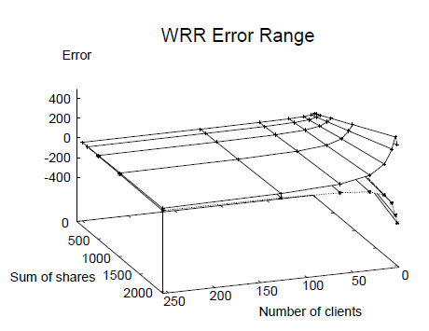
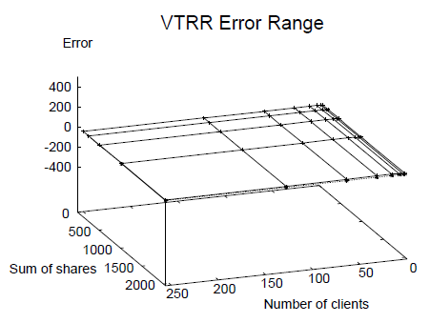
VTRR: Measurements & Results
WRR vs. VTRR Service Time Error

Slide 44
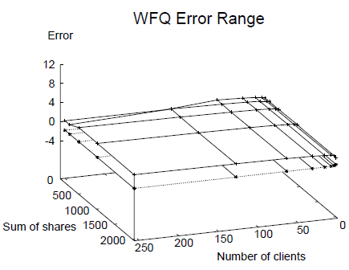
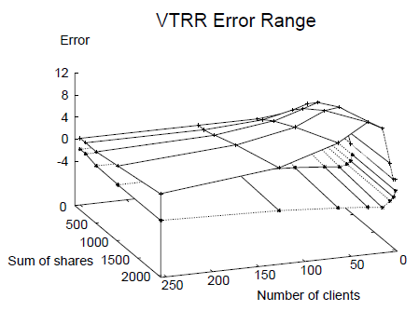
VTRR: Measurements & Results
WFQ vs. VTRR Service Time Error

Slide 45
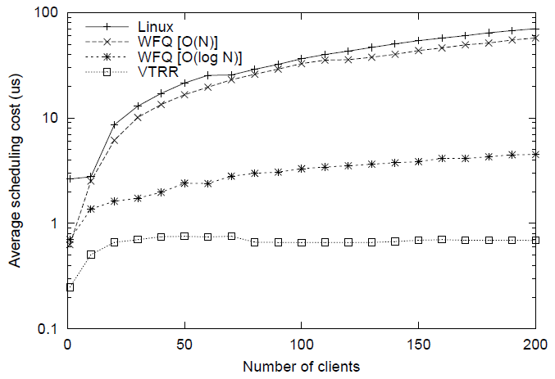
VTRR: Measurements & Results
Average Scheduling Overhead

Slide 46
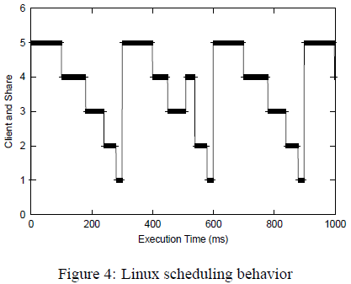
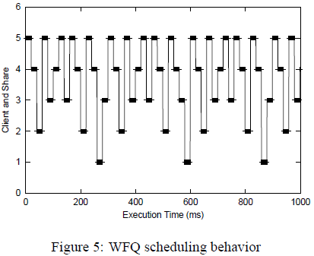
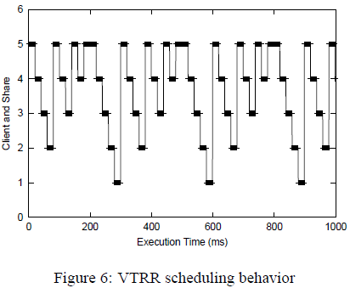
VTRR: Measurements & Results
Scheduling Behavior

Slide 47
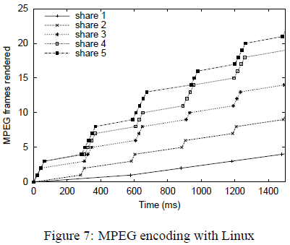
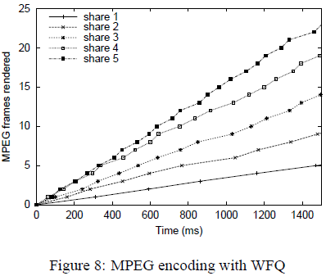
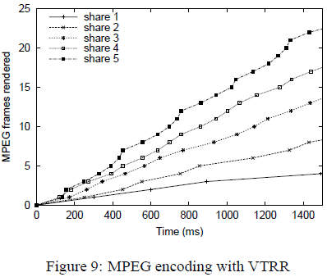
VTRR: Measurements & Results
MPEG Encoding behavior

Slide 48
Conclusion & Future Work
VTRR is simple to implement and easy to integrate into existing commercial operating systems.
Implementing VTRR requires just 100 lines of code in Linux.
VTRR combines the benefits of accurate proportional share resource management with very low overhead.
Future work involves, evaluating VTRR in a multi-processor context.
Group Ratio Round-Robin: O(1) Proportional Share Scheduling for Uniprocessor and Multiprocessor Systems; 2005 USENIX Annual Technical Conference

Slide 49
Questions?
Please send both your positive and negative feedback on
parang@cs.vt.edu

