Slide 1
Operating System Support for Virtual Machines
Samuel T. King, George W. Dunlap,Peter M.Chen
Presented By,
Rajesh
References
[1] Virtual Machines: Supporting Changing Technology and New Applications, ECE Dept. Georgia Tech., November 14, 2006
[2] James Smith, Ravi Nair, “The Architectures of Virtual Machines,” IEEE Computer, May 2005, pp. 32-38.

Slide 2
Why Virtual Machines?
It provides abstraction
  Thus simplifying the use of resources
It provides isolation
  This enhances / improves the security of executing applications
It provides interoperability
  Scenario where interoperability is needed
    If application programs are distributed as compiled binaries which are tied to specific ISA

Slide 3
Computer System Architecture ^{[2]}

Slide 4
Instruction Set Architecture (ISA)
Marks the division of h/w & s/w
Consists of interfaces 3 & 4
Interface 4
  User ISA -> visible to user application
Interface 3
  System ISA -> visible to OS
  Responsible for managing hardware resources

Slide 5
Application Binary Interface (ABI)
Provides a program access to the h/w resources through user ISA & system call(interface 2)
ABI does not include system instructions
Programs interacts with h/w indirectly using system call

Slide 6
Application Programming Interface (API)
Contains high-level languages (HLL) library calls(interface 1)
Systems calls are performed through libraries

Slide 7
What is a “Machine” ?
From process perspective
  A machine consists of a logical address space, user-level instructions, registers
  Machine’s I/O is visible through OS
  ABI defines the machine
From operating system perspective
  It is the complete execution environment consisting of numerous processes executing simultaneously & sharing resources
  The underlying h/w defines the machine
  ISA provides the interface between the OS & h/w

Slide 8
Process VM
A process VM is a virtual platform that executes an individual process
The virtualizing s/w that implements a process VM is called as ‘runtime software’
The virtualizing s/w is at the ABI level
Not persistent

Slide 9
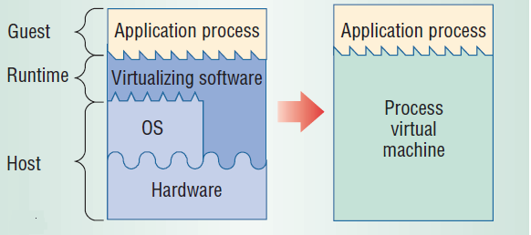
Process VM

Slide 10
System VM
Provides a complete persistent system environment
Supports an OS along with its many user processes
The virtualizing s/w that implements a system VM is called as ‘virtual machine monitor ’
Provides the guest OS with access to virtual resources

Slide 11
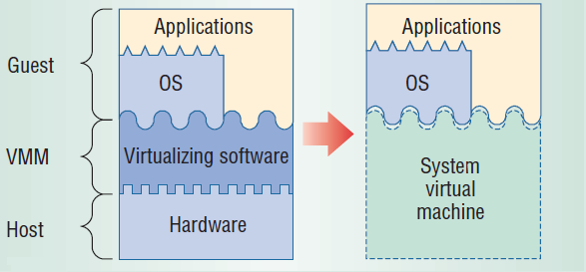
System VM

Slide 12
Virtual Machine Taxonomy
Process VMs
System VMs
different
different
same ISA
same ISA
ISA
ISA
Multi
Dynamic
Classic
Whole
programmed
Translators
OS VMs
System VMs
Systems
Dynamic
Hosted
Co-Designed
HLL VMs
VMs
VMs
Binary
Optimizers

Slide 13
Operating System Support for Virtual Machine
Introduction
Types of VMM
UMLinux
UMLinux Performance Issues
Proposed Solution
Evaluation of Proposed Solution
Conclusion

Slide 14
Introduction
Virtual Machine (VM)
  A software implementation of a machine that executes programs like a physical machine
Virtual Machine Monitor (VMM)
  A layer of s/w that emulates the h/w of a computer system
  Provides s/w abstraction to VM
Ref: http://en.wikipedia.org/wiki/Virtual_machine

Slide 15
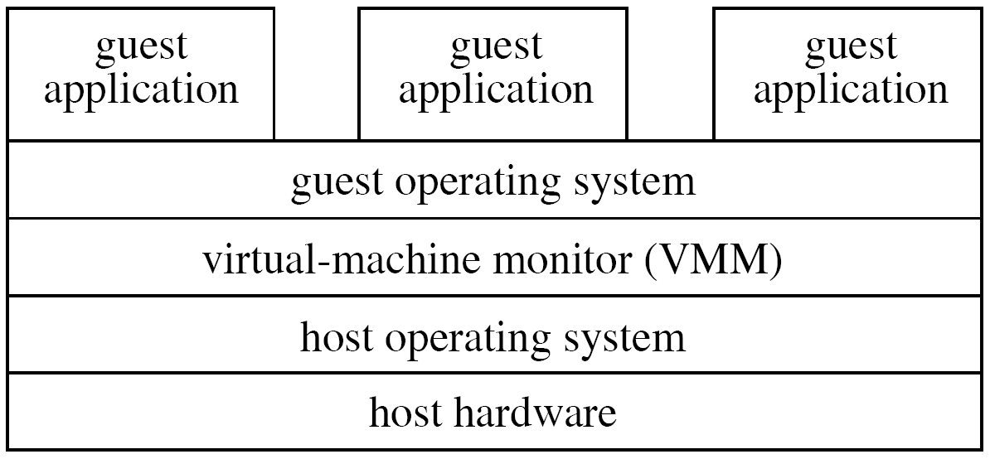
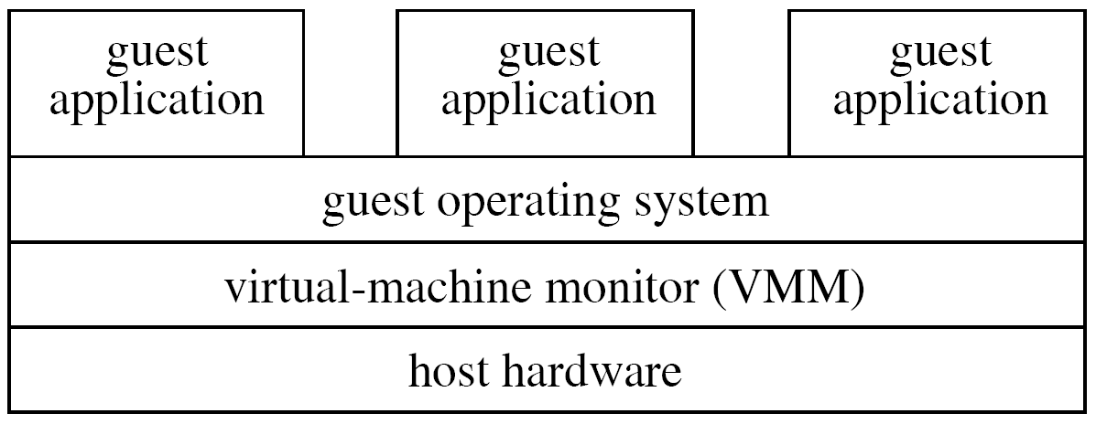
Types of VMM
Type 1
  Runs directly on h/w
  High performance
Type 2
  Runs on host OS
  Elegant design
  More overhead involved resulting in low performance

Slide 16
UMLinux
A type-2 VMM
It is Linux OS running top of Linux
Guest machine process
  The guest operating system & guest applications run as a single process
The interfaces provided by UMLinux is similar but not identical to underlying h/w
Uses functionality supplied by underlying OS

Slide 17
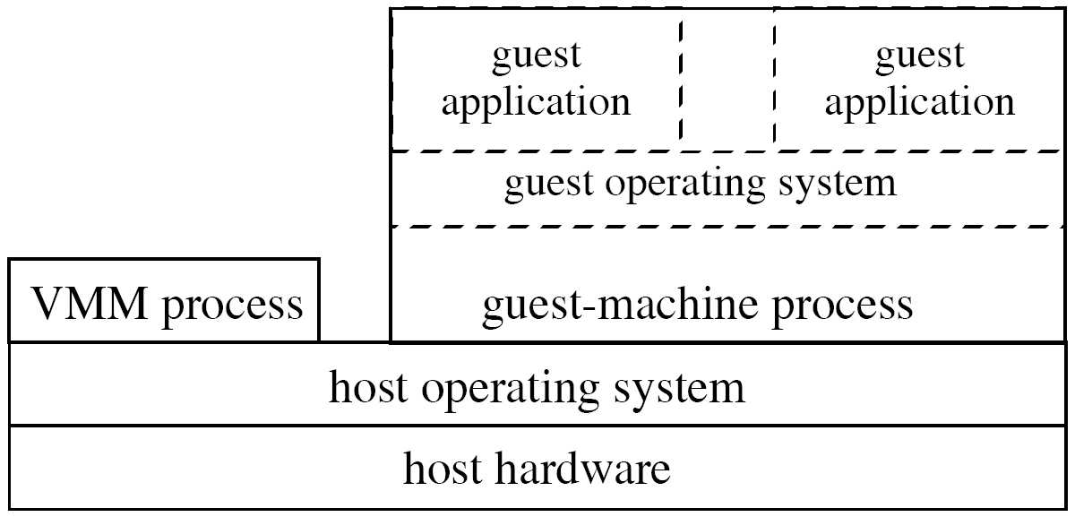
UMLinux
Uses two host processes
  Guest machine process
    Executes the guest OS & applications
  VMM process
    Uses ptrace to mediate access between the guest machine process and the host operating system
    Restricts the set of system calls allowed by the guest OS

Slide 18
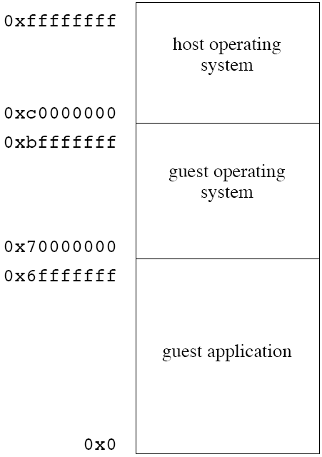
UMLinux Address Space
In all Linux processes
  Host kernel address space will be
    [0xc0000000,0xffffffff]
  While application is given
    [0x0,0xc0000000]
For UMLinux guest process
  Guest OS
    [0x70000000,0xc0000000]
  Guest application
    [0x0, 0x70000000]

Slide 19
UMLinux System Call
1. guest application issues system call; intercepted by VMM process via ptrace
2. VMM process changes system call to no-op (getpid)
3. getpid returns; intercepted by VMM process
4. VMM process sends SIGUSR1 signal to guest SIGUSR1 handler
5. guest SIGUSR1 handler calls mmap to allow access to guest kernel data; intercepted by VMM process
6. VMM process allows mmap to pass through
7. mmap returns to VMM process
8. VMM process returns to guest SIGUSR1 handler, which handles the guest application’s system call

Slide 20
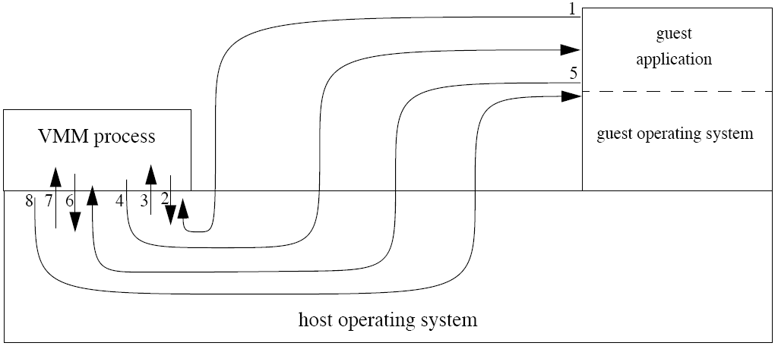
UMLinux System Call

Slide 21
Type-2 VMM Performance Issues
Three major bottlenecks associated while running type-2 VMM
  Two separate processes causes an inordinate no. of context switches on the host
  Switching b/w the guest kernel space & guest user spaces generates large no. of memory protection operations
  Switching b/w two guest application processes generates a large no. of memory mapping operations

Slide 22
Issue 1: Extra host context switches
Solution
  Move VMM process’s functionality into host kernel
  It will be a loadable kernel module
  Involves modification of host’s kernel
    To transfer control to VMM kernel module

Slide 23
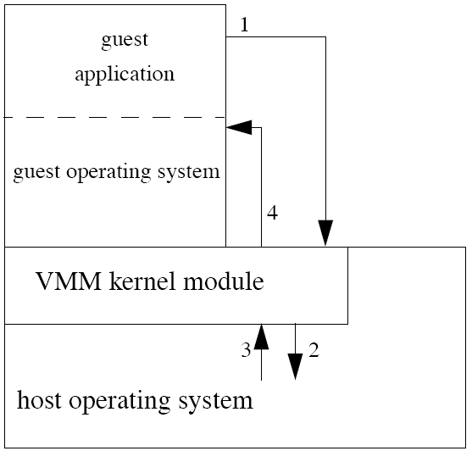
Modified UMLinux System Call
1. guest application issues system call; intercepted
by VMM kernel module
2. VMM kernel module calls mmap to allow access
to guest kernel data
3. mmap returns to VMM kernel module
4. VMM kernel module sends SIGUSR1 to guest
SIGUSR1 handler

Slide 24
Issue 2: Large No. Of Memory Protection Operations
Solution
  Uses x86 paged segments & privilege mode
  Motivation
  Linux systems uses paging for translation & protection

Slide 25
Reducing Memory Protection Operations
segment bound
A normal Linux host process runs in CPU privilege ring 3
The segment bounds allow access to all addresses
The supervisor-only bit in the page table prevents the host process from accessing the host operating system’s data.
Guest-machine process protects guest kernel data using munmap or mprotect [0x70000000, 0xc0000000) before switching to guest user mode.
0xffffffff
Host OS
0xc0000000
guest kernel-mode
Accessible
Memory
Guest OS
0x70000000
Guest
Apps
0x0000000

Slide 26
Reducing Memory Protection Operations: Solution 1
When running the guest user code the bound on the user code & data is changed to [0x0,0x70000000]
In guest kernel mode , the VMM kernel module grows the user & data segments to its normal range of [0x0,0xffffffff]
0xffffffff
Host OS
guest user-mode
0xc0000000
Guest OS
0x70000000
segment bound
Guest
Apps
Accessible
Memory
0x00000000
Limitation: This solution assumes that the guest kernel space occupies a contiguous region directly below the host kernel space

Slide 27
Reducing Memory Protection Operations: Solution 2
    Uses page table’s supervisor-only bit to distinguish between guest kernel mode and guest user mode
    Guest kernel’s pages are accessible only to supervisor code (ring 0-2)
0xffffffff
Host OS
0xc0000000
guest user-mode
Guest OS
0x70000000
Accessible
Memory
Guest
Apps
0x00000000

Slide 28
Issue 3: Large No. Of Memory Mapping Operations
Switching address space b/w guest application processes
  Involves changes in the current memory mapping b/w guest virtual pages and the pages in virtual machine’s physical memory file.
  Changes are done using the system calls munmap & mmap
Solution
  Modify host OS to allow several address space definition for a single process
  The guest-machine processes switches b/w address space definitions via switch-guest system call

Slide 29
Performance Evaluation
Experiment Setup
  AMD Athlon 188+ CPU, 256 MB of Physical Memory, Host OS – Linux 2.4.18
Performance Measurements
  Micro benchmarks
    A null system call
    Switching b/w two guest application process
    Transferring 10MB of data using TCP across a 100 Mb/s Ethernet switch
  Macro benchmarks
    POV-Ray
    Kernel-build
    SPECweb99

Slide 30
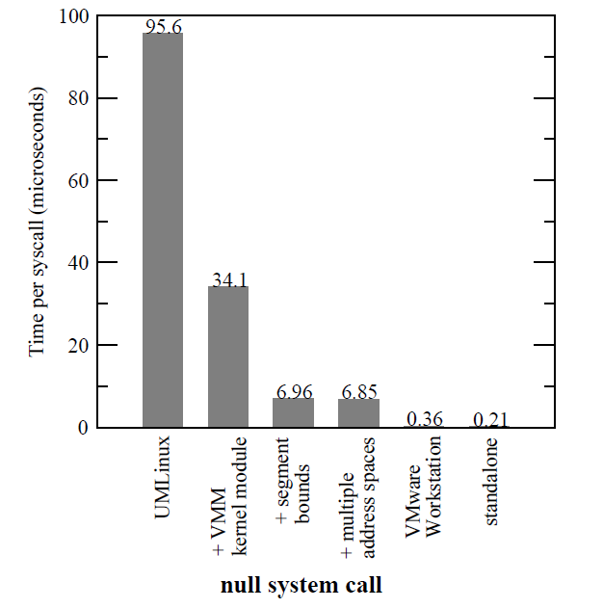
Results
Significant performance gain by reducing the context switches

Slide 31
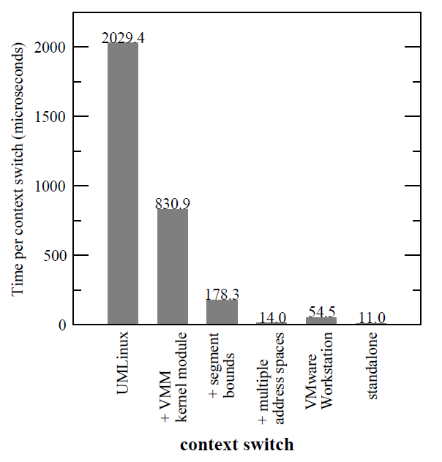
Results
Modified UMLinux performs better than the VMware Workstation

Slide 32
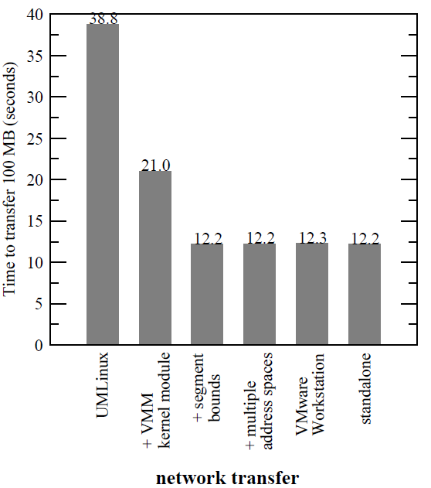
Results
Modified UMLinux & Standalone shows equal performance

Slide 33
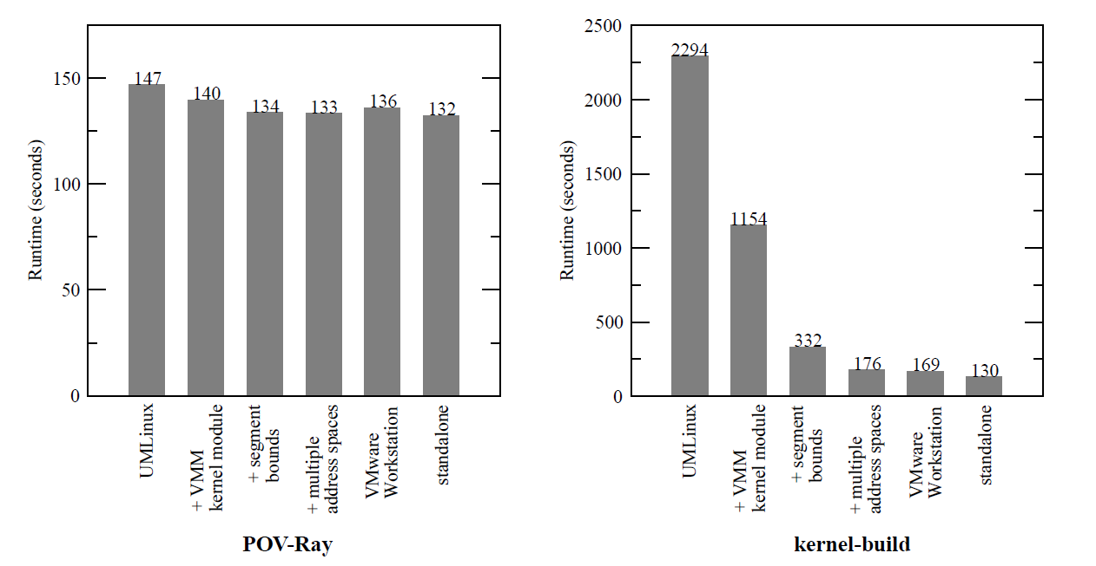
Results
Highly compute intensive & incurs very less virtualization overhead
Modified UMLinux exhibits significant performance gain

Slide 34
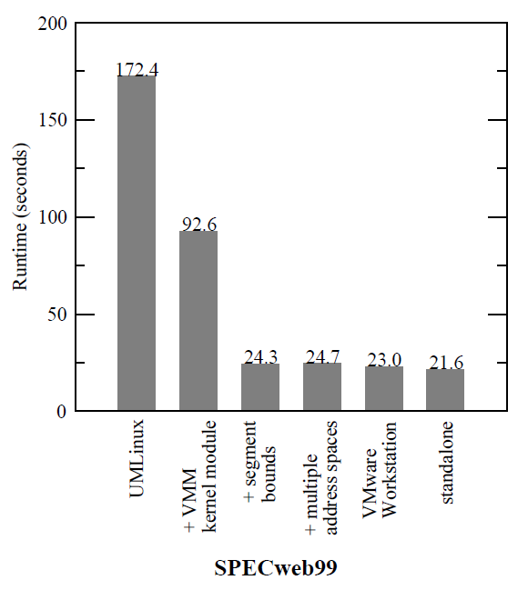
Results

Slide 35
Conclusion
Three performance bottlenecks of type-2 VMM were identified
Proposed solutions to fix these bottlenecks
Experiment results validate the claims of proposed solution

Slide 36
Future Work
Plan to reduce the size of host operating system

