Slide 1
The Multikernel
A new OS architecture for scalable multicore systems
Andrew Baumann Paul Barham Pierre-Evariste Dagand
Tim Harrisy Rebecca Isaacsy Simon Peter
Timothy Roscoe Adrian Schüpbach Akhilesh Singhania
In Proceedings of the ACM SIGOPS 22nd Symposium on Operating Systems Principles
(Big Sky, Montana, USA, October 11 - 14, 2009). SOSP '09
Presented by
A.Vignesh

Slide 2
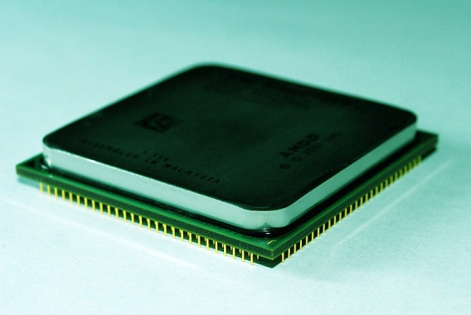
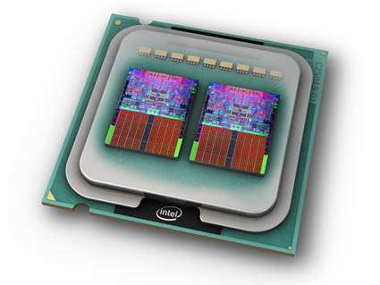
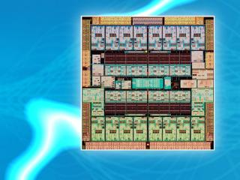
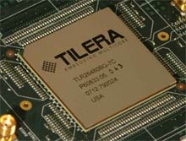
Current Architecture Trends: Increasing number of cores
AMD Athlon 2
2 Core Processor
Intel Core 2 Quad
4 Core Processor
Sun UltraSPARC T3
16 Core Processor
Tilera TILE64
64 Core Processor

Slide 3
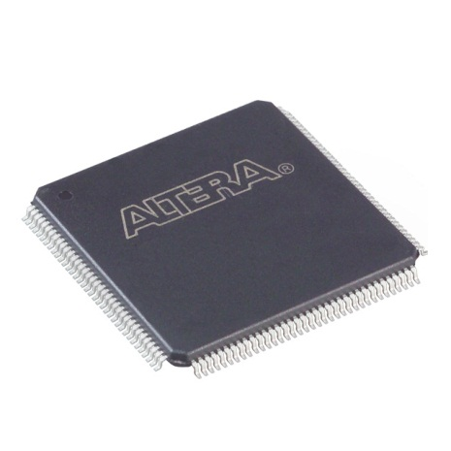
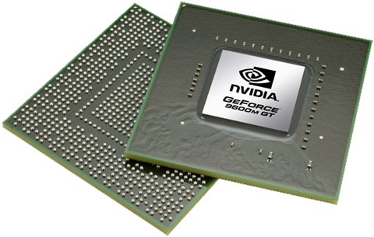
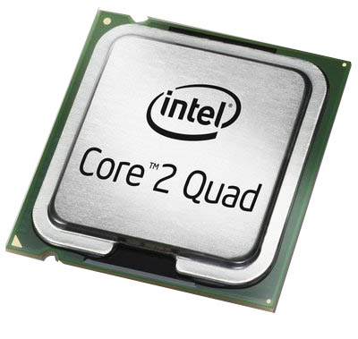

Current Architecture Trends:
Varying types of cores
FPGAs
GPUs
CPUs
APUs

Slide 4
Do current OS architectures scale enough?

Slide 5
Do current OS architectures scale enough?
Can they handle diverse cores?

Slide 6
Do current OS architectures scale enough?
Can they handle diverse cores?
How should the new OS architectures
look like?

Slide 7
Agenda
Motivation
Multikernel design principles
Implementation: Barrelfish
Evaluation
Discussion

Slide 8
Diversity
Diverse Systems
  OS designs optimized for general case
  One design fits all – no longer valid
Diverse Cores
  Heterogeneity is the way to go
  GPUs, FPGAs etc
  Cores no longer share single kernel instance

Slide 9
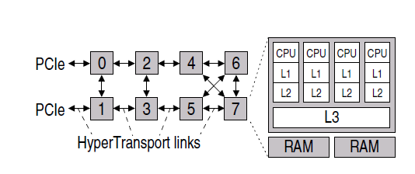
Interconnects
Node Layout of 8X4 AMD system
Message passing network used within cores – to improve scalability
System software should adapt to topology

Slide 10
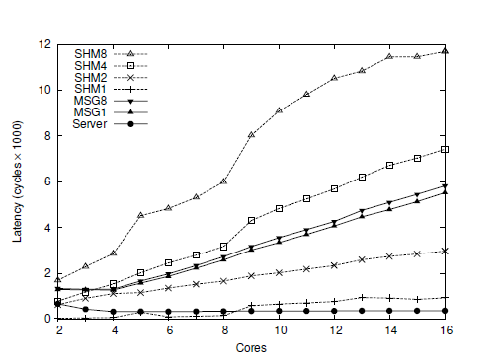
Low cost for messages
Notes:
Context? Needs more information..

Slide 11
Non-coherent caches and easier messages
It is OK not to have coherent caches
  NICs, GPUs etc. do not maintain coherence
Messages getting easier
  Already visited in earlier papers

Slide 12
Agenda
Motivation
Multikernel design principles
Implementation: Barrelfish
Evaluation
Discussion

Slide 13
Multikernel design principles
Make all inter-core communications explicit
Make OS structure hardware-neutral
View state as replicated instead of shared

Slide 14
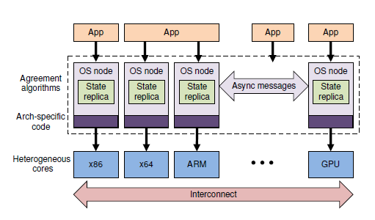
Multikernel model

Slide 15
Explicit inter-core communication
Decouples system structure & communication
  Provides isolation and resource management
    Obvious support for heterogeneous cores
  Well-known network optimizations applied easily (pipelining, batching, etc.)
Allows operations requiring split-phase

Slide 16
Hardware-neutral OS structure
Only 2 aspects targeted specific to machine architecture:
  Message transport mechanism
  Interface to hardware
Minimal changes to code base
Hardware independence → Isolation of communication algorithms & hardware detail
Late binding of protocol implementation & message transport

Slide 17
Replicated states
Better scalability
Reduced load on interconnect
Lesser memory contention
Lesser synchronization overhead
Data nearer to core – lower latency
Consistency by exchanging messages

Slide 18

Agenda
Motivation
Multikernel design principles
Implementation: Barrelfish
Evaluation
Discussion

Slide 19
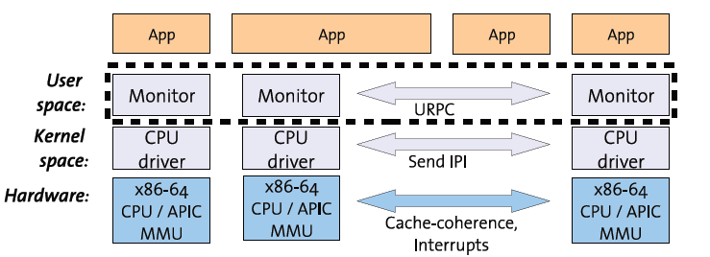
Barrelfish structure

Slide 20
CPU drivers
Enforces protection, performs authorization, mediates access to core/hardware
Performs dispatch and fast messaging between cores
Delivers hardware interrupts to user-space server, time slices user space process

Slide 21
Monitors
Operations on global data
Responsible for communication across cores
Most traditional OS kernel functionality implemented in monitors
User-Space process – suited for split-phase

Slide 22
Inter-core communication
User Level RPC for communication between cores
Messages received by polling
Transport channels set up by monitors

Slide 23
Agenda
Motivation
Multikernel design principles
Implementation: Barrelfish
Evaluation
Discussion

Slide 24
Objective
Good performance for current architectures
Better scalability
Adaptability to diverse cores, heterogeneous architectures

Slide 25
Evaluation: Experiment Methodology
TLB Shootdown: Maintaining TLB consistency
Send message to every core for mapping, wait for acknowledgement
Carried out for increasing number of cores
Protocols:
  Unicast
  Broadcast
  Multicast
  NUMA aware Multicast

Slide 26
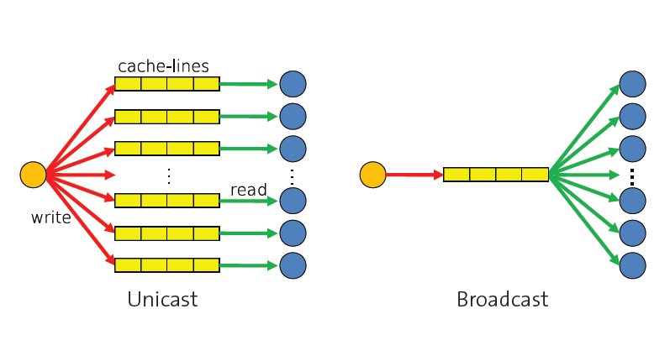
Unmap communication protocols
Slide adapted from presentation at SOSP’ 09 by authors

Slide 27
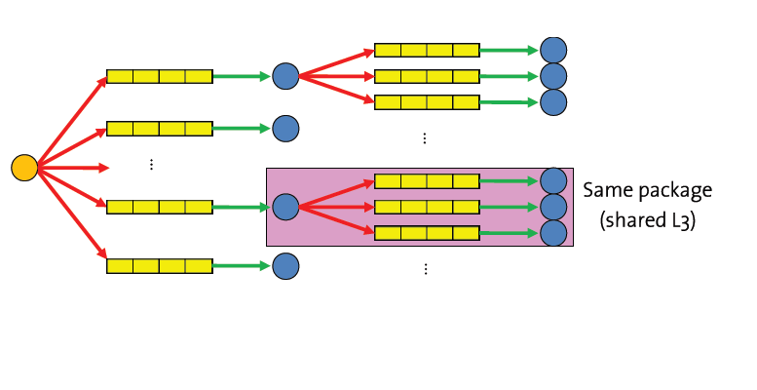
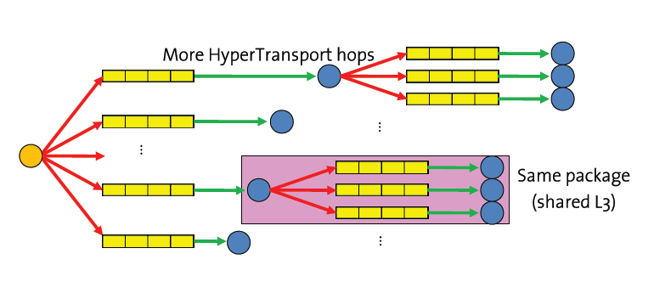
Unmap communication protocols
Multicast
NUMA aware
Multicast
Slide adapted from presentation at SOSP’ 09 by authors

Slide 28
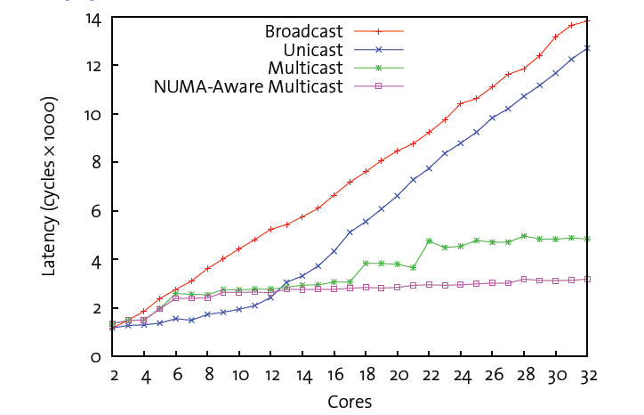
TLB Shootdown protocols
Comparison of TLB shootdown protocols

Slide 29
TLB Shootdown protocols
Comparison of TLB shootdown protocols
NUMA aware multicast scales better

Slide 30
System Knowledge Base
Efficient multicast requires system knowledge
Hardware information stored as look up table
Constraint logic program used
Table queried to construct multicast tree using prolog tree

Slide 31
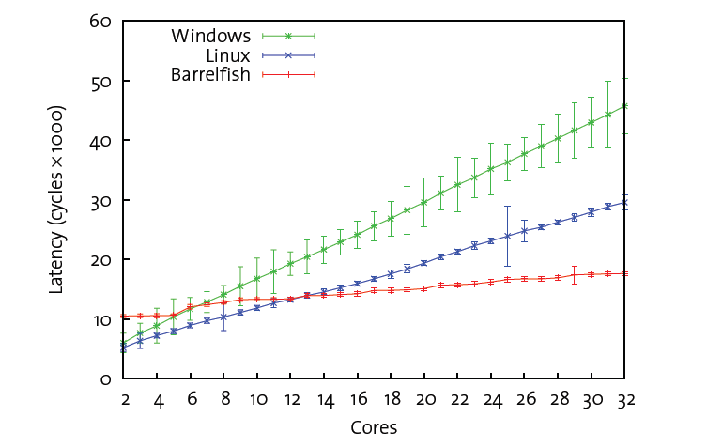
Evaluation: Results
Unmap latency on 8X4-core AMD

Slide 32
Evaluation: Results
Unmap latency on 8X4-core AMD
Better
scalability

Slide 33
Evaluation: Results
Unmap latency on 8X4-core AMD
In future multicores, Barrelfish will be better

Slide 34
Agenda
Motivation
Multikernel design principles
Implementation : Barrelfish
Evaluation
Discussion

Slide 35
Discussion
Experiment with heterogeneity?
Built from scratch
  Does improvements come from new principles
Design principles evaluated independently?
Programming in such an environment?

Slide 36
Questions

