Slide 1
MapReduce: Simplified Data Processing on Large Clusters
Jeffrey Dean &
Sanjay Ghemawat
Presented by: Hemanth Makkapati (makka@vt.edu)
Appeared in: OSDI '04: Sixth Symposium on Operating System Design and Implementation, San Francisco, CA, December, 2004.
Notes:
Greeting
Myself
Today’s topic
Authors
Conference
MapReduce aims to provide a simplified approach to program and run distributed applications
Analogy

Slide 2
Mom told Sam
An apple a day keeps a doctor away!

Slide 3
One day
Sam thought of “drinking” the apple
So, he used a to cut the and a to make juice.
Notes:
Compared to eating apple, drinking juice is fun

Slide 4
Next Day
Sam applied his invention to all the fruits he could find in the fruit basket
Simple!!!
Notes:
Excited by his success at making apple juice, Sam now wants to make juice from multiple fruits
He excelled at this for sometime and then

Slide 5
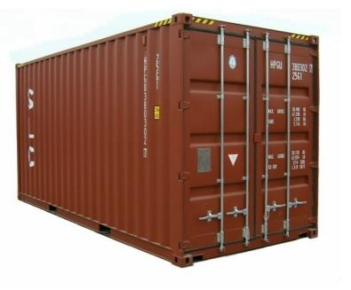
18 Years Later
Sam got his first job with juice making giants, Joogle, for his talent in making juice
But!
Now, it’s not just one basket but a whole container of fruits
Fruits
Also, he has to make juice of different fruits separately
Simple???
Is this representative of computations that process large-scale data?
And, Sam has just ONE and ONE
Notes:
Like with any giant, be it search giants or juice making giants, you are going to have huge numbers at hand
Like search, recommendations, usage analysis, page rank etc?

Slide 6
Why?
The operations themselves are conceptually simple
Making juice
Indexing
Recommendations etc
But, the data to process is HUGE!!!
Google processes over 20 PB of data every day
Sequential execution just won’t scale up

Slide 7
Why?
Parallel execution achieves greater efficiency
But, parallel programming is hard
Parallelization
Race Conditions
Debugging
Fault Tolerance
Data Distribution
Load Balancing
Notes:
This complicates the computation that we want to perform!
So, MapReduce proposes a way to separate computation from managing distributed-ness

Slide 8
MapReduce
“MapReduce is a programming model and an associated implementation for processing and generating large data sets”
Programming model
Abstractions to express simple computations
Library
Takes care of the gory stuff: Parallelization, Fault Tolerance, Data Distribution and Load Balancing
Notes:
Managing of Parallelization, Fault Tolerance, Data Distribution and Load Balancing is invisible to the user and comes free
Motivation: primarily meant for Google’s web indexing
Once the documents are crawled
Several mapreduce operations are run in sequence to index documents

Slide 9
Programming Model
To generate a set of output key-value pairs from a set of input key-value pairs
{ < k_{i}, v_{i} >} → { < k_{o}, v_{o} >}
Expressed using two abstractions:
Map task
<k_{i}, v_{i}> → { < k_{int}, v_{int} > }
Reduce task
< k_{int}, {v_{int}} > → < k_{o}, v_{o} >
Library
aggregates all the all intermediate values associated with the same intermediate key
passes the intermediate key-value pairs to reduce function
Notes:
Abstract: Take something ustructured and derive meaningful data out of it

Slide 10
Inspiration
‘map’ & ‘reduce/fold’ of functional programming languages
(map f list [list₂ list₃ …])
(map square (1 2 3 4)) → (1 4 9 16)
(reduce f list […])
(reduce + (1 4 9 16)) → 30
(reduce + (map square (map – l₁ l₂))))
Notes:
Functional languages: logic is expressed as expressions
No mutable data and state.
computed values cannot be dependent on previously computed values. ( X -> Y -> Z )
Order does not matter

Slide 11
Example
Map
Reduce

Slide 12
Example: Word Count
map(String input_key, String input_value):
// input_key: document name
// input_value: document contents
for each word w in input_value:
EmitIntermediate(w, "1");
reduce(String output_key, Iterator intermediate_values):
// output_key: a word
// output_values: a list of counts
int result = 0;
for each v in intermediate_values:
result += ParseInt(v);
Emit(AsString(result));
<“Sam”, “1”>, <“Apple”, “1”>, <“Sam”, “1”>, <“Mom”, “1”>, <“Sam”, “1”>, <“Mom”, “1”>,
<“Sam” , [“1”,”1”,”1”]>, <“Apple” , [“1”]>, <“Mom” , [“1”, “1”]>
“3”
“1”
“2”

Slide 13
Implementation
Large cluster of commodity PCs
Connected together with switched Ethernet
X86 dual-processor, 2-4 GB memory each
Linux OS
Storage by GFS on IDE disks
Scheduling system
Users submit jobs
Tasks are scheduled to available machines on cluster

Slide 14
Google File System (GFS)
File is divided into several chunks of predetermined size
Typically, 16-64 MB
Replicates each chunk by a predetermined factor
Usually, three replicas
Replication to achieve fault-tolerance
Availability
Reliability

Slide 15
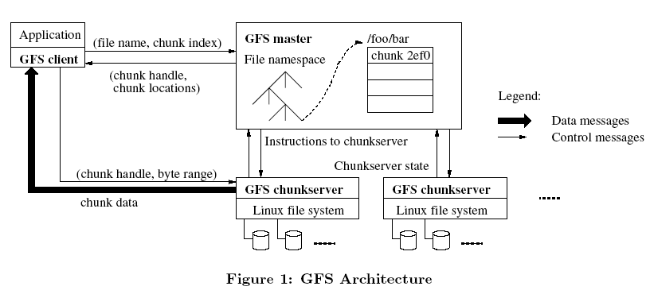
GFS Architecture

Slide 16
Execution
User specifies
M: no. of map tasks
R: no. of reduce tasks
Map Phase
input is partitioned into M splits
map tasks are distributed across multiple machines
Reduce Phase
reduce tasks are distributed across multiple machines
intermediate keys are partitioned (using partitioning function) to be processed by desired reduce task

Slide 17
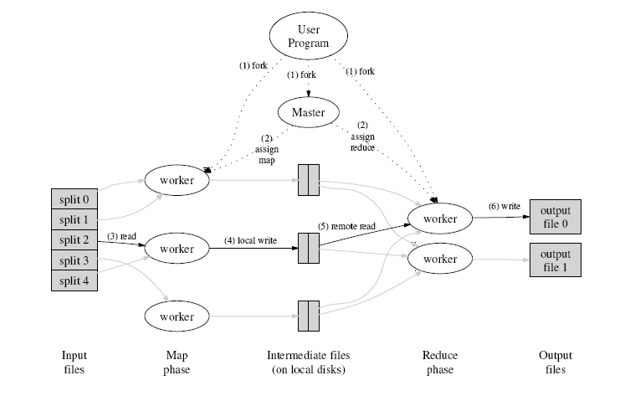
Execution Flow
Notes:
1. The MapReduce library in the user program first splits the input les into M pieces of typically 16 megabytes to 64 megabytes (MB) per piece (controllable by the user via an optional parameter). It then starts up many copies of the program on a cluster of machines.
2. One of the copies of the program is special . the master. The rest are workers that are assigned work by the master. There are M map tasks and R reduce tasks to assign. The master picks idle workers and assigns each one a map task or a reduce task.
3. A worker who is assigned a map task reads the contents of the corresponding input split. It parses key/value pairs out of the input data and passes each pair to the user-defined Map function. The intermediate key/value pairs produced by the Map function are buffered in memory.
4. Periodically, the buffered pairs are written to local disk, partitioned into R regions by the partitioning function. The locations of these buffered pairs on the local disk are passed back to the master, who is responsible for forwarding these locations to the reduce workers.
5. When a reduce worker is notified by the master about these locations, it uses remote procedure calls to read the buffered data from the local disks of the map workers. When a reduce worker has read all intermediate data, it sorts it by the intermediate keys so that all occurrences of the same key are grouped together. The sorting is needed because typically many different keys map to the same reduce task. If the amount of intermediate data is too large to t in memory, an external sort is used.
6. The reduce worker iterates over the sorted intermediate data and for each unique intermediate key encountered, it passes the key and the corresponding set of intermediate values to the user's Reduce function. The output of the Reduce function is appended to a final output file for this reduce partition.
7. When all map tasks and reduce tasks have been completed, the master wakes up the user program. At this point, the MapReduce call in the user program returns back to the user code.

Slide 18
Sam & MapReduce
Sam implemented a parallel version of his innovation
Fruits

Slide 19
Master Data Structures
For each task
State { idle, in-progress, completed }
Identity of the worker machine
For each completed map task
Size and location of intermediate data

Slide 20
Fault Tolerance
Worker failure – handled via re-execution
Identified by no response to heartbeat messages
In-progress and Completed map tasks are re-scheduled
Workers executing reduce tasks are notified of re-scheduling
Completed reduce tasks are not re-scheduled
Master failure
Rare
Can be recovered from checkpoints
All tasks abort
Notes:
Sometimes a secondary Master is employed

Slide 21
Disk Locality
Leveraging GFS
Map tasks are scheduled close to data
on nodes that have input data
if not, on nodes that are nearer to input data
Ex. Same network switch
Conserves network bandwidth

Slide 22
Task Granularity
No. of map tasks > no. of worker nodes
Better load balancing
Better recovery
But, increases load on Master
More scheduling decisions
More states to be saved
M could be chosen w.r.t to block size of the file system
to effectively leverage locality
R is usually specified by users
Each reduce task produces one output file

Slide 23
Stragglers
Slow workers delay completion time
Bad disks with soft errors
Other tasks eating up resources
Strange reasons like processor cache being disabled
Start back-up tasks as the job nears completion
First task to complete is considered

Slide 24
Refinement: Partitioning Function
Identifies the desired reduce task
Given the intermediate key and R
Default partitioning function
hash(key) mod R
Important to choose well-balanced partitioning functions
If not, reduce tasks may delay completion time

Slide 25
Refinement: Combiner Function
Mini-reduce phase before the intermediate data is sent to reduce
Significant repetition of intermediate keys possible
Merge values of intermediate keys before sending to reduce tasks
Similar to reduce function
Saves network bandwidth

Slide 26
Refinement: Skipping Bad Records
Map/Reduce tasks may fail on certain records due to bugs
Ideally, debug and fix
Not possible if third-party code is buggy
When worker dies, Master is notified of the record
If more than one worker dies on the same record
Master re-schedules the task and asks to skip the record

Slide 27
Refinements: others
Ordering guarantees
sorted output file
Temporary files
Local sequential execution
to debug and test
Status Information
input, intermediate & output bytes processed so far
error & failure reports
Counters
to keep track of specific events

Slide 28
Performance
Evaluated on two programs running on a large cluster & processing 1 TB data
grep & sort
Cluster Configuration
1800 machines
2 GHz Intel Xeon processors
4 GB memory
two 160 GB IDE disks
gigabit Ethernet link
Hosted in the same facility

Slide 29
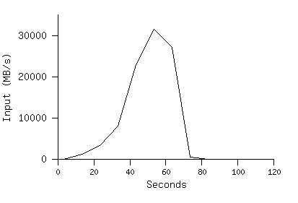
Grep
Scans for a three character pattern
M = 15000 @ 64 MB per split
R = 1
Entire computation takes 150s
Startup overhead apprx. 60s
Propagation of programs to worker machines
GFS operations
Information of locality optimizations

Slide 30
Sort
Models TeraSort benchmark
M = 15000 @ 64 MB per split
R = 4000
Workers = 1700
Evaluated on three executions
with backup tasks
without backup tasks
with machine failures

Slide 31
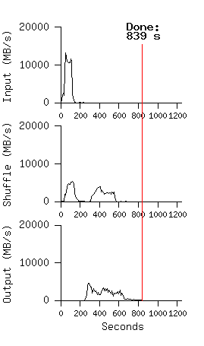
Sort
Normal execution
Without backup tasks
With machine failures

Slide 32
Experience: Google Indexing System
Complete re-write using MapReduce
Modeled as a sequence of multiple MapReduce operations
Much simpler code
fewer LoC
shorter code changes
easier to improve performance

Slide 33
Conclusion
Easy to use scalable programming model for large-scale data processing on clusters
Allows users to focus on computations
Hides issues of
parallelization, fault tolerance, data partitioning & load balancing
Achieves efficiency through disk-locality
Achieves fault-tolerance through replication

Slide 34
New Trend: Disk-locality Irrelevant
Assumes disk bandwidth exceeds network bandwidth
Network speeds fast improving
Disk speeds have stagnated
Next step: attain memory-locality

Slide 35
Hadoop
An open-source framework for data-intensive distributed applications
Inspired from Google’s MapReduce & GFS
Implemented in Java
Name after the toy elephant of creator’s son

Slide 36
Hadoop History
Nutch, an effort to develop open-souce search engine
Soon, encountered scalability issues to store and process large data sets
Google published MapReduce and GFS
Attempted re-creation for Nutch
Yahoo! got interested and contributed

Slide 37
Hadoop Ecosystem
Hadoop MapReduce
inspired by Google’s MapReduce
Hadoop Distributed File System(HDFS)
inspired by Google File System
HBase – Hadoop Database
inspired by Google BigTable
Cassandra – Distributed Key-Value Store
Inspired by Amazon Dynamo & Google BigTable

Slide 38
References
Google File System
http://labs.google.com/papers/gfs.html
Google BigTable
http://labs.google.com/papers/bigtable.html
Apache Hadoop
http://hadoop.apache.org/
Juice Example
http://esaliya.blogspot.com/2010/03/mapreduce-explained-simply-as-story-of.html

Slide 39
Thank you

