Slide 1
FlexSC: Flexible System Call Scheduling with Exception-Less System Calls
Livio Soares, Michael Stumm
University of Toronto
Presented by Md. Maksudul Alam
29 September, 2011
CS 5204

Slide 2
System Calls
Mechanism used by an application program to request service from operating system kernel
De facto interface for 30+ years
Synchronous in nature
Application Blocks

Slide 3
How system calls works?
Blocked
User Process
Syscall Handler
int main() {
fork();
return 0;
}
system_call()
# EAX = 2
call *sys_call_table[EAX]
Interrupt Descriptor Table
0x00
Division By Zero
0x01
Debugger
0x02
…
…
0x80
System Calls
NMI
Syscall Table
1
sys_exit()
2
sys_fork()
3
4
sys_write()
sys_read()
libc.a
fork() {
MOVL 2, EAX
INT 0x80
}
System Call: fork()
sys_fork(){
…
}
User Mode
Kernel Mode

Slide 4
How system calls works?
Blocked
User Process
Syscall Handler
int main() {
fork();
return 0;
}
system_call()
# EAX = 2
call *sys_call_table[EAX]
Interrupt Descriptor Table
0x00
Division By Zero
0x01
Debugger
0x02
…
…
0x80
System Calls
NMI
Syscall Table
1
sys_exit()
2
sys_fork()
3
4
sys_write()
sys_read()
libc.a
fork() {
MOVL 2, EAX
INT 0x80
}
System Call: fork()
sys_fork(){
…
}
User Mode
Kernel Mode

Slide 5
System Call Costs!
Direct Cost:
Mode Switch Time: between user mode and kernel mode
Flushing of processor pipeline
Indirect Cost:
Processor Pollution: critical system structures are flushed during context switch
Translation Look-aside Buffer (TLB)
Branch Prediction Tables
Cache (L1, L2, L3)

Slide 6
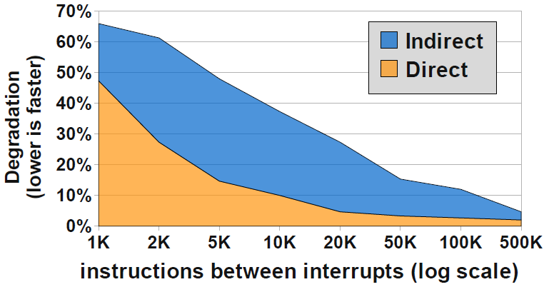
System Call Impact on User IPC
Direct and Indirect Cost are significant
Degrades Performance, up to 65% degradation
System call pwrite impact on user mode IPC

Slide 7
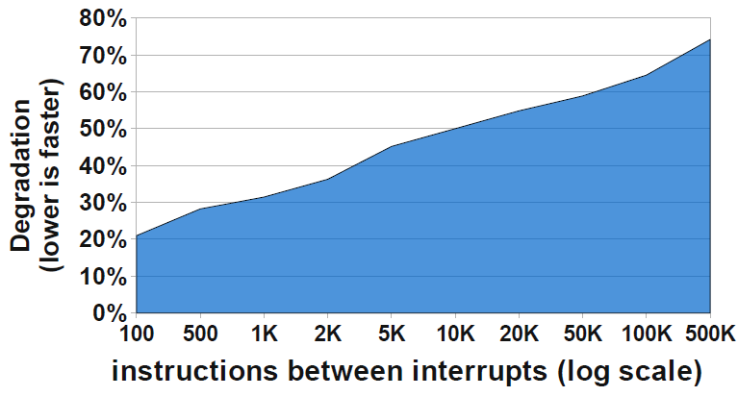
Mode Switching Cost on Kernel IPC
Opposite of user mode trends
The more system call, the more kernel state is maintained
System call pwrite impact on kernel mode IPC

Slide 8
Principle of Locality
Temporal Locality: if at one point in time a particular memory location is referenced, then it is likely that the same location will be referenced again in the near future
Spatial Locality: if a particular memory location is referenced at a particular time, then it is likely that nearby memory locations will be referenced in the near future

Slide 9
Synchronous System Calls are BAD!!
User
Kernel
Exception
Exception
Traditional Synchronous System Call

Slide 10
Improve Performance
Minimize Mode Switch – eliminate Direct Cost
Asynchronous system calls
Maximize Locality – eliminate Indirect Cost
Batch processing of system calls
Decouple Execution from Invocation

Slide 11
Exception Less System Call
1
Asynchronous System Call:
Minimize Mode Switch
Invoker
User
Sys Call Page
Shared Memory
Kernel
Executor
2
Syscall Threads:
Maximize Locality
Asynchronous Exception Less System Call

Slide 12
FlexSC: Flexible System Call
FlexSC:
Implementation of the exception-less system call on Linux
A library exposing API for application using exception-less system call
Has a thread scheduler to schedule syscall thread
Applicable for event driven applications
FlexSC-Thread:
A POSIX compliant thread library
Binary compatible with NPTL
For thread oriented application such as MySQL, Apache
M-on-N threading model (M-user & N-kernel-visible threads)

Slide 13
Syscall Page
Shared memory pages between user and kernel
Each entry contains one syscall requests
64 Bytes
Sys Call Page
Syscall Page
syscall number
# of args
status
arg 0
…
arg 6
return value

Slide 14
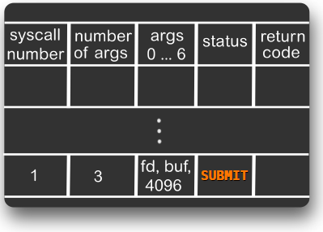
System Call Interface
write(fd, buf, 4096);
entry = free_syscall_entry();
/* write syscall */
entry->syscall = 1;
entry->num_args = 3;
entry->args[0] = fd;
entry->args[1] = buf;
entry->args[2] = 4096;
entry->status = SUBMIT;
while (entry->status != DONE)
do_something_else();
return entry->return_code;

Slide 15
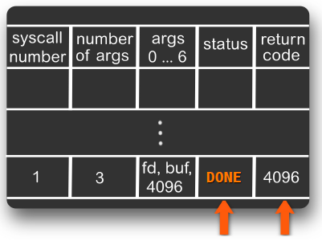
System Call Interface
write(fd, buf, 4096);
entry = free_syscall_entry();
/* write syscall */
entry->syscall = 1;
entry->num_args = 3;
entry->args[0] = fd;
entry->args[1] = buf;
entry->args[2] = 4096;
entry->status = SUBMIT;
while (entry->status != DONE)
do_something_else();
return entry->return_code;

Slide 16
FlexSC System calls
Two new systems calls are implemented:
flexsc_register – to register flexsc syscall threads
flexsc_wait – to notify kernel
flexsc_register explicitly creates the syscall threads
When user level thread has nothing to do it issue flexsc_wait system call
FlexSC will wake up the thread

Slide 17
Syscall Threads
Kernel only threads
Virtual address is same as application
Created during flexsc_register system call, which preserves this address
Each thread processes an syscall page entry
Only one thread is active per application/core
User
Sys Call Page
Kernel
Syscall Threads

Slide 18
Syscall Thread Scheduler
Post as many request as possible
No more threads? Call flexsc_wait, jump to kernel
Syscall scheduler wakes up syscall threads
Does not wake up user thread until:
All calls are issued and
At least one is finished and others blocked
Only one thread can be active
For multi-core system more threads can be active in different cores

Slide 19
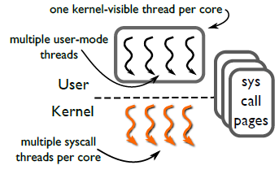
FlexSC-Threads
To use FlexSC, existing apps need modification
Not feasible for thread based applications
Use FlexSC-Threads, a thread library supporting FlexSC
M-on-N thread model, POSIX and NPTL compliant
One kernel-visible thread per core

Slide 20
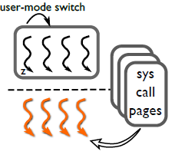
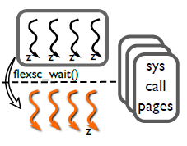
How FlexSC-Thread works
Redirect system calls (libc) to FlexSC
Post system calls to syscall page and switch thread
find syscall page for finished entries if no more threads
Call flexsc_wait to block the kernel visible thread
4
2

Slide 21
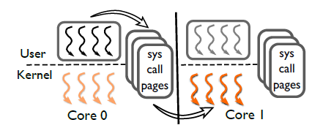
Multi Core specialization
FlexSC-Threads support multicore specialization
A single kernel-visible thread per core
Private syscall page per core
User threads and kernel threads can run on different threads

Slide 22
Performance Evaluation
Linux kernel 2.6.33
Intel Nehalem (Core i7) processor with 4 Cores
Remote Client 1 Gbps network
Results are average of 5 runs

Slide 23
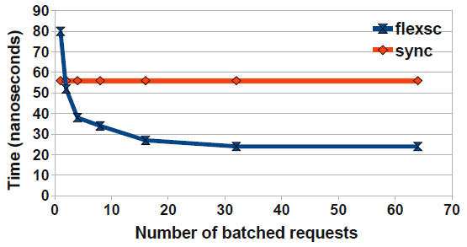
Direct Cost – Single Core
getppid() - measures direct cost
For 1 syscall flexsc is 43% slower than sync
For more syscall batch flexsc is up to 130% faster

Slide 24
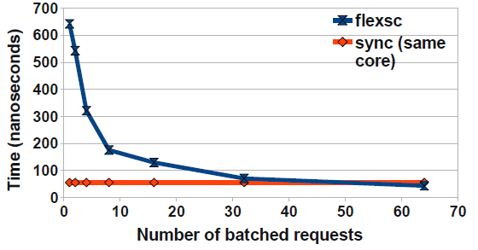
Direct Cost – Remote-core
Inter-processor interrupt (IPI) to wake remote threads
For one system call flexsc 10 times slower than sync
for 32 or more batch flexsc catches sync
However it was worst case scenario

Slide 25
Apache
Apache 2.2.15
Two scenario:
NPTL: 200 user threads
FlexSC-Threads: 1000 user threads
ApacheBench as workload

Slide 26
Apache Throughput
Single Core: Only syscall batching 86% improvement
4-Cores: With multi-core specialization 115% improvement

Slide 27
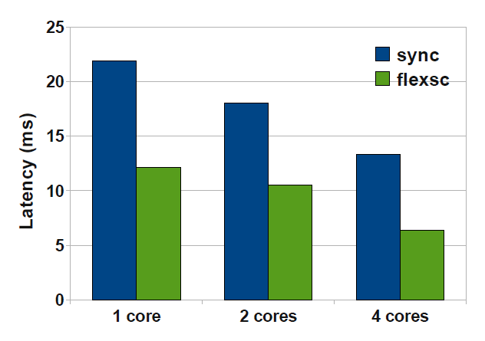
Apache Latency with 256 requests
One would expect high latency because of batching and asynchronous processing, but it is opposite in this case
Up to 50% reduction in latency
Comparison of Apache latency of Linux/NPTL and FlexSC

Slide 28
MySQL
MySQL 5.5.4 with InnoDB
sysbench as workload generator
Database with 5M rows = 1.2GB data
Disabled synchronous transactions

Slide 29
MySQL Throughput
Single Core: Only syscall batching 15% improvement
4-Cores: With multi-core specialization 40% improvement

Slide 30
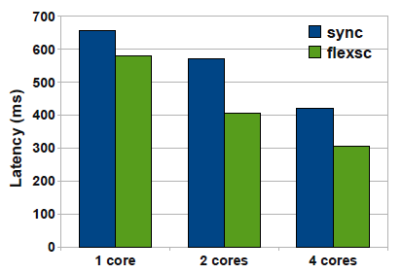
MySQL Latency with 256 requests
FlexSC response is 70-88% of NPTL
Modest improvements
Comparison of MySQL latency of Linux/NPTL and FlexSC

Slide 31
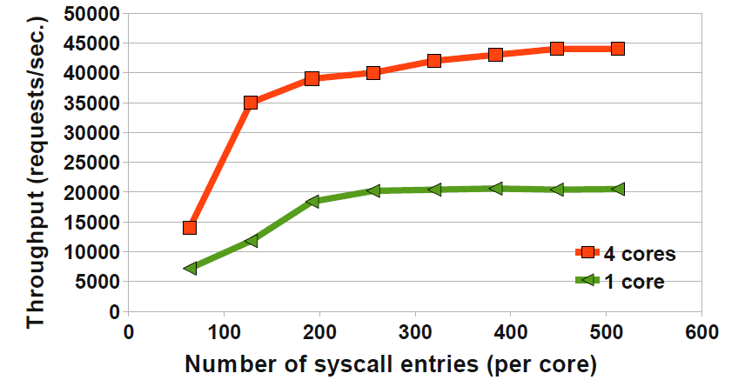
Sensitivity Analysis
How much syscall entries would be best?
Apache serving 2048 concurrent requests:
Single core: 200 – 250 entries (3/4 syscall page)
4-Cores: 300 – 400 entries (6/7 syscall pages)

Slide 32
Summary
Synchronous System call degrades performance
Indirect cost is huge
Exception-less system calls improve performance of applications that need many systems calls
Event based application can use FlexSC directly
Thread oriented application can use FlexSC-Thread by just swapping NPTL library
Performance of server centric application is very good
Multi-core facility will be a big advantage

Slide 33
Questions?
maksud@cs.vt.edu

Slide 34
Thank You!

