Slide 1
Availability in Globally Distributed Storage Systems
Daniel Ford, Franc¸ois Labelle, Florentina I. Popovici, Murray Stokely, Van-Anh Truong,
Luiz Barroso, Carrie Grimes, and Sean Quinlan
- Nabeel

Slide 2
Distributed Storage System
Exponential increase in storage needs
Uses shared nothing architecture
Uses low commodity hardware
Software layer provides fault tolerance
Suitable for data parallel, I/O bound computations
Highly scalable and cost effective

Slide 3
Data Center

Slide 4
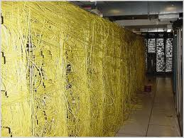
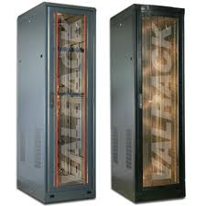
Data Center Components
Server Components
Interconnects ☺
Racks
Cluster of Racks

Slide 5
Data Center Components
ALL THESE COMPONENTS CAN FAIL
Server Components
Interconnects ☺
Racks
Cluster of Racks

Slide 6
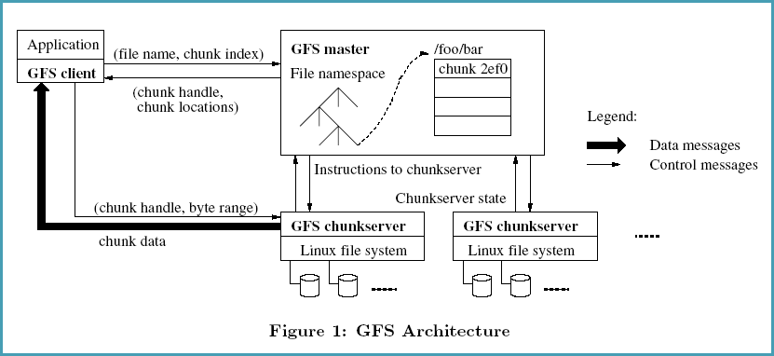
Google File System

Slide 7
Cell, Stripe and Chunk
Stripe 1 Stripe 2
Stripe 1 Stripe 2
GFS Instance 1
GFS Instance 2
Chunks
Chunks
Chunks
Chunks
CELL 1
CELL 2

Slide 8
Failure Sources and Events
Failure Sources
Hardware – Disks, Memory etc.
Software – chunk server process
Network Interconnect
Power Distribution Unit
Failure Events
Node restart
Planned reboot
Unplanned reboot

Slide 9
Fault Tolerance Mechanisms
Replication (R = n)
‘n’ identical chunks (replication factor) are placed across storage nodes in different rack/cell/DC
Erasure Coding ( RS (n, m))
‘n’ distinct data blocks and ‘m’ code blocks
Can recover utmost ‘m’ blocks from the remaining ‘n-m’ blocks

Slide 10
Replication
5 replicas
1 Chunk
Fast Encoding / Decoding
Very Space Inefficient

Slide 11
Erasure Coding
‘n’ data blocks
‘m’ code blocks
Encode
‘n + m’ blocks

Slide 12
Erasure Coding
‘n’ data blocks
‘m’ code blocks
Encode
‘n + m’ blocks

Slide 13
Erasure Coding
‘n’ data blocks
‘m’ code blocks
Encode
‘n + m’ blocks
‘n’ data blocks
Decode
Highly Space Efficient
Slow Encoding / Decoding

Slide 14
Goal of the Paper
Characterizes the availability properties of cloud storage systems
Suggests a good availability model that helps in data placement and replication strategies

Slide 15
Agenda
Introduction
Findings from the fleet
Correlated failures
Modeling availability data
Conclusion

Slide 16
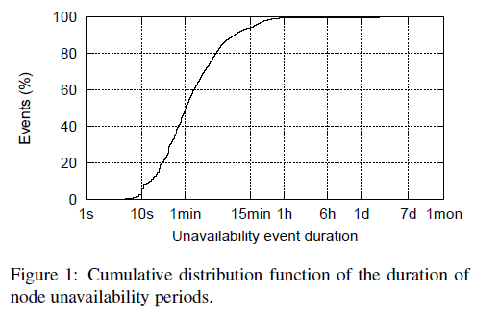
CDF of Node Unavailability

Slide 17
CDF of Node Unavailability

Slide 18
Average Availability and MTTF
Average availability of ‘N’ nodes
A_{N} = -----------------------------
Mean Time To Failure (MTTF)
uptime downtime
MTTF = --------------------
No. of failures Failure 1 Failure 2
Uptime

Slide 19
CDF of Node Unavailability by Cause

Slide 20
Node Unavailability

Slide 21
Correlated Failures
Failure Domain
Set of machines that simultaneously fails from a common source of failure
Failure Burst
Sequence of node failures each occurring within a time window ‘w’ of the next
37% of all failures are part of a burst of at-least 2 nodes

Slide 22
Failure Burst

Slide 23
Failure Burst

Slide 24
Failure Burst

Slide 25
Failure Burst (cont..)

Slide 26
Failure Burst (cont..)

Slide 27
Failure Burst (cont..)

Slide 28
Failure Burst (cont..)

Slide 29
Failure Burst (cont..)

Slide 30
Domain Related Failures
Domain related issues – causes of correlated failures
A metric is devised
To determine if a failure burst is domain related or random
In evaluating the importance of domain diversity in cell design and data placement

Slide 31
Rack Affinity
Probability that a burst of the same size affecting randomly chosen nodes have smaller affinity score
Rack Affinity Score
Determines the rack concentration of the burst
No. of ways of choosing 2 nodes from the burst within the same rack
where k_{i} is the no. of nodes affected in the
i^{th} rack affected. Eg. (1,4) and (1,1,1,2)

Slide 32
Stripe MTTF Vs Burst Size

Slide 33
Stripe MTTF Vs Burst Size

Slide 34
Stripe MTTF Vs Burst Size

Slide 35
Trace Simulation

Slide 36
Markov Model
To model & understand the impact of hardware and software changes in availability
Focused on the availability of a stripe
State : No. of available chunks (in the stripe)
Transition : Rates by which a stripe moves to the next state due to:
Chunk Failure ( reduces available chunks)
Chunk Recoveries ( increases available chunks)

Slide 37
Markov Chain

Slide 38
Markov Model Findings
RS (6,3)
No correlated failures
10% reduction in recovery time results in 19% reduction in unavailability
Correlated failures
Reduced MTTF when correlated failures are modeled
90% reduction in recovery time results in 6% reduction in unavailability
Reduces the benefit of increased data redundancy

Slide 39
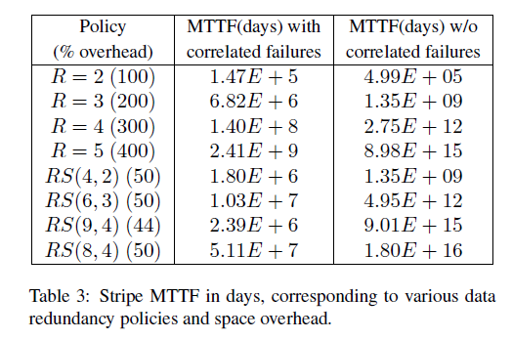
Markov Model Findings (cont..)

Slide 40
Markov Model Findings (cont..)
R = 3 and increase in availability
10% reduction in disk latency error has negative effect ???
10% reduction in disk failure rate has 1.5% improvement
10% reduction in node failure rate has 18% improvement
Improvements below the node layer of the storage stack do not significantly improve data availability

Slide 41
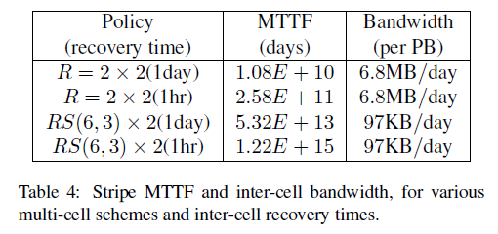
Single Cell Vs Multi-Cell
Trade off between availability & inter cell recovery bandwidth. Higher MTTF with Multicell replication.

Slide 42
Single Cell Vs Multi Cell (cont..)
CELL A
CELL A
CELL B
R1
R2
R1
R3
R3
R4
R2
R4
Single Cell
Multi Cell

Slide 43
Conclusion
Correlation among node failures is important
Correlated failures share common failure domains
Most unavailability periods are transient and differs significantly by cause
Reduce reboot times for kernel upgrades
The findings provides a feedback for improving
Replication and encoding schemes
Data placement strategies
Primary causes of data unavailability

