Slide 1
Transactional Memory
Part 2: Software-Based Approaches

Slide 2
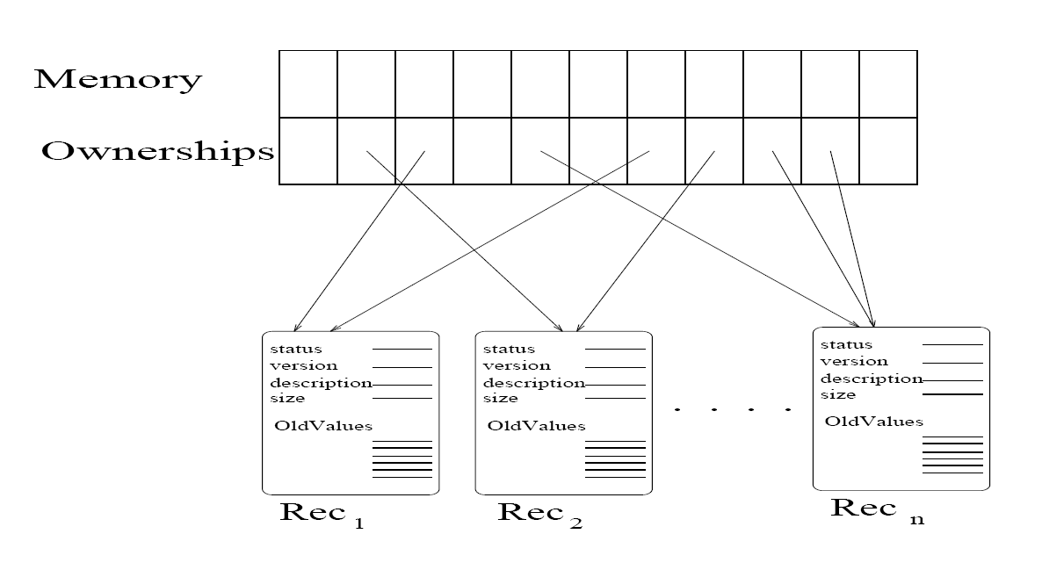
Word-based STM (Shavit&Touitou)
Guarantees lock-freedom
Uses a non-recursive “helping” strategy
Limitations
Static transactions: ownership must be acquired in some total order to avoid livelock
Memory costs
Helping requires transaction to yield same results under multiple (partial) executions
Basic transaction process:
Read old values into transaction record
Acquire ownership of memory location for each value
Succeed: Perform transaction; update memory; release ownership.
Fail: release ownership; help if not already helping (non-recursive); abort.

Slide 3
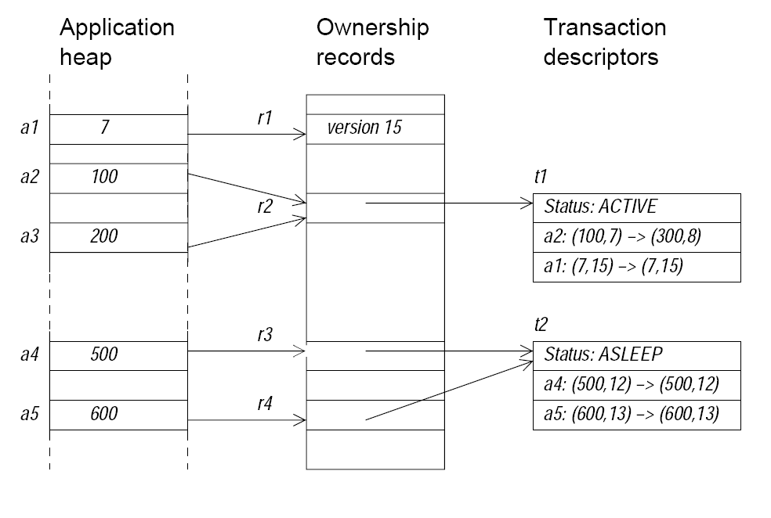
Word-based STM (WSTM): Harris&Fraser
Multiple addresses map to the same ownership record.
Logical state: a (value, version) pair representing the contents of a memory location.
Ownership record stores either version number of address or transaction descriptor.
Read/write operations create entries in a transaction descriptor.
Commit operation attempts to gain ownership of the locations it reads/writes by placing the address of its transaction descriptor in the ownership records.
Guarantees obstruction-free execution.

Slide 4
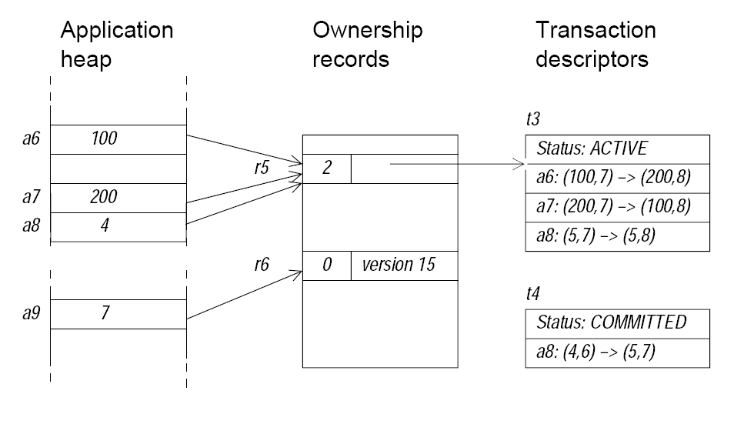
Stealing
Transaction attempting to commit, “steals” transaction entry from conflicting transaction
Provides non-blocking commit operation (guarantee of obstruction-free execution)
Requires ownership record to store the number of transaction holding a transaction record for a location mapping to the ownership record

Slide 5
Language Support
Conditional Critical Region (CCR)
Syntax:
atomic (condition) {
statements;
}
Translation:
boolean done = false;
while (!done) {
STMStart();
try {
if (condition) {
statements;
done = STMCommit();
} else {
STMWait();
} catch (Throwable t) {
done = STMCommit();
if (done) {
throw t;
}
}
}
conditional critical region syntax added to Java
source-to-bytecode compiler handles translation of atomic blocks and creates separate method of each atomic block
methods of data access provide STMRead and STMWrite for methods defined for atomic blocks

Slide 6
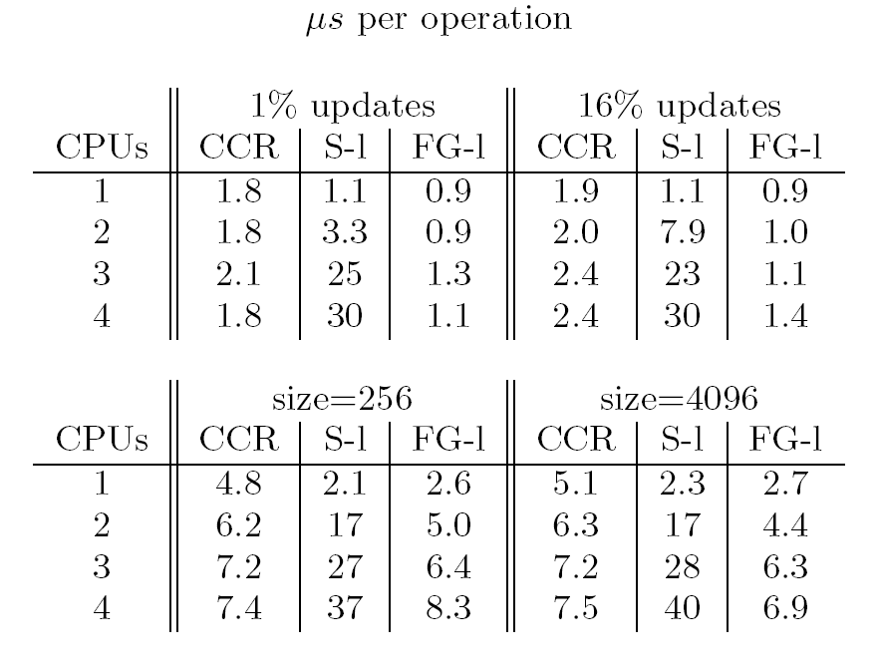
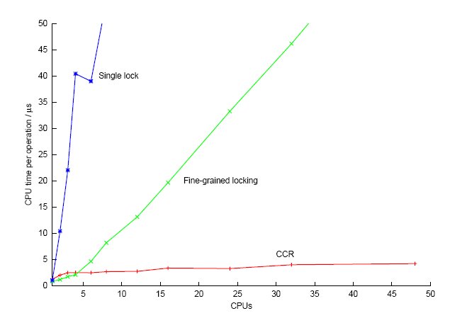
Performance
WSTM is superior to simple synchronization schemes (CCR vs. S-1) on few processors
WSTM is competitive with sophisticated synchronization schemes (CCR vs. FG-1) on few processors
WSTM is superior to other synchronization schemes on large number of processors

Slide 7
Dynamic STM (DTSM): Herlihy et.al.
TM Object
Locator
Transaction
Transaction
New Object
Old Object
object data
object data
TMObject is a handle for an object.
An “open” operation on the TMObject is required before object can be accessed.
Transaction state may be: ACTIVE, COMMITTED, ABORTED.
The “current” form of the object data is maintained (Old Object).
A shadow copy of to-be-committed updates to the object is also maintained.

Slide 8
Opening a TMObject for Writing
Locator
Transaction
T1: Committed
New Object
Old Object
object data
TM Object
CAS
object data
Copy
Locator
Transaction
T2: Active
New Object
Old Object
object data

Slide 9
Opening a TMObject for Writing
Locator
Transaction
T1: Aborted
New Object
Old Object
object data
TM Object
CAS
object data
Locator
Copy
Transaction
T2: Active
New Object
Old Object
object data

Slide 10
Opening a TMObject for Writing
TM Object
Locator
Transaction
T1: Active
New Object
open for writing
Old Object
object data
T2: Active
object data
one of T1 or T2 must abort to resolve conflict without blocking
each thread has a ContentionManager
aggressive – always/immediately aborts conflicting transaction
polite – adaptive back-off
contention reduced by “early release”
reference to object dropped before transaction commits
releasing transaction must insure that subsequent changes to the released object does not jeopardize consistency

Slide 11
Opening a TMObject for Reading
Transaction
TM Object
Locator
Transaction
T1: Committed
T2: Active
read-only list
New Object
Old Object
object data
object
object data
value
next

Slide 12
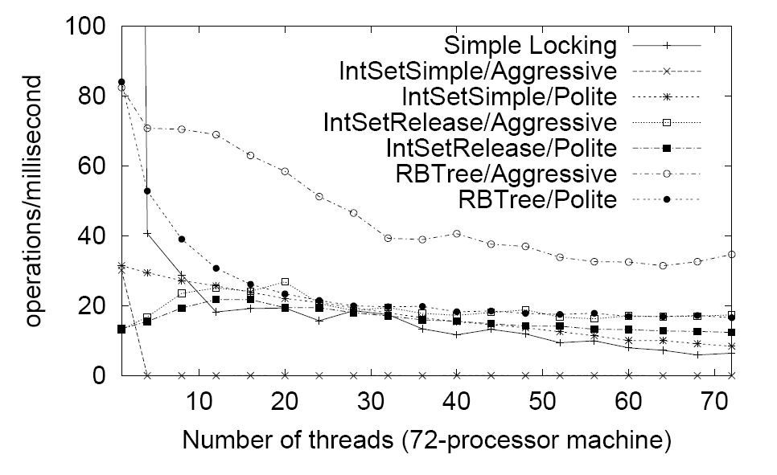
Performance
STM versions competitive with simple locking scheme
Aggressive contention management can cause performance to collapse under high contention

Slide 13
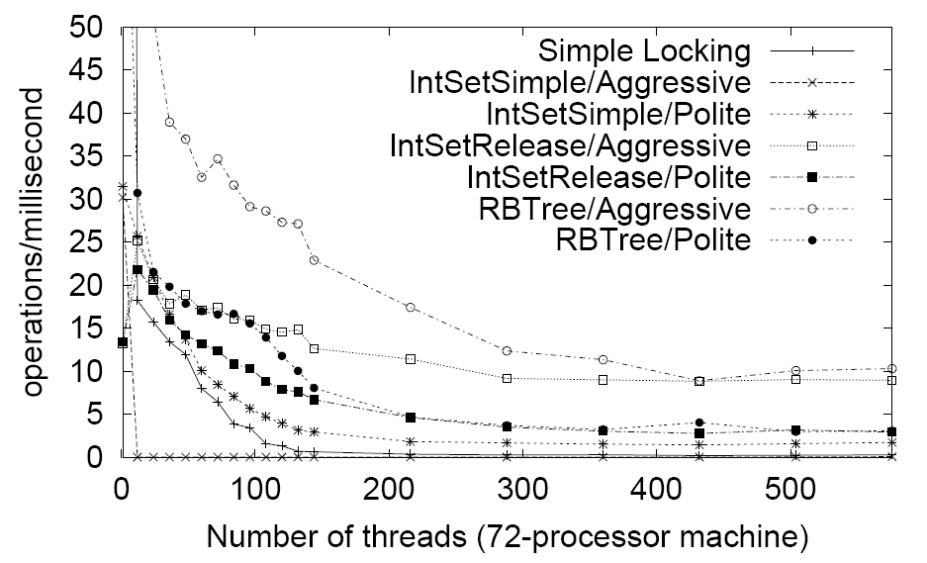
Performance
By lowering contention, early release sustains performance of aggressive contention management.
Contention management useful and has possibly complex relationship to data structure design.

Slide 14
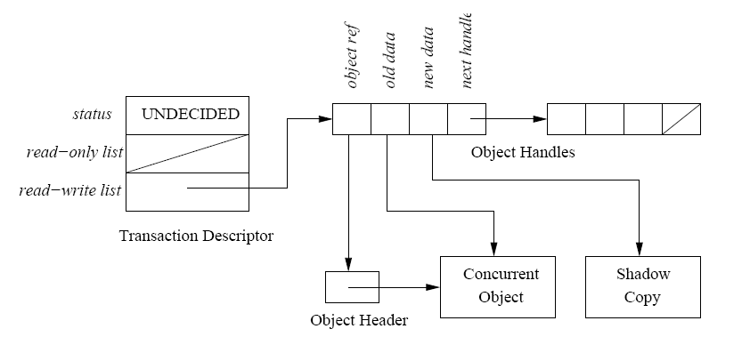
FSTM: Fraser
Objects are accessed by an open operation on the object header
An object may be open in multiple transactions at the same time
Transaction maintains an object handle for each open object
Object handles are organized into two lists: a read-only list and a read-write list
For each writeable object the transaction maintains a shadow copy of the object private to the transaction
Conflicts among transactions are detected and resolved at commit-time
Guarantees lock-freedom

Slide 15
Commit operation in FTSM
Phase | Description
Acquire | Action: Acquire each object in the read-write list in global total order using atomic CAS for each object Outcomes: Abort if conflict with committed transaction detected Help if conflict with uncommitted transaction detected
Read-checking | Action: Verify consistency of each object in the read-only list Outcomes: Abort if change is detected in object held by Undecided transaction If conflict detected with Read-checking transaction: Help if other transaction precedes current transaction Abort if current transaction precedes other transaction
Release | Release each acquired object

Slide 16
Comparison Criteria*
Strong or Weak Isolation
Weak isolation: conflicting operation outside of a transaction may not follow the STM protocols
Strong isolation: all conflicting operations are (converted to) execute in transactions
Transaction Granularity
Word: conflicts detected at word level
Block: conflicts detected at block level
Direct of Deferred Update
Direct: memory is updated by transaction and restored to original value on abort
Deferred: updates are stored privately and applied to memory on commit
Update in place: private values copied to memory
Cloned replacement: private copy replaces original memory
Concurrency control
Pessimistic: conflict is immediately detected and resolved
Optimistic: conflict detection and/or resolution deferred
Synchronization
Blocking
Non-blocking (wait-, lock-, obstruction-freedom)
* From: Transactional Memory, James Larus and Ravi Rajwar

Slide 17
Comparison Criteria* (cont.)
Conflict Detection
Early: conflicts detected on open/acquire or by explicit validation
Late: conflicts detected at time of commit operation
Inconsistent reads
Validation: check for updates to memory being read
Invalidation: abort reading transaction when update is made
Toleration: allow inconsistency (expecting subsequent validation/abort)
Conflict resolution
System-defined: help or abort conflicting transactions
Application-defined: contention manager resolves conflicts
Nested Transactions
Flattened: aborting inner transaction aborts outer transaction - inner transaction only commits when outer transaction commits
Not-Flattened: aborting inner transaction does not cause outer transaction to abort
Closed: effects of inner transaction not visible to other transaction until outer transaction commits (rollback possible)
Open: effects of inner transaction visible to other transaction when inner transaction commits (rollback not possible)
Exceptions
Terminate: a commit operation is attempted when an exception occurs in the transaction before propagating the exception
Abort: the transaction is aborted
* From: Transactional Memory, James Larus and Ravi Rajwar

Slide 18
Comparison
Characteristic | System
 | STM-1 | WSTM | DSTM | FSTM
Strong/Weak Isolation | N/A | Weak | Weak | Weak
Granularity | Word | Word | Object | Object
Direct/Deferred Update | Direct | Deferred (update in place) | Deferred (clone replacement) | Deferred (clone replacement)
Concurrency Control | Pessimistic | Optimistic | Optimistic | Optimistic
Synchronization | Lock-free | Obstruction-free | Obstruction-free | Lock-free
Conflict Detection | Early | Late | Early | Late
Inconsistent Reads | None | Toleration | Validation | Validation
Conflict Resolution | Helping | Helping/aborting | Contention manager | Abort
Nested Transactions |  | Flattened | Flattened | Closed
Exceptions |  | Terminate

