Slide 1
Trusted Platform Module
Integrity Measurement, Reporting, and Evaluation

Slide 2
Motivation
Reliance on remote clients/servers
  Financial records and e-commerce
  Electronic medical records
  Cloud computing
Threats to clients from remote servers
  Malicious servers masquerade as legitimate ones
  Legitimate servers subject to attack
    Malware
    Viruses
    Rootkits
Threats to servers from corrupted remote clients
  Penetrating firewalls
  Release of confidential data

Slide 3
Motivation
Need: mechanisms to verify the integrity of remote clients/servers
  Correct patches installed
  Advertised/expected services exist
  System not compromised
Solution
  Provision of critical services by a trusted platform module (TPM) on the local host
  Capability of host to measure integrity of host software
  Protocol to communicate the integrity measurements from the host to a remote party
  Means for remote party to assess the integrity measurements and determine level of trust in the host

Slide 4

Trusted Platform Module (TPM)
Standard defined by the Trusted Computing Group
Availability
  Hardware chip currently in 100M laptops
  HP, Dell, Sony, Lenovo, Toshiba,…
  HP alone ships 1M TPM-enabled laptops each month
Core functionality
  Secure storage
  Platform integrity reporting
  Platform authentication

Slide 5
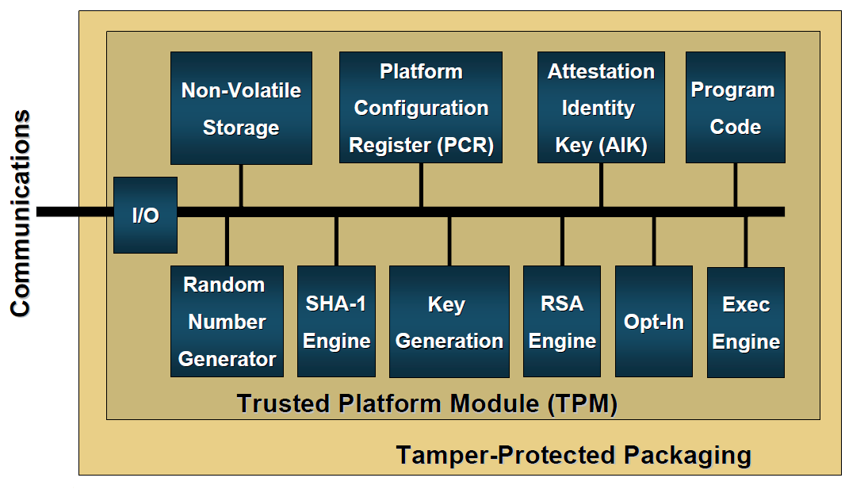
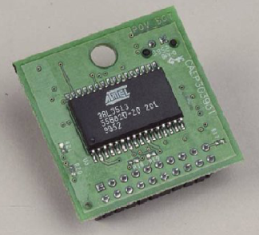
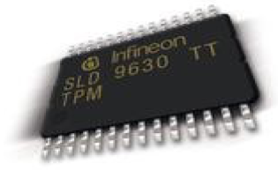
TPM Architecture
keys, owner
authorization data
integrity measures
signing keys
when in use
external
interaction
TPM control

Slide 6
TPM Architecture
symmetric keys,
nonces
encryption keys
initialization
hashes
encrypt/decrypt

Slide 7
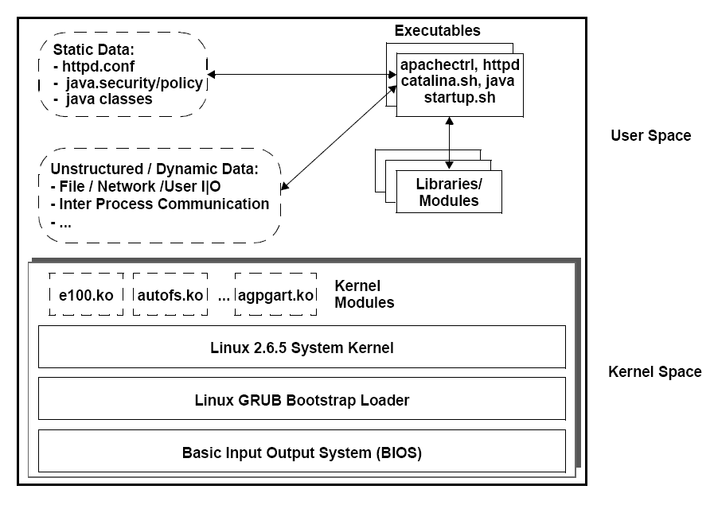
Execution Environment
Executable content
  Types
    programs
    libraries
    scripts
  Loaded by
    kernel
    application
Structured data
  class files
  configuration files
Unstructured data
  databases

Slide 8
Pragmatics
Feasibility
  Manageable number of components to measure for typical systems
    500 for a workstation configured for general technical work (document authoring, programming, browsing, etc.)
    250 for a typical web server
Approach
  Extensible architecture
  Provides essential measurement structures
  Allows future additions

Slide 9
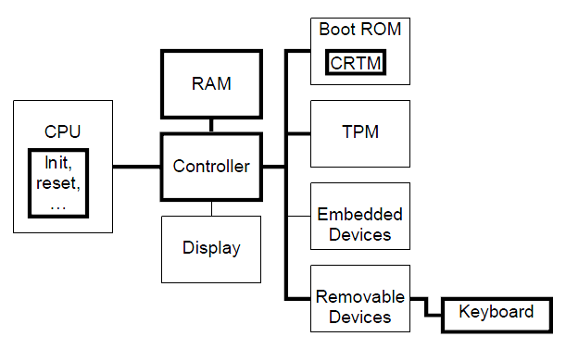
Trusted Building Blocks
TBB do no have shielded locations or protected capabilities (as does TPM)
CRTM: core root of trust for measurement
Keyboard: showing physical presence when needed

Slide 10
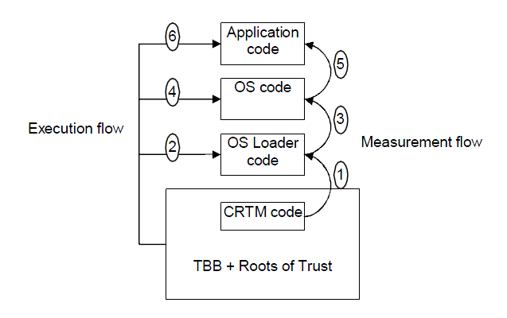
Integrity Measurement
Measure a component before executing it
Record the measurement as a hash value of the code/data (aka, fingerprint)
Produces a hash chain by combining individual hash values
Changes in the executing code can be detected by comparing measurement of executing code against recorded value
The measurements themselves must be protected from undetected manipulation

Slide 11
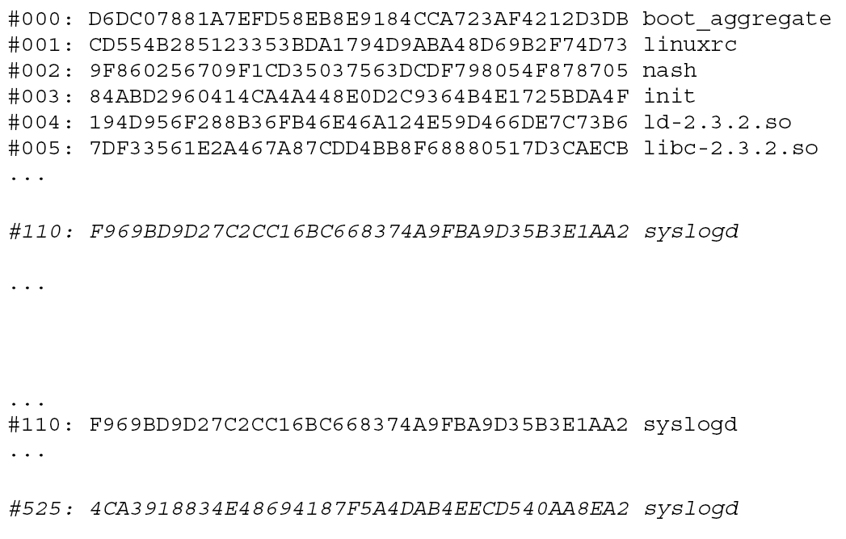
Detecting Malware Attacks
initial
attack
Measurement before
rootkit attack
Measurement after
rootkit attack

Slide 12
Platform Configuration Registers
Zero on reboot, power cycle
PCR
extend
New = SHA-1(current || update)
At least 16 PCR registers, each register stores 20 bytes

Slide 13
Maintaining a Measurement List
executable
measurement agents
load
measurement
system
add
extend
New = SHA-1(current || update)
list
PCR contains the linked hash of all measurements in the list
Alterations to the list values can be detected

Slide 14
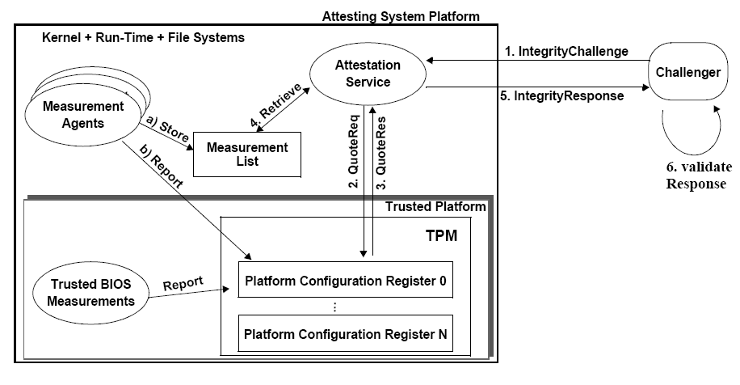
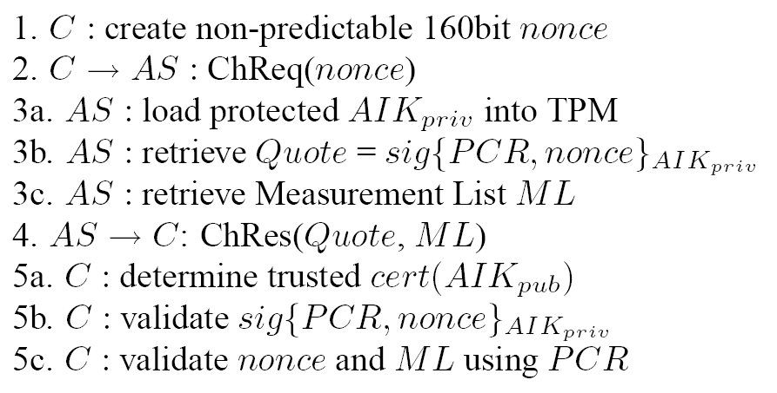
Reporting a Measurement List
Questions
How is the AIK generated?
Where is it stored?
How does the challenger validate the measurement list (ML)?
C: challenger
AS: attesting system
AIK: attestation identity key

Slide 15
Long-term Keys
The TPM has two long-term key pairs stored in non-volatile memory on the TPM
  Endorsement Key (EK)
  Storage Root Key (SRK)
Endorsement Key
  Private key never leaves the TPM
  Limited use to minimize vulnerability
  Identifies individual platform: potential privacy risk
  Public part contained in endorsement credential
  EK and endorsement credential loaded by manufacturer
Storage Root Key
  Basis for a key hierarchy that manages secure storage
  More on this later…

Slide 16
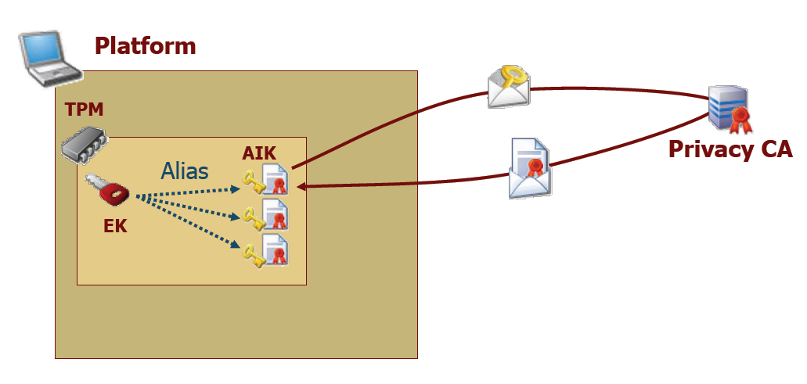
Attestation Identity Keys (AIKs)
Privacy CA
  must be trusted by platform and challenger
AIK
  serves as alias for EK
  platform may have many AIKs to allow a number of unlinkable interactions
  held in secure storage (see later)
  guarantees that platform has a valid TPM (but does not identify platform)

Slide 17
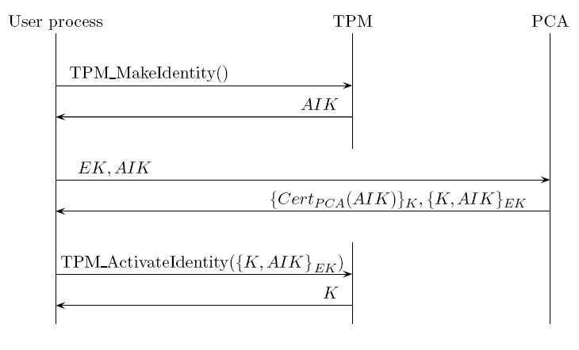
Creating AIKs
AIK cryptographically bound to TPM with specific EK

Slide 18
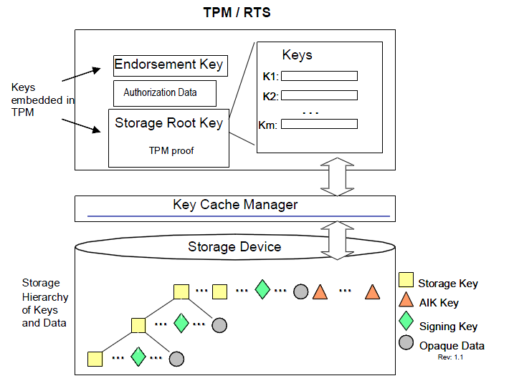
Secure Key Storage
The TPM uses/manages many keys, but has limited storage
Keys (except for the EK and SRK) may be placed in secure storage
Secure storage may be on flash drive, file server, etc.
Authdata (password) is associated with each key
Key and authdata encrypted with storage key (creating a blob)
Two forms: bind (normal encryption) and seal (bound to PCR state)

Slide 19
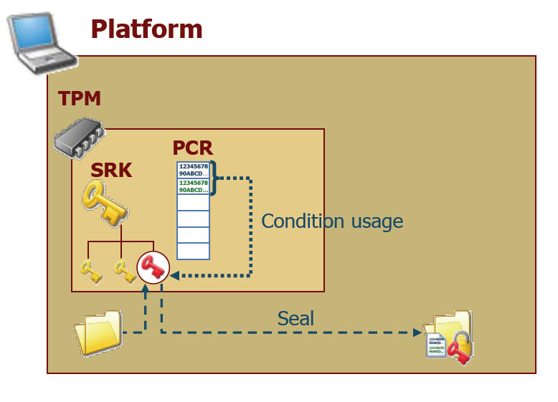
Sealed Storage
Goal: ensure that information is accessible only when the system is in a known/acceptable state
System state determined by PCR value

Slide 20
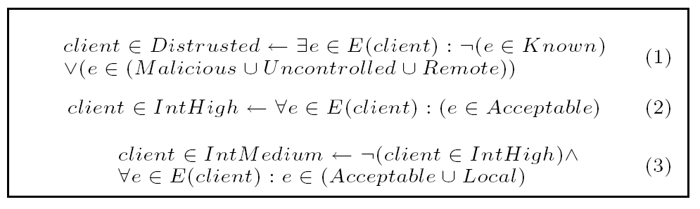
Assessing Integrity
integrity assessment
measurement list
validate
policy
fingerprints
acceptable
malicious
vulnerable-remote
vulnerable-local
unknown/uncontrolled

Slide 21
Adding Measurement Instrumentation
executable
content
executables
file_mmap
libraries
kernel modules
load_modules
measurement
structured
data
bash shell
applications
sysfs
unstructured
data
applications

Slide 22
Measuring New Files
if (found via inode HT) {
if (CLEAN) exit;
if (DIRTY) {
compute fingerprint;
if (same as stored) {
set CLEAR;
exit;
}
else {
search fingerprint HT;
if (found) {
exit;
}
else {
UPDATE();
}
}
}
}
if(not found) {
UPDATE();
}
(fingerprint, CLEAN/DIRTY)
Hash Table
Key: inode
Hash Table
Key: fingerprint
UPDATE() {
add to database;
update HTs;
extend PCR;
}

Slide 23
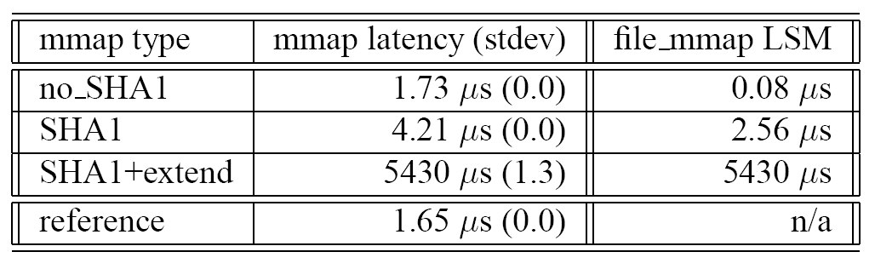
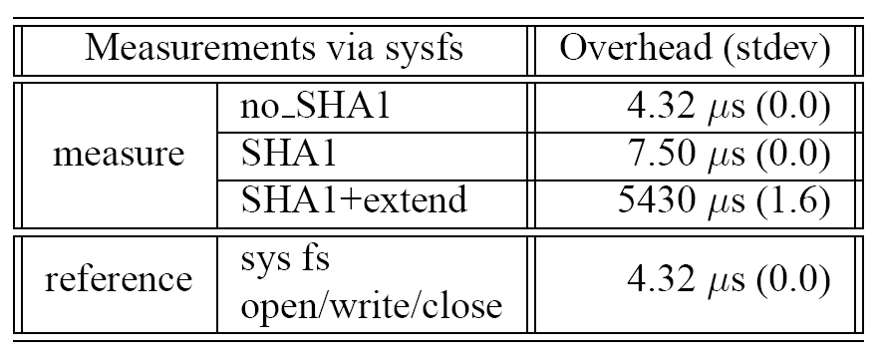
Performance
vast majority of cases does not require +extend

Slide 24
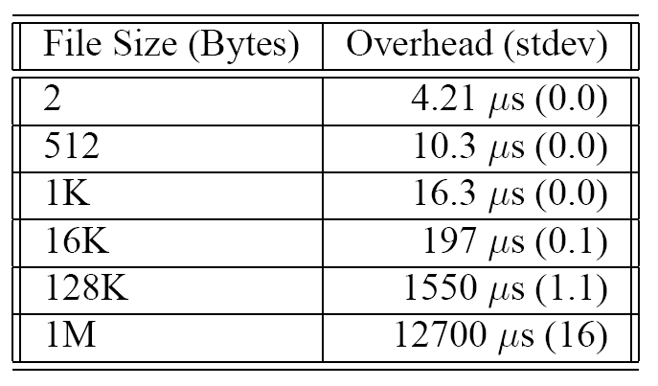
Performance
increase in overhead for computing fingerprint

Slide 25
Secure Monitoring
Monitoring of system activity is important
  Detect information leakage
  Warn of intrusions
  Indicate presence of malware activity
Approach
  Security of monitoring module
    Implemented using LSM hooks
    Secured by SecVisor
  Monitoring result guaranteed to be secure
    LSM-base mandatory access control (MAC)
    DigSig (application integrity and invocation)

Slide 26
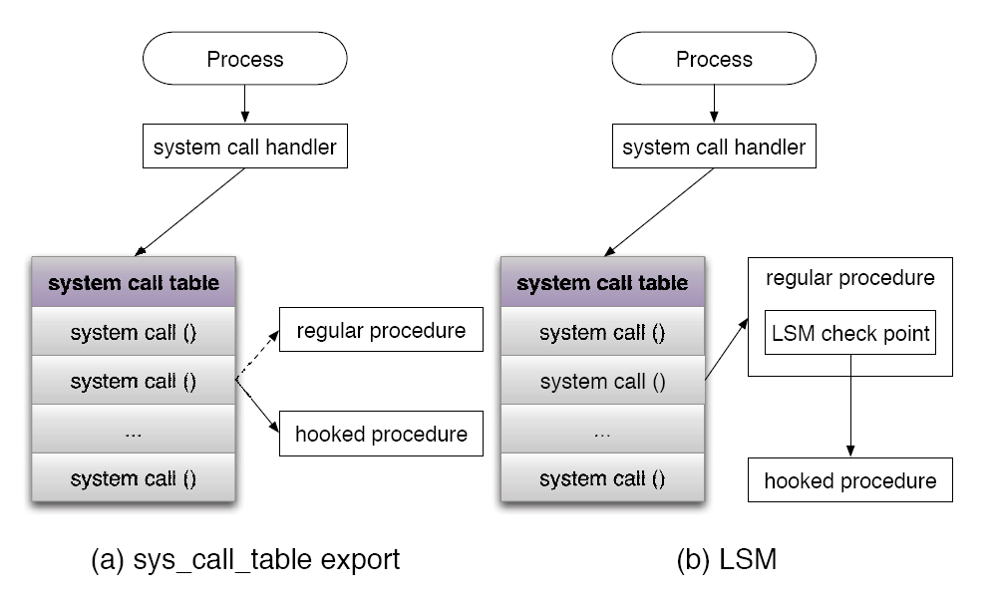
Linux Security Module (LSM)

Slide 27
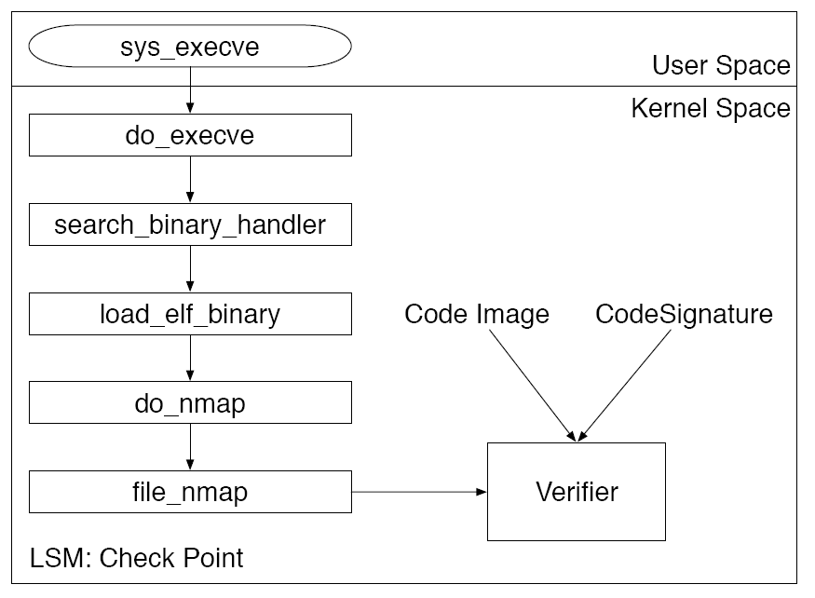
DigSig Verifier
Verifies that load code conforms to signature
Ensures that trusted applications are running

Slide 28
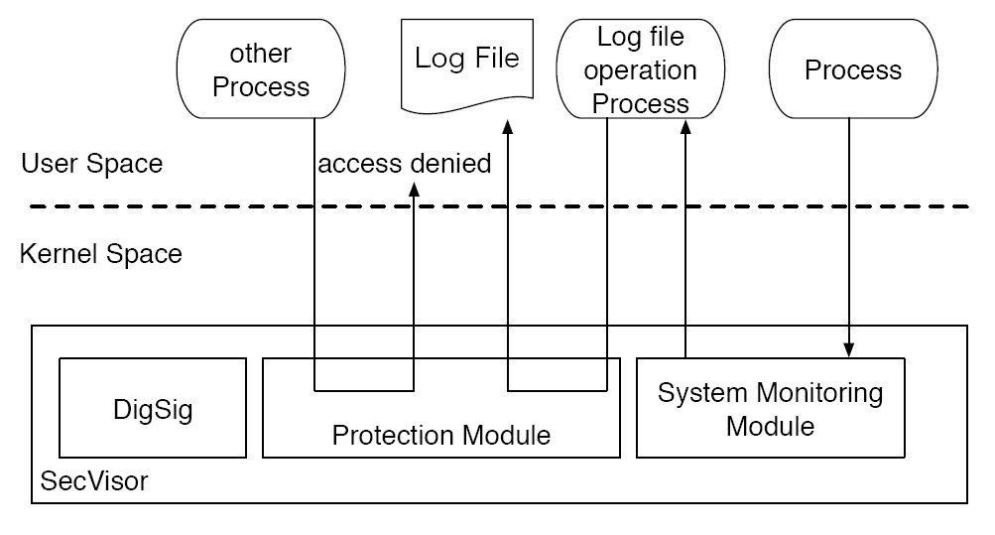
SecVisor
Small hypervisor creating
  Trusted boot
    Boots SecVisor and records SecVisor fingerprint in TPM
    Boots Linux kernel and records kernel fingerprint in TPM
  Memory protection
    During boot processes and kernel execution
  Provides run-time protection of kernel against rootkit attacks

Slide 29
Protection Module
Add figure 6

Slide 30
Performance
Add table iii and iv

