Slide 1
π Calculus
Reasoning about concurrency and communication (Part 2).

Slide 2
A Process with Alternative Behavior
A vending machine that dispenses chocolate candies allows either a 1p (p for pence) or a 2p coin to be inserted. After inserting a 1p coin, a button labelled “little” may be pressed and the machine will then dispense a small chocolate. After inserting a 2p coin, the “big” button may be pressed and the machine will then dispense a large chocolate. The candy must be collected before additional coins can be inserted.
big
little
2p
1p
collect

Slide 3
An Process with Alternative Behavior
big
little
2p
1p
collect
VM(big, little, collect, 1p, 2p) =
2p.big.collect largeChoc.VM(big, little, collect, 1p, 2p)
+ 1p.little.collect smallChoc.VM(big, little, collect, 1p, 2p)
The plus (“+”) operator expresses alternative behavior.

Slide 4
Modeling a Bounded Buffer
Suppose that a buffer has get and put operations and can hold up to three data items. Ignoring the content of the data items, and focusing only on the operations, a buffer can be defined as:
  Buffer ₀(put, get) = put.Buffer ₁(put, get)
  Buffer ₁(put, get) = put.Buffer ₂(put, get) + get.Buffer ₀(put, get)
  Buffer ₂(put, get) = put.Buffer ₃(put, get) + get.Buffer ₁(put, get)
  Buffer ₃(put, get) = get.Buffer ₂(put, get)
Notice that this captures the idea that a get operation is not possible when the buffer is empty (i.e., in state Buffer ₀ ) and a put operation is not possible when the buffer is full (i.e., in state Buffer ₃ ).

Slide 5
Reusing a Process Definition
a
CELL
b
CELL(a,b) = a.b.CELL(a,b)
a
CELL
c
c
CELL
b
C0 = CELL(a, c)
C1 = CELL(c, b)
BUFF2 = (ν c) ( C0 | C1 )
a
CELL
c
c
CELL
d
d
CELL
b
C0 = CELL (a,c)
C1 = CELL (c,d)
C2 = CELL (d,b)
BUFF3 = (ν c)(ν d)( C0 | C1 | C2 )

Slide 6
Modeling Mutual Exclusion
A lock to control access to a critical region is modeled by:
Lock(lock, unlock) = lock.Locked(lock, unlock)
  Locked(lock, unlock) = unlock.Lock(lock, unlock)
A generic process with a critical region follows the locking protocol is:
Process(enter, exit, lock, unlock)
= lock.enter.exit.unlock.Process(enter, exit, lock, unlock)
A system of two processes is:
Process₁ = Process (enter₁, exit₁, lock, unlock)
Process₂ = Process (enter₂, exit₂, lock, unlock)
MutexSystem = (ν lock) (ν unlock) (Process₁ | Process₂ | Lock )

Slide 7
Modeling Mutual Exclusion
A system of two processes is:
Process₁ = Process (enter₁, exit₁, lock, unlock)
Process₂ = Process (enter₂, exit₂, lock, unlock)
MutexSystem = new lock, unlock (Process₁ | Process₂ | Lock )
A “specification” for this system is:
MutexSpec(enter₁, exit₁, enter₂, exit₂)
= enter₁.exit₁.MutexSpec(enter₁, exit₁, enter₂, exit₂ )
+ enter₂.exit₂.MutexSpec(enter₁, exit₁ , enter₂, exit₂ )

Slide 8
Modeling a Bounded Buffer
The Buffer equations might be thought of as the “specification” of the bounded buffer because it only refers to states of the buffer and not to any internal components or machinery to create these states.
An “implementation” of the bounded buffer is readily available by re-labeling the BUFF3 agent developed earlier
CELL = a.b.CELL
C0 = CELL (put , c)
C1 = CELL (c , d)
C2 = CELL (d , get)
BufferImpl = (ν c) (ν d) ( C0 | C1 | C2 )

Slide 9
Equality of Processes
We would like to know if two process have the same
behavior (interchagable), or if an implementation
has the behavior required by a given specification
(conformance). For example:
is Buffer₀ = BufferImpl ?
is MutexSystem = MutexSpec ?
How do we tell if two behaviors are the same?

Slide 10
Structural Congruence
Two expressions are the same if one can be transformed to the other
using these rules:
(1) change of bound names : (ν a) (a.P) = (ν c) (c.P)
(2) reordering of terms in summation: a.P + b.Q = b.Q + a.P
(3) P | 0 = P, P | Q = Q | P, P | (Q | R) = (P | Q) | R
(4) (ν x) (P | Q) = P | (ν x) Q if x is not a free name in P,
(ν x) 0 = 0, (ν x) (ν y) P = (ν y) (ν x) P

Slide 11
Reaction Rules
An equation can be changed by the application of these rules that
express the “reaction” of the system being described:
COMM: (x(y).P + M) | x z.Q + N) {z/y}P | Q
PAR:
P P’
RES:
P P’
P | Q P’ | Q
(ν x) P (ν x) P’
STRUCT:
Q=P P P’ P’=Q’
Q Q’

Slide 12
Reaction Rules
  Processes: A(a,c) = a.A'(a,c) B(c,b) = c.B'(c,b)
  A' (a,c) = c.A(a,c) B'(c,b) = b.B(c,b)
A system: System = ν c (A | B )
Show: ν c (A' | B) ν c (A | B')
by REACT: c.A | c.B' A | B'
by RES: ν c(c.A | c.B' ) ν c (A | B')
by definition: ν c (A' | B) ν c(A | B')

Slide 13
Depicting an Agent's Behavior
Define:
    A = a.A' B = c.B'
    A' = c.A B' = b.B
    System = (ν c) ( A | B )
Draw a graph to show all possible sequences of actions. Here is the start:
(A|B)
a
(A'|B)
τ
(A|B')
...
...

Slide 14
More of the Behavior
(A|B)
a
(A'|B)
τ
(A|B')
b
a
(A|B)
(A'|B')
a
b
(A'|B)
(A'|B)

Slide 15
Depicting an Agent's Behavior
(A|B)
a
b
(A'|B)
τ
(A|B')
b
a
(A'|B')

Slide 16
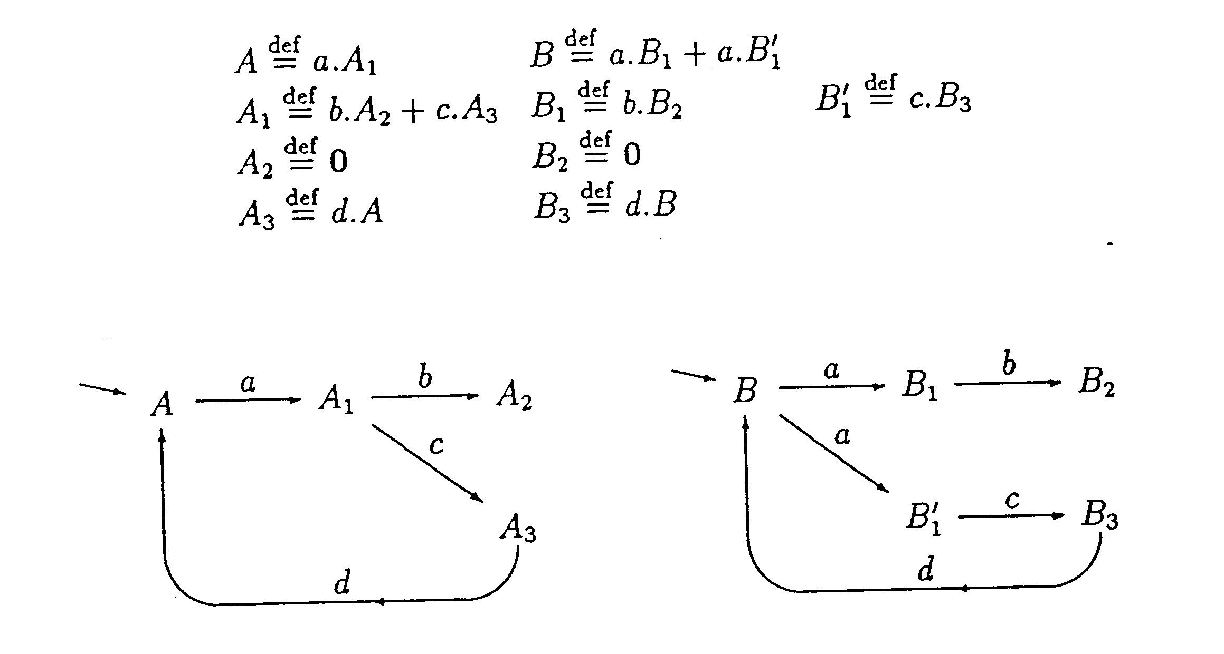
Equivalence of Agents

Slide 17
Bisimulation
The behavior of two process are equal when each can simulate
exactly the behavior of the other.
I can do everything
you can do!
I can do everything
you can do!
P
Q

