Slide 1
Paxos
A Consensus Algorithm for
Fault Tolerant Replication

Slide 2
System Model
replicas
client
. . .
Replicas
  identical
  fail/stop/restart failures
  stable storage available
Messages
  possible indefinite delay
  possible duplication or loss
  delivered messages not corrupted
Goal: insure that all replicas remain identical despite replica failure and message loss.

Slide 3
Safety requirements
replicas
client
. . .
Only a value that has been proposed (by a replica) may be chosen.
Only a single value is chosen.
A process never learns that a value has been chosen unless it actually has been.

Slide 4
Multi-Paxos
consensus
values
v₁
v₂
v₃
…
v_{n}
instance
Within each instance (basic) Praxos is used to arrive at a consensus of the value to be used by all replicas
The sequence of instances determines a sequence of values accepted by all replicas

Slide 5
Roles
Proposer(s): offer proposals of the form [value, number].
Acceptor(s): accept or reject offered proposals so as to reach consensus on the chosen proposal/value.
Learner(s): become aware of the chosen proposal/value.
Notes:
  The proposal number is unique
  A single distinguished proposer can be elected to guarantee progress
  A single distinguished learner can be elected
  In practice, all replicas play all roles
  In practice, an elected “master” plays the roles of the distinguished proposer and the distinguished learner

Slide 6
Majority consensus
majority
A
…
A
A
A
…
A
majority
P₁
P₂
Each proposer makes a proposal to some majority of the acceptors.
A majority of acceptors must accept a proposal for the proposed value to be chosen as the consensus value.
If P₁ and P₂ are making different proposals, then there must be at least one acceptor that they share in common (and this common acceptor will decide which proposal prevails).

Slide 7
Choosing a value
[V_{C}, N_{C}]
[V₁, N₁]
[V_{C}, N_{k+1}]
[V_{C}, N_{k+2}]
[V_{k}, N_{k}]
[V₂, N₂]
An acceptor will accept the proposal with the largest proposal number.
A value is chosen once a majority of acceptors have accepted a proposal with that value.
Once a proposal/value is chosen all proposals with a higher proposal number are “forced” to have the chosen value.

Slide 8
Key idea
The property:
  P2^{b}: If a proposal with value v is chosen, then every higher-numbered proposal issued by any proposer has value v.
is guaranteed by maintaining the invariant:
  P2^{c}: For any v and n, if a proposal with value v and number n is issued, then there is a set S consisting of a majority of acceptors such that either (a) no acceptor in S has accepted any proposal numbered less than n, or (b) v is the value of the highest-number proposal among all proposals numbered less than n accepted by the acceptors in S.

Slide 9
Paxos Protocol
Proposer
(a) Select proposal number n and send a prepare request with n to a majority of acceptors.
Phase 1
Acceptor
(b) If n greater than that of any prepare request to which it has already responded, then (1) respond with the highest-numbered proposal (if any) it has accepted, (2) do not accept any proposal numbered less than n.
(a) If majority response received, then send accept request for proposal [v,n] where v is the value of the highest-number proposal among the responses or any value it chooses.
(b) Accept the proposal in the accept request unless it has already responded to a prepare request having a higher number.
Phase 2

Slide 10
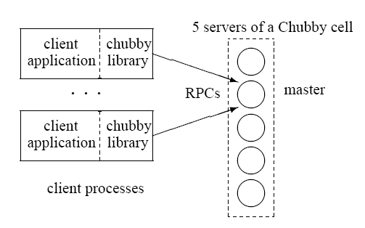
Chubby – applying Paxos
A high-availability lock service
Stores small files for applications having elected primary servers to advertise their existence and parameters
Based on replicated
architecture with
elected master
Used by GFS, Bigtable

Slide 11
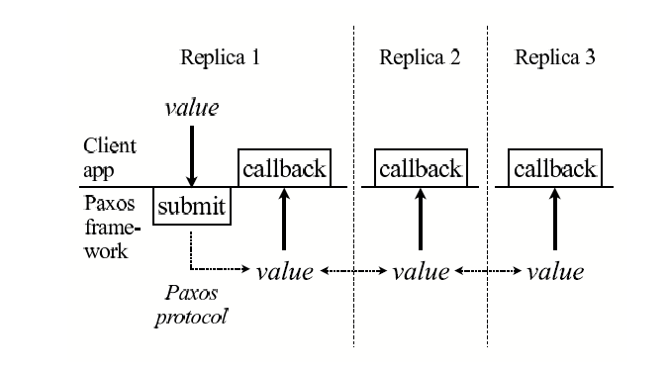
Chubby – Paxos framework

Slide 12
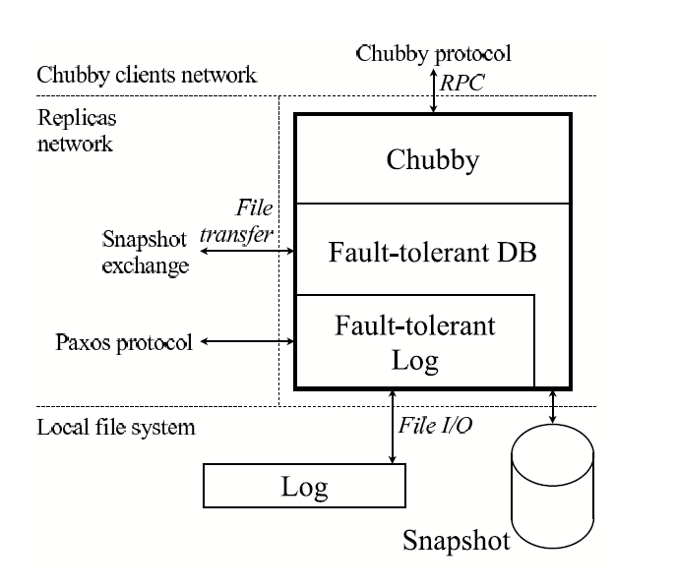
Chubby – Replica Architecture

