Slide 1
MapReduce
Concurrency for data-intensive applications

Slide 2
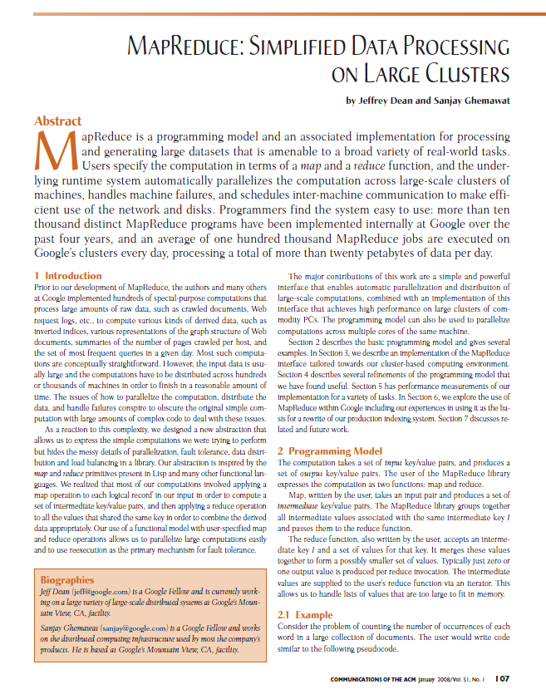

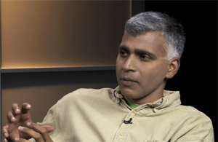
MapReduce
Jeff Dean
Sanjay Ghemawat

Slide 3
Motivation
Application characteristics
  Large/massive amounts of data
  Simple application processing requirements
  Desired portability across variety of execution platforms
Execution platforms
 | Cluster | CMP/SMP | GPGPU
Architecture | SPMD | MIMD | SIMD
Granularity | Process | Thread x 10 | Thread x 100
Partition | File | Buffer | Sub-array
Bandwidth | Scare | GB/sec | GB/sec x 10
Failures | Common | Uncommon | Uncommon

Slide 4
Motivation
Programming model
  Purpose
    Focus developer time/effort on salient (unique, distinguished) application requirements
    Allow common but complex application requirements (e.g., distribution, load balancing, scheduling, failures) to be met by support environment
    Enhance portability via specialized run-time support for different architectures
  Pragmatics
    Model correlated with characteristics of application domain
    Allows simpler model semantics and more efficient support environment
    May not express well applications in other domains

Slide 5
MapReduce model
Basic operations
  Map: produce a list of (key, value) pairs from the input structured as a (key value) pair of a different type
  (k1,v1) → list (k2, v2)
  Reduce: produce a list of values from an input that consists of a key and a list of values associated with that key
  (k2, list(v2)) → list(v2)
Note: inspired by map/reduce functions in Lisp and other functional programming languages.

Slide 6
Example
map(String key, String value) :
// key: document name
// value: document contents
for each word w in value:
EmitIntermediate(w, “1”);
reduce(String key, Iterator values) :
// key: a word
// values: a list of counts
int result = 0;
for each v in values:
result += ParseInt(v);
Emit(AsString(result));

Slide 7
Example: map phase
inputs
tasks (M=3)
partitions (intermediate files) (R=2)
When in the course of human events it …
map
(when,1), (course,1) (human,1) (events,1) (best,1) …
(in,1) (the,1) (of,1) (it,1) (it,1) (was,1) (the,1) (of,1) …
It was the best of times and the worst of times…
Over the past five years, the authors and many…
map
(over,1), (past,1) (five,1) (years,1) (authors,1) (many,1) …
(the,1), (the,1) (and,1) …
This paper evaluates the suitability of the …
map
(this,1) (paper,1) (evaluates,1) (suitability,1) …
(the,1) (of,1) (the,1) …
Note: partition function places small words in one partition and large words in another.

Slide 8
Example: reduce phase
partition (intermediate files) (R=2)
reduce task
(in,1) (the,1) (of,1) (it,1) (it,1) (was,1) (the,1) (of,1) …
sort
run-time function
(the,1), (the,1) (and,1) …
(the,1) (of,1) (the,1) …
(and, (1)) (in,(1)) (it, (1,1)) (the, (1,1,1,1,1,1))
(of, (1,1,1)) (was,(1))
reduce
user’s function
(and,1) (in,1) (it, 2) (of, 3) (the,6) (was,1)
Note: only one of the two reduce tasks shown

Slide 9
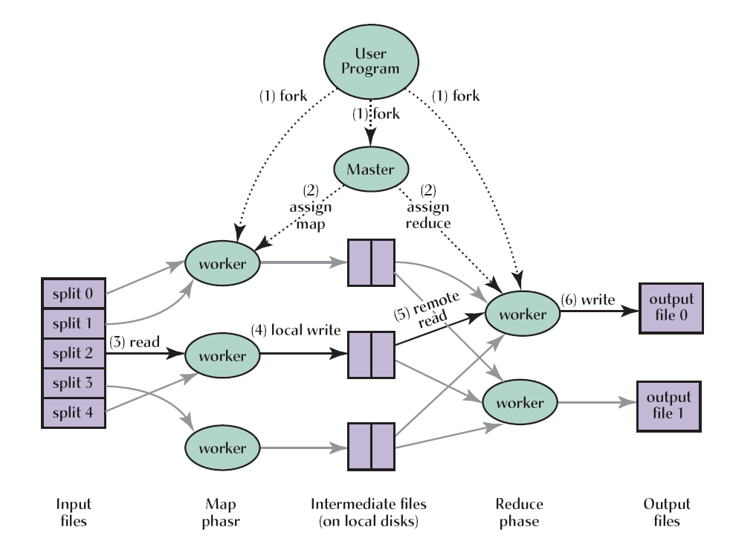
Execution Environment

Slide 10
Execution Environment
No reduce can begin until map is complete
Tasks scheduled based on location of data
If map worker fails any time before reduce finishes, task must be completely rerun
Master must communicate locations of intermediate files
Note: figure and text from presentation by Jeff Dean.

Slide 11
Backup Tasks
A slow running task (straggler) prolong overall execution
Stragglers often caused by circumstances local to the worker on which the straggler task is running
  Overload on worker machined due to scheduler
  Frequent recoverable disk errors
Solution
  Abort stragglers when map/reduce computation is near end (progress monitored by Master)
  For each aborted straggler, schedule backup (replacement) task on another worker
Can significantly improve overall completion time

Slide 12
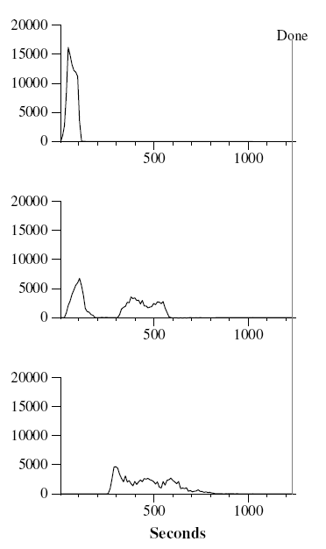
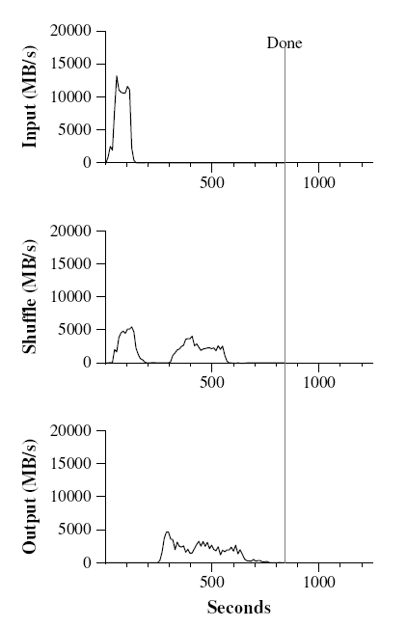
Backup Tasks
(1) without backup tasks
(2) with backup tasks (normal)

Slide 13
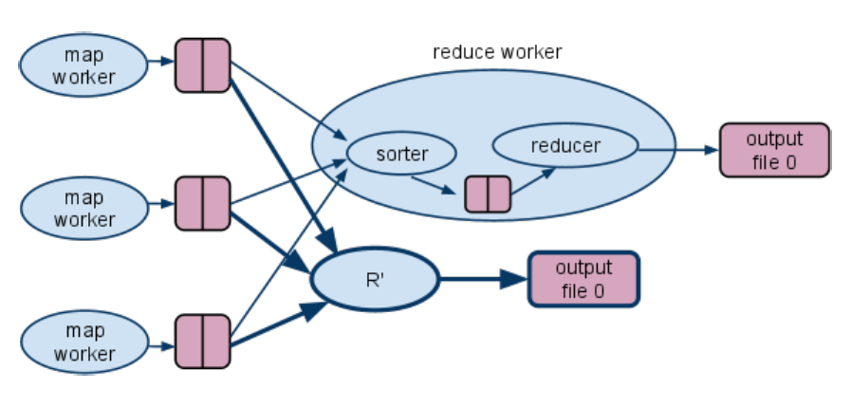
Strategies for Backup Tasks
(1) Create replica of backup task when necessary
Note: figure from presentation by Jerry Zhao and Jelena Pjesivac-Grbovic

Slide 14
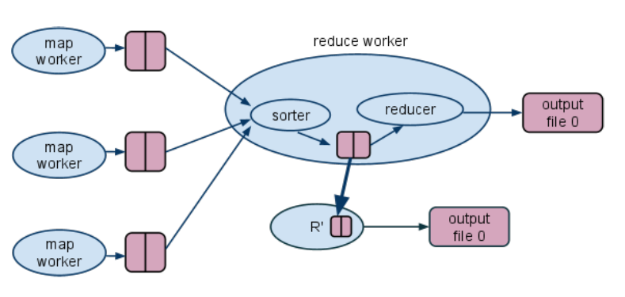
Strategies for Backup Tasks
(2) Leverage work completed by straggler - avoid resorting
Note: figure from presentation by Jerry Zhao and Jelena Pjesivac-Grbovic

Slide 15
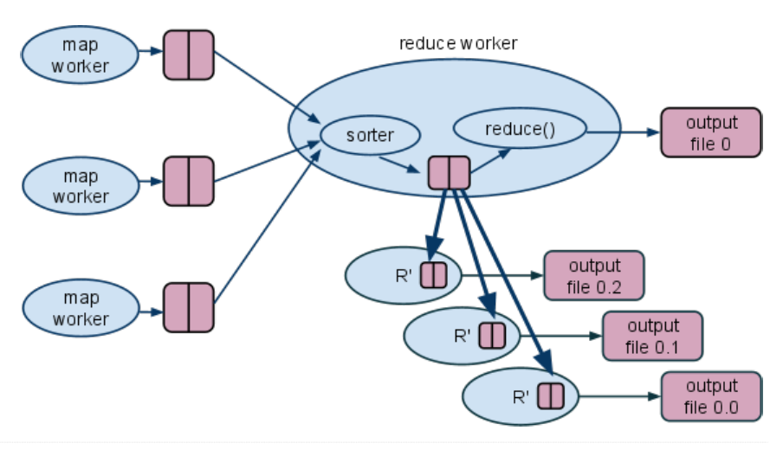
Strategies for Backup Tasks
(3) Increase degree of parallelism – subdivide partitions
Note: figure from presentation by Jerry Zhao and Jelena Pjesivac-Grbovic

Slide 16
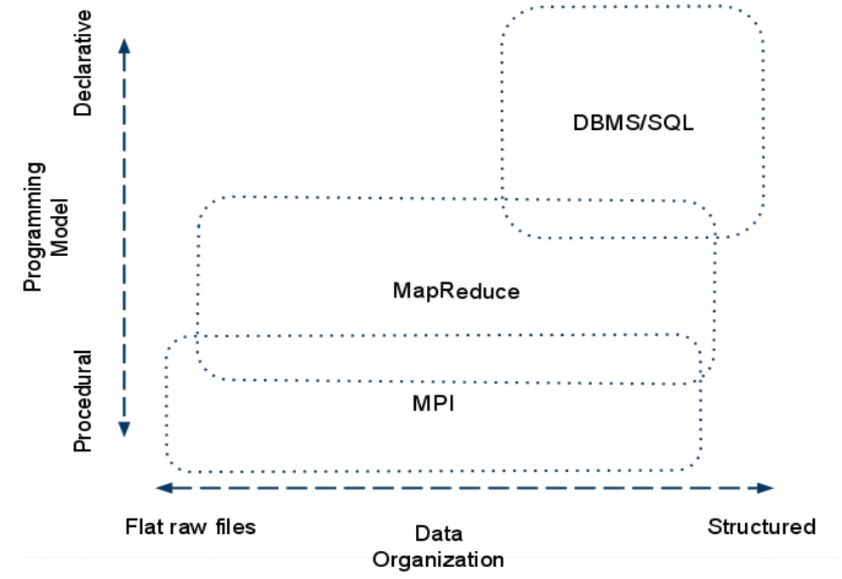
Positioning MapReduce
Note: figure from presentation by Jerry Zhao and Jelena Pjesivac-Grbovic

Slide 17
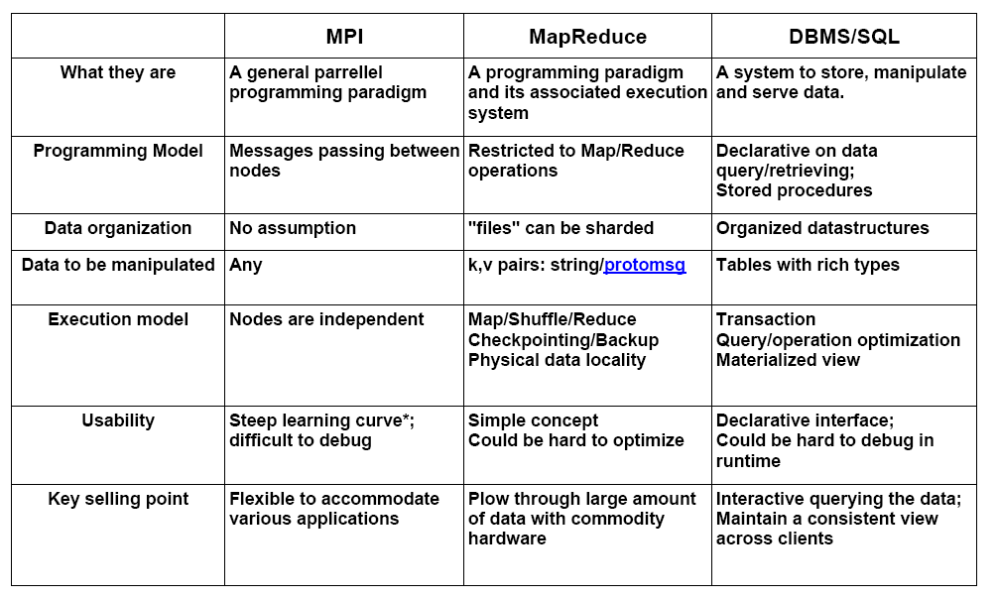
Positioning MapReduce
Note: figure from presentation by Jerry Zhao and Jelena Pjesivac-Grbovic

Slide 18
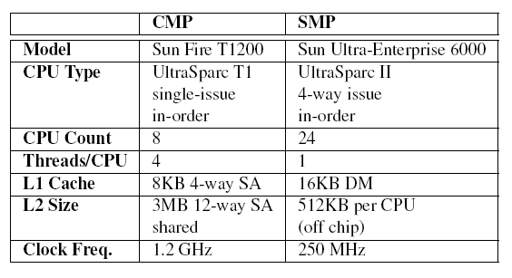
MapReduce on SMP/CMP
SMP
CMP
L1 cache
L1 cache
. . .
L2 cache
L2 cache
memory
memory
L1 cache
L2 cache
memory

Slide 19
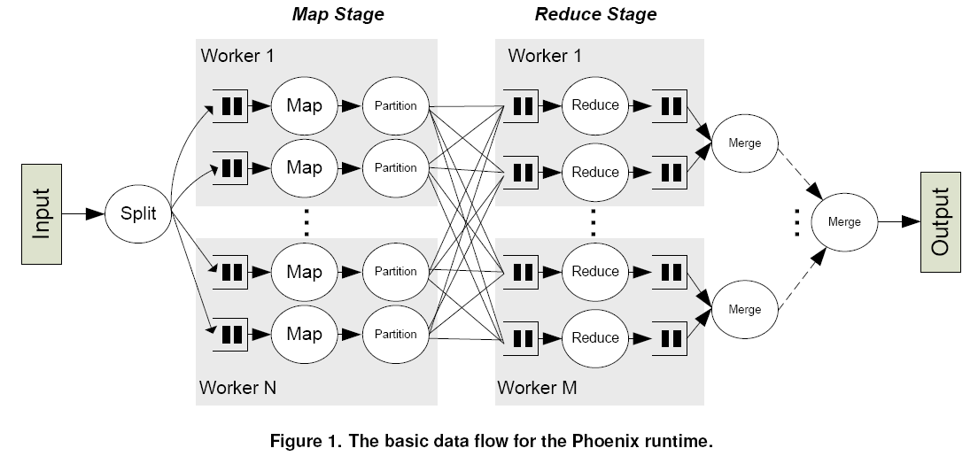
Phoenix runtime structure

Slide 20
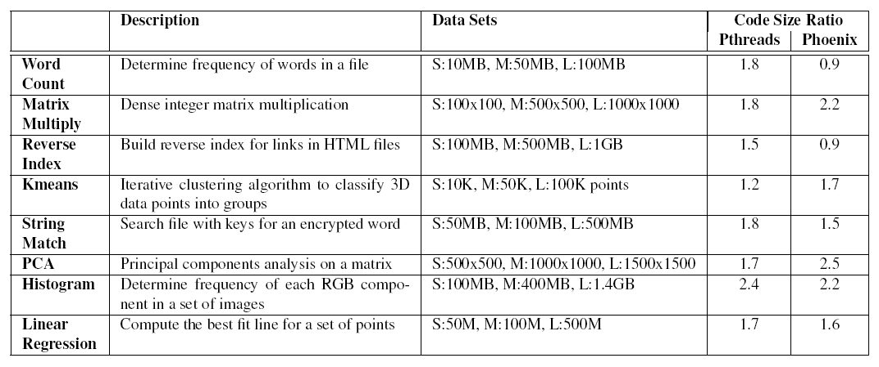
Code size
Comparison with respect to sequential code size
Observations
  Concurrency add significantly to code size ( ~ 40%)
  MapReduce is code efficient in compatible applications
  Overall, little difference in code size of MR vs Pthreads
  Pthreads version lacks fault tolerance, load balancing, etc.
  Development time and correctness not known

Slide 21
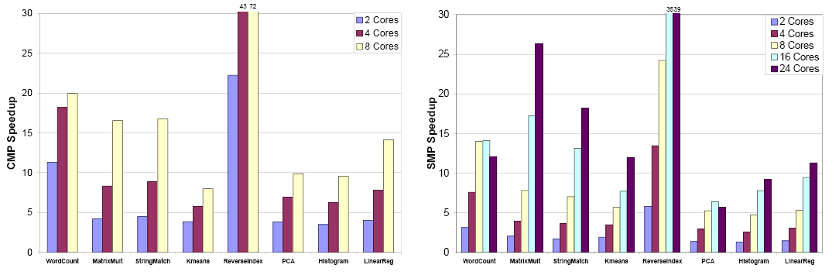
Speedup measures
Significant speedup is possible on either architecture
Clear differences based on application characteristics
Effects of application characteristics more pronounced than architectural differences
Superlinear speedup due to
  Increased cache capacity with more cores
  Distribution of heaps lowers heap operation costs
  More core and cache capacity for final merge/sort step

Slide 22
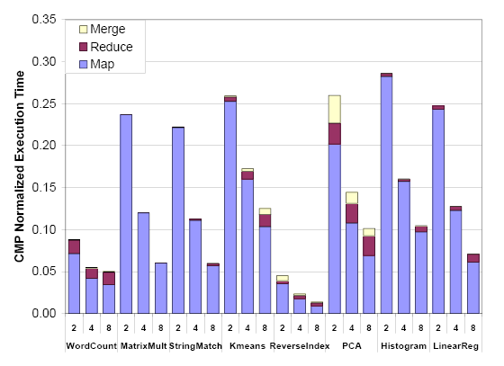
Execution time distribution
Execution time dominated by Map task

Slide 23
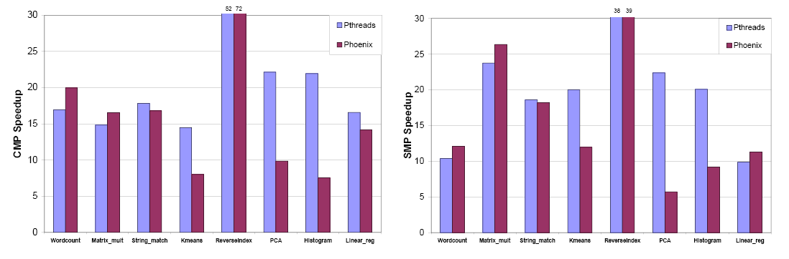
MapReduce vs Pthreads
MapReduce compares favorably with Pthreads on applications where the MapReduce programming model is appropriate
MapReduce is not a general-purpose programming model

Slide 24
MapReduce on GPGPU
General Purpose Graphics Processing Unit (GPGPU)
  Available as commodity hardware
  GPU vs. CPU
    10x more processors in GPU
    GPU processors have lower clock speed
    Smaller caches on GPU
  Used previously for non-graphics computation in various application domains
  Architectural details are vendor-specific
  Programming interfaces emerging
Question
  Can MapReduce be implemented efficiently on a GPGPU?

Slide 25
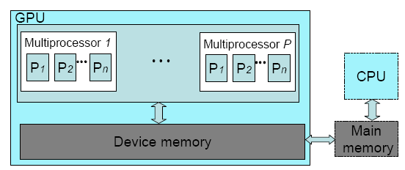
GPGPU Architecture
Many Single-instruction, Multiple-data (SIMD) multiprocessors
High bandwidth to device memory
GPU threads: fast context switch, low creation time
Scheduling
  Threads on each multiprocessor organized into thread groups
  Thread groups are dynamically scheduled on the multiprocessors
GPU cannot perform I/O; requires support from CPU
Application: kernel code (GPU) and host code (CPU)

Slide 26
System Issues
Challenges
  Requires low synchronization overhead
  Fine-grain load balancing
  Core tasks of MapReduce are unconventional to GPGPU and must be implemented efficiently
  Memory management
    No dynamic memory allocation
    Write conflicts occur when two threads write to the same shared region

Slide 27
System Issues
Optimizations
  Two-step memory access scheme to deal with memory management issue
    Steps
      Determine size of output for each thread
      Compute prefix sum of output sizes
    Results in fixed size allocation of correct size and allows each thread to write to pre-determined location without conflict

Slide 28
System Issues
Optimizations (continued)
  Hashing (of keys)
    Minimizes more costly comparison of full key value
  Coalesced accesses
    Access by different threads to consecutive memory address are combined into one operation
    Keys/values for threads are arranged in adjacent memory locations to exploit coalescing
  Built in vector types
    Data may consist of multiple items of same type
    For certain types (char4, int4) entire vector can be read as a single operations

Slide 29
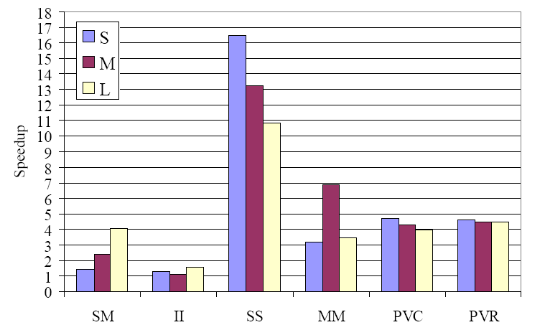
Mars Speedup
Compared to Phoenix
Optimizations
  Hashing (1.4-4.1X)
  Coalesced accesses (1.2-2.1X)
  Built-in vector types (1.1-2.1X)

Slide 30
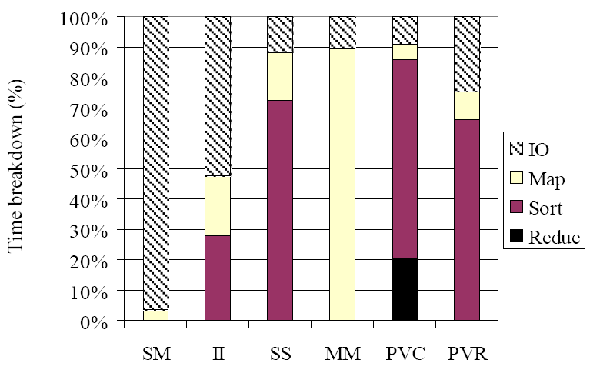
Execution time distribution
Significant execution time in infrastructure operations
  IO
  Sort

Slide 31
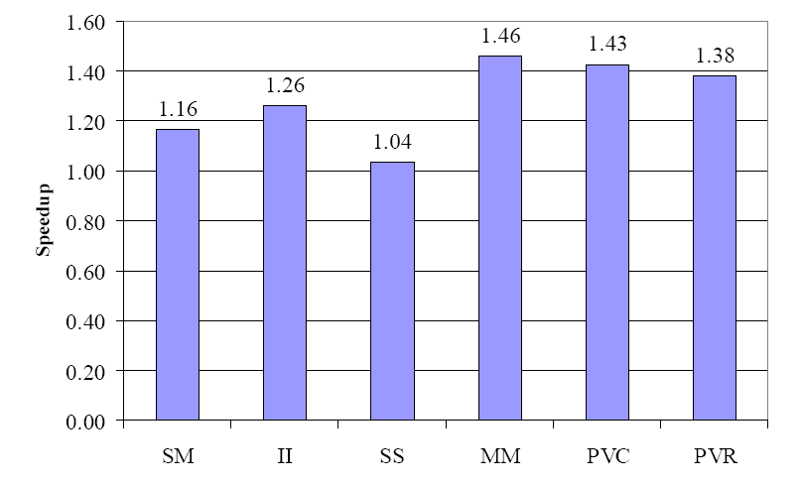
Co-processing
Co-processing (speed-up vs. GPU only)
  CPU – Phoenix
  GPU - Mars

Slide 32
Overall Conclusion
MapReduce is an effective programming model for a class of data-intensive applications
MapReduce is not appropriate for some applications
MapReduce can be effectively implemented on a variety of platforms
  Cluster
  CMP/SMP
  GPGPU

