Slide 1
Google File System

Slide 2
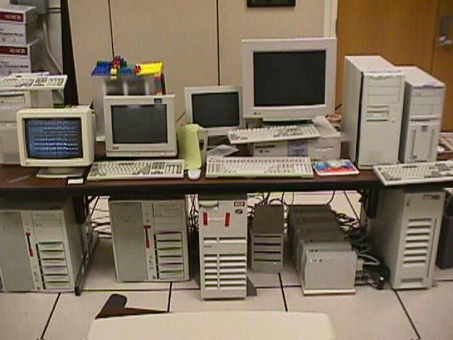
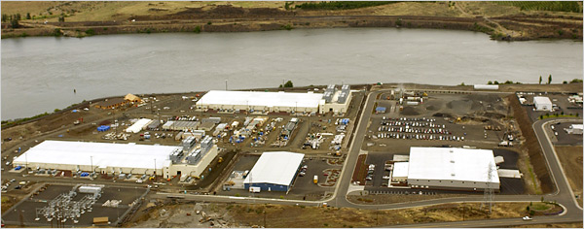
Google Disk Farm
Early days…
…today

Slide 3
Design
Design factors
Failures are common (built from inexpensive commodity components)
Files
large (multi-GB)
mutation principally via appending new data
low-overhead atomicity essential
Co-design applications and file system API
Sustained bandwidth more critical than low latency
File structure
Divided into 64 MB chunks
Chunk identified by 64-bit handle
Chunks replicated (default 3 replicas)
Chunks divided into 64KB blocks
Each block has a 32-bit checksum
chunk
file
…
blocks

Slide 4
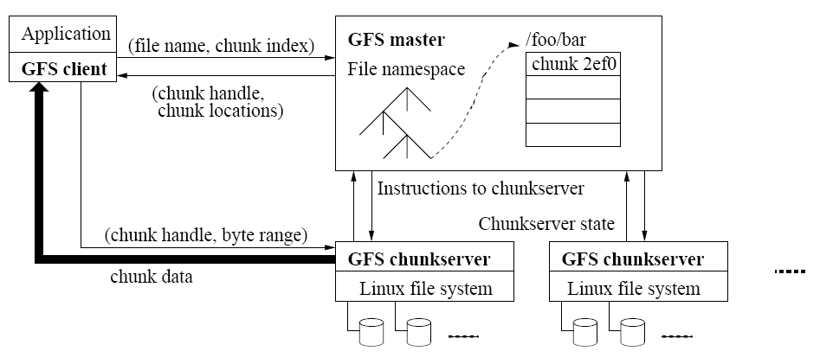
Architecture
metadata
data
Master
Manages namespace/metadata
Manages chunk creation, replication, placement
Performs snapshot operation to create duplicate of file or directory tree
Performs checkpointing and logging of changes to metadata
Chunkservers
Stores chunk data and checksum for each block
On startup/failure recovery, reports chunks to master
Periodically reports sub-set of chunks to master (to detect no longer needed chunks)

Slide 5
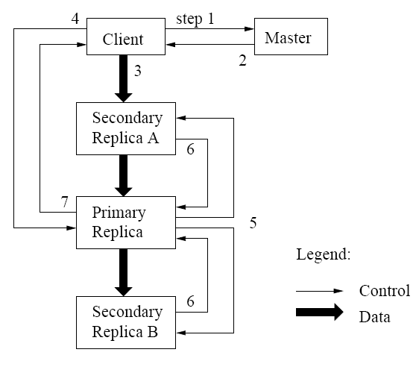
Mutation operations
Primary replica
Holds lease assigned by master (60 sec. default)
Assigns serial order for all mutation operations performed on replicas
Write operation
1-2: client obtains replica locations and identity of primary replica
3: client pushes data to replicas (stored in LRU buffer by chunk servers holding replicas)
4: client issues update request to primary
5: primary forwards/performs write request
6: primary receives replies from replica
7: primary replies to client
Record append operation
Performed atomically (one byte sequence)
At-least-once semantics
Append location chosen by GFS and returned to client
Extension to step 5:
If record fits in current chunk: write record and tell replicas the offset
If record exceeds chunk: pad the chunk, reply to client to use next chunk

Slide 6
Consistency Guarantees
primary
primary
primary
replica
replica
replica
defined
consistent
inconsistent
Write
Concurrent writes may be consistent but undefined
Write operations that are large or cross chunk boundaries are subdivided by client into individual writes
Concurrent writes may become interleaved
Record append
Atomically, at-least-once semantics
Client retries failed operation
After successful retry, replicas are defined in region of append but may have intervening undefined regions
Application safeguards
Use record append rather than write
Insert checksums in record headers to detect fragments
Insert sequence numbers to detect duplicates

Slide 7
Metadata management
pathname
lock
chunk list
Logical structure
/home
read
Chunk4400488,…
/save
Chunk8ffe07783,…
/home/user/foo
write
Chunk6254ee0,…
/home/user
read
Chunk88f703,…
Namespace
Logically a mapping from pathname to chunk list
Allows concurrent file creation in same directory
Read/write locks prevent conflicting operations
File deletion by renaming to a hidden name; removed during regular scan
Operation log
Historical record of metadata changes
Kept on multiple remote machines
Checkpoint created when log exceeds threshold
When checkpointing, switch to new log and create checkpoint in separate thread
Recovery made from most recent checkpoint and subsequent log
Snapshot
Revokes leases on chunks in file/directory
Log operation
Duplicate metadata (not the chunks!) for the source
On first client write to chunk:
Required for client to gain access to chunk
Reference count > 1 indicates a duplicated chunk
Create a new chunk and update chunk list for duplicate

Slide 8
Chunk/replica management
Placement
On chunkservers with below-average disk space utilization
Limit number of “recent” creations on a chunkserver (since access traffic will follow)
Spread replicas across racks (for reliability)
Reclamation
Chunk become garbage when file of which they are a part is deleted
Lazy strategy (garbage college) is used since no attempt is made to reclaim chunks at time of deletion
In periodic “HeartBeat” message chunkserver reports to the master a subset of its current chunks
Master identifies which reported chunks are no longer accessible (i.e., are garbage)
Chunkserver reclaims garbage chunks
Stale replica detection
Master assigns a version number to each chunk/replica
Version number incremented each time a lease is granted
Replicas on failed chunkservers will not have the current version number
Stale replicas removed as part of garbage collection

Slide 9
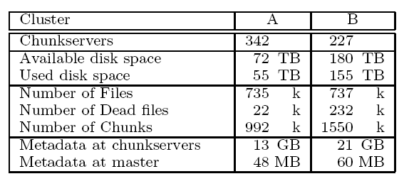
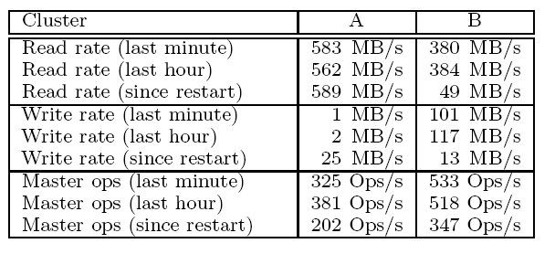
Performance

