Slide 1
File Systems

Slide 2
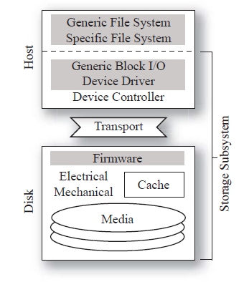
Structure of a File System
buffer cache
buffer cache
improves efficiency
delayed writes, read ahead
improved scheduling
contains both data and metadata
metadata
file organization (inode)
naming (directories)
management (bitmaps)
data
application defined

Slide 3
File Metadata
inode
data
access
ref. count
direct
data
data
direct
indirect
I
dbl. ind.
data
I
DI
I

Slide 4
Directory Metadata
name
inode
directory
file of directory entries
root directory at a known location
directory entry
name component
inode of sub-directory file
example
/usr/staff/mgr
(root)
usr
97
name
inode
(97)
staff
27
name
inode
(27)
mgr
152

Slide 5
Management Metadata
bitmap
1 0 0 1 1 1 0 1 1 0 0 0 0 1 1 1
inode
logical
physical
disk block
disk block
disk block
bitmap
1 1 1 0 1 1 0 1 0 0 1 0 0 1 0 1

Slide 6
Failure Modes
buffer cache
host (system) failure
cached data and metadata lost
disk contents
stable (survives)
metadata may be inconsistent
disk (media) failure
potential corruption of arbitrary data/metadata

Slide 7
Goals & Approaches
Improving performance
Creating a different structure
Log-structured file systems
Google file system
Improving resilience to crashes
Changing structure to reduce/eliminate consistency problems
Log-structured file system
Google file system
Maintaining consistency on disk
Journaling (a logging technique)
Soft updates (enforcing update dependencies)

Slide 8
Log-structured file system
Concept
write
at end of log
log
read
from end of log
more recently written block renders obsolete a version of that block written earlier.
Issue | Approach
How to structure data/metadata | segments
How to manage disk space | segment cleaning

Slide 9
LFS structure
Superblock - list: (segment, size)
Checkpoint region:
LFS
inode map
seg. usage table map
superblock
checkpoint
region
segment
segment
segment
segment
segment
segment
inode map – list: (inode location, version#)
segment usage table – list: (live bytes, modified time)
segment
segment
segment
segment
Segment summary block – list: (inode, version, block)

Slide 10
Checkpoint
Creation
Flush to disk
data
I-nodes
I-node map blocks
segment usage table
In fixed checkpoint region, write addresses of I-node map blocks and segment usage table blocks.
Mark checkpoint region with “current” timestamp.
Use two checkpoints for reliability

Slide 11
Recovery
Read latest checkpoint
Roll-forward
Scan segment usage blocks
New inodes are incorporated into inode map (data blocks automatically included)
Data blocks for new versions are ignored
Adjust segment utilizations in segment table map
Insure consistency of directories and inodes
Directory operations log
Records entry for each directory change
Written to log before directory/inode blocks

Slide 12
Segment cleaning
2. clean
LFS
1. read
3. update
When to execute the segment cleaner?
Clean segments are below a threshold
How many segments to clean at once?
Until clean segments exceeds a threshold
Which segments to clean?
How should live blocks be grouped?

Slide 13
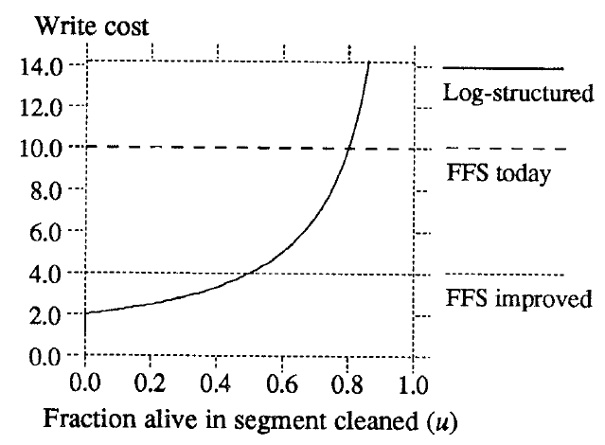
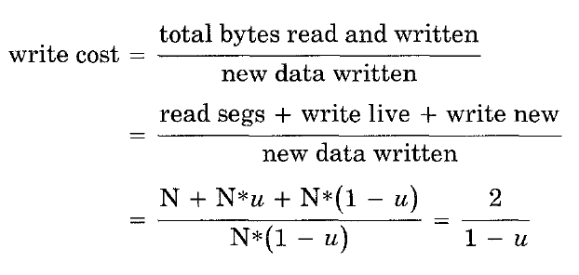
Cleaning Policies
“The key to achieving high performance at low cost in a log-structured file system is to force the disk into a bimodal segment distribution where most of the segments are nearly full, a few are empty or nearly empty, and the cleaner can almost always work with the empty segments.” (Rosenblum/Ousterhout)

Slide 14
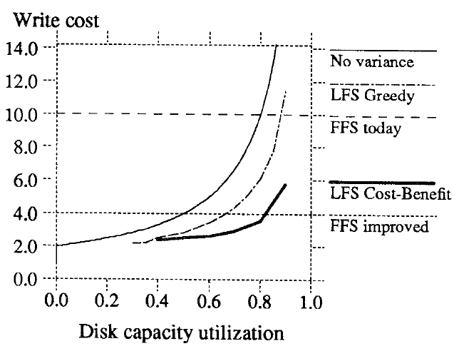
Cost benefit policy
Select for cleaning the segment with the highest ratio of benefit to cost
Use age to approximate the stability of the data in a segment

Slide 15
LFS Performace

Slide 16
LFS Performance

Slide 17
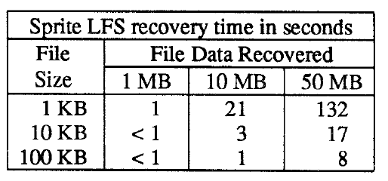
LFS Overhead
Recovery time is dominated by the number of files.
Resources are highly focused on user data.

Slide 18
Soft Update Concept
Idea: maintain dependencies among in-cache metadata blocks so that writes to disk will preserve the consistency of the on-disk metadata.
Ensures that the only metadata inconsistencies are unclaimed blocks or inodes that can be reclaimed by a background process examining the active file system
Reduces by 40% to 70% the number of disk writes in file intensive environments

Slide 19
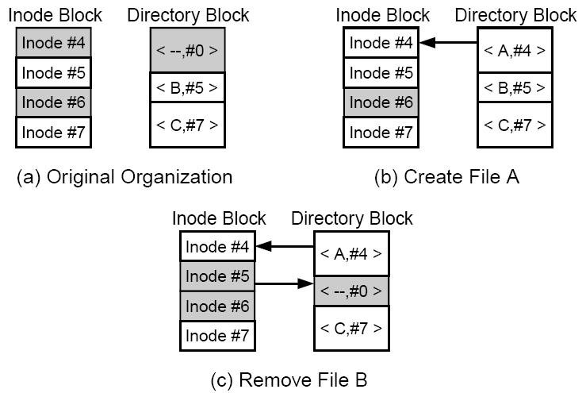
Metadata Dependencies
File operations create dependencies between related metadata changes
Cyclic dependencies can arise between metadata blocks

Slide 20
Soft Updates Example
dependency
change
A
old
Y
new
X
change
Y-old
X-old
Y-new
X-new
B
C
Maintaining old/new values allows undo-redo operations
Cyclic dependencies can arise between metadata blocks

Slide 21
Soft Updates Example
A
Write block A:
Rollback X in A using X-old
Rollback Y in A using Y-old
Write A to disk
Restore X in A using X-new
Restore Y in A using Y-new
X
Y
Y-old
X-old
Y-new
X-new
B
C
Write block B:
Write B to disk
Remove dependency from X in A

Slide 22
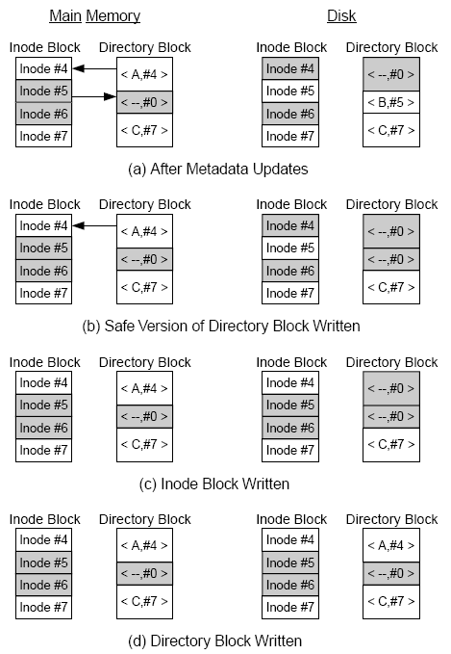
Example
A metadata block may be written more than once to insure consistency

Slide 23
Journaling
1
3
A
X
B
2
4
Y
Journal
(A, X)
(B, Y)
memory
disk
6
7
5
(A, X)
(B, Y)

Slide 24
Journaling
Process:
record changes to cached metadata blocks in journal
periodically write the journal to disk
on-disk journal records changes in metadata blocks that have not yet themselves been written to disk
Recovery:
apply to disk changes recorded in on-disk journal
resume use of file system
On-disk journal
maintained on same file system as metadata
stored on separate, stand-alone file system

Slide 25
Journaling Transaction Structure
A journal transaction
consists of all metadata updates related to a single operation
transaction order must obey constraints implied by operations
the memory journal is a single, merged transaction
Examples
Creating a file
creating a directory entry (modifying a directory block),
allocating an inode (modifying the inode bitmap),
initializing the inode (modifying an inode block)
Writing to a file
updating the file’s write timestamp ( modifying an inode block)
may also cause changes to inode mapping information and block bitmap if new data blocks are allocated

Slide 26
Journaling in Linux (ext2fs)
Close the (merged) transaction
Start flushing the transaction to disk
Full metadata block is written to journal
Descriptor blocks are written that give the home disk location for each metadata block
Wait for all outstanding filesystem operations in this transaction to complete
Wait for all outstanding transaction updates to be completely
Update the journal header blocks to record the new head/tail
When all metadata blocks have been written to their home disk location, write a new set of journal header blocks to free the journal space occupied by the (now completed) transaction

Slide 27
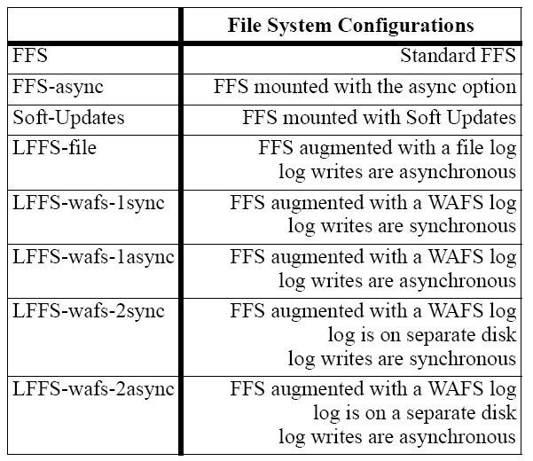
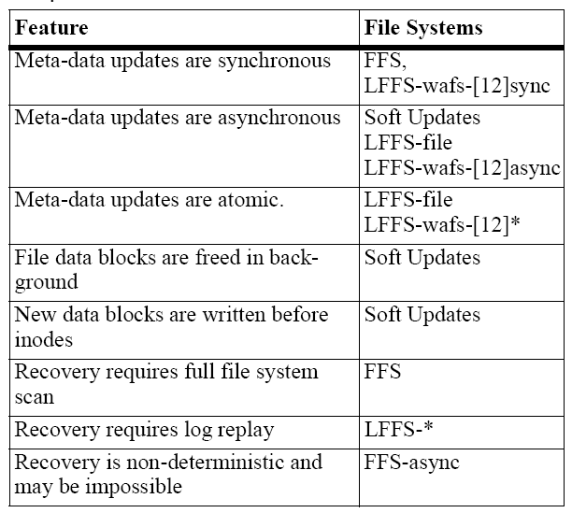
Configurations & Features

Slide 28
Benchmark study
SSH Benchmark

