Slide 1
Computer Science 5204
Operating Systems
Fall, 2010
Dr. Dennis Kafura
Course Overview

Slide 2
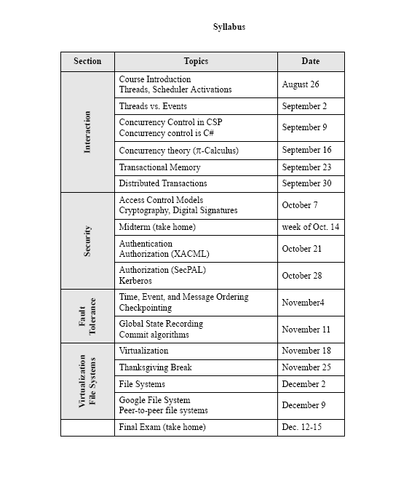
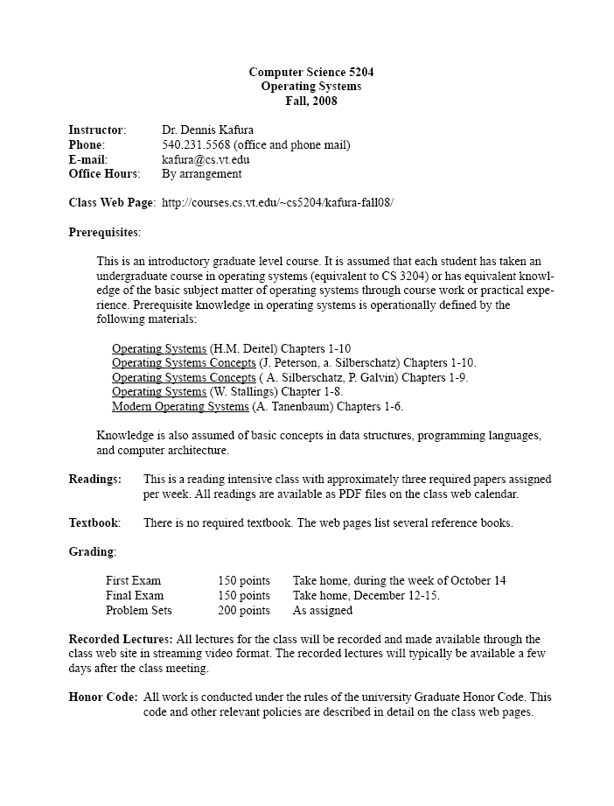
Organization
Reading intensive
  35 +/- papers
  No required text
Balance
  Theory vs. technology
  Contemporary vs. classic
  Survey vs. depth
  Centralized vs. distributed
Syllabus on web site

Slide 3
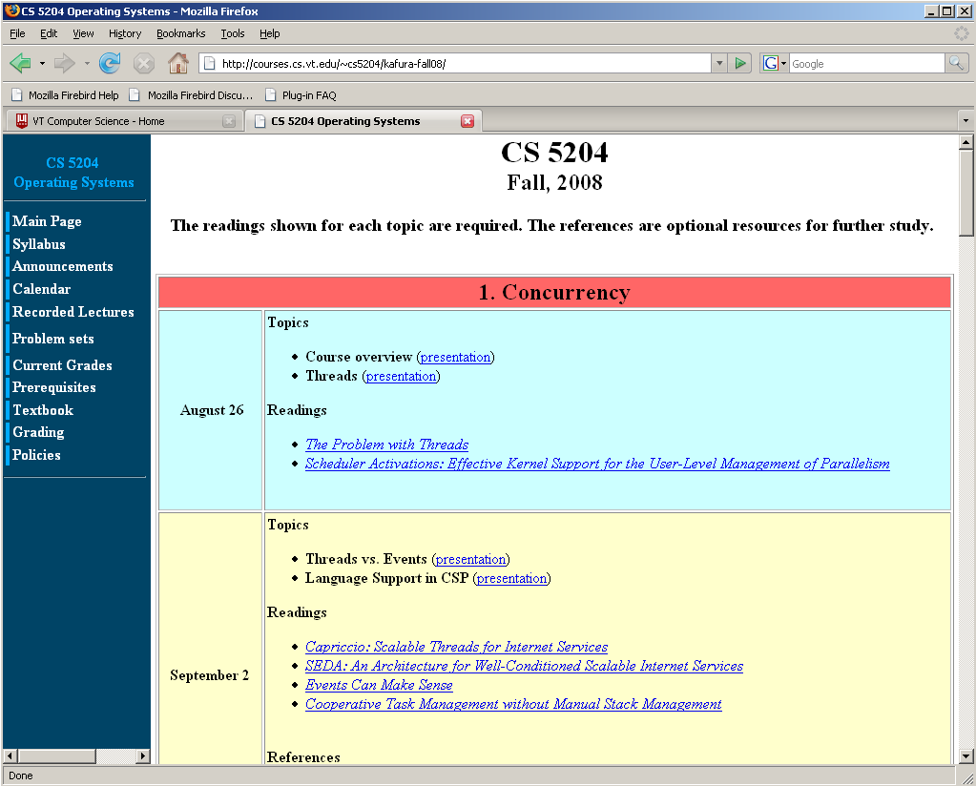
Course Web site
http://courses.cs.vt.edu/~cs5204/fall10--kafura-NVC

Slide 4
Major Topics and Themes
Topic | Theme
 | Atomicity | Order | Consistency | Theory | Google
1. Concurrency | x | x |  | x | x
2. Security |  |  |  | x
3. File systems | x | x | x |  | x
4. Fault tolerance | x | x | x |  | x

Slide 5
1. Concurrency
  How can concurrent processing be structured on a single processor?
  What are the problems and issues in developing systems with concurrent activities?
  What are emerging models for concurrent programming?
  How can the problems with multi-threaded programming be alleviated?
  How can transaction-style semantics be supported locally in hardware or software?
  How can concurrency and communication be represented formally?

Slide 6
Process vs. Thread Models
. . .
. . .
user
user
kernel
kernel
process-centered
thread-centered

Slide 7
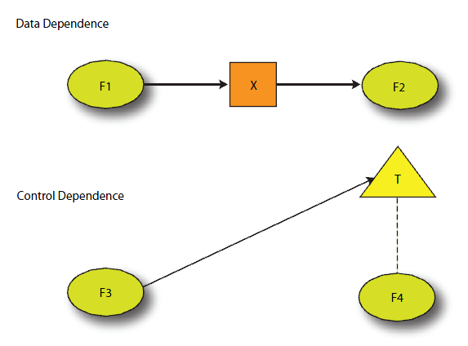
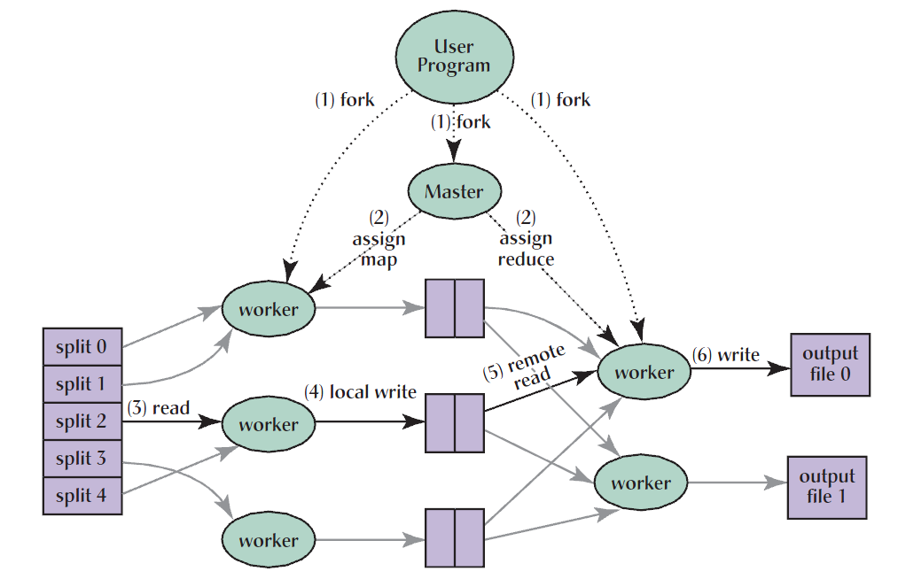



Models of Concurrent Computation
MapReduce
Concurrent Collections (CnC)
step
item
tag

Slide 8
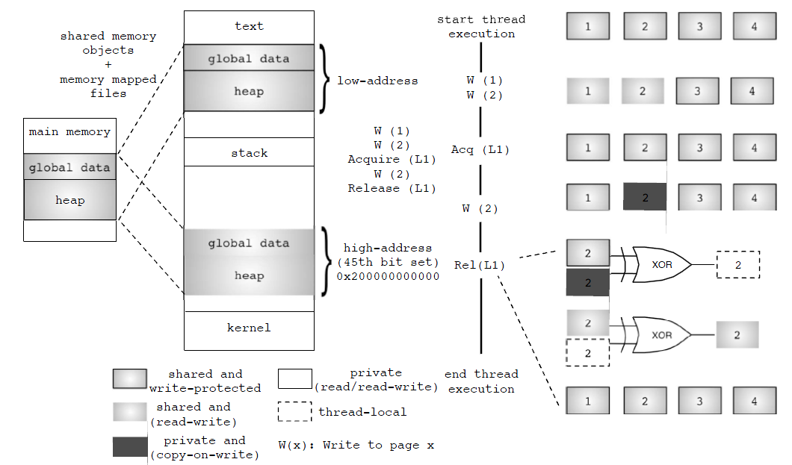
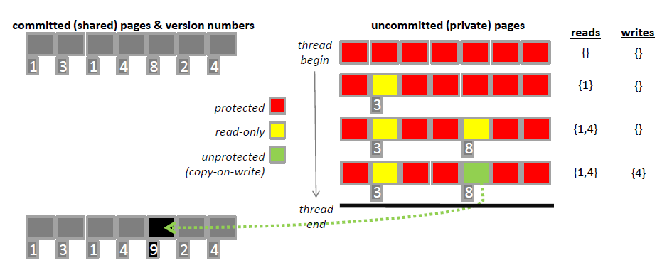
Thread-per-process models
Communicating Sequential Processes
Sequential process
Communication channel
Sammati
Grace

Slide 9
Supporting Transaction Semantics
repeat {
BeginTransaction(); /* initialize transaction */
<read input values>
success = Validate(); /* test if inputs consistent */
if (success) {
<generate updates>
success = Commit(); /* attempt permanent update */
if (!success)
Abort(); /* terminate if unable to commit */
}
EndTransaction(); /* close transaction */
} until (success);
TM Object
Locator
Transaction
Transaction
New Object
Old Object
object data
object data

Slide 10
π-Calculus
An algebra that captures the notions of communication, interaction, and synchronization among concurrently executing entities.
talk₁
switch₁
talk₂
switch₂
Trans
Idtrans
IdTrans
Trans
lose₁
lose₂
lose₁
lose₂
gain₁
Control
gain₂
gain₁
Control
gain₂

Slide 11
2. Security
  How can rights for access control be structured for effective use and management?
  How can a digital document be “signed” so as to identify authorship?
  How can communicating parties be confident of each other’s identities?
  How can a platform attest to the validity of its execution environment?
  How can access policies be expressed and enforced?

Slide 12
Security Overview
certificate
refers to
identity
public key
issues
Certificate Authority
private
key
trusts/
verifies
establish
server
secure communication channel
access
control
information
resources

Slide 13
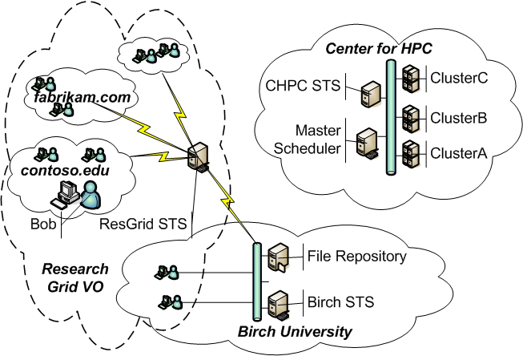
Security in distributed systems
Describe explicit trust relationships
Express security token issuance policies
Provide security tokens that contain identities, capabilities, and/or delegation policies
Express resource authorization and delegation policies

Slide 14
3. File Systems
  What does a “typical” file structure look like?
  What problems can arise in the file sytems when systems fail?
  How can file systems be structured to withstand
  (or more easily recover from) system failures?
  How can file systems be structured to handle tera-bytes of information?

Slide 15
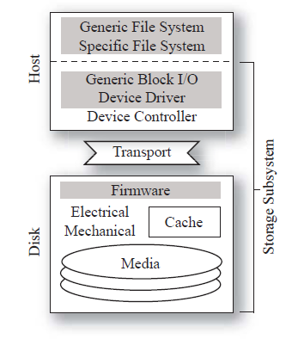
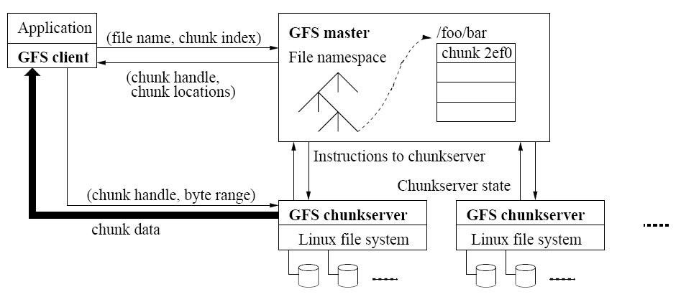
File Systems
Storage Stack
Local File Systems Structures
Log-structured file system
Journaling and soft updates
Google File System

Slide 16
4. Fault Tolerance
  How can events be ordered in a distributed system lacking a shared clock?
  How can this ordering give rise to a form of virtual time?
  What are basic approaches to recovery from failure?
  What is the taxonomy of strategies of “backward” recovery?
  How can the state of system be captured so that it can be recovered in the event of failure?
  How can distributed elements agree on commit to accepting a change in the system state?

Slide 17
Event Ordering
P₁
P₂
P₃
P
Q₁
Q₂
Q₃
Q
How can the events on P be related to the events on Q?
Which events of P “happened before” which events of Q?
When does it matter how we answer these questions?

Slide 18
Recovery
fault
causes
erroneous state
error
recovery
leads to
valid state
failure
An error is a manifestation of a fault that can lead to a failure.
Failure Recovery:
    backward recovery
      operation­based (do­undo­redo logs)
      state­based (checkpoints)
    forward recovery

