Slide 1
Concurrent Collections (CnC)
A programming model for
parallel programming

Slide 2
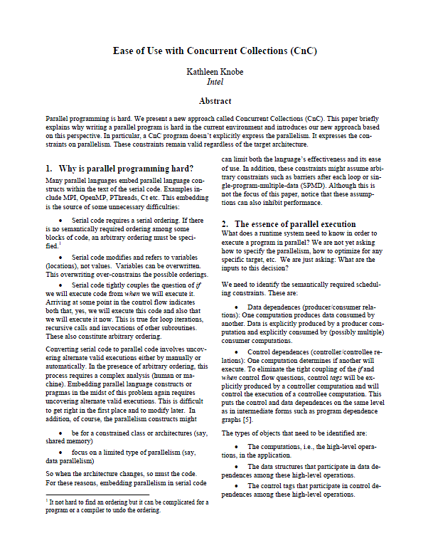


CnC
Kathleen Knobe
Intel

Slide 3
Overview
Ideas
  Separate if an operation is executed from when that operation is executed
    Focus on ordering constraints dictated by semantics of application
    Programming languages usually bind these together
      Overburdens development effort
      Limits implementation alternatives
  Dynamic single assignment
    Use write-once values rather than variables (locations)
    Avoids issues of synchronization, overwriting, etc.

Slide 4
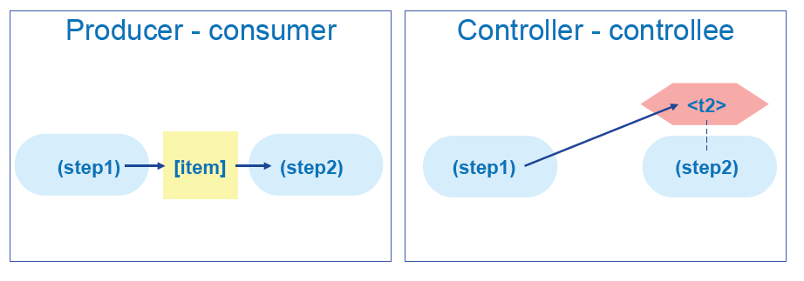
Overview
Representations
  Diagram (“whiteboard”) version and text formats
  Relationships between high level operations (steps)
    Data dependencies (producer-consumer relationship)
    Control dependencies (controller-controllee relationship)
  High level operations (steps)
    Purely functional
    Implemented in conventional programming language
Note: figure from presentation by Kathleen Knobe (Intel) and Vivek Sarkar (Rice)

Slide 5
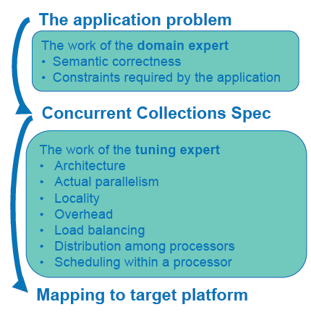
Overview
Advantages
  Allows roles and expertise of domain expert and tuning expert to be differentiated and combined by allowing each to focus on the aspects of the computation related to their expertise.
    Domain expert need not
    know about parallelism
    Tuning expert need not
    know about domain
Note: figure from presentation by Kathleen Knobe (Intel) and Vivek Sarkar (Rice)

Slide 6
Overview
Advantages (cont.)
  Avoids specifying/reasoning/deducing which operations can execute in parallel
    This is difficult to do
    Depends on architecture
  Allows run-time support to be tailored for different architectures
  Creates portability across different architectures

Slide 7
Basic Structures
Element | CnC name | Graphical form | Textual form
computation | step |  | (foo)
data | item |  | [x]
control | tag |  | <T>
environment |  |  | env
foo
x
T

Slide 8
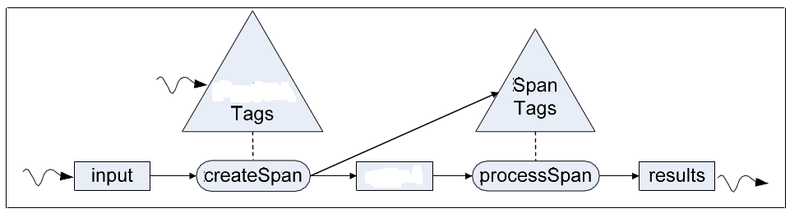
Simple Example
Produce odd length sequences of consecutive identical characters
string
span
“aaa”
“aaa”
“aaaffqqqmmmmmmm”
“ff”
“qqq”
“qqq”
“mmmmmmm”
“mmmmmmm”

Slide 9
Relations
prescriptive
string
span
producer
consumer

Slide 10
Item Collections
Multiple item instances correspond to different values of the item kind
Each instance is distinguished by a user-defined instance tag
string
span
[“aaa” :1,1]
[“aaa” :1,1]
[“ff” : 1,2]
[“qqq” : 1,3]
[“aaaffqqqmmmmmmm” : 1]
[“qqq” : 1,3]
[“mmmmmmm” : 1,4]
[“mmmmmmm” : 1,4]
input
results
span

Slide 11
Step Collections
Multiple steps instances correspond to different instantiations of the code implementing the step
Each instance is distinguished by a user-defined instance tag
string
span
processSpan
(processSpan :1,1)
(createSpan : 1)
(processSpan : 1,2)
(processSpan : 1,3)
createSpan
(processSpan : 1,4)

Slide 12
Tag Collections
Tag collections are sets of tags of the same type/structure as the step with which they are associated
spanTags
stringTags
<1,1>
<1,2>
<1,3>
<1>
<1,4>
string
span

Slide 13
Execution Semantics
A step instance with a given tag will execute when
a matching tag instance is present, and
the step instances matching inputs are
available
spanTags
<1,3>
[“qqq” : 1,3]
(processSpan : 1,3)
span
processSpan

Slide 14
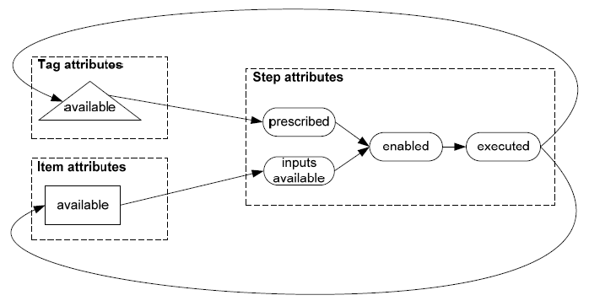
Semantics
When (S : t1) executes, if it produces [I, t2], then [I, t2] becomes available.
When (S : t1) executes, if it produces <T: t2>, then <T, t2> becomes available.
If <T> prescribes (S), when <T : t> is available then (S : t) becomes prescribed.
If forall {I, t1] such that (S: t2) gets [I, t1]
[I,t1] is available // if all inputs of (S: t2) are available
then (S: t2) is inputs-available.
If (S: t) is both inputs-available and prescribed then is its enabled.
Any enabled step is ready to execute.

Slide 15
Semantics
Execution frontier: the set of instances that have any attributes and are not dead.
Program termination: no step is currently executing and no unexecuted step is currently enabled.
Valid program termination: a program terminates and all prescribed steps have executed.
Instances that are dead may be garbage collected.
Note: parallel execution is possible but not mandated; thus testing/debugging on a sequential machine is possible.

Slide 16
Sources of Parallelism
string
span
[“aaa” :1,1]
(processSpan :1,1)
[“aaaffqqqmmmmmmm” : 1]
[“bbbxxxxxxffxxxxxyy” : 2]
[“ff” : 1,2]
[“qqq” : 1,3]
(processSpan :1,3)
[“mmmmmmm” : 1,4]
(processSpan :2,2)
input
[“bbb” : 2,1]
(processSpan : 2,3)
[“xxxxxx” : 2, 2]
[“ff” : 2,3]
(createSpan : 2)
span
executing

Slide 17
Textual Representation
string
span
<stringTags: int stringID>;
<spanTags: int stringID, int spanID>;
[input: int stringID];
[span: int stringID, int spanID];
[results: int stringID, int spanID];
env -> [input], <stringTags>;
[results], <spanTags> -> env;

Slide 18
Textual Representation
string
span
<stringTags> :: (createSpan);
<spanTags> :: (processSpan);
[input: stringID] -> (createSpan: stringID);
(createSpan: stringID) -> <spanTags: stringID, spanID>;
(createSpan: stringID) -> [span: stringID, spanID];
[span: stringID, spanID] -> (processSpan: stringID, spanID);
(processSpan: stringID, spanID) -> [results: stringID, spanID];

Slide 19
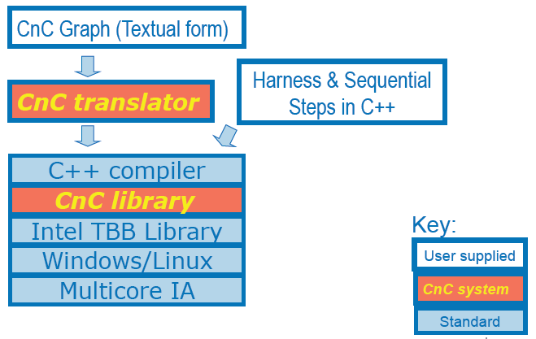
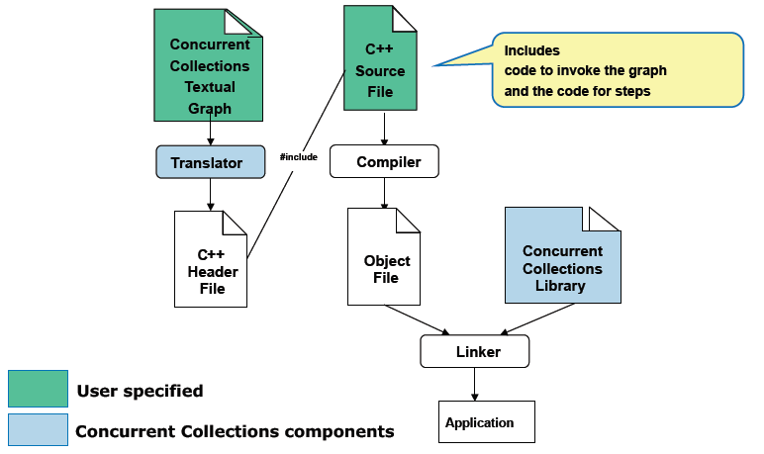
Mechanics
Note: graphics from Kathleen Knobe (Intel), Vivek Sarkar (Rice), PLDI Tuturial, 2009

Slide 20
A coded step
int createSpan::execute(const int & t, partStr_context & c) const
{ string in;
c.input.get(t, in);
if(! in.empty()) {
char ch – in[0];
int len = 0;
unsigned int i=0;
unsigned int j = 0;
while (i < in.length()) {
if (in[j] == ch) {
i++; len++;
} else {
c.span.put(t, j, in.substr(j, len));
c.spanTags.put (t,j);
ch = in[i];
len = 0; j = i;
}
}
c.span.put(t, j, in.substr(j.len);
c.spanTags,put(t, j);
}
return CnC::CNC_Success;
}

Slide 21
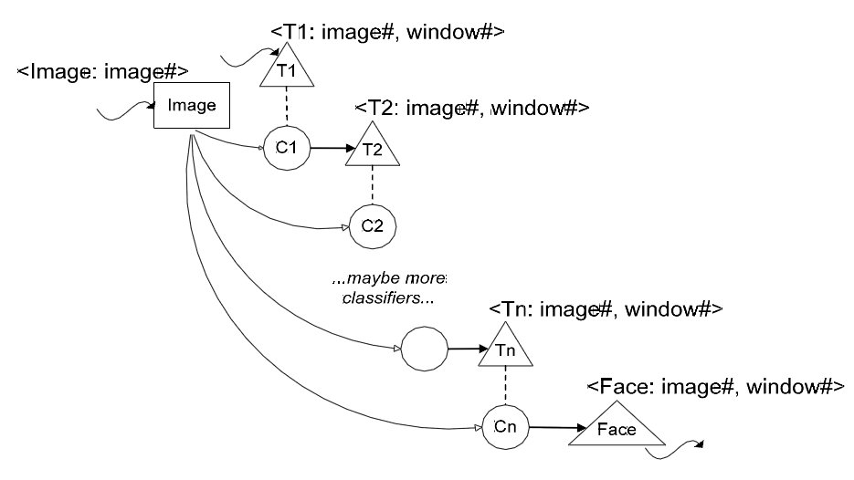
Another Example

Slide 22
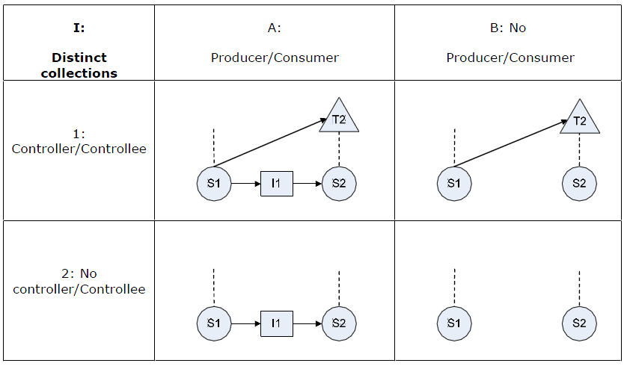
Patterns – steps in different collections

Slide 23
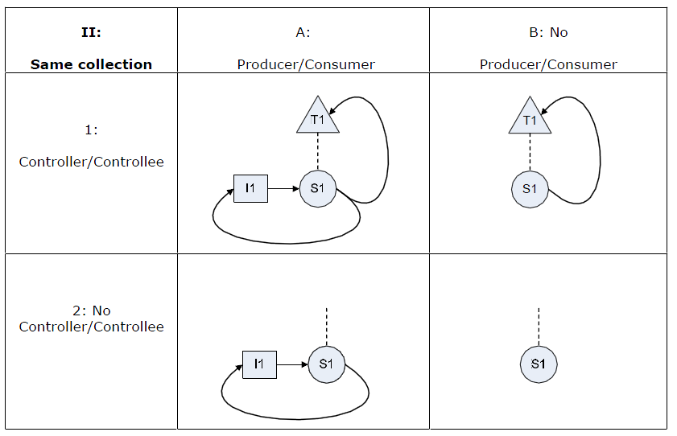
Patterns – steps in same collection

Slide 24
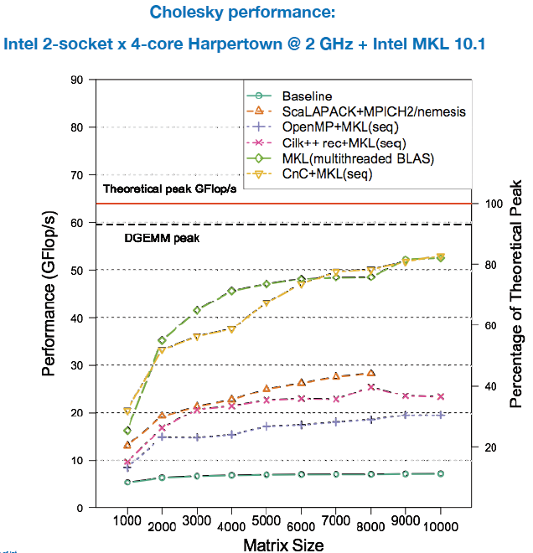
Performance
Acknowledgements: Aparna Chandramolishwaran, Rich Vuduc (Georgia Tech)

Slide 25
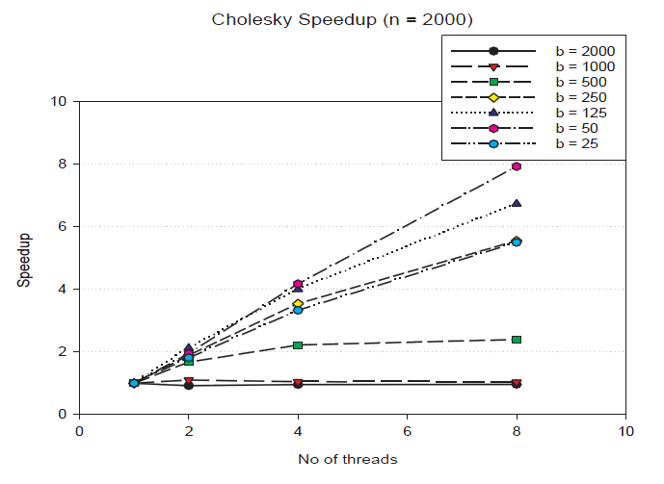
Performance
TBB implementation, 8-way Intel dual Xeon Harpertown SMP system.

Slide 26
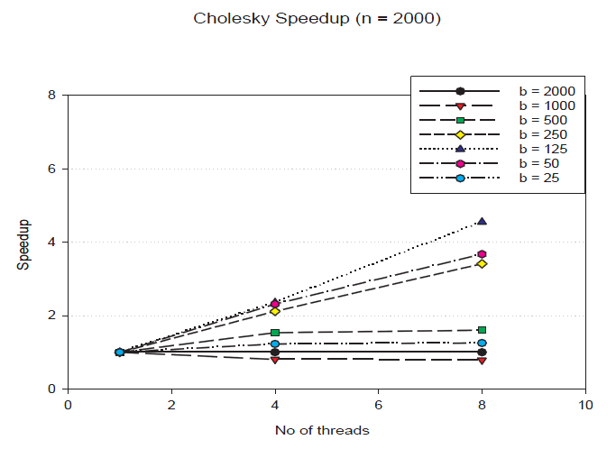
Performance
Habenero-Java implementation, 8-way Intel dual Xeon Harpertown SMP system.

Slide 27
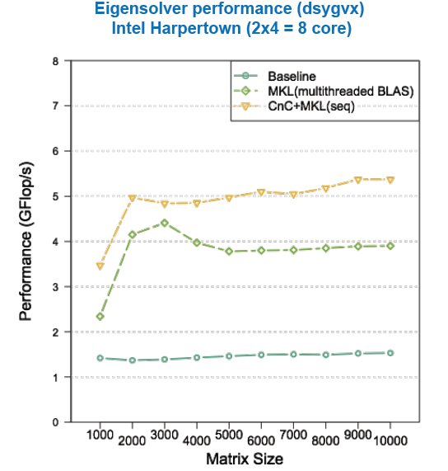
Performance
Acknowledgements: Aparna Chandramolishwaran, Rich Vuduc (Georgia Tech)

Slide 28
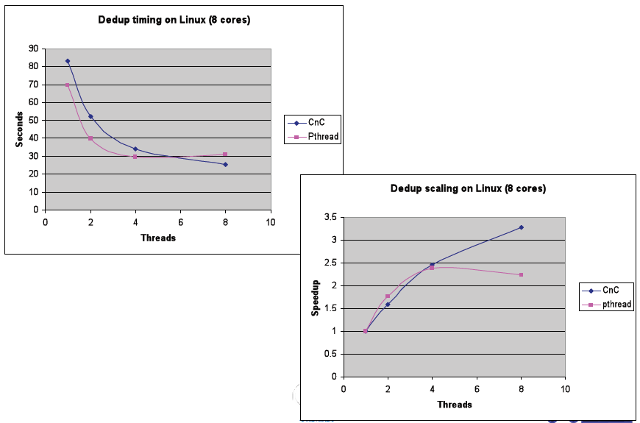
Performance
Input stream compression using “deduplication”

Slide 29
Memory management
Problem
  the lifetime of a produced (data) item is not clear
  the (data) item may be used by multiple steps
  some step using a (data) item may not exist yet
  Serious problem for long-running computations
Solution
  Declarative annotations (slicing annotations) added to step implementations
  Indicates which (data) items will be read by the step
  Converted into reference counting procedures

Slide 30
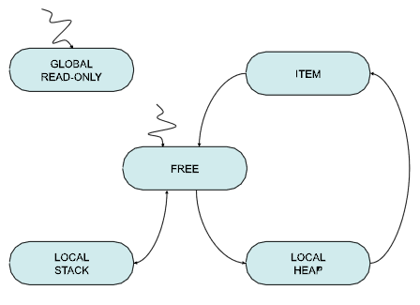
Memory states
5 memory states
Note: no transition from FREE to ITEM
Assumes step implementation manages local stack and local heap correctly

Slide 31
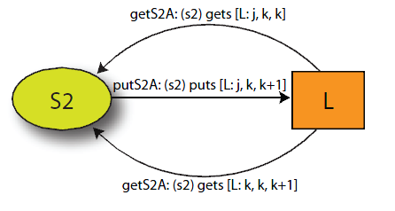
Annotations
General form:
(S: I) is in readers( [C: T]), constraints(I,T)

Slide 32
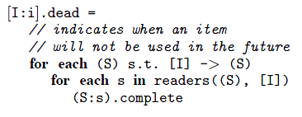
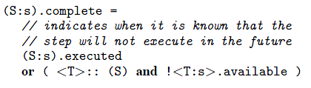
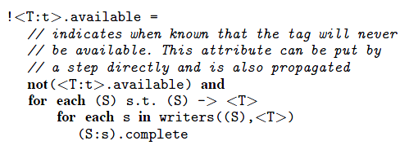
Conditions for removing an item

Slide 33
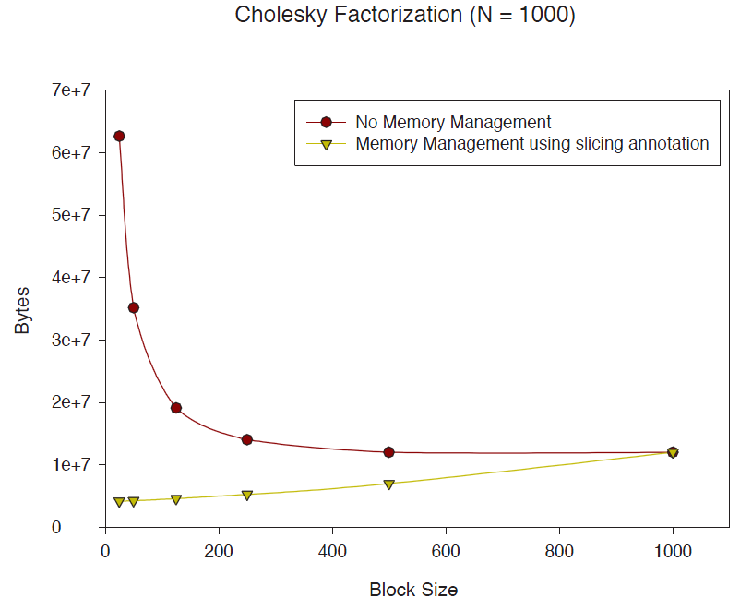
Performance
Memory usage did not vary with number of cores
Optimal (running time) tile size was 125 (for above case)
Memory savings a factor of 7
In other cases, memory savings a factor of 14

