Slide 1
Concurrency Issues
Motivation, Problems, Directions

Slide 2
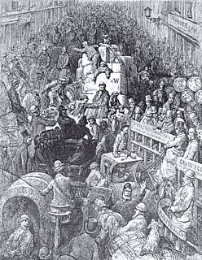
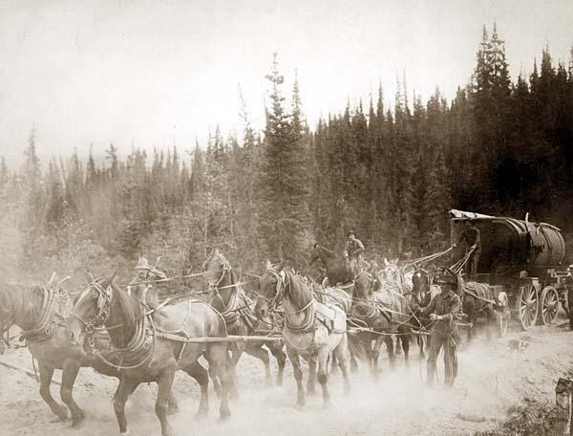
Reasons for Concurrency
coordination
parallelism
multitasking
performance

Slide 3
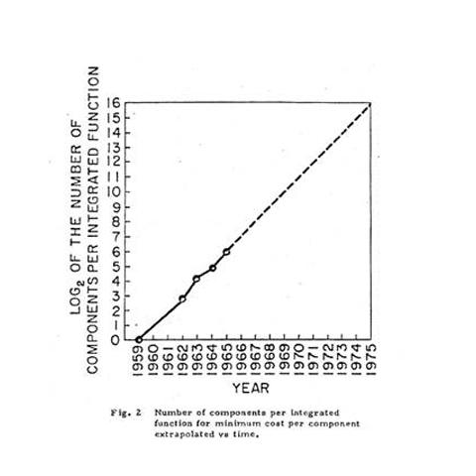
Moore’s Law
“Transistor density on integrated circuits doubles about every two years.”
Gordon E. Moore,
Co-founder,
Intel Corporation.

Slide 4
Hitting the wall…

Slide 5
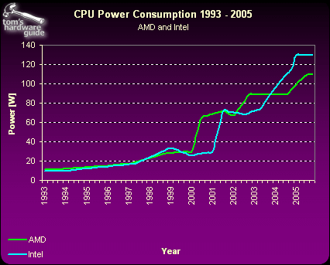
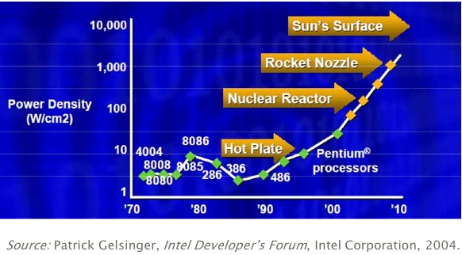
Thermal Density
1993 (CPU and cooler)
2005 (cooler along)

Slide 6
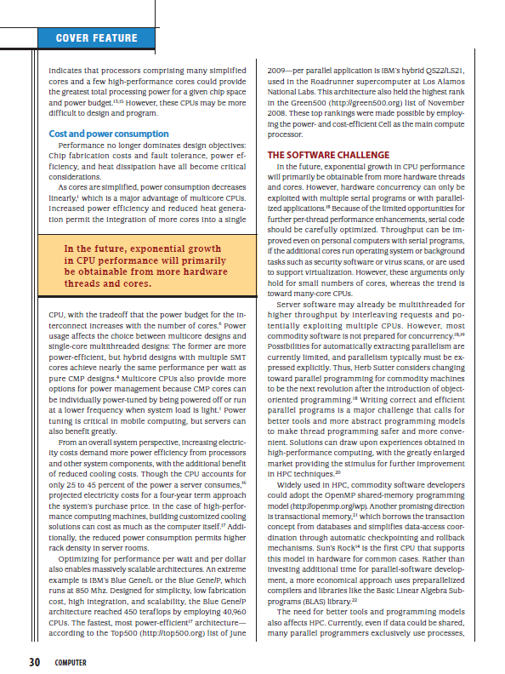
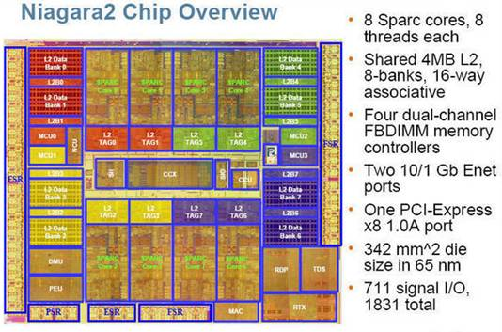
Rise of Multi-/Many- Core Technologies
Intel: Quad Core
Intel: 80 core experimental system
Sun: 8 core chip

Slide 7
Context
Support for concurrent and parallel programming
conform to application semantics
respect priorities of applications
no unnecessary blocking
fast context switch
high processor utilization
functionality
concurrent
parallel
performance
relative importance

Slide 8
“Heavyweight” Process Model
. . .
user
kernel
simple, uni-threaded model
security provided by address space boundaries
high cost for context switch
coarse granularity limits degree of concurrency

Slide 9
“Lightweight” (User-level) Threads
. . .
user
kernel
thread semantics defined by application
fast context switch time (within an order of magnitude of procedure call time)
system scheduler unaware of user thread priorities
unnecessary blocking (I/O, page faults, etc.)
processor under-utilization

Slide 10
Kernel-level Threads
. . .
user
kernel
thread semantics defined by system
overhead incurred due to overly general implementation and cost of kernel traps for thread operations
context switch time better than process switch time by an order of magnitude, but an order of magnitude worse than user-level threads
system scheduler unaware of user thread state (e.g, in a critical region) leading to blocking and lower processor utilization

Slide 11
Threads are Bad
Difficult to program
Synchronizing access to shared state
Deadlock
Hard to debug (race conditions, repeatability)
Break abstractions
Modules must be designed “thread safe”
Difficult to achieve good performance
simple locking lowers concurrency
context switching costs
OS support inconsistent
semantics and tools vary across platforms/systems
May not be right model
Window events do not map to threads but to events

Slide 12
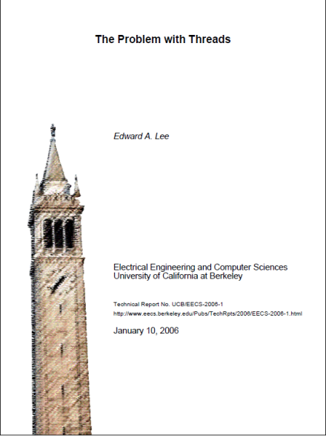
Lee’s Crticisms of Threads
Threads are not composable
Inteference via shared resources
Difficult to reason about threads
Everything can change between steps
Threads are “wildly nondeterministic”
Requires careful “pruning” by programmer
In practice, difficult to program correctly
Experience and examples

Slide 13
Ousterhout’s conclusions

Slide 14
Concurrency Errors in Practice
Characterization study
Four large, mature, open-source systems
105 randomly selected currency errors
Examined bug report, code, corrections
Classified bug patterns, manifestation, fix strategy

Slide 15
Concurrency Error Patterns
Finding (1): Most (72 out of 74) of the examined non-deadlock concurrency bugs are covered by two simple patters: atomicity-violation and order-violation.
A
B
atomicity-violation: interference with a sequence of steps intended to be performed as a unit
order-violation: failure to perform steps in the intended order

Slide 16
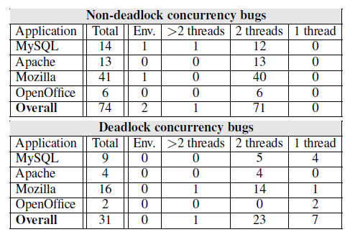
Concurrency Bug Manifestations
Finding (3): The manifestation of most (101 out of 105) examined concurrency bugs involves no more than two threads.
Other findings: most (66%) non-deadlock concurrency bugs involved only one variable and most (97%) of deadlock concurrency bugs involves at most two resources..

Slide 17
Concurrency Bug Fix Strategies
Finding (9): Adding or changing locks is not the major fix strategy.
COND: Condition check Switch: Code switch
Design: algorithm change Lock: add or change lock
Another finding: transactional memory (TM) can help avoid many (41 or 105) concurrency bugs.

Slide 18
Solutions to thread problems
New models of concurrent computation
MapReduce
Large-scale data
Highly distributed, massively parallel environment
Concurrent Collections (CnC)
General concurrent programming vehicle
Multicore architectures
Thread-per-process models
Communicating Sequential Processes
Grace
Sammati

