Slide 1
Checkpointing-Recovery

Slide 2
Fault Tolerance
fault
causes
erroneous state
error
recovery
leads to
valid state
failure
An error is a manifestation of a fault that can lead to a failure.
Failure Recovery:
    backward recovery
      operation­based (do­undo­redo logs)
      state­based (checkpointing/logging)
    forward recovery

Slide 3
System Model
Basic approaches
  checkpointing : copying/restoring the state of a process
  logging : recording/replaying messages

Slide 4
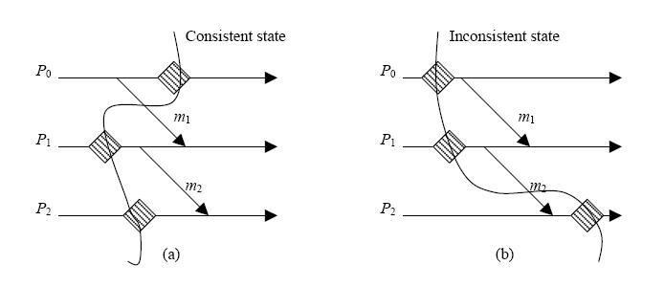
Orphan Message
x₁
X
y₁
m
Y

Slide 5
Lost Messages
x₁
X
m
y₁
Y
Regenerating lost messages on recovery:
  if implemented on unreliable communication channels, the application is
  responsible
  if impelmented on reliable communication channels, the recovery
  algorithm is responsible

Slide 6
Domino Effect
x₁
x₂
x₃
X
y₁
y₂
m
Y
z₁
z₂
n
Z
Cases:
  X fails after x₃
  Y fails after sending message m
  Z fails after sending message n

Slide 7
Other Issues
Output commit
  the state from which messages are sent to the “outside world” can be recovered
  affects latency of message delivery to “outside world” and overhead of checkpoint/logging
Stable storage
  survives process failures
  contains checkpoint/logging information
Garbage collection
  removal of checkpoints/logs no longer needed

Slide 8
Logging Protocols
Elements
  Piecewise deterministic (PWD) assumption – the system state can be
  recovered by replaying message receptions
  Determinant – record of information needed to recover receipt of message
Determinants for m₅ and m₆ not logged

Slide 9
Taxonomy
Rollback-Recovery
checkpointing
logging
uncoordinated
coordinated
communication-induced
pessimistic
optimistic
causal
blocking
non-blocking
model-based
index-based

Slide 10
Uncoordinated Checkpointing
Rollback-Recovery
checkpointing
susceptible to domino effect
can generate useless checkpoints
complicates storage/GC
not suitable for frequent output commits
uncoordinated

Slide 11
Cordinated/Blocking Protocols
Rollback-Recovery
checkpointing
x₂
x₁
X
y₁
y₂
m
Y
coordinated
z₁
z₂
Z
blocking
no messages can be in transit during checkpointing
{x₁, y₁, z₁} forms “recovery line”

Slide 12
Coordinated/Blocking Notation
Each node maintains:
a monotonically increasing counter with which each message from that node is labeled.
records of the last message from/to and the first message to all other nodes.
last_label_rcvd_{X}[Y]
last_label_sent_{X}[Y]
X
m.l (a message m and its label l)
Y
first_label_sent_{Y}[X]
Note: “sl” denotes a “smallest label” that is < any other label and
“ll” denotes a “largest label” that is > any other label

Slide 13
Coordinated/Blocking Algorithm
(1) When must I take a checkpoint?
(2) Who else has to take a checkpoint when I do?
x₁
x₂
tentative checkpoint
X
y₁
m
y₂
Y
z₁
z₂
Z
(1) When I (Y) have sent a message to the checkpointing process, X, since my last
checkpoint:
last_label_rcvd_{X}[Y] >= first_label_sent_{Y}[X] > sl
(2) Any other process from whom I have received messages since my last checkpoint.
ckpt_cohort_{X} = {Y | last_label_rcvd_{X}[Y] > sl}

Slide 14
Coordinated/Blocking Algorithm
(1) When must I rollback?
(2) Who else might have to rollback when I do?
x₁
x₂
X
y₁
y₂
Y
z₁
z₂
Z
(1) When I ,Y, have received a message from the restarting process,X,
since X's last checkpoint.
    last_label_rcvd_{Y}(X) > last_label_sent_{X}(Y)
(2) Any other process to whom I can send messages.
roll_cohort _{Y} = {Z | Y can send message to Z}

Slide 15
Taxonomy
Rollback-Recovery
checkpointing
Approach:
  “tag” message to trigger checkpointing
Example:
  global-state recording algorithm
coordinated
non-blocking

Slide 16
Communication-Induced Checkpointing
Rollback-Recovery
checkpointing
communication-induced
Z-path:[m₁,m₂] and [m₃,m₄]
Z-cycle: [m₃,m₄,m₅]
Checkpoints (like c_{2,2}) in a z-cycle are useless
Cause checkpoints to be taken to avoid z-cycles

Slide 17
Logging
Rollback-Recovery
Orphan process: a non-failed process whose state depends on a non-deterministic event that cannot be reproduced during recovery.
Determinant: the information need to “replay” the occurrence of a non-deterministic event (e.g., message reception).
logging
pessimistic
optimistic
causal
Avoid orphan processes by guaranteeing:
  For all e : not Stable(e) => Depend(e) < Log(e)
where: Depend(e) – set of processes affected by event e
  Log(e) – set of processes with e logged on volatile memory
  Stable(e) – set of processes with e logged on stable storage

Slide 18
Pessimistic Logging
Determinant is logged to stable storage before message is delivered
Disadvantage: performance penalty for synchronous logging
Advantages:
  immediate output commit
  restart from most recent checkpoint
  recovery limited to failed process(es)
  simple garbage collection

Slide 19
Optimistic Logging
determinants are logged asynchronously to stable storage
consider: P₂ fails before m₅ is logged
advantage: better performance in failure-free execution
disadvantages:
  coordination required on output commit
  more complex garbage collection

Slide 20
Causal logging
combines advantages of optimistic and pessimistic logging
based on the set of events that causally precede the state of a process
guarantees determinants of all causally preceding events are logged to stable storage or are available locally at non-failed process
non-failed process “guides” recovery of failed processes
piggybacks on each message information about causally preceding messages
reduce cost of piggybacked information by send only difference between current information and information on last message

