Slide 1
Authorization
Security Policy Assertion Language

Slide 2
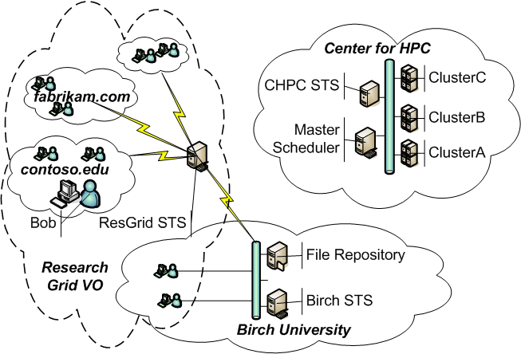
The Grid
Resources and user belong to a variety of different independent organizations
Resources and users are connected via communication networks
A virtual organization (VO) is a set of independent collaborating (real) organizations who establish a trust relationship for the purpose of sharing resources and skills to achieve a common objective

Slide 3
The Problems
users are identified by their (local) organization and are unknown to other organizations in the VO
resources are controlled by policies defined by their controlling organizations
a user may want to combine the use of resources from different organizations for which the user has been separately authorized

Slide 4
The Goals
Describe explicit trust relationships
Express security token issuance policies
Provide security tokens that contain identities, capabilities, and/or delegation policies
Express resource authorization and delegation policies

Slide 5
Elements
Security tokens - digitally signed statements relevant to the authorization process (e.g., identities, capabilities, delegations)
Security Token Server (STS) – a server that issues security tokens on behalf of a security principal
Security Principal –
  an entity capable of issuing authoritative statements (may be a person, organization, or service)
  identified by a cryptographic key (e.g. K-ResGrid is the public key for the principal ResGrid)
Assertion – a statement that a security principal believes to be valid possibly depending on other facts and constraints
A says fact if fact₁,…,fact_{n},c
issuer
conditional facts
constraint

Slide 6
Types of Assertions
Attribute
  Expressing a binding between a principal and one or more attributes
    STS says Alice is a researcher
Capability
  Expressing the right of a principal to exercise one or more actions on a resource
    FileServer says Alice can read /project
Delegation
  Expressing the granting of a capability possessed by one principal to a second principal
    Alice says Cluster can read /project/data
    If currentTime() <= 07/09/2006
Trust
  Expressing the willingness of one principal to believe certain types of assertions made by a second principal
    Cluster says STS can say x is a researcher
    FileSys says Univ can say x can say y can read /project

Slide 7
Variables
An assertion may contain variables (see previous examples).
Variables
  are strongly typed
  can be unrestricted (bind to any concrete value of the correct type)
  can be restricted to a subset of concrete values based on a specific pattern
A phrase is “ground” when it has no variables
Examples
  Cluster says x can execute dbgrep if x is a researcher
  FileServer says x can say y can read file if
  x can read dir, file in dir, markedConfidential(file)=no
  (The later is a constrained delegation rule)

Slide 8
Constraints, Flat
Constraints
  Equality and inequality
  Path constraints (hierarchical resources like file systems)
  Regular expressions (patterns)
Flat
  A fact is “flat” if it does not include “can say” and nested otherwise
  “Bob can read f” is flat
  “Charlie can say Bob can read f” is nested

Slide 9
Patterns
Pattern | Matches
^ | beginning of line
$ | end of line
. | any single character
[ … ] | any character in …
x-y | any character in the range x to y
x+ | one or more occurrences of x
(x?) | character x if it occurs
\ | escape
\w | single character in a-zA-Z0-9
character | itself
The SecPAL prototype uses the pattern-matching symbols shown in the table
Examples:
K-CHPC says K-ResGrid can say x possess rfc822Name=^[-_a-zA-Z0-9]+@[-_a-zA-Z0-9]+$
K-CHPC says K-Birch can say x possess serviceName=^http(s?):\w+\.birch\.edu/\w$

Slide 10
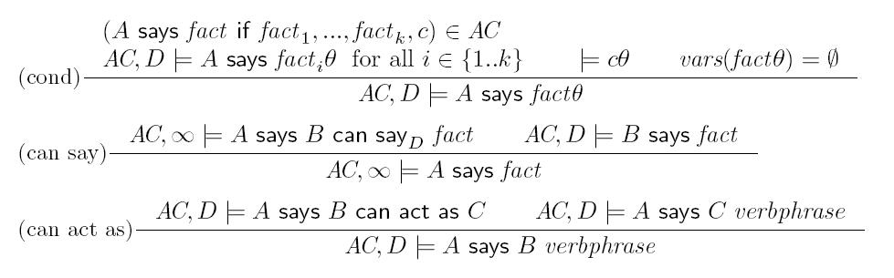
Deduction Rules
AC is the assertion context
D is the delegation flag (0=no delegation, infinity is unbounded delegation)
θ is a binding of variables to constants and variables
vars(f) is the set of free variables in f

Slide 11
Using the deduction rules
Assertions:
  STS says Alice is a researcher (1)
  Cluster says STS can say x is a researcher (2)
  Cluster says x can execute dbgrep if x is a researcher (3)
Proof of “Cluster says Alice can execute dbgrep”:
  Cluster says STS can say x is a researcher (2)
  STS says Alice is a researcher (1)
  Cluster says Alice is a researcher (can say)(4)
  Cluster says x can execute dbgrep if x is a researcher (3)
  Cluster says Alice is a researcher (4)
  Cluster says Alice can execute dbgrep (cond) (5)

Slide 12
Authorization Queries
environment (e.g., current time)
authorization query
Decision
Point
authorization decision
(returns bindings satisfying query)
assertion context
tokens
assertions
policies
Authorization query:
  K-ResGrid says x possess rfc822Name=e
Authorization decision:
  K-ResGrid says K-Bob posess rfc822Name=bob@contoso.edu

Slide 13
Authorization Query Table
Provided by a local assertion context
Maps parameterized operation names to predefined queries
Resource guard invokes parameterized operation
Example (containing deny-overrides):
    check-access-permission(x):
    FileServer says x has access from t₁ till t₂
    t₁ <= currentTime() <= t₂,
    not exists t₃,t₄ (
    FileServer says x has no access from t₃ till t₄,
    t₃ <= currentTime() <= t₄)

Slide 14
Policy Idioms
Mandatory Access Control (MAC)
FileServer says x can read f if
x is a user, f is a file, level(x) >= level(f)
FileServer says x can write f if
x is a user, f is a file, level(x) <= level(f)
Roles
NHS says FoundationTrainee can read /docs/
NHS says SpecialistTrainee can act as FoundationTrainee
NHS says SeniorMD can act as SpecialistTrainee
NHS says Alice can act as SeniorMD

Slide 15
Policy Idioms
Attribute-based delegation: assigns permissions based on attributes rather than identity
Example:
Shop says x is entitled to discount if
x is a student till date,
currentTime() <= date, currentDay() = Friday
Shop says univ can say x is a student till date if
univ is a university,
Shop says CommonwealthOfVirginia can say
univ is a university

Slide 16
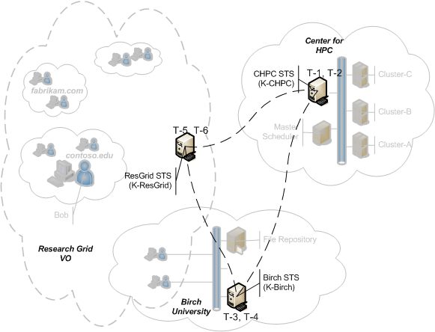
Federated Trust
pattern denotes a pattern
Trust Policies
T-1: K-CHPC says K-ResGrid can say x possess rfc822Name=name, groupName=ResGrid/group
T-2: K-CHPC says K-Birch can say x possess serviceName=http(s?)://server.birch.edu/service
T-3: K-Birch says K-ResGrid can say x possess rfc822Name=name, groupName=ResGrid/group
T-4: K-Birch says K-CHPC can say x possess appName=app,dnsName=name.chpc.com
T-5: K-ResGrid says K-Birch can say x possess serviceName=http(s?)://service.birch.edu
T-6: K-ResGrid says K-CHPC can say x possess serviceName=http(s?)://server.c-hpc.com/service

Slide 17
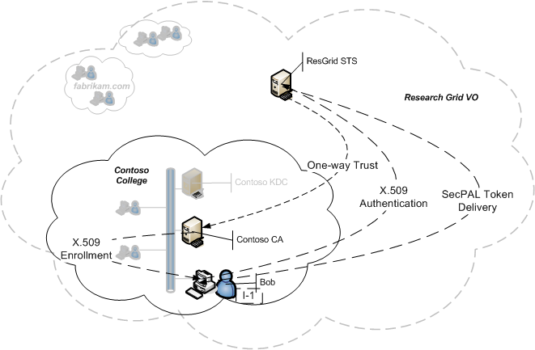
Identity Token Acquisition
Steps
1. Bob receives X.509 identity certificate
from Contoso CA
2. ResGrid trusts Contoso CA to issue
X.509 identity certificates
3. Bob passes certificate to ResGrid STS
4. ResGrid STS issues SecPAL token
Assertions
ResGrid STS trust policy: K-ResGrid says K-Contoso can say x possess rfc822Name=name@contoso.edu
ResGrid from X.509 cert.: K-Contoso says K-Bob possess rfc822Name=bob@contoso.edu
ResGrid evaluates/issues: K-ResGrid says K-Bob possess rfc822Name=bob@contoso.edu

