Slide 1
Protection and Security
An overview of basic principles

Slide 2
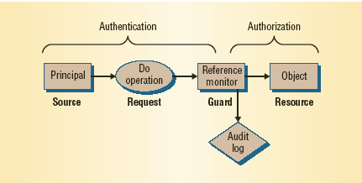
Protection and Security
Issues:
  authentication: verifying a claim of identity
  authorization: verifying a claim of permission
  audit: verifying the (non)occurrence of previous
  actions
Authentication
Authorization
Audit
(Au = gold)
aka: AAA
Reference Monitor Model
From: “Computer Security in the Real World”, Lampson, 2004.

Slide 3
Security Goals and Principles
Goals:
  integrity - modification only by authorized parties
  confidentiality - access only by authorized parties
  non-repudiation - inability to disclaim authorship
  authenticity - verifiability of source
  availability - continuous access by authorized parties
Principles:
  least privilege - minimization of rights
  separation of duties (by task, by person)
  economy of mechanism - simplest means of enforcement
  acceptability – adoptable/usable by user community
  complete mediation - universal enforcement of control
  open design - secrecy of enforcement mechanisms is not important

Slide 4
Elements of a Secure System
Specification/Policy
  secrecy
  integrity
  availability
  accountability
Implementation/Mechanism
  isolation (impractical)
  exclusion (code signing, firewalls)
  restriction (sandboxing)
  recovery
  punishment
Correctness/Assurance
  trusted computing base
  defense in depth
  usability
  theory
From: “Computer Security in the Real World”, Lampson, 2004.

Slide 5
Access Matrix
Access Matrix Model
Objects
o
s
Subjects
P[s,o]

Slide 6
Access Matrix
objects
subjects

Slide 7
Manipulating the Access Matrix

Slide 8
Capability Lists
O₁
O₂
O₃
s₁
r₁
r₂
s₂
r₃
r₄
s₃
r₅
grouped by subject
s₁
(r₁, O₁)
(r₂, O₃)
s₂
(r₃, O₂)
(r₄, O₃)
s₃
(r₅, O₁)
Capability Lists

Slide 9
Access Control Lists
O₁
O₂
O₃
s₁
r₁
r₂
s₂
r₃
r₄
s₃
r₅
Grouped by object
O₁
O₂
O₃
(s₁, r₁)
(s₂, r₃)
(s₁, r₂)
(s₃, r₅)
(s₂, r₄)
Access Control Lists

Slide 10
Role-Based Access Control (RBAC)
O₁
O₂
O₃
s₁
r₁
r₂
s₂
r₂
r₁
s₃
r₃
r₄
s₄
r₃
r₄
s₅
r₃
r₄
grouped by multiple subjects
s₁
Role₁
Role₁
(r₁,O₁)
(r₂,O₂)
Role
assignment
s₂
Role₁
s₃
Role₂
Role₂
(r₃,O₂)
(r₄,O₃)
s₄
Role₂
s₅
Role₂
Privilege assignment

Slide 11
Role-Based Access Control (RBAC)
Roles model particular jobs or duties in an organization
Single user may play multiple roles at the same or different times
Multiple users may play the same role at the same or different times
The user-role assignment may be made separately from the role-permission assignment

Slide 12
Classes, Levels, Domains
O₁
O₂
O₃
O₄
O₅
s₁
r₁
r₁
r₁
s₂
r₁
r₃
r₁
s₃
r₂
r₂
r₃
r₃
Grouped by multiple objects
O₁ & O₂
O₃ & O₅
O₄
(s₁, r₁)
(s₂, r₁)
(s₁, r₁)
classes, levels, domains
(s₃, r₂)
(s₃, r₃)
(s₂, r₃)

Slide 13
Bell­LaPadula Model
classification
clearance
level n
w
i
r,w
level i
r
objects
subject
level 1
*-property

Slide 14
Lock and Key Method
subjects possess
a set of keys:
Key
Key
(O, k)
Lock
(k, {r ₁ , r ₂ ,...})
objects are associated
with a set of locks

Slide 15
Comparison of methods
Capability list
Access Control List
Locks & Keys
propagation
1
3
1
review
4
revocation
4
reclamation
2
1. need copy bit/count for control
2. need reference count
3. need user/hierarchical control
4. need to know subject­key mapping

Slide 16
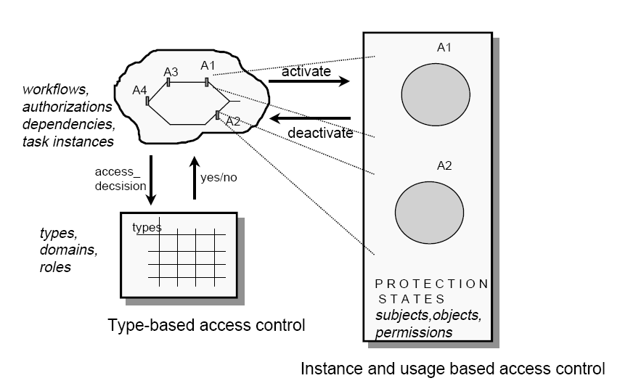
Task-based Access Control (TBAC)
R.K. Thomas and R.S. Sandhu, “Task-based Authorization Controls (TBAC): A Family of Model for Active and Enterprise-oriented Authorization Management.”

Slide 17
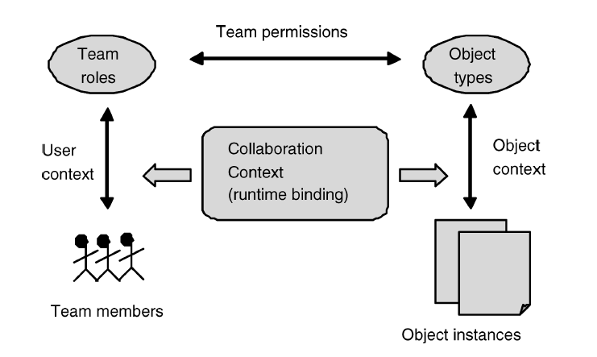
Team-based Access Control
W. Tolone, G. Ahn, T. Pai, “Access Control in Collaborative Systems.”

