Slide 1
Automatic Trust Negotiation

Slide 2
Motivation
Two remote interacting parties will disclosure information to each other only when each has established an appropriate level of trust in the other.
Elements
  Remote peers
    Requester (of a controlled resource)
    Controller (of a requested resource)
  Sensitive Information
    data/services requested by remote peer
    certificates
      credentials: issued by trusted third party (e.g, affiliation)
      declarations: attributes describing peer (e.g., preferences)
  Negotiation
    bilateral, incremental exchange leading to an authorization decision
  Policies
    drives exchange sequence
    establish requirements for the disclosure of resources
    alternative policies may exist for the same resource

Slide 3

Negotiation Overview
Requestor
Controller
Resource request
Policy Base
Policy Base
Policies
Policies
Subject Profile
Credentials
Subject Profile
Credentials
Resource granted
Slide modified from: http://www.ccs.neu.edu/home/ahchan/wsl/symposium/bertino.ppt

Slide 4
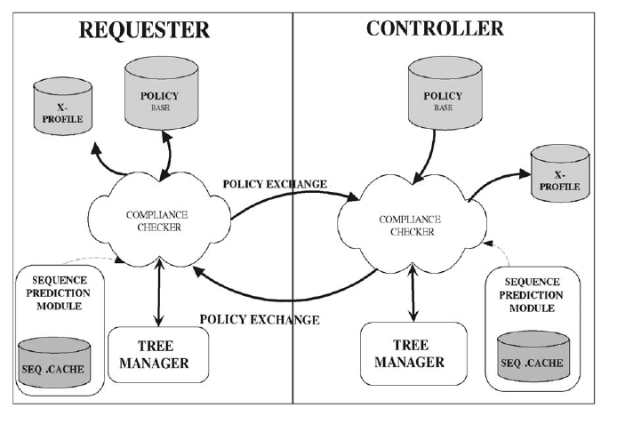
Trust-X Framework
disclosure policies
certificates
negotiation
engine
recorded similar
prior negotiations
negotiation state

Slide 5


Scenario
Employees of Corrier
request
Rental Car
Agency
A
request
Unknown
B
Policy
(A) Employees of Corrier must provide company badge and ID card
(B) Others must provide drivers license and credit card

Slide 6
Disclosure Policy
resource
precondition
rule
{ R ← DELIV }
terms
policy
{p₁,…p_{n}} ,
{ R ← τ₁, …, τ_{n}}
certificate:
P(C)
condition
If at least one precondition is met, R can be disclosed if the peer can satisfy the policy terms.
variable:
X(C)
attr op expr
pol₃ = ( {pol₂} , Rental_Car ← Credit_Card(name=Rental_Car.name,
Rental_Car.ReturnDate < ExpirationDate));

Slide 7
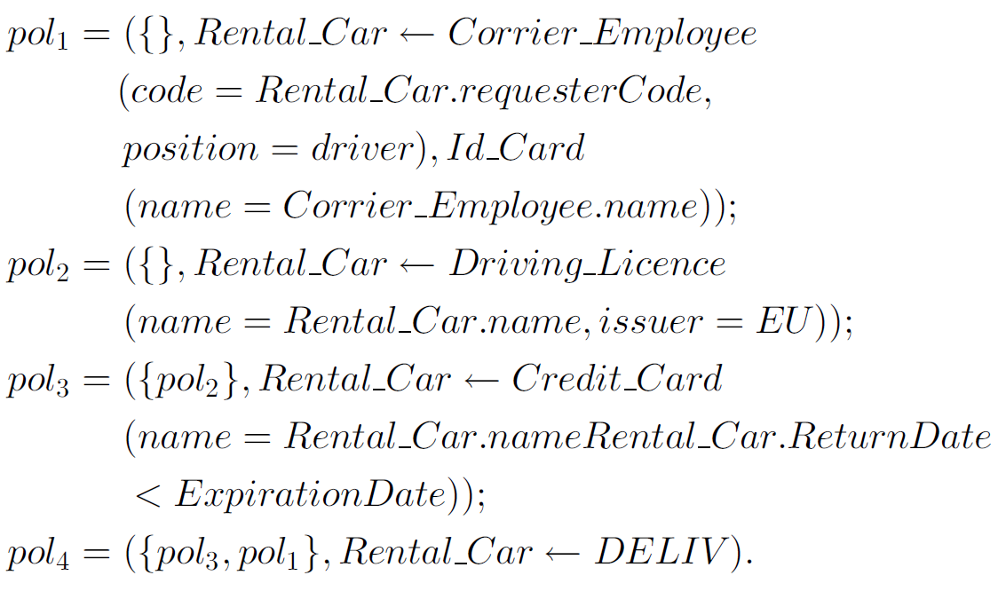
Policy for Scenario

Slide 8
Negotiation Process
Requestor
Controller
Service request
Preliminary
Information
exchange
INTRODUCTORY
PHASE
Qualifications/preferences
Disclosure policies
Bilateral
disclosure
of policies
POLICY
EVALUATION
PHASE
Disclosure policies
Credential and or/Declaration
Actual credential
disclosure
CERTIFICATE
EXCHANGE
Credential and/or Declaration
Service granted
RESOURCE
DISCLOSURE
Slide modified from: http://www.ccs.neu.edu/home/ahchan/wsl/symposium/bertino.ppt

Slide 9
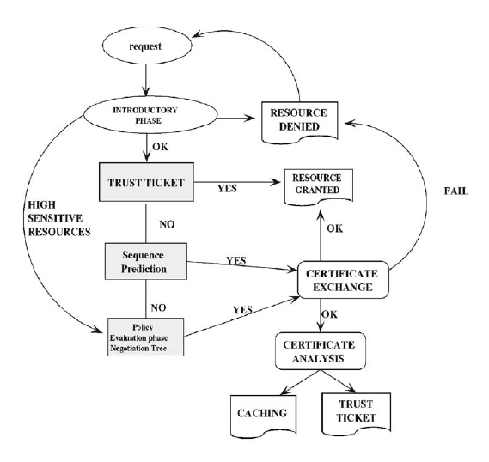
Negotiation Process
Sequence
generation
phase
Three ways to build trust:
  1. Trust tickets
  2. Sequence prediction
  3. Policy evaluation

Slide 10
1. Trust Ticket
Allows for expedited processing of repeat(ed) requests
Certifies that parties have already successfully completed a negotiation for a given resource
Issued by each party to the other at the end of a successful negotiation for access to that
Reused for subsequent request for that resource
Elements
  Sequence of certificates
  Validity time
  Signature of issuer

Slide 11
2. Sequence Generation
At the end of a successful negotiation for access to resource R, information about the sequence of peer credentials involved in the negotiation can be cached
In a subsequent negotiation for resource R, the cached sequence can be retrieved and tested for applicability
Useful in cases of repeated forms of negotiation with different parties

Slide 12
3. Policy Evaluation
Process
  Incremental exchange of policies driven by the resources each party requires of the other
  No credentials are exchanged during this phase
  Begins with initial request for access to resource
  Ends when
    One party determines it cannot satisfy the policies of the other, or
    Both parties believe/claim that they can each satisfy the other’s policies
Elements
  Negotiation tree – maintains the state of the negotiation
  Labels - determine subsequent credential exchange order
  Views
    path through the negotiation tree
    trust sequence: a view where all policies are satisfied

Slide 13
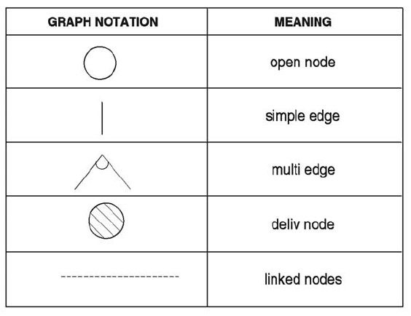
Negotiation Tree
owner: CN
owner: RQ
owner: CN
owner: RQ
node: <resource, state, owner>
state: open or DELIV
owner: RQ (requestor), CN (controller)

Slide 14
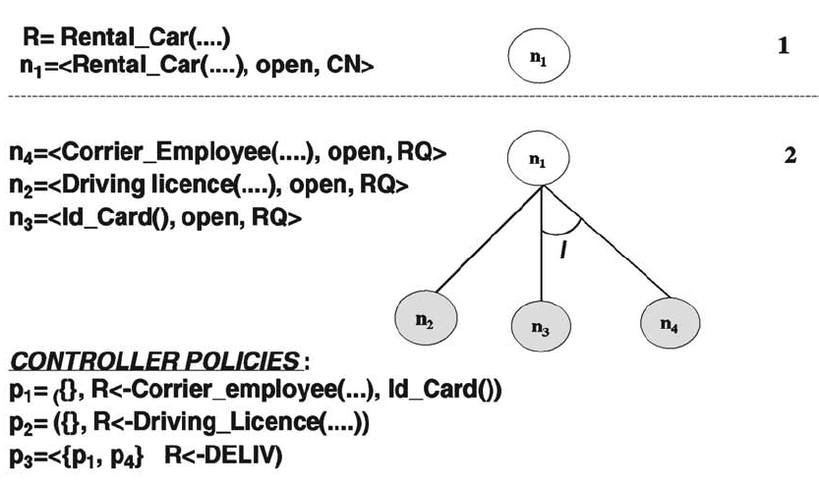
Example Negotiation Tree

Slide 15
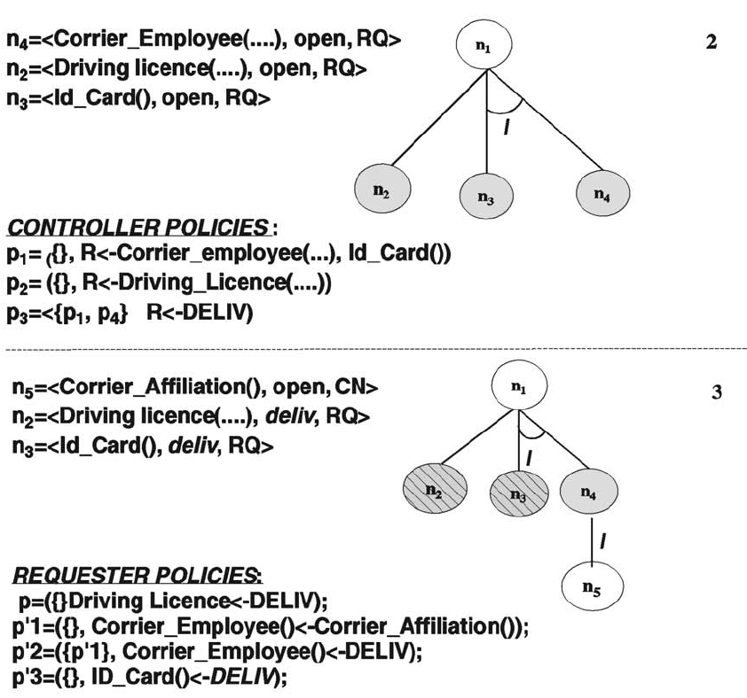
Example Negotiation Tree

Slide 16
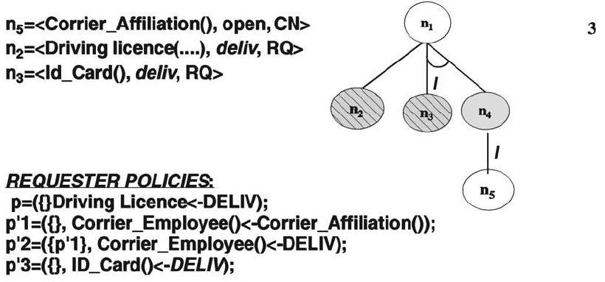
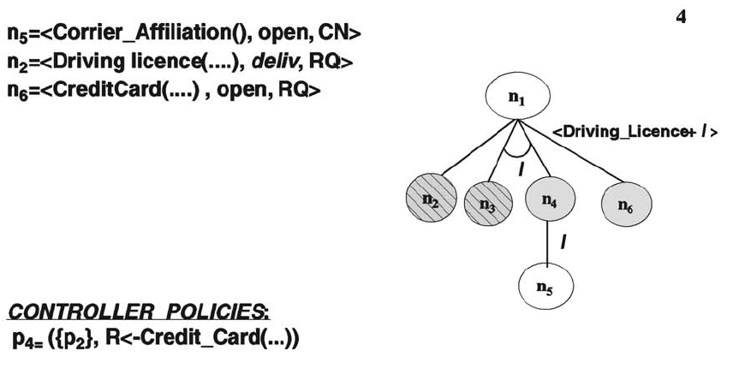
Example Negotiation Tree

Slide 17
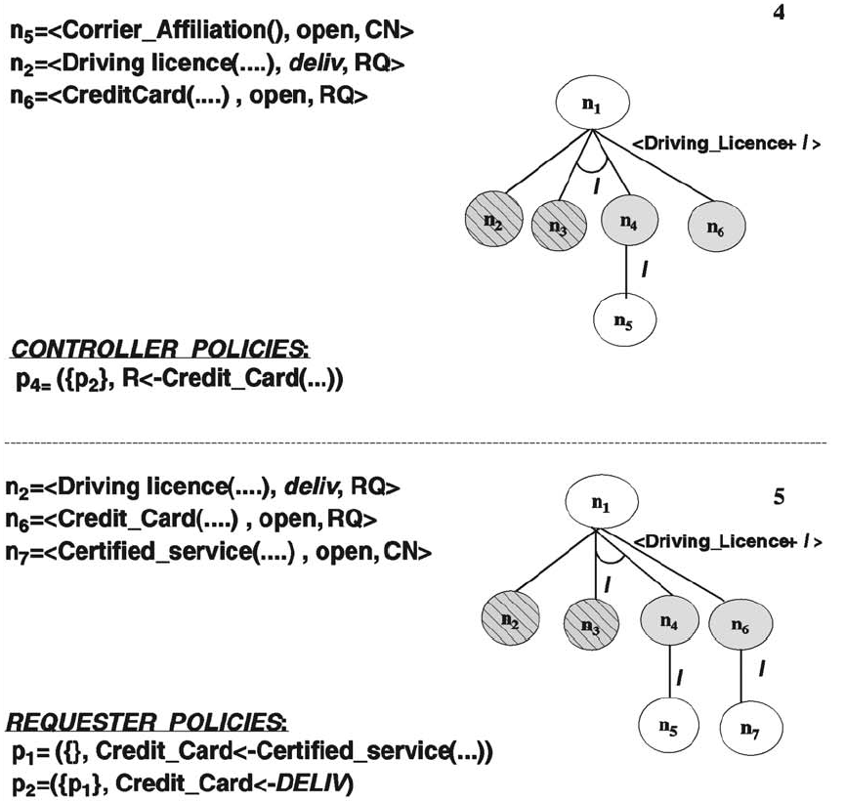
Example Negotiation Tree

Slide 18
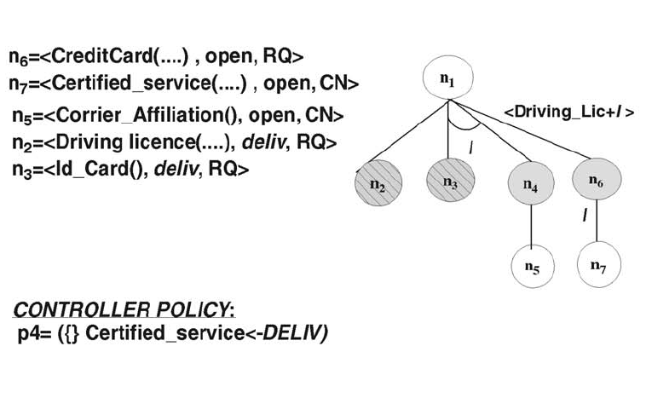
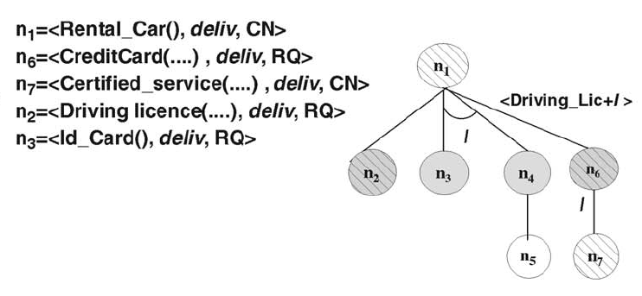
Example Negotiation Tree
5
Assume that Certified_service is not controlled by any policy
6

Slide 19
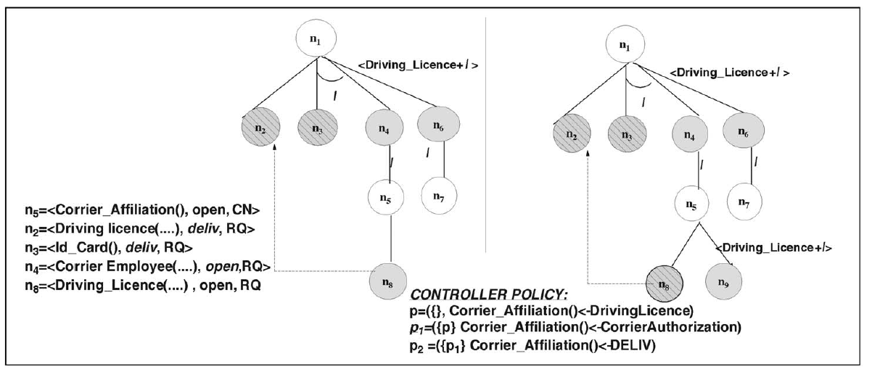
Repeated Nodes
link nodes referring to the same resource to avoid duplicating exchange/evaluation

Slide 20
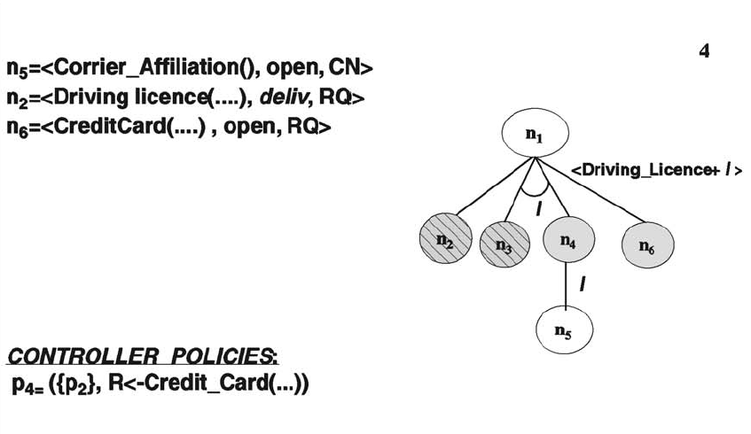
Edge Labels
When the precondition for a policy, P, is satisfied, nodes corresponding to P can be added to the negotiation tree
The certificates satisfying the precondition policies are used to label the edges for the nodes corresponding to P
The edge labels denote the order of credential exchange

