Slide 1
Hidden Markov Model and Its Application in Bioinformatics Liqing Zhang @ Department of Computer Science

Slide 2
HMM Review
Four components:
Initial hidden state distributions
The set of hidden states
Transition probabilities among hidden states
Emission probabilities for each hidden state
Three problems:
Scoring problem: p(d/M)
Alignment problem: argmax_h (p(h/d,M))
Training problem: p(M/d)
Notes:
Forward algorithm, Viterbi algorithm, Baum-Welch algorithm (EM alg)

Slide 3
Example applications
Gene prediction
Pairwise and multiple sequence alignment
Base-calling
Modeling DNA sequencing errors
Protein secondary structure prediction
ncRNA identification
RNA structural alignment
Acceleration of RNA folding and alignment
Noncoding RNA annotation
More…

Slide 4
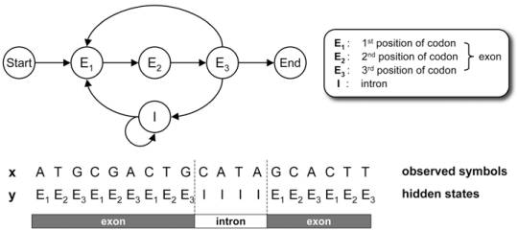
Gene Prediction
A Simple HMM for Modeling Eukaryotic Genes

Slide 5
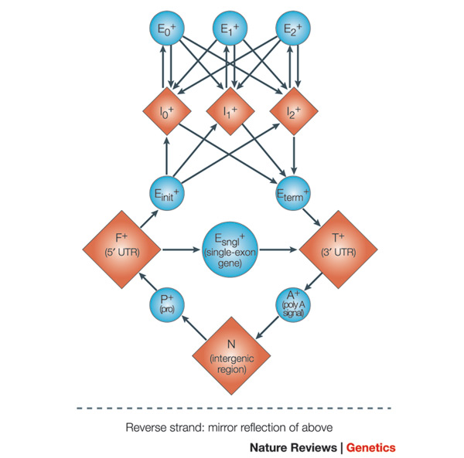

Slide 6
Some variants of HMMs and their application
Profile HMM
Pair-HMMs
Context-Sensitive HMMs and Profile-csHMMs

Slide 7
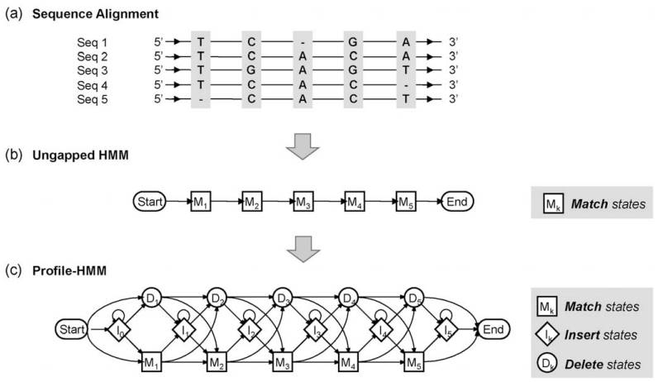
Profile hidden Markov model
Notes:
(a) Multiple sequence alignment for constructing the profile-HMM. (b) The ungapped HMM that represents the consensus sequence of the alignment. (c) The final profile-HMM that allows insertions and deletions.

Slide 8
Application of profile HMM
modeling the characteristics of a number of protein families
Protein classification,
motif detection,
finding multiple sequence alignment
available software packages
HMMER and SAM

Slide 9
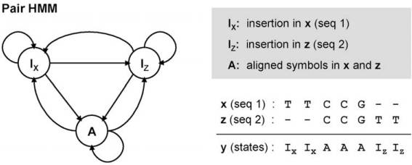
Pair HMMs
Modeling Aligned Sequence Pairs

Slide 10
Application of Pair-HMM
Pair sequence alignment
Extend to multiple sequence alignment
Gene prediction (align cDNA to genome seq)
Advantage of pair-HMM over the common seq alignment: can compute a probability!

Slide 11
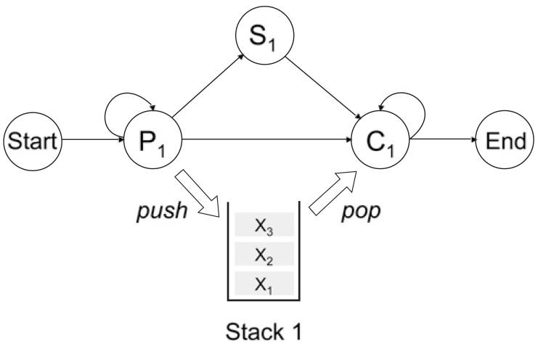
Context-sensitive HMMs
csHMMs use three different types of hidden states: single-emission states Sn, pairwise-emission states Pn, and context-sensitive states Cn.
Application: use to model RNA sequences
Notes:
A context-sensitive HMM that generates only symmetric sequences, or palindromes
long-range correlations between symbols

Slide 12
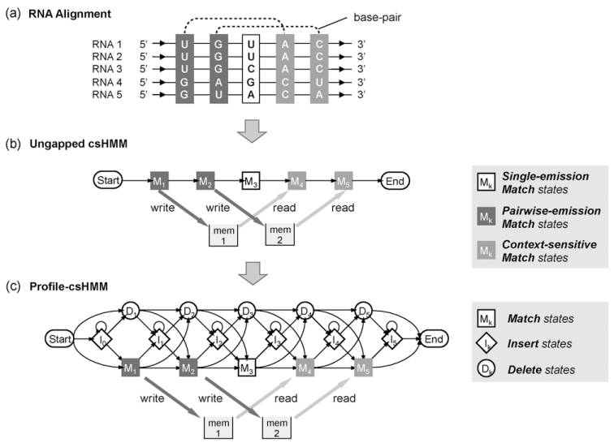
Profile cs-HMMs

