Slide 1
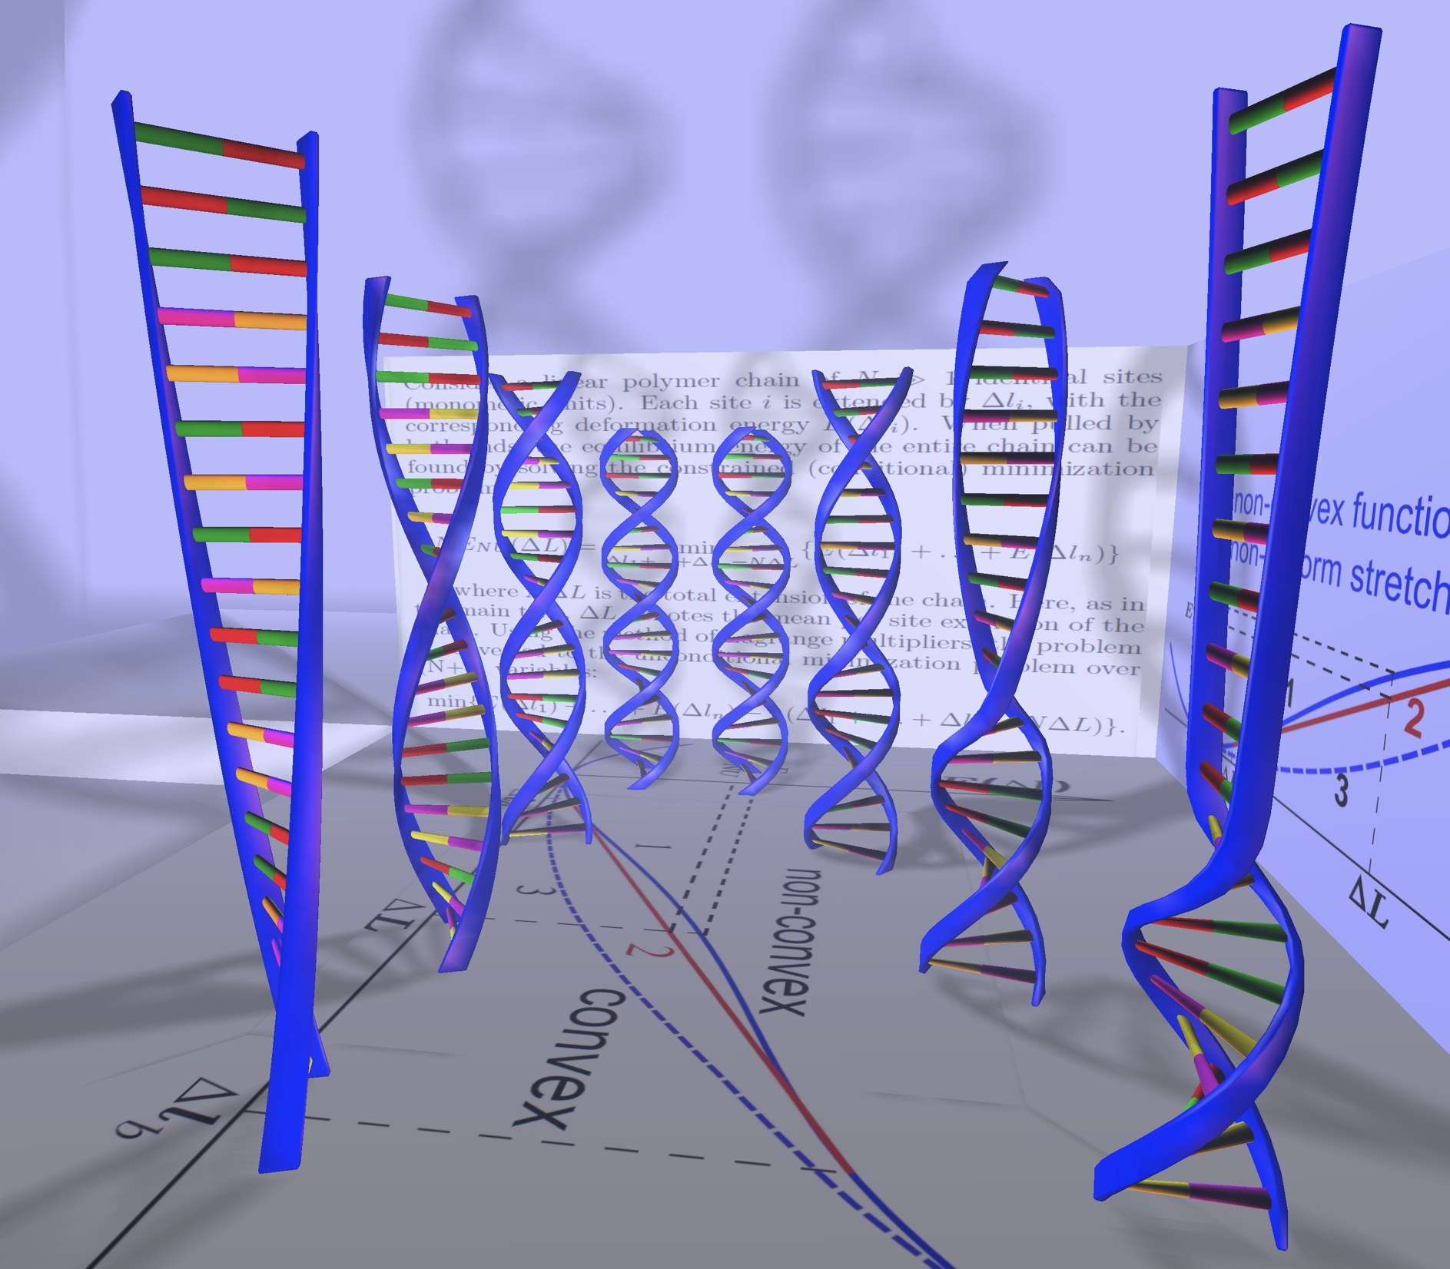
CS3414
Numerical Methods
Igor S Tolokh
Department of CS at VT

Slide 2
How important are Numerical Methods or in more general terms
Computational Approach ?

Slide 3
We are living in the time of a paradigm shift in science
One of the definitions of a paradigm shift:
an important change that happens when the usual way of thinking about or doing something is replaced by a new and different way
Described by Thomas Kuhn in The Structure of Scientific Revolutions. 1962

Slide 4
Science now: a paradigm shift
Experiment
From the Greeks to the recent past
Theory
Now
Computation
Definition: an important change that happens when the usual way of
thinking about or doing something is replaced by a new and different way

Slide 5
How it works
Image credit: http://www.physics.orst.edu/~rubin/INSTANCES/index.html

Slide 6
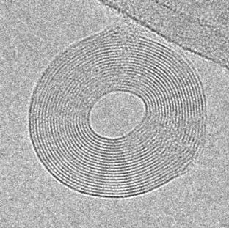
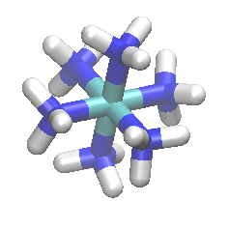
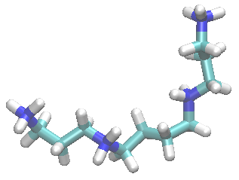
DNA molecules condensation (aggregation) phenomenon
Common condensing Ions:
Cobalt(III) Hexamine, 3+
Spermine, 4+ (polyamine)
DNA condensed by trivalent ions
(From Bloomfield et al. 1992)

Slide 7

Classical model of effective DNA-DNA attraction mediated by multivalent counterions
When multivalent counterions are added to solution, they bind to the surface of NA molecules displacing monovalent counterion diffuse clouds
_
_
_
_
_
_
_
_

Slide 8
Classical model of effective DNA-DNA attraction mediated by multivalent counterions
When about 90% of NA charge is neutralized, the attraction of bound ions to opposite NA molecules, facilitated by multivalent ion-ion correlations, results in NA aggregation (condensation)
_
_
_
_
+
_
_
_
_
+
+
+
+
+
+
+

Slide 9
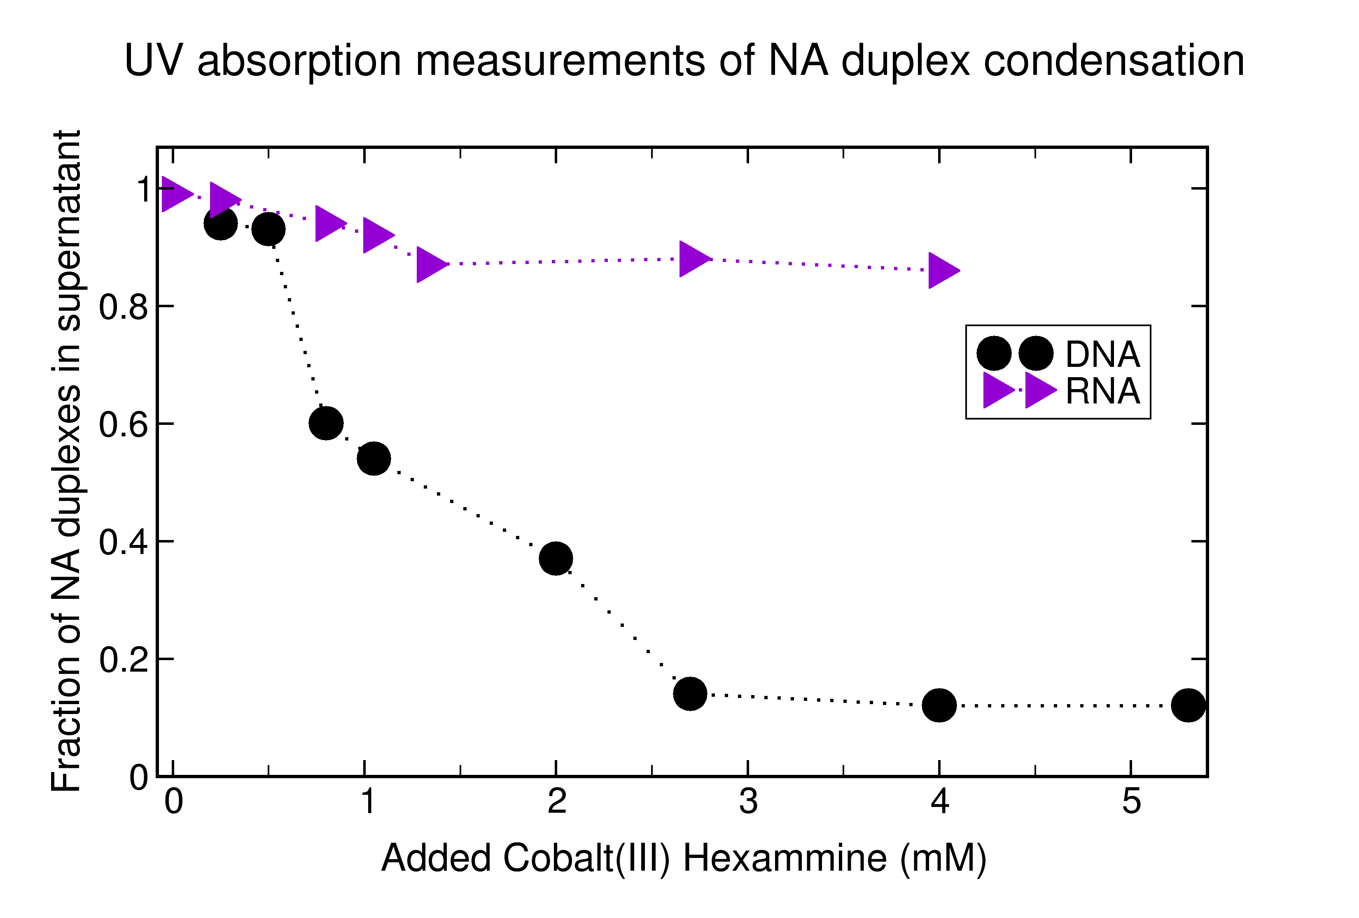
A simple experiment with RNA in 2011 that broke that “classical” picture.
Short (25 bp) duplex RNA resists condensation when DNA duplexes of equivalent sequence readily condense. Lois Pollack’s group results.
L. Li et al. (2011) Double-stranded RNA resists condensation. Phys. Rev. Lett., 106, 108101 .

Slide 10
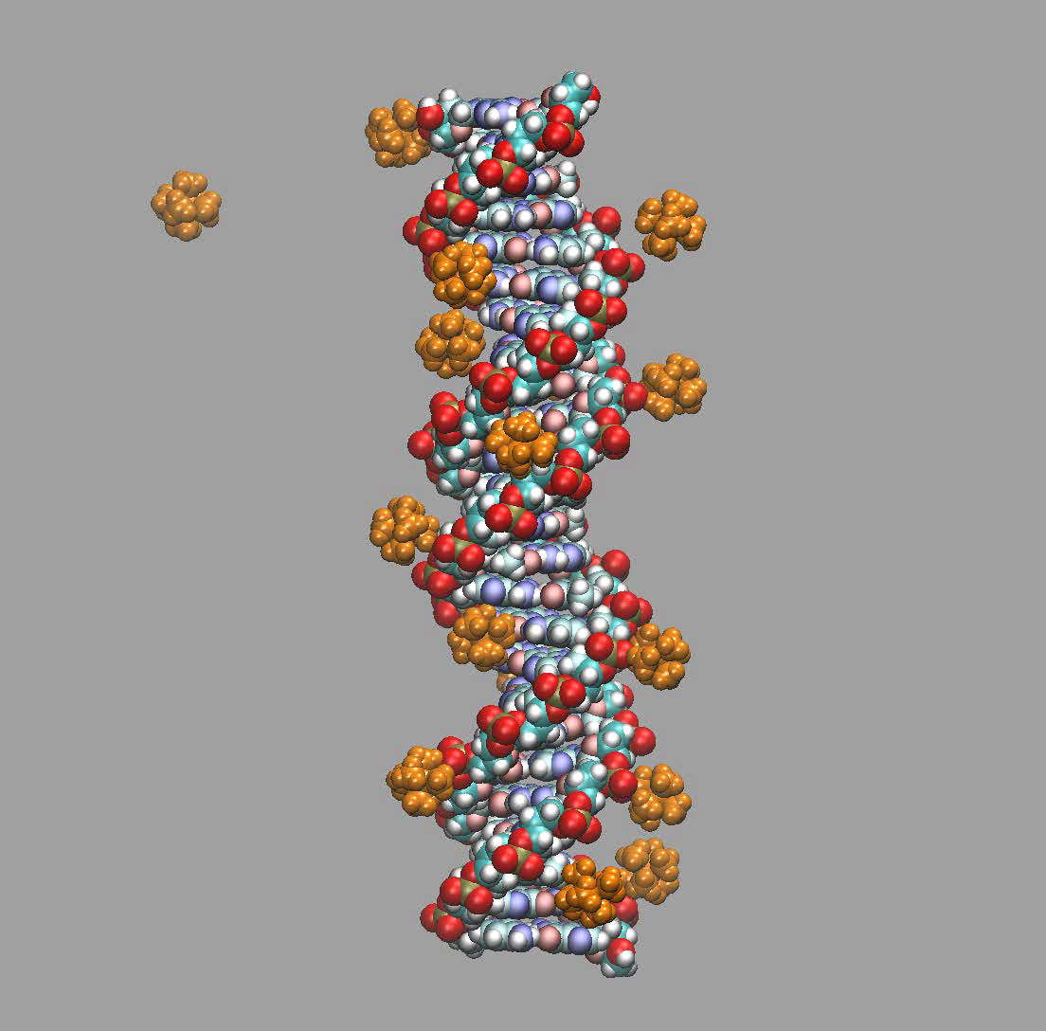
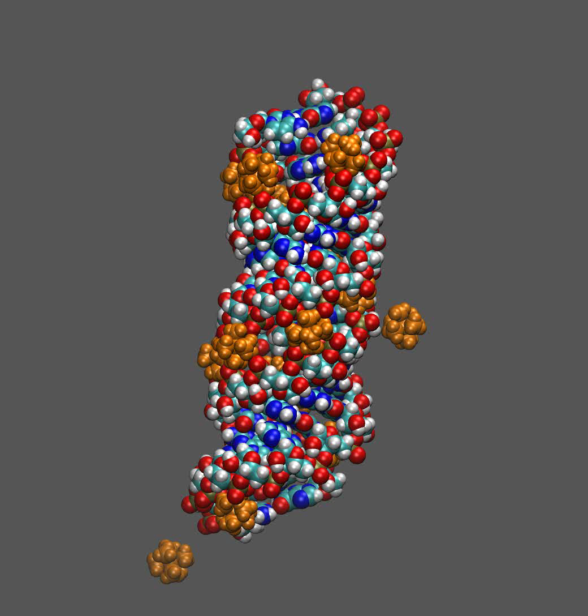
CoHex ions around DNA and RNA 25 base pair duplexes:
Molecular Dynamics simulation – numerical solution of the Newton equations of motion
Movie 1
Movie 2

Slide 11
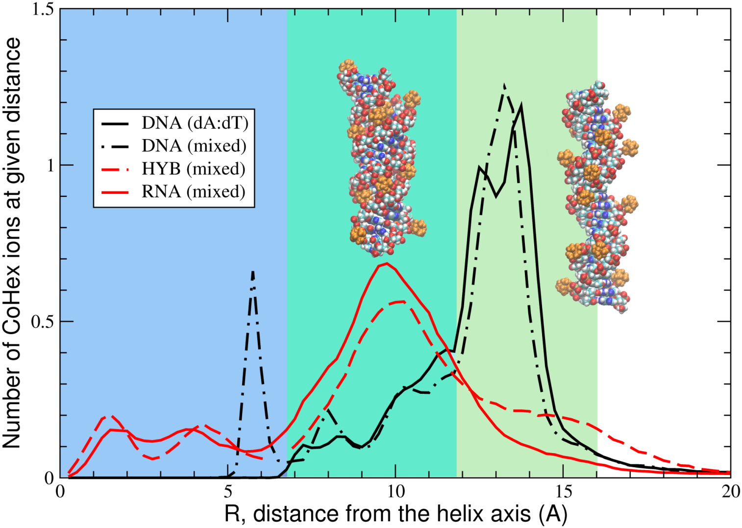
Distributions of bound CoHex counterions around NA duplexes from MD simulations. CoHex ion binding shells: 7-12 A (internal),12-16 A (external). Amount of ions in the external shells correlates with the NA duplex condensation propensity.
Internal shell
External shell
AMBER12 ff99bsc0
16800 TIP3P water mol.
16 CoHex ions
65Ax65Ax118A box
320 ns trajectories

Slide 12
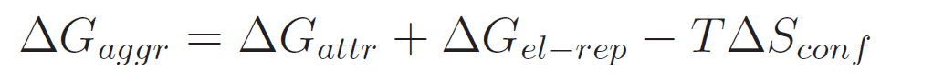
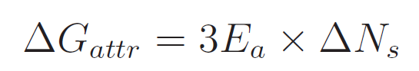
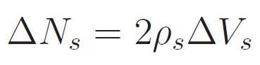
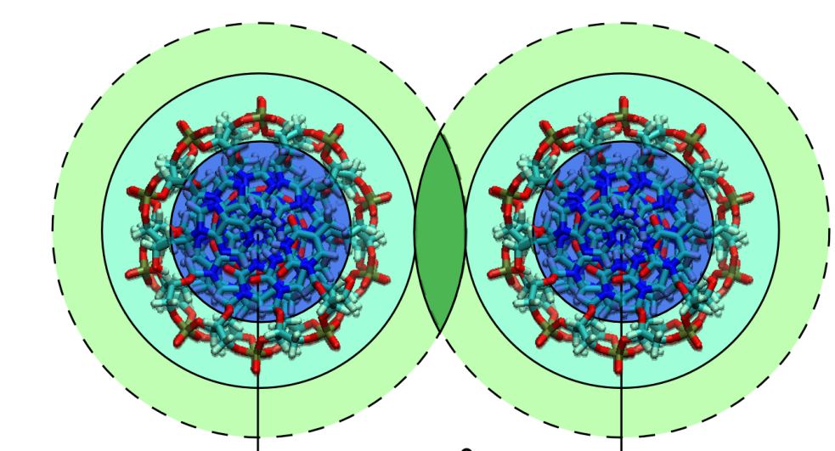

Aggregation free energy: attractive component
Number of ions in the shell
overlapping region
Average binding energy for
additional CoHex ion entering
the external ion binding shell
of the opposite duplex
CoHex affinity
to the external
ion binding shell
of a single duplex

Slide 13
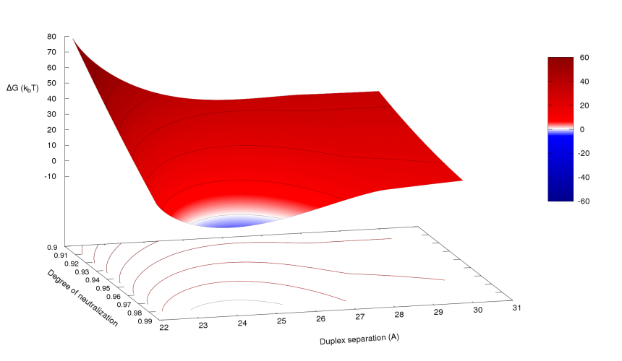
Aggregation free energy as a function of distance and degree of duplex neutralization: RNA
condensation
Compared to the DNA, parameter space region favorable for the aggregation of RNA is shifted to shorter inter-duplex distances. Prediction: RNA aggregates will be more tightly packed than DNA aggregates.

Slide 14
Computational Science/Scientific Computing in the grand scheme of things.
Natural Science
Computer Science
Computational Science
Math
Applied math
Computational Science:
solving science problems with computers
Pure CS: software and hardware,
Stand-alone algorithms (just like math)

Slide 15
Examples
Human Genome
Stealth Fighter
MRI in medicine
Weather Forecasts
Protein Folding
??? (input from class)

Slide 16
Numerical methods for science:
Speed up finding a solution
Find additional solutions
Find solutions otherwise impossible to find
Discover new fundamental laws???

Slide 17
Where are numerical methods used outside of science?
EVERYWHERE
Google (image recognition, search (matrix manipulations))
Engineering (any subfields left where these methods are not used heavily? Aerospace, mechanical: differential equations, optimization, solution of equations, matrix manipulations)
Finance (optimization, extrapolation, data fitting,
differential equations, statistical analysis)
Medicine (different modern imaging methods, processing, reconstruction)

Slide 18
What is this class about?
Gives you the very basics of numerical methods.
Shows how numerical math is different from math.
Introduces a number of useful tools and concepts.
Hands on experience with numerical methods.

Slide 19
What this class is not:
Programming.
In-depth numerical methods, where you learn everything there is to know about one or two common methods (e.g. finite elements, CS5484).
Focused on high performance libraries (e.g. LINPACK).

Slide 20
Specifics. Course structure.
Class web site: http://courses.cs.vt.edu/cs3414/tolokh/

Slide 21
Topics:
Machine arithmetic and associated errors.
Taylor series (review).
Roots of equations.
Minimization of functions.
Intro into “real world” numerical packages: Mathematica, GNU Scientific Library (GSL), Numerical Recipes in C.
Interpolation.
Least squares.
Numerical Integration.
Systems of linear equations (review of liner algebra included).
Advanced topics (Differential equations, etc.)

Slide 22
Important Practical Details
TODAY and NEXT LECTURE MEETING:
Online Force-Add process: log into https://www.cs.vt.edu/S17Force-Adds
password: 3414ist#
By next class:
Install latest Mathematica (VT network software)
Find a way to compile c++ code

Slide 23
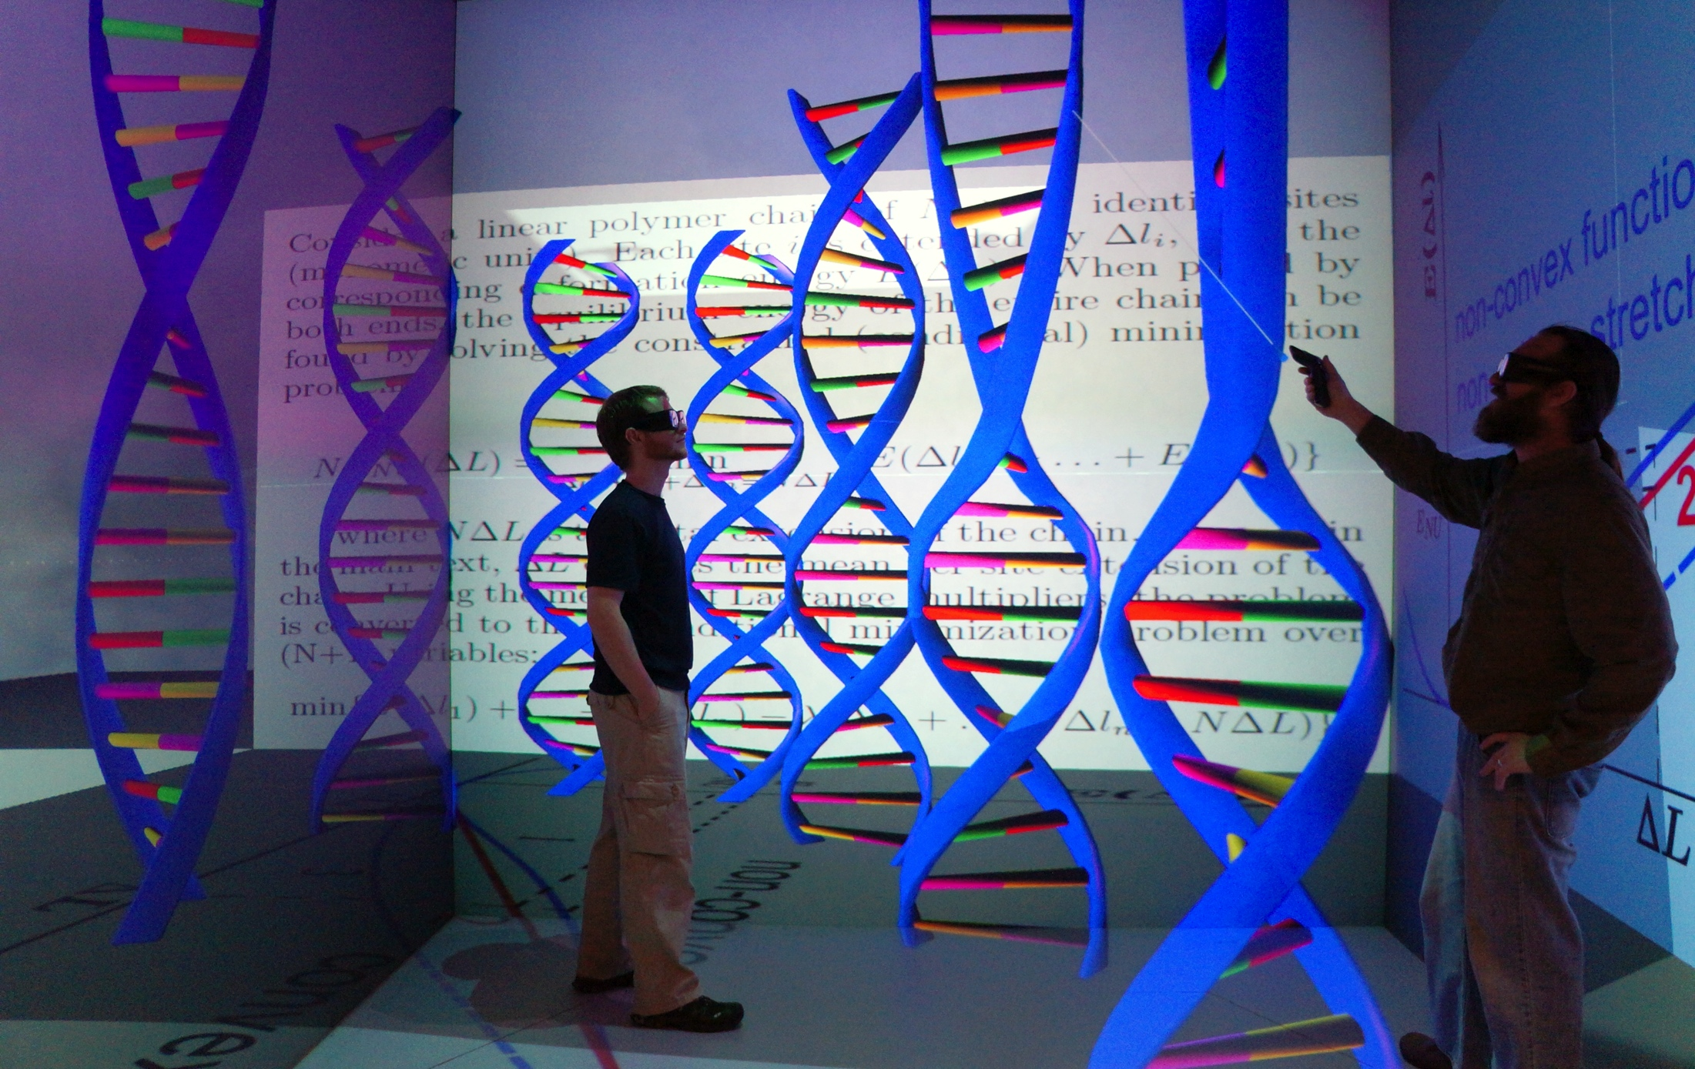
Enjoy!

