Slide 1
The basics of mathematical modeling (Not every computational science project requires a supercomputer)

Slide 2
Population dynamics

Slide 3
More over…
The flour beetle Tribolium pictured here has been studied in a laboratory in which the biologists experimentally adjusted the adult mortality rate (number dying per unit time). For some values of the mortality rate, an equilibrium population resulted. In other words, the total number of beetles did not change even though beetles were continually being born and dying. Yet, when the mortality rate was increased beyond some value, the population was found to undergo periodic oscillations in time. Under some conditions, the variation in population level became chaotic, that is, with no discernable regularity or repeating pattern. Why do we get such different-looking patters of population dynamics? What general mathematical model could produce both sets of patterns?
Example from R. Landau’s course, U. Oregon.

Slide 4
The basic model:
Population increase ΔP = birth – death.

Slide 5
The basic model:
Population increase ΔP = birth – death.
Birth = b*(current population) = bP.
where b = birth rate.

Slide 6
Do we need to make the model more complex?
Check the outcomes. Do they make sense?
For convenience, convert difference equation
to differential (we assume it is OK to do so).
So, ΔP -> dP, and, introducing the time
interval dt (instead of unit time), we get
dP = bPdt, or dP/dt = bP.
Solution? P(t)=?

Slide 7
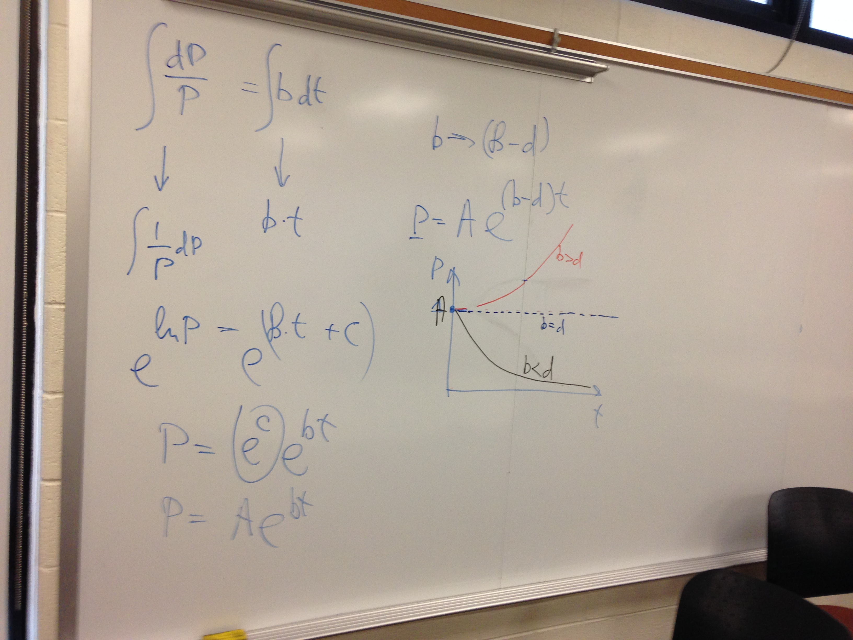
Three qualitatively different solutions:

Slide 8
The basic model:
Population increase ΔP = birth – death.
Birth = b*(current population) = bP.
where b = birth rate.
Death = ?

Slide 9
The basic model:
Population increase ΔP = birth – death.
Birth = b*(current population) = bP.
where b = birth rate.
Death = ?
Death = d*(current population) ?

Slide 10
The basic model:
Population increase ΔP = birth – death.
Birth = b*(current population) = bP.
where b = birth rate.
Death = ?
Death = d*(current population) ?
Death = -d*(current population) ² = dP²
ΔP = b*P(1 –(d/b)*P).

Slide 11
The discrete model:
ΔP = b*P(1 –(d/b)*P)
P(t+1) = P(t) + ΔP
Switch to dimensionless variable p:
P(t+1) = rp(t)*(1 – p).
A single parameter model: “r” controls
the balance between birth and death.
Meaning: r*(1-p) = effective growth rate,
becomes zero when population reaches max.
What is needed to start a calculation?

Slide 12
Start with sanity checks. Basics behavior.
What if p << 1?

Slide 13
Start with sanity checks. Basics behavior.
What if p << 1?
What if p -> 1?

Slide 14
Start with sanity checks. Basics behavior.
What if p << 1?
What if p -> 1?
Steady state? No change, p(t+1) = p(t).

Slide 15
Start with sanity checks. Basics behavior.
What if p << 1?
What if p -> 1?
Steady state? No change, p(t+1) = p(t).
p=0, or 1 = r(1-p).

Slide 16
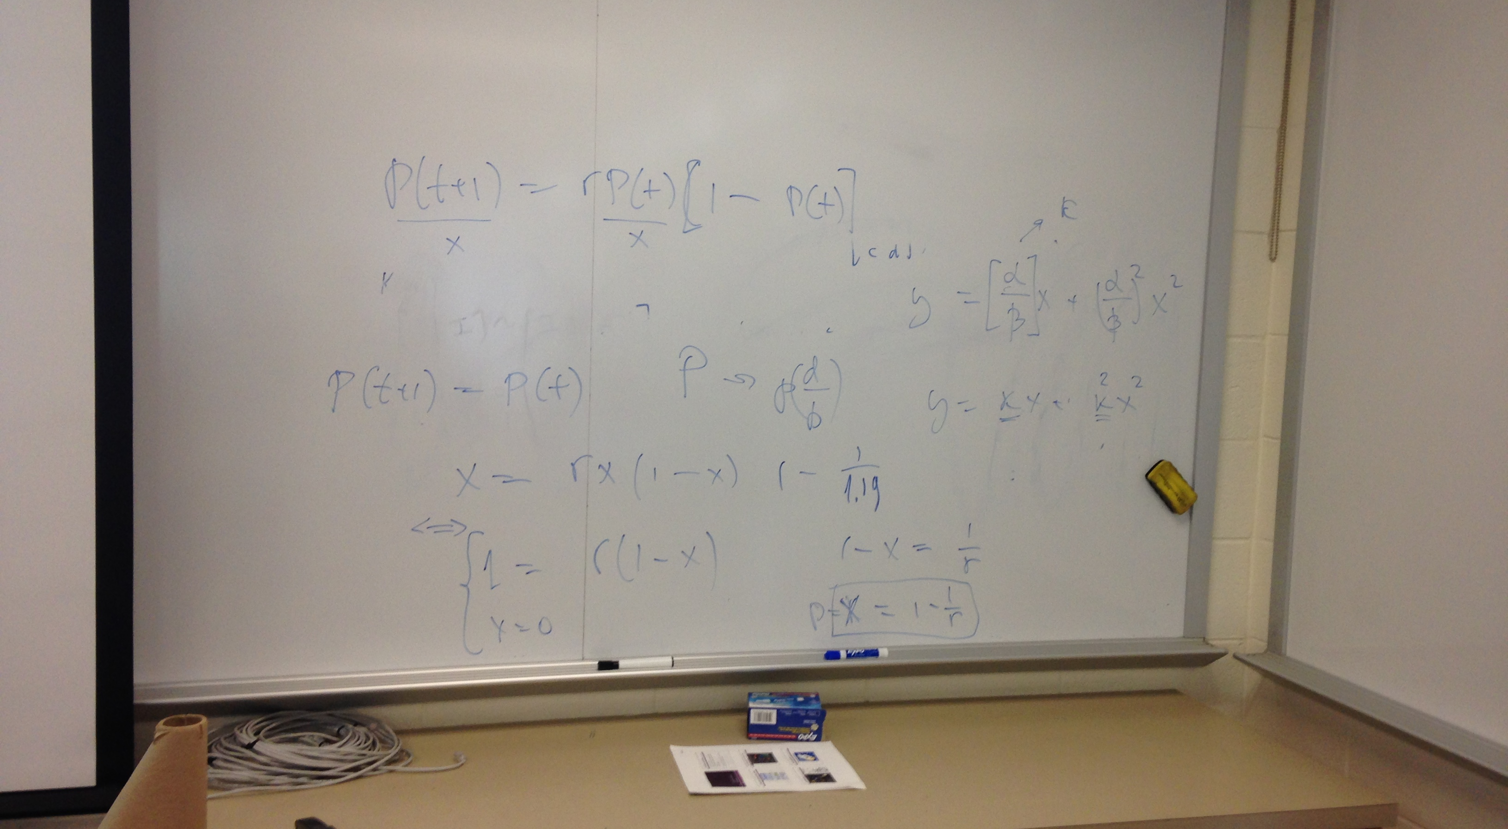
Some details

Slide 17
Explore the logistic equation using Mathematica

Slide 18
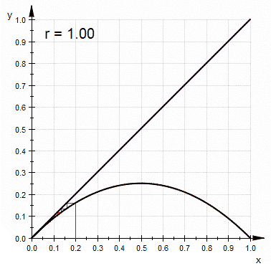
Origin of the oscillations and the chaos.

Slide 19
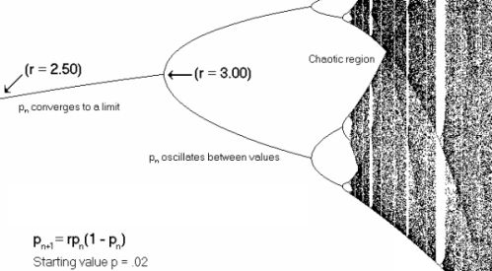
The bifurcation plot

Slide 20
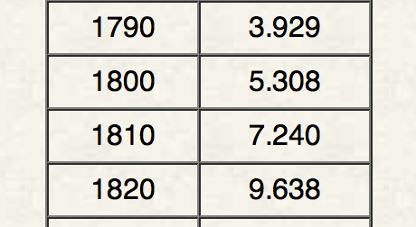
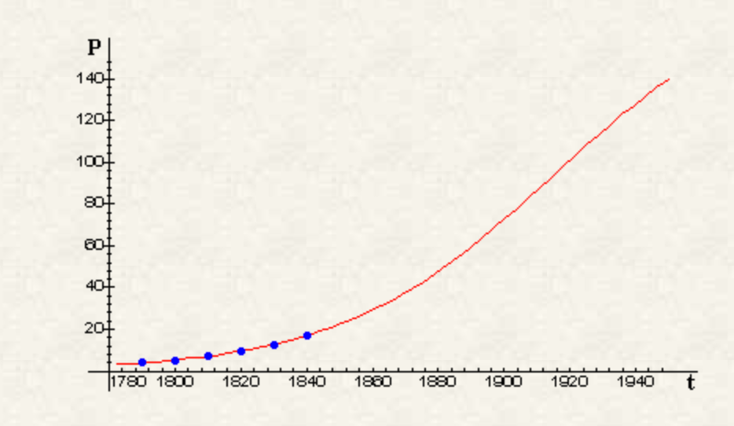
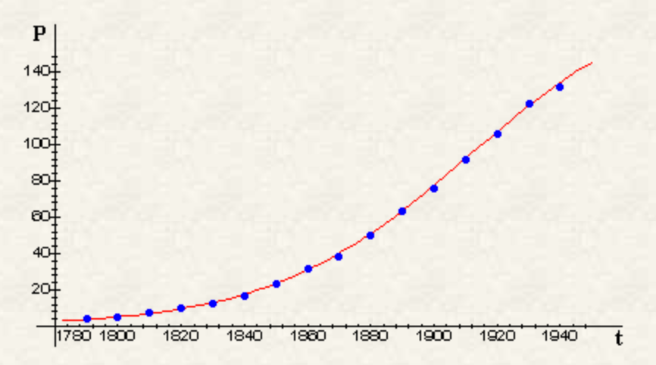
A good model must have generality
US census data.
Model prediction
made in 1840
Actual data from 1940

Slide 21
The take home message:
You don’t need complexity for rich behavior; simple, basics models can still show very rich behavior.
Simpler models tend to be more general and robust, are more likely to hold water.
No need to overcomplicate things: simpler solutions are often right (think Geocentric
vs. Heliocentric models).
Start from the very basics: do not introduce more complexity unless you absolutely can not describe the experiment without it.

