Slide 1
CS 3214: Project 2
Fork-Join Threadpool
Saturday March 22nd , 2025; 7:00pm EDT
Qasim Raza <qasimraza21@vt.edu>
Eric Kaupi <erickauppi43@vt.edu>
Phat Cao <peterc03@vt.edu>

Slide 2
Topics
Getting Started and Basics
Threadpool Design
Codebase Intro
Logistics
Grading
Test Driver
Scoreboard
Debugging
Performance
Advice
Questions

Slide 3
Getting Started and Basics

Slide 4
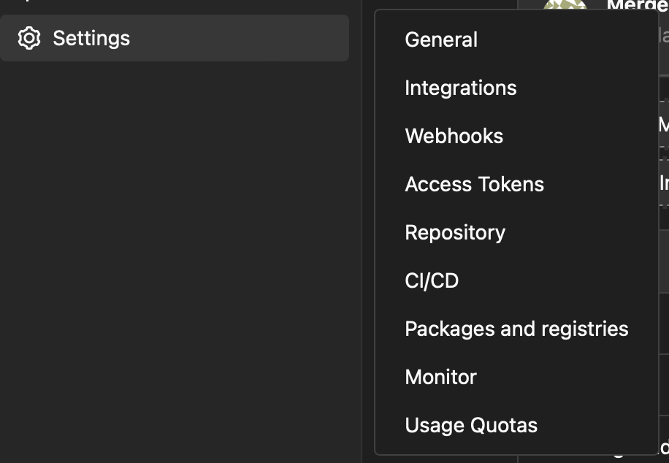
First Step!
One member will fork the base repository:
https://git.cs.vt.edu/cs3214-staff/threadlab
Invite partner to collaborate
Go to Settings > Members to add them
Check partner role permissions too
Both members will clone the forked repository on their machines:
IMPORTANT: Set forked repository to private
Go to Settings > General > Visibility, project features, permissions
Potential Honor Code Violation if not set to private
$ git clone <your git repo url>.git
threadlab
*Your forked repository will have a navigation menu on the left side. Click under Settings to add members and set repo to private

Slide 5
Some Basics
Thread
A single sequential flow within a program
A single process can have multiple threads
Threadpool - collection of idle threads that to do work for an external program
Doesn’t do anything unless work is given to it
Provides an API for external programs or clients to use without adding locking semantics
Less-headache way to add concurrency to programs

Slide 6
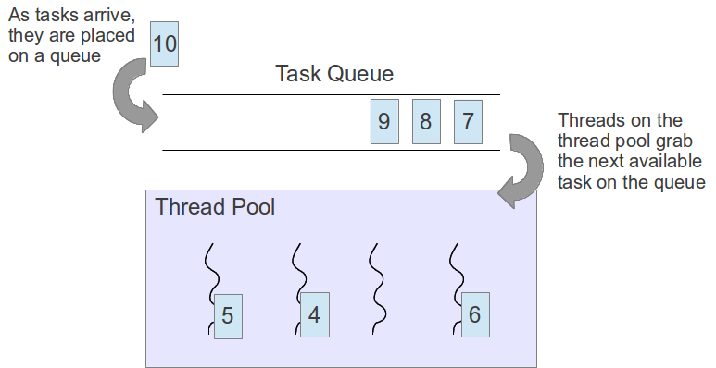
Basic Illustration
Source: https://www.classes.cs.uchicago.edu/archive/2016/spring/12300-1/pa3.html

Slide 7
Where you come in...
You will create your own Threadpool API that external programs will call
What do we write?
threadpool.c
Implementations for functions and structs from threadpool.h
Static helper functions

Slide 8
Functions you will implement
struct thread_pool * thread_pool_new(int nthreads);
void thread_pool_shutdown_and_destroy(struct thread_pool *);
struct future * thread_pool_submit(struct thread_pool *pool, fork_join_task_t task, void * data)
void * future_get(struct future *);
void future_free(struct future *);
Read over threadpool.h for full documentation: you must implement these functions!
Not included are static function(s) you’ll add to threadpool.c

Slide 9
Threadpool Design

Slide 10
Threadpool Design
Methodologies
Split up tasks among n workers
Work Sharing / Work Stealing
Internal and External Submissions
Work Helping
No global variables! (exception of thread-local variables - we will talk about these later)

Slide 11
Work Sharing
Single, central queue from which all threads remove tasks
Drawback: queue can become a point of contention especially with handling small tasks

Slide 12
Work Stealing
Global list of tasks
Local lists of tasks for each worker
Worker main loop:
Do I have tasks? Pop from front (LIFO)
Are there global tasks? Pop from back (FIFO)
Does anyone else have tasks? Pop from back (FIFO)
Notes:
“we’ll get back to this” is in reference to work helping. Technically, you can implement work helping with work sharing though, so this is purely to make the presentation flow intuitively for students

Slide 13
Work Stealing (cont.)
Stealing spreads work evenly to idle threads
Each queue/deque needs to be protected
Workers still wait for other threads to steal and finish futures they depend on (we’ll get back to this)
Notes:
“we’ll get back to this” is in reference to work helping. Technically, you can implement work helping with work sharing though, so this is purely to make the presentation flow intuitively for students

Slide 14
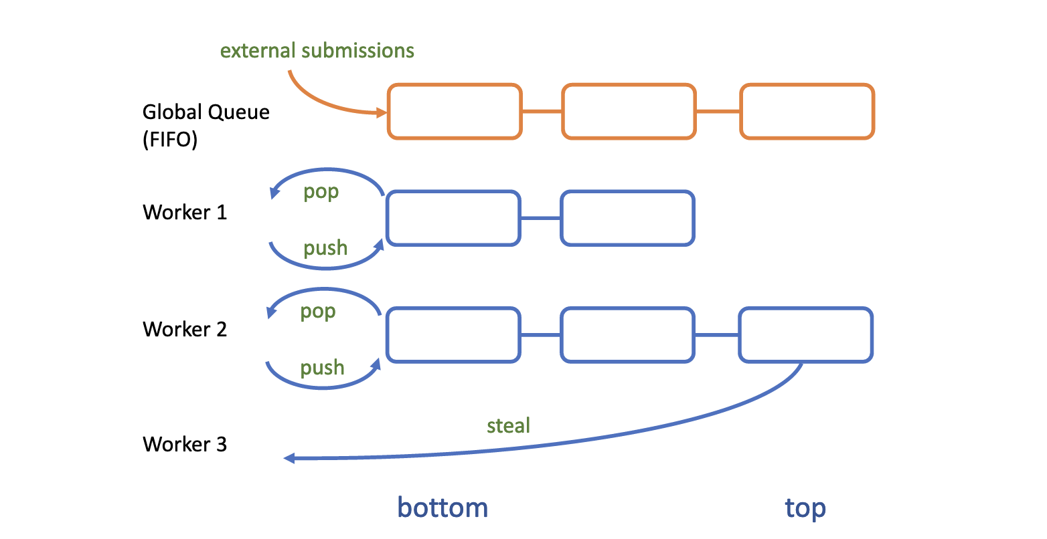

Slide 15
Internal vs External Task Submissions
External Submission - client submits a new task to threadpool
Task gets added to the global queue
Internal Submission - thread submits a subtask
“Subtask” gets added to worker’s local deque
Worker executes it later
Or a co-worker steals the task to execute itself
For submissions to the threadpool, you’ll need to distinguish these cases
But how?

Slide 16
Mergesort
sort(A[0..64])
sort(A[0..32])
sort(A[32..64])
sort(A[0..16])
sort(A[16..32])
sort(A[32..48])
sort(A[48..64])

Slide 17
Example
* Check out mergesort.c to see full functions
mergesort_parallel(int *array, int N) {
int * tmp = malloc(sizeof(int) * (N));
struct msort_task root = {
.left = 0, .right = N-1, .array = array, .tmp = tmp
};
struct thread_pool * threadpool = thread_pool_new(nthreads);
//EXTERNAL submission from client
struct future * top = thread_pool_submit(threadpool, //internal function
(fork_join_task_t) mergesort_internal_parallel,
&root);
//demands answer once it’s ready
future_get(top);
future_free(top);
thread_pool_shutdown_and_destroy(threadpool);
free (tmp);
}

Slide 18
Example (part 2)
static void
mergesort_internal_parallel(struct thread_pool * threadpool, struct msort_task * s)
{ //If array small, no more submitting just internal sort (BASE CASE)
if (right - left <= min_task_size) { mergesort_internal(array, tmp+left, left, right); }
... not all code shown ....
//INTERNAL Submission from the worker thread
struct future * lhalf = thread_pool_submit(threadpool, (fork_join_task_t) mergesort_internal_parallel,
&mleft);
//Worker thread works on other half
mergesort_internal_parallel(threadpool, &mright);
future_get(lhalf);
future_free(lhalf);
merge(array, tmp, left, left, m, right);
}
}

Slide 19
Work Helping
In future_get, you can only return the result once the future is done executing
The task might not be completed when future_get is called (or even running)
Consider cases for getting the result from future_get:
If future already executed -> Hurray!
But what happens if the future isn’t ready?
What should the thread do while waiting?
Task
-----------
-----------
Task
-----------
-----------
?

Slide 20
Work Helping (cont.)
Threads should make best use of their time by…
Minimizing sleeping
Maximizing time spent executing tasks
If no threads are executing a task you depend on, do it yourself
Workers can then recursively handle their own dequeue (FIFO)
If a thread is executing the task you depend on? May be beneficial to execute other tasks instead of waiting

Slide 21
Design Advice
You are asked to implement the work stealing with work helping thread pool design
Better load balancing
Lower synchronization requirements
However, you can implement work sharing for only 80% credit (not recommended)

Slide 22
Thread Local Variables
Want to be able to access your workers deque (and probably locks) during thread_pool_submit()
How can we distinguish external/internal submissions?

Slide 23
Thread Local Variables
Naive approach would be to loop through workers and check pthread_self(),...
Instead, use some variable which would be different for each thread
AKA thread-local variables/storage

Slide 24
Implementation Tips

Slide 25
struct thread_pool
Should contain any state you need for a threadpool
Ideas:
Locks (pthread_mutex_t)
To protect the global queue
Queues/Deques (provided list struct from previous project)
Semaphores (sem_t)
Conditional Variables (pthread_cond_t)
Shutdown flag
List of workers associated with this thread_pool
Etc.
Notes:
Don’t be scared of semaphores!

Slide 26
struct worker
Should contain a worker struct as well
Ideas:
Maintain which pool this worker is for
Queue of internal submissions
Lock for local queue
etc…
Notes:
Don’t be scared of semaphores!

Slide 27
Futures
How do we represent a task we need to do?
future
Threadpool: an instance of a task that you must execute
Client: a promise we will give them a reply when they ask for it
struct future
{
fork_join_task_t task; // typedef of a function pointer type that you will execute
void* args; // the data from thread_pool_submit
void* result; // will store task result once it completes execution
…
// may also need synchronization primitives (mutexes, semaphores, etc)
};

Slide 28
Futures (cont.)
You will invoke “task” as a method, it represents the method passed through by thread_pool_submit, the return value gets stored into the result

Slide 29
Future Illustration
1.
Task
-----------
-----------
KEY:
Client submits task to threadpool’s global queue
Client immediately receives a future
A worker thread snags the submitted task to their local deque for work
Client demands to get the completed task affiliated with future
The completed task is returned, client frees the future
2.
3.
Task
-----------
----------
4.
RESULT ACQUIRED
5.
Task
-----------
-----------

Slide 30
Functions you will implement
struct thread_pool * thread_pool_new(int nthreads);
void thread_pool_shutdown_and_destroy(struct thread_pool *);
struct future * thread_pool_submit(struct thread_pool *pool, fork_join_task_t task, void * data)
void * future_get(struct future *);
void future_free(struct future *);
Read over threadpool.h for full documentation: you must implement these functions!
You can also add static function(s) to threadpool.c

Slide 31
thread_pool_new
Create thread pool
Initialize worker threads
Call pthread_create: starts a new thread in the calling process. The new thread starts execution by invoking start_routine(); arg is passed as the argument of start_routine()

Slide 32
Logistics

Slide 33
Grading
Submit code that compiles
Test using the driver before submitting
When grading, tests will be run 3-5 times, if you crash a single time it’s considered failing
Benchmarked times will be the average of the 3-5 runs, assuming you pass all of them

Slide 34
Grading (cont.)
Breakdown
Git Usage
Functionality Tests (Basic/Advanced ~ 25% each)
Performance ~ 40%
GTAs will determine the exact breakdown of points
Performance will breakdown into rough categories based on real time scores
You must pass the basic tests before getting anything for performance

Slide 35
Performance
Relative to peers and sample implementations
Points only for the tests on the scoreboard
N Queens, Mergesort, Quicksort (8, 16, and 32 threads), possibly Fibonacci
A rough cutoff for real time benchmarks will be posted later on by Dr. Back (last semester’s scoreboard)

Slide 36
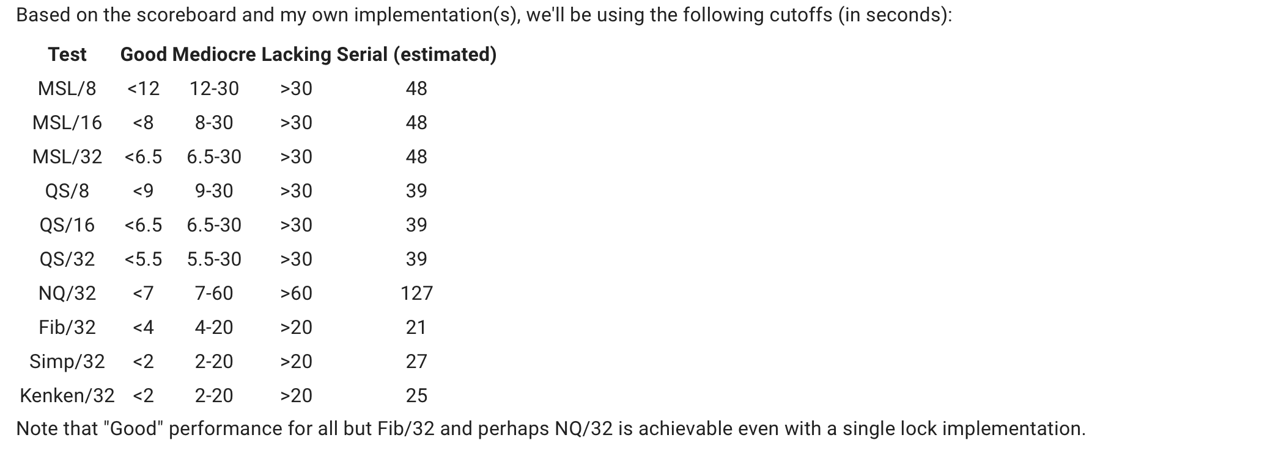
Performance
ONLY for reference - numbers will likely change

Slide 37
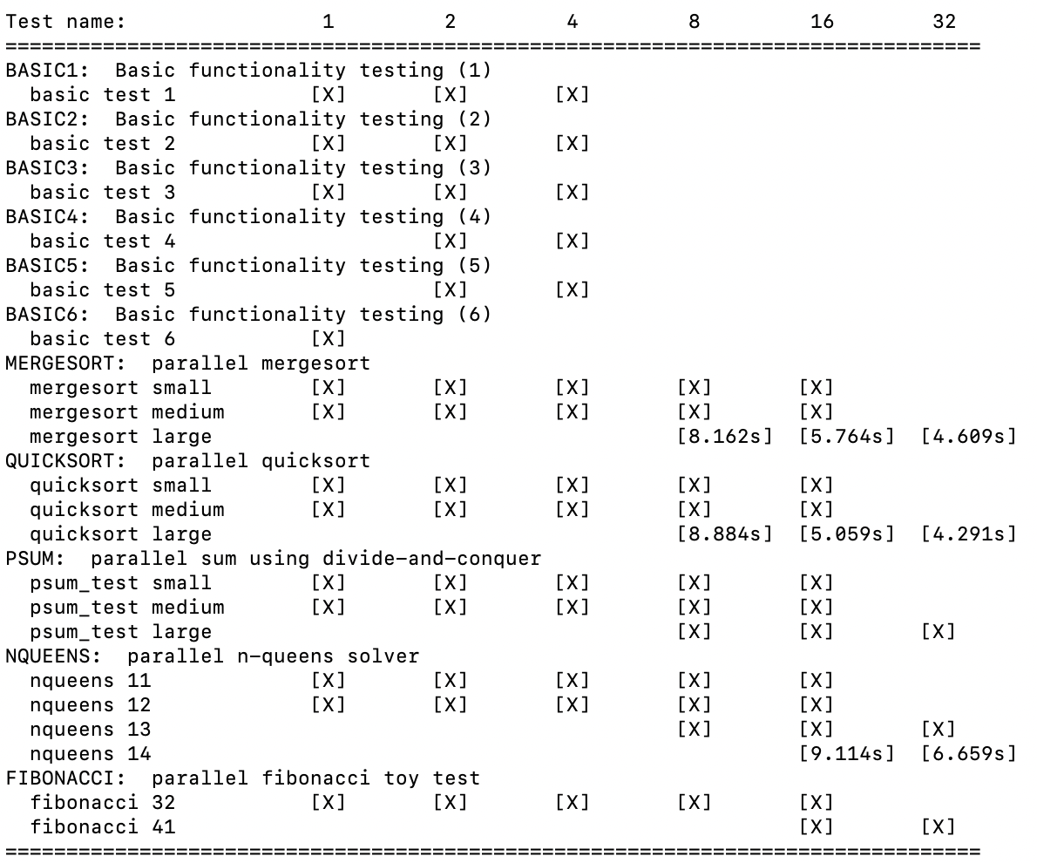
Performance

Slide 38
Visual Studio Code Terminal Issues
Use a separate terminal (like git bash) to run the tests
VS Code spins up some extra processes on rlogin to manage files, they interfere with the somewhat strict thread limits we enforce on the tests to guarantee your thread pool isn't creating additional workers to juice performance numbers

Slide 39
Test Driver
$ ~cs3214/bin/fjdriver.py [options]
Can take a long time to run all tests
Reports if you passed each test, and times for the benchmarked ones

Slide 40
Test Driver
Make sure to run tests multiple times, race conditions can cause you to crash only 20% of the time
Will run multiple times to ensure consistency when grading (and get a good average for times)
All of the tests are C programs, compiled against your threadpool

Slide 41
Test Driver
$ ~cs3214/bin/fjdriver.py -g -B 5
Runs the tests 5 times and averages the results
Helpful to simulate grading environment

Slide 42
Scoreboard
https://courses.cs.vt.edu/cs3214/spring2025/projects/project2scoreboard
You can post your results to the scoreboard by using the fjpostresults.py script

Slide 43
Debugging Tools

Slide 44
Debugging
Debugging multi-threaded programs can be difficult
Don’t just use printf()
This project will challenge you in your debugging skills (GDB, Helgrind..)
Helgrind**
Valgrind tool
Enable using --tool=helgrind in Valgrind command line
Your best friend for tracing deadlocks and synchronization errors
https://www.valgrind.org/docs/manual/hg-manual.html/

Slide 45
GDB Demo
*Make sure you have the debugging flags set in Makefile
gdb attach –p <PID> - Attach gdb to given process
info thread - see how many threads there are
thread <thread_num> - switch current thread
thread apply all bt - see what each thread is doing
Checking who owns a lock

Slide 46
Improving Performance
Make sure you aren’t on a busy rlogin node!
ssh <username>@portal.cs.vt.edu
Minimize sleeping, maximize execution of tasks
“... We recommend that you intentionally break the rule of signaling with the lock held”
Advanced Optimizations - CPU Pinning, Fixing False Sharing, Lockless Queues
CPU profiling – htop, perf
Ask on Discourse! There’s a lot of other optimizations to try

Slide 47
General Advice
Start Early (...now)
How many lines of code?
~250-350 lines (not a good benchmark for difficulty)
Most of time is spent debugging
GDB, Helgrind, and Valgrind are your friends
Debugging multi-threaded programs is difficult and time consuming
Try different strategies
Most of the learning is trying out different approaches - telling you exactly what would give the best results would reduce the educational experience

Slide 48
Any Questions?

Slide 49
Good Luck!

