Slide 1

CS 3214: Project 4
Personal Web and Video Server
Help Session: Wednesday April 30th, 2025 - 7:00pm EST
Thomas Tran (thomastran@vt.edu)

Slide 2
Topics
Overview of a Web Server (prerequisite knowledge)
  OSI, TCP, HTTP, JSON, JWT
Basics / Getting Started
Web Server Design
  Serving Files
  Authentication
  Robustness, Performance, & Scalability
  IPv6
  MP4 Streaming
Logistics and Grading
Fuzzing!
Notes:
Tanvi
Won’t do too much theory

Slide 3
Overview of Web Server
Prerequisite Knowledge:
OSI, TCP, HTTP, JSON, JWT
Notes:
Alice

Slide 4
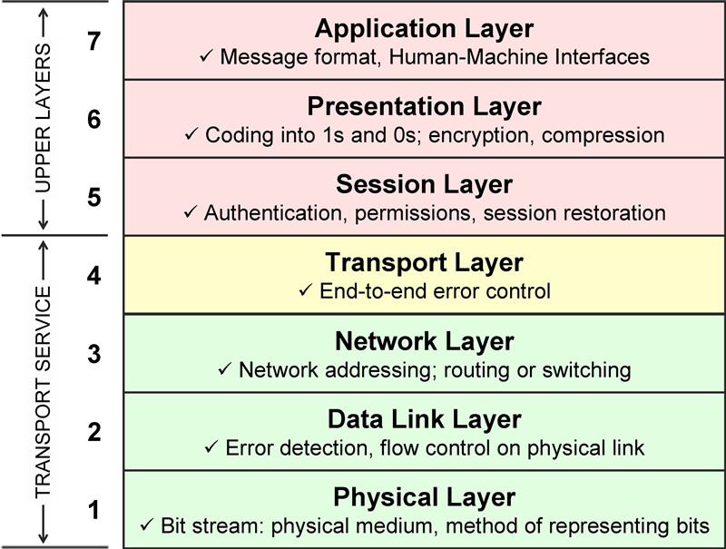
OSI Model
Network “Stack”
Notes:
Alice

Slide 5
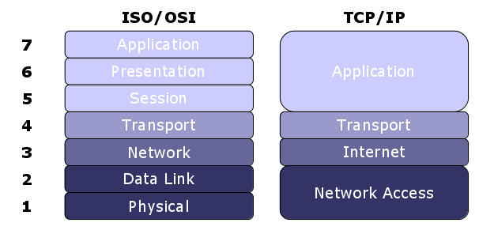
OSI Model
Slightly more modern approach
(your server is here)
Notes:
Alice

Slide 6
Socket Programming
Medium through which programs access network
System calls:
  socket(): create the socket file descriptor
  bind(): assign to (local) address and port
  listen(): start queueing incoming requests
  accept(): connect to a client, return new socket
All sockets by default are blocking
Notes:
Alice
Listen: assigns the address specified by address to the socket
Accept: connects to client, new socket returned representing connection with a specific client.
Used to recv() and send() data.

Slide 7
HTTP
Hypertext Transfer Protocol
Exists in the application layer of the OSI model
  Normally takes place over TCP/IP connections
Developed at CERN in 1989 and governed by W3C (World Wide Web Consortium)
Request and Response messages use verbiage to denote intent
  GET, POST, PUT, DELETE
  Stateless
Notes:
Alice
Don’t maintain state across requests, each request treated independently
Reduces complexity
Less management

Slide 8
HTTP Requests
Version 1.1 requests are structured as follows:
POST /index.html HTTP/1.1
Host: localhost:12345
User-Agent: curl/7.81.0
Accept: text/html
Content-Type: application/json
Content-Length: 67
<67 bytes of data>
<method> <target> <version>
<header name>: <header value>
<blank line: CRLF> ("\r\n")
<message body>
Notes:
Alice
Remember headers

Slide 9
HTTP Responses
Version 1.1 responses are structured as follows:
HTTP/1.1 200 OK
Accept-Ranges: bytes
Server: CS3214-Personal-Server
Content-Type: text/html
Content-Encoding: UTF-8
Content-Length: 3968
<contents of index.html>
<version> <response code>
<header name>: <header value>
<blank line: CRLF> ("\r\n")
<message body>
Notes:
Alice
2xx = Success
3xx = Redirection
4xx = Client Error
5xx = Server Error

Slide 10
HTTP Standard
Each line ends in:
  CR: carriage return, \r
  LF: line feed, \n
Has version and status
Optional header fields
Blank CRLF, then message content (if any)
HTTP status codes
Notes:
Alice
Helper functions handle most of this
send_response_header/ send_response
You’re setting up status codes, headers, body

Slide 11
JSON
“Javascript Object Notation”
Key, value store in a well-defined format
{
"a": "Example text",
"b": 0,
"c": [1, 2, 3, 4],
"d": {
"a": [],
"b": "Hello world"
}
}
Notes:
Alice
Check out https://jansson.readthedocs.io/en/2.1/apiref.html

Slide 12

JSON Web Tokens
JSON Web Tokens are an open, industry standard RFC 7519 method for representing claims securely between two parties
Debugged on main website: https://jwt.io
Three parts:
  Header
  Payload
  Signature
Notes:
Alice
Used for authentication

Slide 13
Example JWT
Encoded JWT token is delimited by dots
eyJ0eXAiOiJKV1QiLCJhbGciOiJIUzI1NiJ9.eyJleHAiOjE2OTcyNzE2MDAsImlhdCI6MTY5NzE4NTIwMCwic3ViIjoidXNlcjIwMjMifQ.qtaLIlrQ23PemNtCeEMOlaP3vaWtfXbYJQfWEzbPy30
{
"typ": "JWT",
"alg": "HS256"
}
{
"exp": 1697271600,
"iat": 1697185200,
"sub": "user2023"
}
HMACSHA256 signature
You’ll see this later!
Notes:
Alice
sub - to describe the subject
iat - the time at which the claim was issued
exp - the time at which the claim will expire
use hs (rs is asymmetric)

Slide 14
Basics / Getting Started
Notes:
Tanvi

Slide 15
Getting Started
Fork / clone the repo
  Set to private!
Use the provided./install-dependencies.sh to set up the project libraries
Build the Svelte frontend & add some videos
  Make sure npm and node are ones in ~cs3214/bin!
$ git clone <your fork of cs3214-staff/pserv.git>
$ cd pserv && ./install-dependencies.sh
$ cd svelte-app && npm install && npm run build
$ cd ../tests && ./build.sh
$ cd ../src && make
Notes:
Tanvi

Slide 16
Getting Started
Understand the code
The front-end (Svlete App), files, etc. is handled for you
What do we write?
Any files you like, modifying http.c heavily
Hint: You’re only messing with 4 files! ✨
Handle
  Authentication
  IPv4 and IPv6 dual support
  HTML5 Fallback
  Multi-client support
  MP4 streaming
Notes:
Tanvi
Main, http, socket
Only really need frontend for ex5

Slide 17
Provided Base Code
Base code already supports:
  HTTP request parsing,
  HTTP response building,
  File mime-type guessing,
  Serving one client at a time.
Alright, then where do I start?
Get a feel for static file serving first (GET request to /something.txt).
Start with minimum requirements (200 OK response to GET /api/login, multiple simultaneous connections) .
Move to IPv6 support, then authentication functionality.
Notes:
Tanvi
Study helper functions

Slide 18
HTTP Transaction Struct
Base code parses request headers into structs (think Project 1)
The information is inside a buffer (struct bufio)
http_process_headers processes it and stores important info in struct http_transaction
You should store extra information such as:
  Authentication token
  Request range
  Content Type
Store as an offset or value? Up to you!
Notes:
test_auth_long_header
causes a reallocation of the receive buffer
Store jwt_token as ofs

Slide 19
Parsing Arguments
Already supported for you!
Supports the following program arguments:
  -p <port number> defines the port to bind()
  -R <path> defines the server root to use
  -a enables HTML5 fallback
(... plus a few more!)
Notes:
Tanvi

Slide 20
Testing in browser
Use SSH tunneling
On local machine:
(if connecting to a specific host, use <host>.rlogin in place of localhost)
On rlogin, start server normally:
Open browser to localhost:<port>
$ ssh –L <port>:localhost:<port> <pid>@rlogin.cs.vt.edu
$ ./server –p <port> -R <root data dir>
Notes:
Tanvi

Slide 21
Demo
Getting started
Common pitfalls
Notes:
Alice
<jwt.h>: no such file or directory
Run ./install-dependencies.sh
Not opening any files
Running without -R
Leaking source code
Running with -R .
Leaking private files
Fix IDOR attacks
Load whole videos
Fixed later in project
vite: command not found
npm install first
App doesn't build
Move ~cs3214/bin up in PATH
Site looks weird
Support CSS

Slide 22
Web Server Design
Authentication & Higher-Level Design (and curl)
Notes:
Alice

Slide 23
Serving Static Files
/hello.txt
Client asks for the contents of hello.txt
GET
Server opens hello.txt and responds with its contents and type.
Hello world!
text/plain
Serve any file in the root directory
  Be mindful of security vulnerabilities in the provided path (what about ‘.’ and ‘..’?)
GET
/../../private/passwords.txt
Notes:
Alice
Simple: .. in req path, just fail it

Slide 24
Authentication
Client supplies correct login information
/api/login
POST
Server returns authentication token
{"exp":1697271600,"iat":1697185200,"sub":"user2023"}
application/json
/private/secure.txt
Client supplies token in a cookie
GET
Server looks at cookie, verifies the token, and provides the private file
This file is secure!
text/plain
Notes:
Alice

Slide 25
Auth. Credentials
Only need to handle a single user:
Hardwiring credentials in source code is often bad practice.
Hard-coding will not pass testing!
The autograder supplies environment variables:
  USER_NAME
  USER_PASS
  SECRET
Use env to supply these to the unit tests.
{"username":“<USER_NAME>","password":“<USER_PASS>"}
Notes:
getenv

Slide 26
Secure File Auth.
Checking for the presence of a cookie in the HTTP header
> GET /private/secure.txt HTTP/1.1
> User-Agent: curl/7.81.0
> Host: localhost:12345
> Accept: */*
> Cookie: auth_jwt_token=<encrypted token>
Client asks for secure file
To show the server it can be trusted, it sends an auth token in a cookie
< HTTP/1.1 200 OK
< Server: CS3214-Personal-Server
< Content-Length: 21
< Content-Type: text/plain
<
This file is secure!
Server checks the token to see that the client was previously authenticated
Server puts the contents of the secure file in its response message
Notes:
Alice

Slide 27
HTML5 Fallback
Should a request be sent on every click?
  “Client-side routing” - updates via JS code
Clients can change URL in the address bar
  What if the “fake” URL is bookmarked?
Policy for a Svelte application (request → fallback):
Existing file/API → as is
͏/ (server root) → index.html
͏/some/path → /some/path.html
else: 200.html
Notes:
Alice

Slide 28
Quick Sidenote: curl
Debugging tool for HTTP requests
Arguments include urls to query and flags
  Great way to see the request and response flow between a client and server
  Helps debug hanging and malformed headers
  Can chain URLs together
Flags:
  -v: verbose mode
  -0 / --http1.0: use HTTP 1.0
  --path-as-is: do not truncate dot dot sequences
Notes:
Alice

Slide 29
curl Examples
Send a POST request with body
View headers
Manually set session cookies
$ curl -X POST -d \
'{"username":"user2023","password":"passwordf23"}' \
localhost:12345/api/login
$ curl -I localhost:12345/private/secure.txt
$ curl -v --cookie "auth_jwt_token=token" \
localhost:12345/private/secure.txt
Notes:
Alice

Slide 30
Demo
Talking to a server using curl
Notes:
Alice
TODO

Slide 31
Web Server Design
Robustness, Performance, & Scalability
Notes:
Tanvi

Slide 32
Multithreaded Servers
Client threads:
  Should not bring down / block the whole server
Ideal case:
  All threads are doing productive work all the time, like in a threadpool
  Must be mindful of latency
Be mindful of return values!
Notes:
Tanvi
Doing I/O, etc.
Server shouldn’t be blocked for everyone else
no error incurred while handling one client’s request should impede your server’s ability to accept and handle future clients

Slide 33
Spawning Threads
Look for inspiration in literature and other server implementations, like NGINX and Apache
Suggestions:
  Repurpose threadpool
  Epoll set
  Thread-per-client-connection
Be mindful of the underlying hardware
Web servers can be “embarrassingly” parallel because HTTP is stateless
DO NOT write a forking/process-based server.
Notes:
Tanvi
Pthread detach: don’t care about exit status, resources automatically released when its terminated

Slide 34
EPoll
Asynchronous event listener handling accept() and recv()
Threads execute an event loop where they call epoll_wait()
  Kernel returns an array of ready file descriptors
  Thread is responsible for cleaning up dead connections (and freeing related memory)
  For best performance, vary number of threads and max size of event array
Notes:
Tanvi
main approach is to just create a new thread per client
epoll: manage through several clients in 1 thread without losing concurrency
- Use state-machine to avoid blocking for I/O
- event-based model
requires a significant rewrite of the http system

Slide 35
Web Server Design
IPv6 and Version Conformance
Notes:
Tanvi

Slide 36
IPv4 versus IPv6
IPv4
  Looks like: 192.168.1.30
IPv6
  Looks like: 2001:db8:85a3::8a2e:370:7334
Study the differences between network structures and attributes
Server must support both IPv4 and IPv6 connections
  Rlogin supports dual-binding
Notes:
Tanvi
dual-binding: use single socket for both ipv4 and ipv6
- don’t have to manage 2 separate sockets for ipv4 and v6

Slide 37
Version Differences
Persistent connections:
  HTTP 1.1 by default keeps the connection alive
  HTTP 1.0 by default closes the connection
  The connection header is respected
Additional status states added
Host header not required for HTTP 1.0, but required for HTTP 1.1
Notes:
Tanvi

Slide 38
Web Server Design
MP4 Streaming
Notes:
Tanvi

Slide 39
Video API Endpoint
Your server will support the /api/video endpoint.
  Upon GET request, send back a JSON array of videos.
CLIENT
GET /api/video HTTP/1.1
...
SERVER
[
{
“size”: 12345678,
“name”: “video1.mp4”
},
{
“size”: 24681012,
“name”: “video2.mp4”
},
]
Notes:
Tanvi

Slide 40
Range Requests
Your server will send the Accept-Ranges header and accept Range headers sent by clients.
  Range header means: “give me bytes A-B of this file”
The server responds with a 206 PARTIAL CONTENT status code and a Content-Range header.
CLIENT
GET /video1.mp4 HTTP/1.1
Range: bytes=42-31415
SERVER
HTTP/1.1 206 PARTIAL CONTENT
Content-Range: bytes
42-31415/1234567
...
<bytes>
Notes:
Tanvi

Slide 41
Project Logistics
Grading and Advice
Notes:
Tanvi/Alice

Slide 42
Debugging
The usual: gdb, strace, etc.
Use curl to simulate interactions
  HTTPie
  Postman
Hexdump function (hexdump.c)
Fuzzing utilities
Very relevant skills for life outside of CS 3214
Notes:
Alice

Slide 43
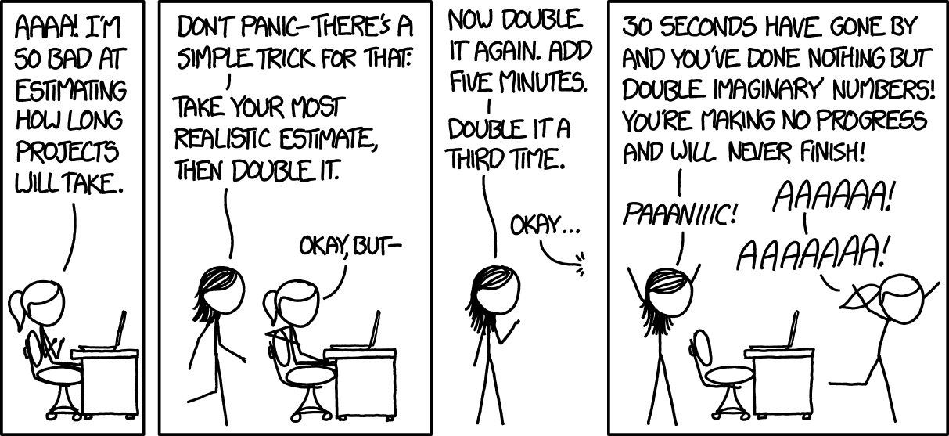
Start Early!
Hard due date: TBD

Slide 44
Logistics
Please submit code that compiles
Test using the driver before submitting!
  Run the tests individually when debugging
  Run them all at once to see how you’ll be graded
“Passing” a test means that you get the correct result without crashing, within the time limit
  A failing test can crash the rest of its section!
Full scores required on some sections for others to run:
  Minimum → auth/extra → malicious → benchmarks
Benchmarks will be run after the deadline
Benchmarked scores will be the median of 3 runs, assuming you pass all of them
Notes:
Alice

Slide 45
Logistics: Test Points
Grade breakdown (125 points total):
  95 points via server_unit_test_pserv.py
    25 points Minimum Requirements
    20 points Authentication Functionality
    5 points HTML5 Fallback
    10 points Video Streaming
    5 points IPv6 Support
    15 points Extra Tests
    15 points Robustness (malicious tests)
  20 points via server_bench.py (5 tests × 4 points)
  10 points via documentation & version control
15 extra-credit points via fuzz-pserv.py
10 extra-credit points via superb performance (e.g. EPoll)
Notes:
Tanvi

Slide 46
Scoreboard
Just like projects 2 and 3, you can submit your performance results to the scoreboard.
See the course website for detailed rules and instructions.
Great way to see how well your server is doing.
~cs3214/bin/sspostresult.py
Notes:
Tanvi

Slide 47
I think this should be a fun project and you'll learn something new, even if you're already an experienced web programmer.
– Dr. Back

Slide 48
Where to start
Concepts
Read the project spec (Take notes!)
Understand the starter code (Write comments! Look up system calls!)
Implementation
Start with serving static files
Move to authentication (/api/login)
Move to serving /api/video and Range requests
Save performance for last (easier debugging)
Notes:
Alice

Slide 49
Helpful Links
The Project Home Page
Socket Programming
  socket() man page
bind() man page
listen() man page
accept() man page
HTTP
Mozilla Documentation - Message Formats
Notes:
Alice

Slide 50
Fuzzing
(Not required, but fun 🙂)
Notes:
Tanvi

Slide 51
What is Fuzzing?
Fuzzing is a software security testing technique: give a program some unexpected input, with the intention of crashing it or altering its behavior.
It’s a great way to find bugs and security vulnerabilities in our programs. Bugs in web servers are dangerous!
Notes:
Tanvi

Slide 52

Enter AFL++
AFL++ is a source-code-guided fuzzer that can efficiently find bugs in C programs.
Originally only works with programs reading from STDIN/files. It runs forever until stopped, getting smarter as it goes.
We’ve created a library to allow it to work with network sockets, and a series of scripts for you to easily “fuzz” your server.
AFL++ GitHub Repo
AFL++ Website
(“We” meaning Dr. Back and Connor Shugg. This was part of a VT CS research project for Connor Shugg’s MS thesis.)
Notes:
Tanvi

Slide 53
AFL++ and your server
Tools have been provided to enable the fuzzing of your servers. Once you’ve got a functional server, give it a whirl!
Step 1: run ~cs3214/bin/fuzz-pserv.py
  Let it run. See if it finds some issues!
Step 2: output_dir/fuzz-rerun-gdb.sh
  Run this with the “crash files” or “hang files” discovered by the fuzzer to debug your issues.
(This is an excellent bug-finding and bug-reproducing system!)
Notes:
Tanvi

Slide 54
Demo
Fuzzing a buggy server
Notes:
Alice
Demoing fuzz-pserv.py
Navigate to your demo server
Invoke fuzz-pserv.py to see the help menu
Fuzz the server (with -j) until it crashes
View the summary, and take a look at a crash file
Debugging a crash
Run the provided GDB command to reproduce the crash
Determine the location of the crash
Ask for issues and iteratively fix them
Run fuzzer again and confirm the issue is fixed

Slide 55
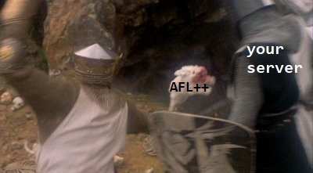
Fuzzing Documentation
Markdown Documentation (multiple locations):
On the course site
In the base code repo (check sfi/)
Notes:
Tanvi

Slide 56
Fuzzing Extra Credit
Using the fuzzer allows you to earn extra credit - up to extra points. You get more points the better your server does while the fuzzer is attacking it:
Stage 1: getting the fuzzer running. (+5)
Stage 2: fuzzer finds zero bugs in 15 seconds. (+2)
Stage 3: fuzzer finds zero bugs in 2 minutes. (+2)
Stage 4: fuzzer finds zero bugs in 10 minutes. (+2)
Stage 5: fuzzer finds zero bugs in 1 hour. (+4)
Notes:
Tanvi

Slide 57
Questions?
Thank you for attending!

