Slide 1

CS 3214: Project 1
The Customizable Shell
Help Session:
Friday Feb 9, 2023 7:00 PM
Isaiah Hipolito <isaiahh@vt.edu>
Anthony Nguyen <anthonyn33@vt.edu>
Steve Park <stevep00@vt.edu>
Notes:
Anthony

Slide 2
Topics
Shell Concepts
Project Overview / Logistics
Version Control (Git & Gitlab)
Debugging (GDB & Valgrind)
Advice
Q & A

Slide 3
Shell Concepts
Notes:
Zhuowei

Slide 4
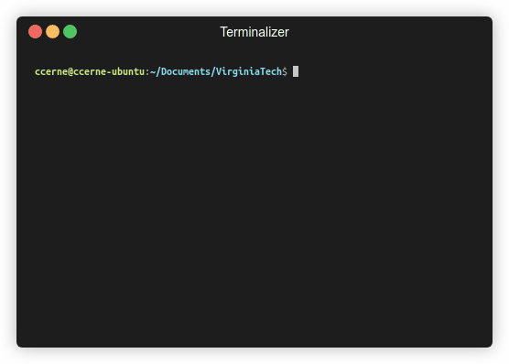
What is a shell?
Command Interpreter
  Reads user input and executes user requests
  Not to be confused with a “Terminal” (next slide explains distinction)

Slide 5
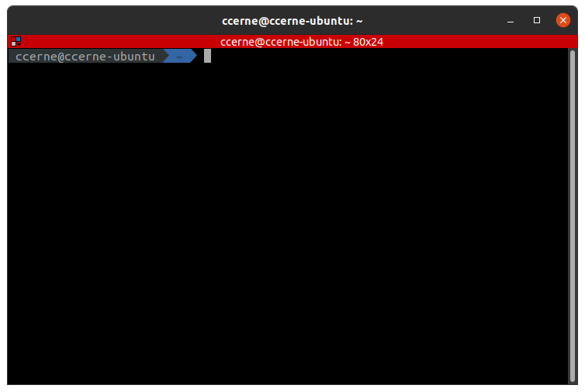
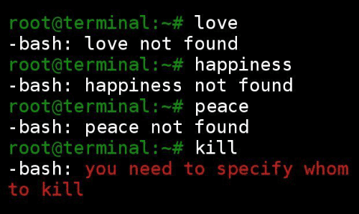
Terminal vs Shell
Terminal (the front-end GUI of our shell)
Shell (an executable with no GUI)
This terminal is running bash, a shell program
Examples: gnome-terminal, terminator, Terminal.app (macOS) etc.
Notes:
Shell is a program which processes commands and returns output. Terminal is a program that runs a shell, in the old days, was literally hardware but now the concept is translated in software (like Gnome-Terminal)
We will not be making a terminal - Timothy

Slide 6


Behind the Scenes
FOUR STEPS for non-built-in
1. Shell waits for user input
2. Shell interprets command
3. Forks a process
4. If the command is a foreground process, the parent waits for the child to finish before taking in new command. If it's a background process, the parent waits for a signal from the child but at the meantime accepts additional command.
$ echo 'Welcome to Systems!'
Welcome to Systems!
fork
- Child executes the command and writes to stdout
Notes:
Isaiah

Slide 7
Additional Features for the Shell (where you come in)
Foreground / Background Processes
Process Groups
Built-in Commands
I/O Piping
I/O Redirection
Signal Handling
Notes:
Vineet

Slide 8
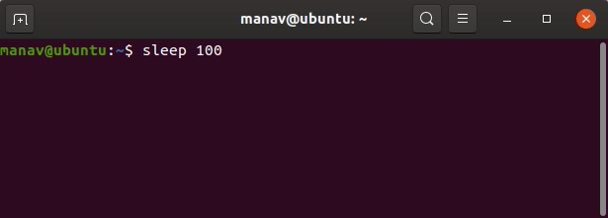
Foreground / Background Processes
The shell can fork processes into the foreground or background
Foreground | Background
Only one foreground process group at a time Process has access to the terminal | Process doesn’t have terminal access Using ‘&’ sends command to background to run
Notes:
Vineet

Slide 9
Process Groups
A Job is essentially a pipelined-command
Each Job has its own process group
  Each command within a Job should have the same PGID
  Two methodologies of creating new processes:
    fork() and execvp()
    posix_spawn
Jobs are deleted when they are completed
  Be careful not to delete a job prematurely
  See the comment above wait_for_job()
Notes:
Isaiah

Slide 10

Notice the PID and PGID!
Notes:
Vineet

Slide 11
POSIX Spawn
Replaces fork() + exec() entirely
Code is streamlined rather than handling multiple processes in if-else statements
posix_spawnattr_t and posix_spawn_file_actions_t are structs that store information about process groups and I/O redirection/piping respectively. These structs don’t do anything until posix_spawnp is used.
  You will need to setup/configure these structs
Example: posix_spawn(3) - Linux manual page (man7.org)
Note: You need to include “spawn.h” in your cush.c to use these functions. The file is located in the posix_spawn directory. Also be sure to use the “make” command to compile posix_spawn.
Notes:
Zhuowei

Slide 12
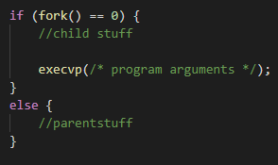
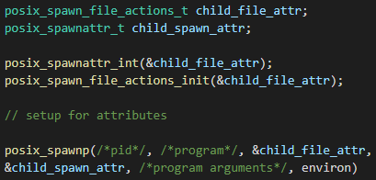

fork() + exec()
posix_spawn()
You can use fork() + exec() for this project, but our recommendation is:
Notes:
Zhuowei
While both posix_spawnattr_t and posix_spawn_file_actions_t structures store important configuration information, they are passive on their own. That means simply defining or populating these structures doesn't enact any changes. The function posix_spawnp() is what activates or uses these configurations. When called, posix_spawnp() takes the data stored in these structures to create a new process with the specified attributes and file actions.

Slide 13
POSIX Spawn Attributes
Process Groups - posix_spawnattr_setpgroup()
Terminal Control - posix_spawnattr_tcsetpgrp_np()
Piping - posix_spawn_file_actions_adddup2()
I/O Redirection - posix_spawn_file_actions_addopen()
More listed on both the spec and <spawn.h>.
Notes:
Zhuowei

Slide 14
Built-in Commands
Commands that are defined within the program by you
  No need to fork off and execute an external program
Required Built-In Commands for your shell:
  kill - kills a process
  jobs - displays a list of jobs
  stop - stops a process
  fg - sends a process to foreground
  bg - sends a process to background
  exit - exits the shell
Built-in Commands are not considered Jobs
Two additional built-ins / functionality extenders also required (examples in later slide)
  One low-effort (cd, custom prompt, etc.)
  One high-effort (glob expansion, history, etc.)
Notes:
Vineet

Slide 15
Built-ins Behind the Scenes
FOUR STEPS for built-in
1. Shell waits for user input
2. Shell realizes this is a built in command
3. Shell executes built-in (no forking)
4. After execution, shell repeats
$ jobs
[1]+ Stopped vim
[2]- Running sleep 20 &
Notes:
Vineet

Slide 16


I/O Piping
ls -l | grep *.txt | wc
ls -l
The Shell will fork off a child process to execute each command in a pipeline
But since this is a pipeline of commands, we’ll also need to wire STDIN and STDOUT for each process….
Redirect the output to grep
grep *.txt
Redirect the output to wc
wc
Output to stdout
Notes:
Vineet

Slide 17
I/O Piping
Processes will wait on previous process, final process outputs to terminal
STDIN and STDOUT for processes are joined to create the pipeline
ls -l
grep *.txt
wc
Stdin:
Stdout:
ls -l | grep *.txt | wc
1 9 58
Notes:
Draw Example on the Board if possible - Vineet

Slide 18
I/O Redirection
> overwrites original file contents before writingnew output
>> appends new content to the end of the original file
< read input from a file rather than STDIN
Notes:
Zhuowei (greater sign) (double greater sign) (less than sign)

Slide 19

I/O Redirection (Output)
echo 'Welcome to Systems!' > output.txt
fork
output.txt
Welcome to Systems!
Notes:
Zhuowei

Slide 20
I/O Redirection (Input)
wc < hello.txt
fork
1 2 12
hello.txt
Notes:
Zhuowei

Slide 21

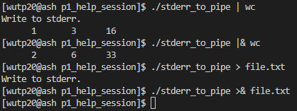
I/O Redirection (Stderr)
Contents written to STDERR can also be piped into other processes using |& and outputted to files using >&.
Notice how the message “Write to stderr.” was not outputted.
Notes:
Zhuowei
When you use | it only pipes the stdout to the wc, as you can see the “write to stderr” line is from stderr
When you use the |&, it pipes both stdout and stderr to wc
When you use >, it only redirects stdout to file.txt
When you use >&, it redirects both stdout and stderr to file.txt

Slide 22
Signal Handling
Shells can handle signals sent to them
  SIGINT (Ctrl + C)
  SIGTSTP (Ctrl + Z)
  SIGCHLD (when a child process terminates)
Most of the functionality of this will be done in
handle_child_status(pid_t pid, int status)
Notes:
Vineet

Slide 23
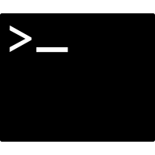


Handling SIGINT (Ctrl + C)
1. Shell and single child process (in the foreground) are running
2. User sends SIGINT (Ctrl +C)
3. Signal sent to foreground process group
4. Group is forced to terminate, shell reacquires terminal control
Explanation : https://en.wikipedia.org/wiki/Process_group#Applications
Notes:
Vineet: The only signal that you absolutely must catch is SIGCHLD (according to FAQ)

Slide 24

Handling SIGTSTP (Ctrl + Z)
1. Shell and single child process (in the foreground) are running
2. User sends SIGTSTP (Ctrl + Z)
3. Signal sent to foreground process group
4. Group is forced to stop, shell reacquires terminal control
Z
Explanation : https://en.wikipedia.org/wiki/Process_group#Applications
Notes:
Vineet The only signal that you absolutely must catch is SIGCHLD (according to FAQ)

Slide 25

Handling SIGCHLD
Process 3657 just exited
1. Shell and single child process (foreground or background) are running
2. Child process is finished and terminates - notifies parent by sending SIGCHLD
3. The shell’s SIGCHLD handler code to capture child status and perform any necessary bookkeeping (in next slide)
4. Shell continues running
Explanation : https://en.wikipedia.org/wiki/Process_group#Applications
Notes:
Vineet

Slide 26
Handling SIGCHLD: WIF* Macros
When wait* is called it will return a pid and a status for a child process that changes state. Using macros, we can decode this status to discover what state a process changed to and how it happened:
  WIFEXITED(status) - did child process exit normally?
  WIFSIGNALED(status) - was child process signaled to terminate?
  WIFSTOPPED(status) - was child process signaled to stop?
Notes:
Vineet wait and waitpid will have a wstatus argument as an int * which will store the wait status for use with this macro

Slide 27
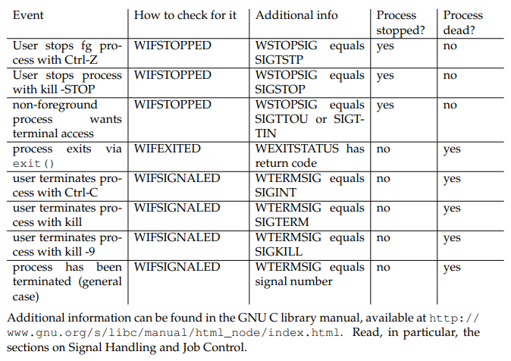
Notes:
Vineet

Slide 28
Project Overview
Notes:
Zhuowei

Slide 29
Requirements and Grading
Basic Functionality - 50 pts
  Start foreground and background jobs
  Built-in commands : ‘jobs’, ‘fg’, ‘bg’, ‘kill’, ‘stop’
  Signal Handling (SIGINT, SIGTSTP, SIGCHLD)
Advanced Functionality - 50 pts
  I/O Piping
  I/O Redirection
  Running programs requiring exclusive terminal access (ex: vim)
Two Extra Built-ins - 20 pts
  One low effort
  One high effort
  Testing required for both
Version Control (git) - 10 pts
  At least 3 commits per partner
Documentation - 10 pts
  a. Write a README.txt
  b. Comments and function headers
Total : 140 points
Notes:
Zhuowei

Slide 30
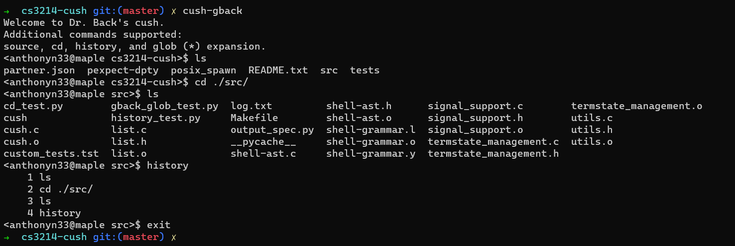
Before You Start Coding ….
Take time to read over, understand the spec and the starter code
Read the provided lecture material
Understand Exercise 1
  fork() / exec() model (please just read posix_spawn)
  Piping : pipe(), dup2(), close()
Check out Dr. Back’s example shell
  ~cs3214/bin/cush-gback in rlogin
  Compare its output with your shell’s
Notes:
Zhuowei

Slide 31
Base Code
Already includes a parser!
Parser spits out hierarchical data structures
All you need to do is process these structs!
Notes:
Vineet

Slide 32
Structs
ast_command_line
ast_pipeline
  A “Job”
  I/O redirection files
  Append (>>)
  Background (&)
ast_command
  Argv
  Stderr redirect
See shell-ast.h for fields and their descriptions!

Slide 33
ast_command_line
ast_command_line
ast_pipeline
ast_pipeline
echo 70 > anthony_midterm.txt; cat isaiah_midterm.txt | rev > steve_mitderm.txt
ast_command
ast_command
ast_command
ast_pipeline
ast_pipeline
echo 70 > anthony_midterm.txt
cat isaiah_midterm.txt | rev > steve_mitderm.txt
ast_command
ast_command
ast_command
echo 70
cat isaiah_midterm.txt
rev
Notes:
Vineet

Slide 34
List Data Structure
You’re also provided with a doubly linked list data structure
  Check out list.h and list.c
You’ll be using this list throughout the semester
Read through list.h before using it
Notes:
Zhuowei

Slide 35
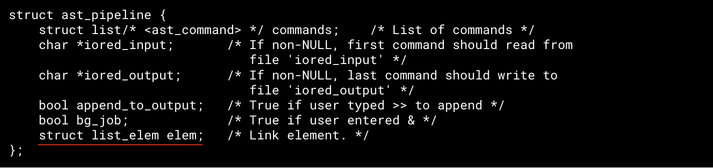
“Data contains node” vs “Node points to data”
Our Linked List
A Regular Linked List
struct list_elem {
struct list_elem * prev;
struct list_elem * next;
}
class listnode<T> {
T data;
listnode <T> prev;
listnode<T> next;
}
Notes:
Zhuowei

Slide 36
“Data contains node” vs “Node points to data”
Our Linked List
A Regular Linked List
struct list_elem {
struct list_elem * prev;
struct list_elem * next;
}
class listnode<T> {
T data;
listnode <T> prev;
listnode<T> next;
}
Struct 1
Struct 2
Sentinel
Node
Node
Sentinel
Other fields
Other fields
Sentinel
list_elem
list_elem
Data
Data
Sentinel
Notes:
Zhuowei

Slide 37
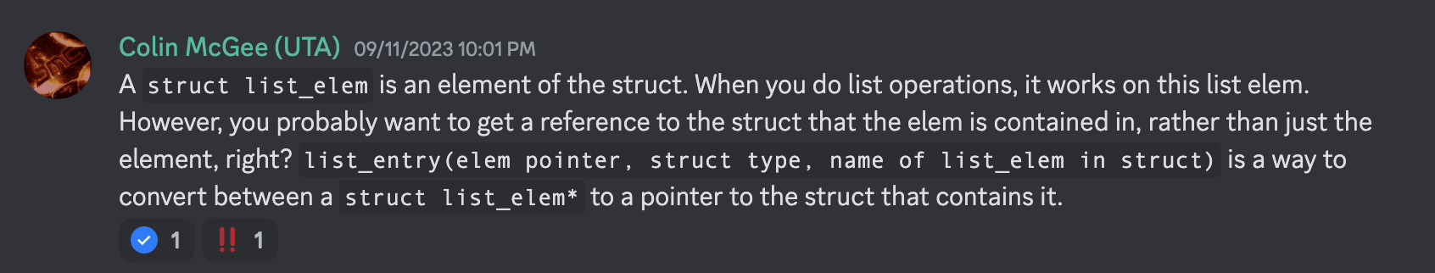
So how do I get my data?
struct ast_command * cmd = list_entry(e, struct ast_command, elem);
Retrieve data from a struct list_elem by using the list_entry macro:
Beautiful explanation by one of our UTA’s :)
Notes:
Zhuowei

Slide 38
List Pitfalls
BAD IDEA :(
// invalid example
for (list_elem in list)
{
// do stuff
if (someCondition)
{
list_remove(currElem);
}
}
Don’t:
  Use the same list_elem for multiple lists
  Edit an element while iterating
    Naive loop to remove elements in a list will fail!
  Forget to list_init()
// valid example: deallocates a pipeline struct and any commands stored in it while iterating
void ast_pipeline_free(struct ast_pipeline *pipe)
{
for (struct list_elem * e = list_begin(&pipe->commands); e != list_end(&pipe->commands); ) {
struct ast_command *cmd = list_entry(e, struct ast_command, elem);
e = list_remove(e); //Acts as the iterator; stores next element into e
ast_command_free(cmd);
}
free(pipe);
} // make sure to remove an ast_pipeline from a list before adding it to another!
// bottom line with lists? ALWAYS TEST
Notes:
Zhuowei

Slide 39
Utility Functions (Strongly Recommended)
Signal Support (signal_support.c / .h)
  signal_block()
  signal_unblock()
  singal_set_handler()
Terminal State Management (termstate_management.c / .h)
  termstate_init()
  termstate_give_terminal_to()
  termstate_give_terminal_back_to_shell()
  termstate_get_current_terminal_owner()
  termstate_save()
  termstate_restore()
Notes:
Vineet

Slide 40
Additional Built-ins and extensions
Your shell must contain two extra built-ins / functionality extensions
  One high effort and one low effort (bolded is low-effort)
Ideas include:
If you have an idea not shown on the list or have any doubts please ask us
Customizable Prompt
Setting/unsetting env vars
Implementing the ‘cd’ built-in
Glob expansion (e.g., *.c)
Timing commands (ex. time)
Alias support
Shell Variables
Directory Stack
Command-line history
Backquote substitution
Smart command-line completion
Embedded Apps
Notes:
Vineet

Slide 41
Testing / Submission
Test the driver before submitting, don’t just run tests individually
When grading, tests will be ran 3-5 times. If you crash a single time, it’s considered failing
Make sure you don’t have undefined behavior by checking the system call return code and using valgrind to address memory related issues
Notes:
Vineet

Slide 42
Test Driver
The driver reads from .tst file that describes a test suite (ex. basic.tst)
  Ex: basic.tst contains a series of test scripts that it will run from the folder /tests/basic
cd src/
../tests/stdriver.py [options]
*- stdriver.py also available at ~cs3214/bin/stdriver.py
Options:
-b : basic tests (processes, built-ins, signals)
-a : advanced tests (I/O Piping, I/O Redirection, exclusive terminal access)
-h : list all the options
Notes:
Vineet

Slide 43
Additional Tests
You are required to write tests for your two extra built-ins
  Create a .tst file in ‘tests’ and create a directory that will store your test scripts
Inside <custom>.tst file:
= <custom> Tests
pts <custom>/<test_name>.py
pts <custom>/<test_name>.py
…
The driver checks number of total points (pts) to use for a test. Since this is just your own custom tests you can put an arbitrary points here
Use gback_glob_test.py as a starter.
= Milestone Tests
1 basic/foreground.py
1 basic/cmdfail_and_exit_test.py
Notes:
Vineet

Slide 44
Additional Tests (Part 2)
Make sure your custom.tst file is of type “ASCII text”
If it includes Windows line terminators (CR, CRLF, etc) it will fail
We want \n, not \r\n
$ file custom.tst
custom.tst: ASCII text
Notes:
Vineet

Slide 45
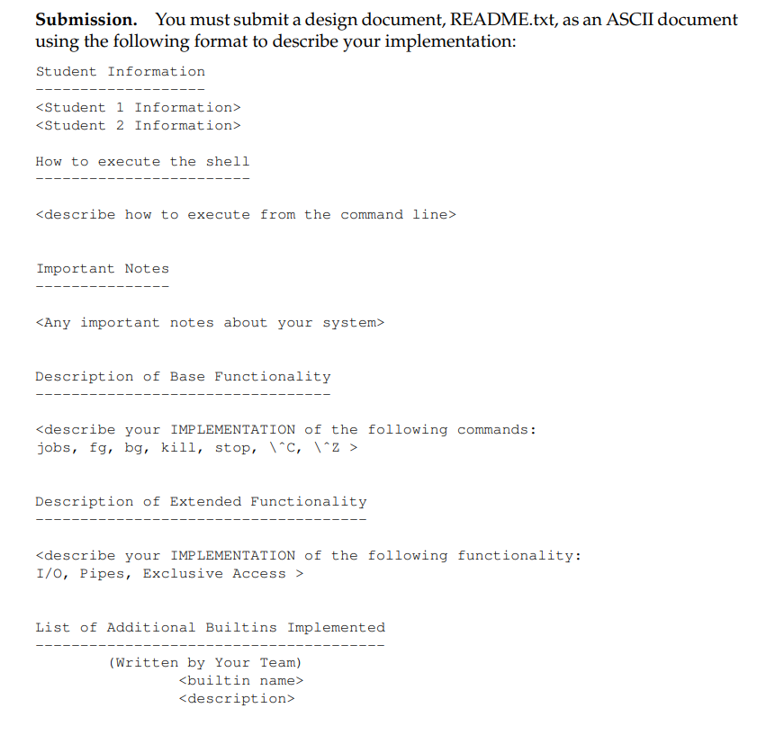
Design Document
When you submit you must include a README.txt describing your implementation of P1
Explain the custom built-ins created and approach taken to develop them.
TAs will assign credit only for the functionality for which test cases and documentation exist
Notes:
Vineet

Slide 46
Version Control
Notes:
Vineet

Slide 47
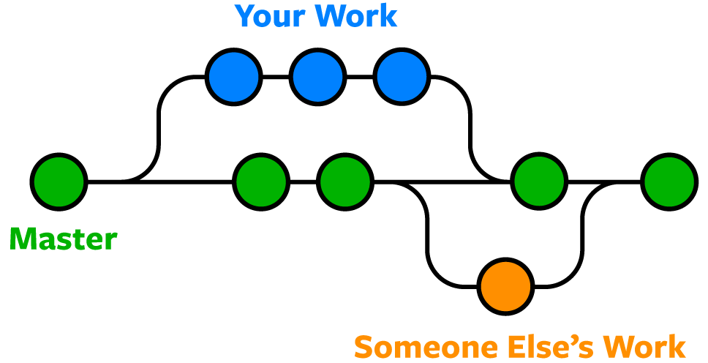

Version Control
You will be using Git and Gitlab for managing your source code
Why?
  Organizes your code
  Keeps track of features
  Allows collaborators to work freely without messing up other existing code
  Back-ups whenever something goes wrong
Notes:
Vineet

Slide 48
Basic Git Commands
Stage file for commit:
Commit files:
Push changes to remote (note: always pull before push!)
$ git add <file_name>
$ git commit -m ‘Add a description here’
$ git push [origin <branch_name>]
Notes:
Vineet

Slide 49
Basic Git Commands
Fetch changes from remote:
Check status:
Revert to the previous commit:
$ git pull
$ git status
$ git reset [--hard]
Notes:
Vineet

Slide 50
Basic Git Commands
Create a new branch from the current branch:
Switch to another branch:
Merge a branch into the current branch
$ git checkout –b <new_branch_name>
$ git checkout <branch_name>
$ git merge <branch_name>
Notes:
Vineet

Slide 51
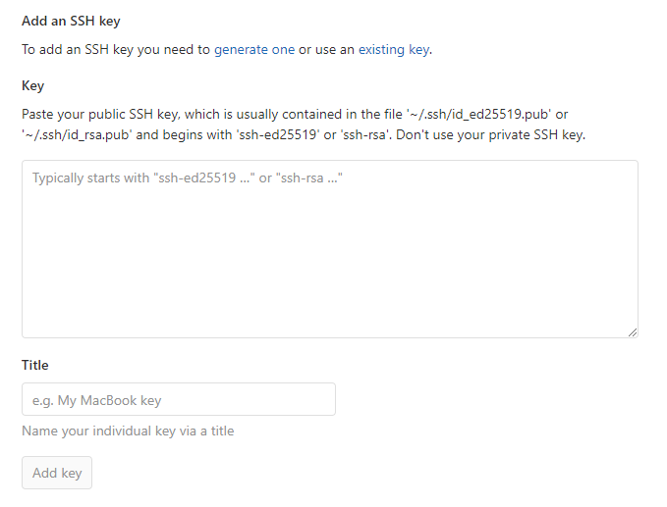
Setup Git Access
You’ll need an SSH Key to get access to projects at git.cs.vt.edu
If you don’t already have a key…
  Create a new key:
  Add Key to https://git.cs.vt.edu/profile/keys
    You will paste public key here ----------->
$ ssh-keygen -t rsa -b 4096 -C "email@vt.edu" \
-f ~/.ssh/id_rsa
Notes:
Vineet

Slide 52
Verify Git Access
Verify you have access
The first time you connect you will be asked to verify the host, just answer ‘Yes’ to continue
You can get in-depth explanations here:
  Generate a key
  Use an existing key
11 spencetk@linden ~ >ssh git@git.cs.vt.edu
PTY allocation request failed on channel 0
Welcome to GitLab, @spencetk! ← Your pid should be displayed here
Connection to git.cs.vt.edu closed.
Notes:
Vineet

Slide 53
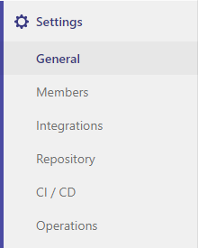
GitLab Project Setup
One member will fork the base repository:
  https://git.cs.vt.edu/cs3214-staff/cs3214-cush
Invite partner to collaborate
  Go to Settings > Members to add them
  Check partner role permissions too
Both members will clone the forked repository on their machines:
IMPORTANT: Set forked repository to private
Go to Settings > General > Visibility, project features, permissions
$ git clone <your git repo url>.git
cs3214-cush
*Your forked repository will have a navigation menu on the left side. Click under Settings to add members and set repo to private
Notes:
Vineet

Slide 54

The GNU Project Debugger (GDB)
Notes:
Zhuowei

Slide 55
Starting GDB
1. Invoke GDB with a program:
2. Run with command
Must be compiled with debug symbols, -g
$ gdb program
(gdb) run arg1 arg2
Notes:
Zhuowei

Slide 56
Breakpoints
Set a breakpoint
Set a conditional breakpoint:
Ignore breakpoint #1 100 times
Show # of times breakpoint was hit
(gdb) b <func_name> OR
(gdb) b <line_number>
(gdb) b <func_name> if <condition>
(gdb) ignore 1 100
(gdb) info b
Notes:
Zhuowei

Slide 57
Backtrace and Frames
Show backtrace:
Show frame:
  After selecting frame, you can print all variables declared in that function call
(gdb) backtrace
(gdb) frame <num>
Notes:
Timothy

Slide 58
Follow-Fork-Mode
Which process to follow after a fork (parent / child):
  ‘parent’ = ignore child process and continue debugging the parent
  ‘child’ = begin debugging the child process when fork() is called
Retaining debugger control after fork:
  After a fork, specify whether to freeze the child or allow it to run (this may make it difficult to find race conditions)
(gdb) set follow-fork-mode <mode>
(gdb) set detach-on-fork <mode>
Light reading: https://visualgdb.com/gdbreference/commands/set_follow-fork-mode
Notes:
Zhuowei

Slide 59
Valgrind
Notes:
Zhuowei

Slide 60
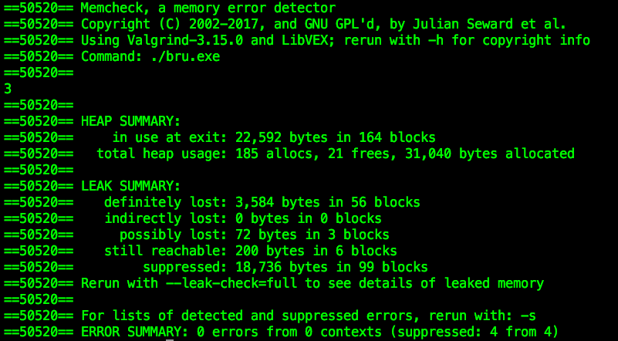
1. Start valgrind
$valgrind --log-file="output.log" --leak-check=full ./cush
2. Run commands in your shell
cush@cedar in src> jobs
cush@cedar in src> ls
3. Check the log file
Notes:
Address the errors such as definitely lost and invalid read in your code

Slide 61
Advice
Notes:
Vineet

Slide 62
Advice
START EARLY
READ! Then create a roadmap before coding
Utilize TAs
  Come with questions prepared, try to figure out what the problem is first
  Be organized and have clean code - the cleaner it is, the faster we can help!
  Run valgrind and try debugging with GDB before consulting us
  TA’s all have unique ways of implementing/coding. You will hear different answers that both work.
  Discord, Zoom, Class Forum
Understand the Exercises
Use valgrind! This can isolate many bugs
Become an expert at the debugger
Find what works best for communicating with your partner
  In-Person Meetings, Discord, Zoom, etc.
Notes:
Vineet

Slide 63
Sources
Referred to previous help session slides created by previous UTA’s Kent McDonough, Connor Shugg, Joe D’Anna, Chris Cerne, Justin Vita, Sam Lightfoot, and Alex Kyer, Timothy Wu, Tanvi Allada, Vineet Marri, and Zhuowei Wen since the Fall 2023 Semester
Spencer Keefer created the revised slides
Notes:
Vineet

Slide 64

Thanks for attending!
Questions?

