Slide 1

CS 3214 P3:
Memory allocator
Tuesday, November 5th, 2024 @ 7:00 PM
Anthony Nguyen anthonyn33@vt.edu
Steve Park stevep00@vt.edu
Based on slides by Abhishek Sathiabalan
Notes:
Zhuowei

Slide 2
Topics
Overview of Memory Management
Intro to P3
  How to Start Malloc
Project Structure
Debugging & Performance Tools
Logistics
  Grading
  Testing Framework
Notes:
Zhuowei

Slide 3

Overview of Memory Management
Notes:
Zhuowei

Slide 4
The Heap
Persistent, unmanaged memory granted to processes
  Memory leak
    Hold onto memory for too long
  Memory Corruption
    Free memory too early
Sometimes memory allocation strategies are coupled with garbage collectors
Managed by the malloc() family in stdlib
Notes:
Zhuowei

Slide 5
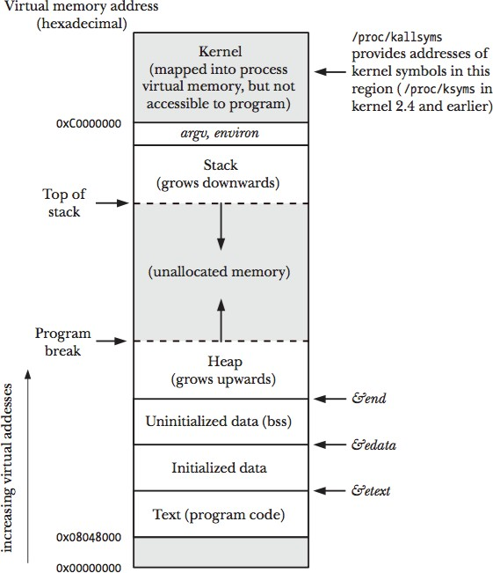
Notes:
Zhuowei

Slide 6
The Goal
Lots of allocators are available
  Hoard
  Google’s TCMalloc
  Glibc
Resource tradeoff
  Time
    Instantly access an available block
  Space
    Find a block that fits exactly
Notes:
Vineet

Slide 7

Intro to P3
Notes:
Vineet

Slide 8
Getting Started
Fork
Fork the repo
  https://git.cs.vt.edu/cs3214-staff/malloclab
  Set to private
  You WILL be graded on git usage
Review
Review the sample implementation
  mm-gback-implicit.c
  Take a close look at design decisions and function preconditions
  Be mindful of conversions between word and bytes
Create
Create and write mm.c
Notes:
Vineet

Slide 9
Provided Functions
1
void* mem_sbrk(int incr);
  Extend the heap by incr bytes and return the start address
2
void* mem_heap_lo(void);
  Return the start address of the heap
3
void* mem_heap_hi(void);
  Return the end address of the heap
4
size_t mem_heapsize(void);
  Return the current size of the heap
5
size_t mem_pagesize(void);
  Return the system’s page size in bytes
Notes:
Vineet

Slide 10
Client-Side Functions
Build off the implicit implementation from Dr. Back
  Int Mm_init(void);
  Void* Mm_malloc(size_t size);
  Void Mm_free(void*ptr);
  Void* mm_realloc(void* ptr, size_t size);
Any helper methods you find suitable
  find_fit()
  place()
  coalesce()
You must be able to handle a wide variety of sizes
Notes:
Vineet

Slide 11

Suggestions &
Project Designs
Notes:
Vineet

Slide 12
Suggestions
Performance
Consider performance implications from the start
  Do extra structs/fields require more memory?
  What edge conditions are important?
  Avoid high time complexity operations whenever possible!
Asserts
Use assert statements liberally
  Ensure alignment
  Test for pre- and post-conditions often
  Figure out where the bug occurs, rather than a side effect
  You will need at least 5 assert statements in your design
Timeline
Start early and Implement in stages
  Play with different designs
Link to lecture slides:
https://docs.google.com/presentation/d/1IC6Kghz-y2OMlzZrI8HRJU4RoDgMr6n7c0lG5tSIpWs/edit#slide=id.g120f7216323_2_722
Notes:
Vineet

Slide 13
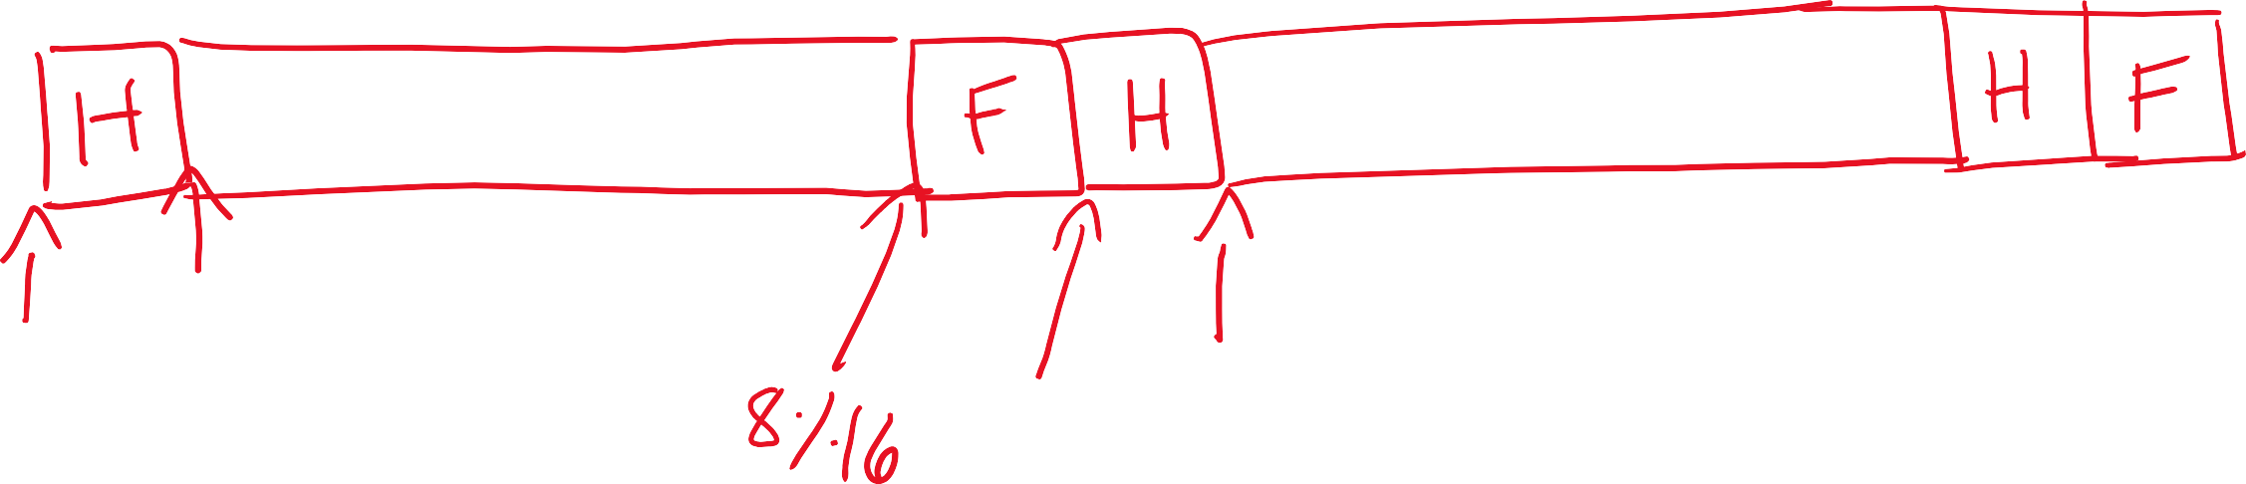






















































Alignment
4
As a side note, when you add pointers remember rlogin is a 64-bit system and thus the pointers are 8 bytes in length.
Notes:
Zhuowei

Slide 14
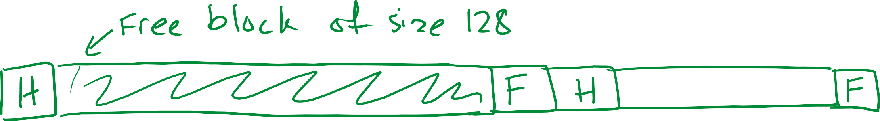











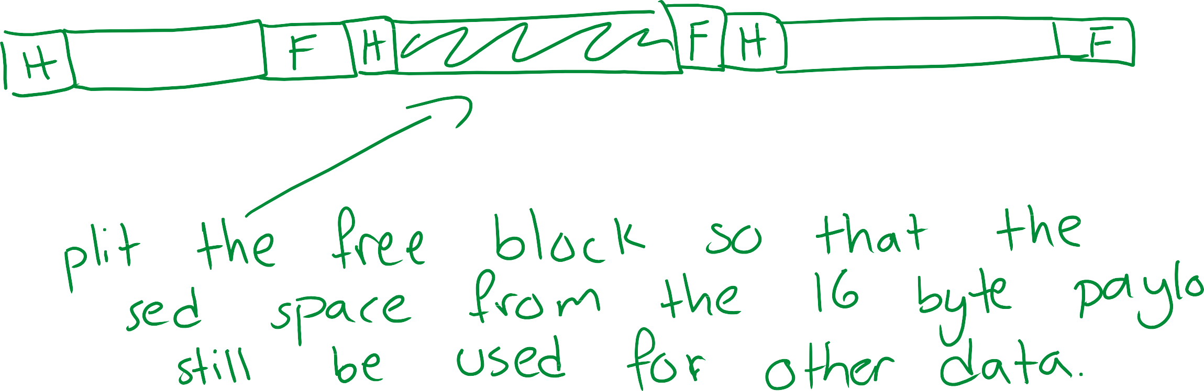






Splitting
Notes:
Zhuowei

Slide 15




















































Coalescing
Notes:
Zhuowei

Slide 16
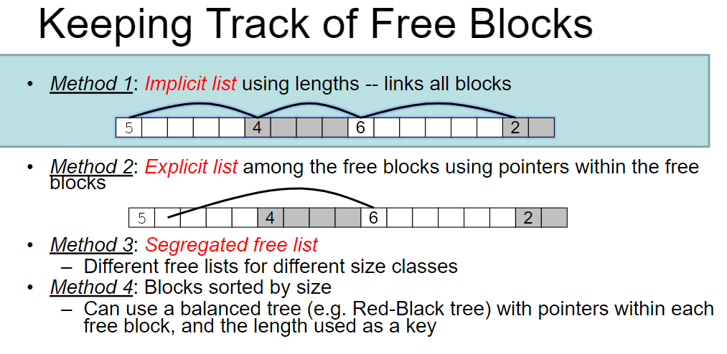
Notes:
Zhuowei

Slide 17
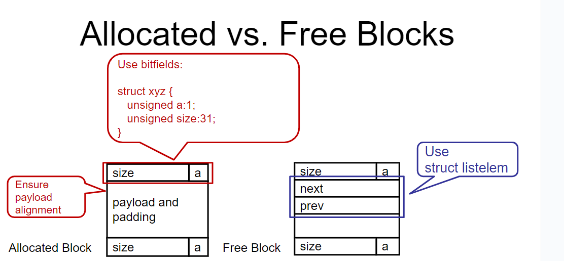

Slide 18











































































Segregated Free Lists
Notes:
Zhuowei

Slide 19
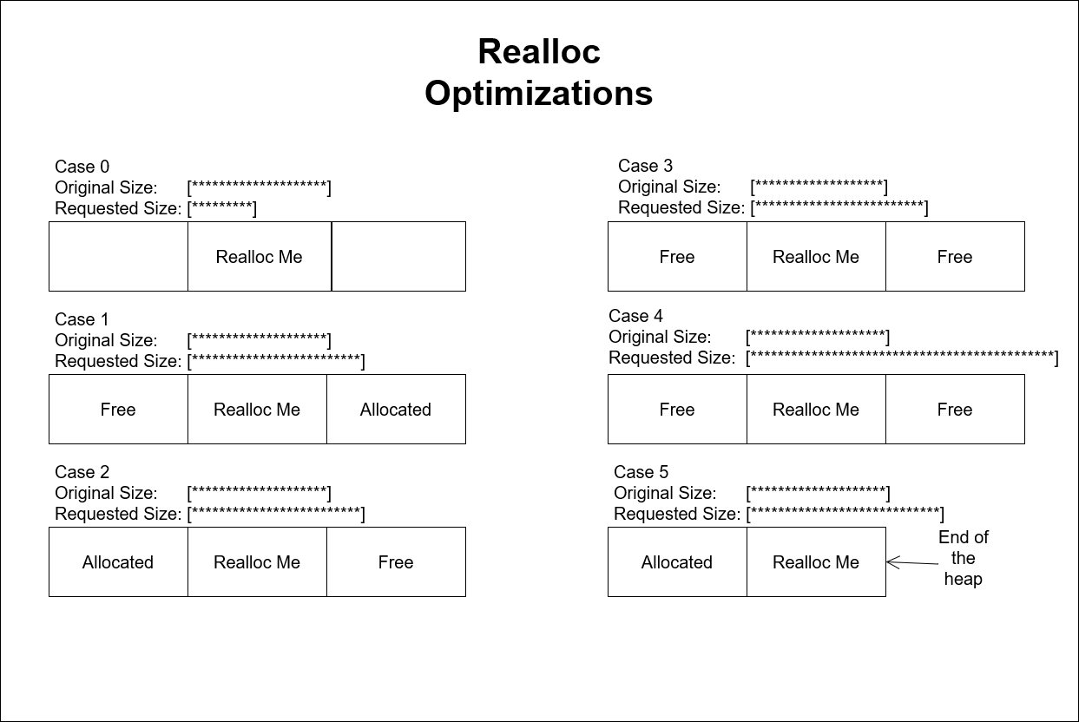
Notes:
Zhuowei

Slide 20

Debugging & Performance Tools
Notes:
Zhuowei

Slide 21
Debugging
mm_checkheap()
  Internal mechanism to check the integrity of the heap through linear iteration
  You will have to implement this to fit your design
GDB
  Check the actual values of variables
Notes:
Zhuowei

Slide 22

Performance Tools
gprof
  Tool that counts function calls and exec time, creating gmon.out
  Requires –pg flag
    Remove this flag during performance testing
  Check output using
    gprof mdriver gmon.out > prof_output
perf
  Same thing basically, but without –pg flag
  Called with perf record then perf report
Notes:
Zhuowei

Slide 23

Debugging Demo
Notes:
Zhuowei

Slide 24
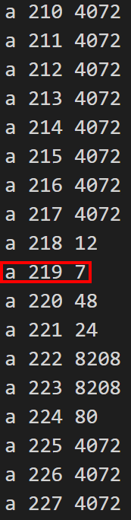
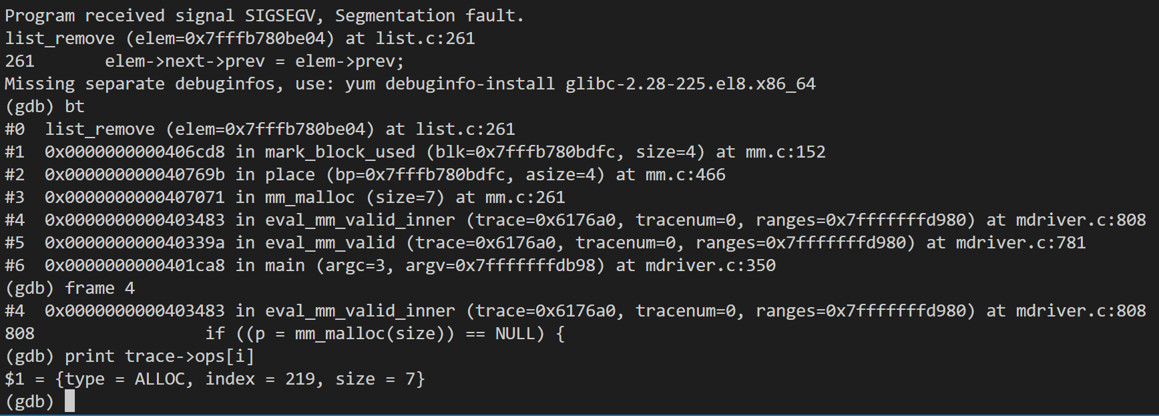
Notes:
Zhuowei

Slide 25

Project Logistics
Notes:
Vineet

Slide 26
Logistics
Submit code that compiles
  Test using the driver locally before submitting
Grading
  Tests will be run 3-5 times, taking the average
  If a single failure occurs, you get a 0
  Components
    Correctness (40%)
    Performance (40%)
      Throughput
      Space Utilization
    Design/Documentation/Git (20%)
      At least 5 assert statements
Notes:
Vineet

Slide 27
Driver
./mdriver
  Flags
  –v for verbose
  -V for MORE verbose
  -f to customize traces
  -s to vary allocation size
  -h for these (and more) flags
Notes:
Vineet

Slide 28
Performance
Throughput
  Number of requests per second
Utilization
  How much space the heap has been expanded by versus the space user data takes
  Overhead
  Fragmentation
Notes:
Vineet

Slide 29
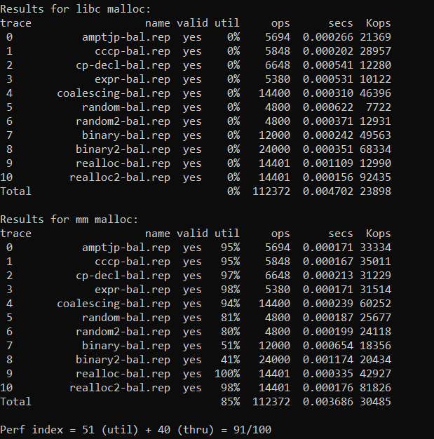
Notes:
Vineet

Slide 30
Test Trace Files
3000000
2847
5694
1
a 0 2040
f 0
// Heap size
// Unique identifiers
// Number of operations
// Weight of trace
Located in /home/courses/cs3214/malloclab/traces
Notes:
Vineet

Slide 31
Reference
[L-MEM1] Dynamic Memory Management (malloc/free)
Implicit vs Explicit
Fragmentation
Coalescing Policies
Notes:
Vineet

Slide 32

Questions?
Thank you for attending!
Notes:
Vineet

