Slide 1
CS 3214: Project 1
The Customizable Shell
Help Session: 09/14/2022
Sam Lightfoot <sabi0delaluz@vt.edu>
Alex Kyer <makyer19@vt.edu>

Slide 2
Topics
Shell Concepts
Project Overview / Logistics
Version Control (Git)
Debugging (GDB)
Advice
Q & A

Slide 3
Shell Concepts

Slide 4
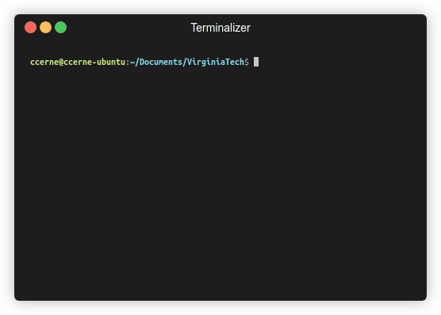
What is a shell?
Command Interpreter
Reads user input and executes user requests
Not to be confused with a “Terminal” (next slide explains distinction)
Notes:
Explanation of shell vs terminal on next page

Slide 5
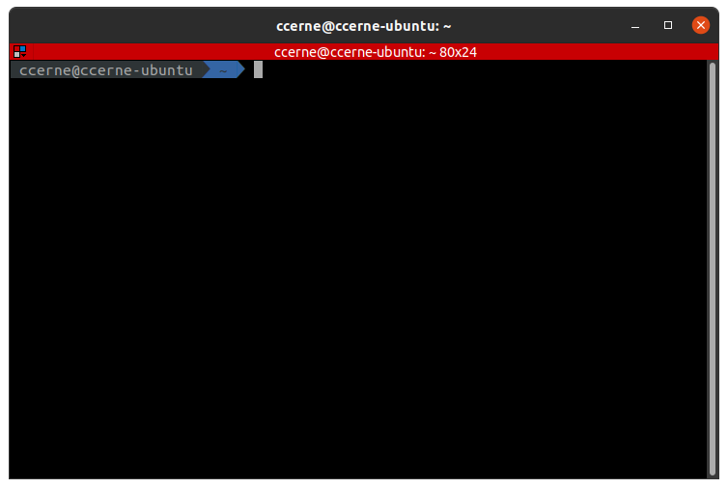
Terminal vs Shell
Terminal (the front-end of our shell)
Shell (an executable with no GUI)
ccerne@ccerne-ubuntu:~/Documents$ ls -l
ls -l
total 16
drwxrwxr-x 7 ccerne ccerne 4096 Aug 23 10:37 CTF
drwxrwxr-x 6 ccerne ccerne 4096 Sep 11 21:42 Programming
drwxrwxr-x 5 ccerne ccerne 4096 Sep 1 16:56 Programs
drwxrwxr-x 5 ccerne ccerne 4096 Sep 13 21:19 VirginiaTech
ccerne@ccerne-ubuntu:~/Documents$ echo $SHELL
/usr/bin/zsh
Examples: gnome-terminal, terminator, Terminal.app (macOS) etc.
This terminal is running zsh, a shell
The 80s called, they want their Terminal back!
Notes:
Shell is a program which processes commands and returns output. Terminal is a program that runs a shell, in the old days, was literally hardware but now the concept is translated in software (like Gnome-Terminal)
We will not be making a terminal

Slide 6
Behind the Scenes
FOUR STEPS for non-built-in
1. Shell waits for user input
2. Shell interprets command
3. Forks a process
4. If it’s a foreground parent waits for child to finish. Else, parent repeats the process again.
Child executes the command
$ echo 'Welcome to Systems!'
fork
Welcome to Systems!

Slide 7
Additional Features for the Shell (where you come in)
Foreground / Background Processes
Process Groups
Built-in Commands
I/O Piping
I/O Redirection
Signal Handling

Slide 8
Foreground / Background Processes
The shell can fork processes into the foreground or background
Foreground | Background
Only one foreground process group at a time Have access to the terminal | Does not have terminal access Using ‘&’ sends command to background to run

Slide 9
Process Groups
Each Job is its own process group
Each command within a Job should have the same PGID
Two methodologies of creating new processes:
Fork
posix_spawn
Jobs are deleted when they are completed
Be careful not to delete a job prematurely
See the comment above wait_for_job()

Slide 10
Notice the PID and PGID!

Slide 11
POSIX Spawn
Replaces fork() + exec() entirely
Code is “linear” rather than handling multiple processes in if-else statements
Example: posix_spawn(3) - Linux manual page (man7.org)
Note: You need to include “spawn.h” in your cush.c to use these functions. The file is located in the posix_spawn directory. Also be sure to use the Makefile and compile posix_spawn.

Slide 12
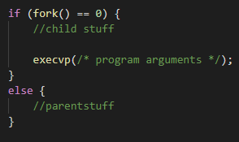
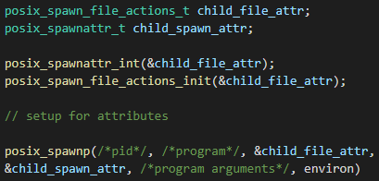
fork() + exec()
posix_spawn()
We recommend using posix_spawn() for this project, but it is not required.

Slide 13
POSIX Spawn Attributes
Process Groups - posix_spawnattr_getpgroup ()
Terminal Control - posix_spawnattr_tcsetpgrp_np()
Piping - posix_spawn_file_actions_adddup2()
More listed on both the spec and <spawn.h>

Slide 14
Built-in Commands
Commands that are defined within the program by you
No need to fork off and execute an external program
Required Built-In Commands for your shell:
kill - kills a process
jobs - displays a list of jobs
stop - stops a process
fg - sends a process to foreground
bg - sends a process to background
exit - exits the shell
Two additional built-ins / functionality extenders also required

Slide 15
Built-ins Behind the Scenes
FOUR STEPS for built-in
1. Shell waits for user input
2. Shell realizes this is a built in command
3. Shell executes built-in (no forking)
4. After execution, shell repeats
$ jobs
[1]+ Stopped vim
[2]- Running sleep 20 &

Slide 16
I/O Piping
ls -l | grep *.txt | wc
ls -l
The Shell will fork off a child process to execute each command in a pipeline
But since this is a pipeline of commands, we’ll also need to wire STDIN and STDOUT for each process….
grep *.txt
wc

Slide 17
I/O Piping
Processes will wait on previous process, final process outputs to terminal
STDIN and STDOUT for processes are joined to create the pipeline
ls -l
grep *.txt
wc
Input:
Output:
ls -l | grep *.txt | wc
1 9 58

Slide 18
I/O Redirection
> overwrites original file contents before writing out
>> appends to the end of contents in file
< read input from existing file rather than STDIN

Slide 19
I/O Redirection (Output)
echo 'Welcome to Systems!' > output.txt
fork
output.txt
Welcome to Systems!

Slide 20
I/O Redirection (Input)
wc < hello.txt
fork
1 2 12
hello.txt

Slide 21
Signal Handling
Shells can handle signals sent to them
SIGINT (Ctrl + C)
SIGTSTP (Ctrl + Z)
SIGCHLD (when a child process terminates)

Slide 22
Handling SIGINT (Ctrl + C)
1. Shell and single child process (in the foreground) are running
2. User sends SIGINT (Ctrl +C)
3. Signal sent to foreground process group
4. Group is forced to terminate, shell reacquires terminal control
Explanation : https://en.wikipedia.org/wiki/Process_group#Applications
Notes:
The only signal that you absolutely must catch is SIGCHLD (according to FAQ)

Slide 23
Handling SIGTSTP (Ctrl + Z)
1. Shell and single child process (in the foreground) are running
2. User sends SIGTSTP (Ctrl + Z)
3. Signal sent to foreground process group
4. Group is forced to stop, shell reacquires terminal control
Z
Explanation : https://en.wikipedia.org/wiki/Process_group#Applications
Notes:
The only signal that you absolutely must catch is SIGCHLD (according to FAQ)

Slide 24
Handling SIGCHLD
Process 3657 just exited
1. Shell and single child process (foreground or background) are running
2. Child process is finished and terminates - notifies parent by sending SIGCHLD
3. The shell’s SIGCHLD handler code uses info to perform any necessary bookkeeping
4. Shell continues running
Explanation : https://en.wikipedia.org/wiki/Process_group#Applications

Slide 25
Handling SIGCHLD: WIF* Macros
When wait* is called it will return a pid and a status for a child process that changes state. Using macros, we can decode this status to discover what state a process changed to and how it happened:
WIFEXITED(status) - did child process exit normally?
WIFSIGNALED(status) - was child process signaled to terminate?
WIFSTOPPED(status) - was child process signaled to stop?
Notes:
wait and waitpid will have a wstatus argument as an int * which will store the wait status for use with this macro

Slide 26
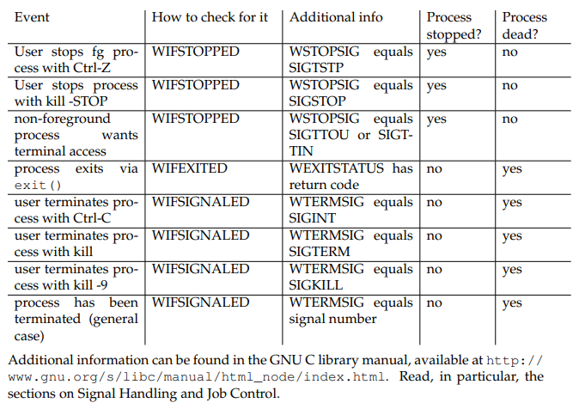

Slide 27
Project Overview

Slide 28
Requirements and Grading
Basic Functionality - 50 pts
Start foreground and background jobs
Built-in commands : ‘jobs’, ‘fg’, ‘bg’, ‘kill’, ‘stop’
Signal Handling (SIGINT, SIGTSTP, SIGCHLD)
Advanced Functionality - 50 pts
I/O Pipes
I/O Redirection
Running programs requiring exclusive terminal access (ex: vim)
Extra Built-ins - 20 pts
Version Control (Git) - 10 pts
Documentation - 10 pts
Total : 140 points

Slide 29
Before You Start Coding ….
Take time to read over and comment the starter code
Read the provided lecture material and Chapter 8 in the textbook
Understand Exercise 1
fork() / exec() model
Piping : pipe(), dup2(), close()
Check out Dr. Back’s example shell
Located at ~cs3214/bin/cush-gback in rlogin
Can be useful for comparing outputs with your shell

Slide 30
Base Code
Already includes a parser!
Parser spits out hierarchical data structures

Slide 31
Data Structures
ast_command_line
ast_pipeline
ast_pipeline
ast_command_line
ast_command
ast_command
ast_command
sleep 10 &; echo hi | rev
ast_pipeline
ast_pipeline
sleep 10 &
echo hi | rev
ast_command
ast_command
ast_command
sleep 10
echo hi
rev

Slide 32
List Data Structure
You’re also provided with a linked list data structure
Check out list.h and list.c
You’ll be using this list throughout the semester
Read through list.c before using it

Slide 33
“Data contains node” vs “Node points to data”
Your Linked List
A Regular Linked List
struct list_elem {
struct list_elem * prev;
struct list_elem * next;
}
class listnode<T> {
T data;
listnode<T> next;
}
Struct 1
Struct 2
Sentinel
Node
Node
Sentinel
….
….
Sentinel
list_elem
list_elem
Sentinel
Data
Data
Retrieve data from a struct list_elem by using the list_entry macro:
struct ast_command * cmd = list_entry(e, struct ast_command, elem);

Slide 34
An example of an element in a list
struct ast_pipeline { struct list/* <ast_command> */ commands; /* List of commands */ char *iored_input; /* If non-NULL, first command should read from file 'iored_input' */ char *iored_output; /* If non-NULL, last command should write to file 'iored_output' */ bool append_to_output; /* True if user typed >> to append */ bool bg_job; /* True if user entered & */ struct list_elem elem; /* Link element. */ };
Adding list_elem to a structure allows this structure to be added to a list

Slide 35
List Pitfalls
BAD IDEA :(
// invalid example
for (list_elem in list)
{
// do stuff
if (someCondition)
{
list_remove(currElem);
}
}
Don’t:
Use the same list_elem for multiple lists
Edit an element while iterating
Naive loop to remove elements in a list will fail!
Forget to list_init()
// valid example: deallocates a pipeline struct and any commands stored in it while iterating
void ast_pipeline_free(struct ast_pipeline *pipe)
{
for (struct list_elem * e = list_begin(&pipe->commands); e != list_end(&pipe->commands); ) {
struct ast_command *cmd = list_entry(e, struct ast_command, elem);
e = list_remove(e); //Acts as the iterator; stores next element into e
ast_command_free(cmd);
}
free(pipe);
} // make sure to remove an ast_pipeline from a list before adding it to another!
// bottom line with lists? ALWAYS TEST

Slide 36
Utility Functions (Strongly Recommended)
Signal Support (signal_support.c / .h)
signal_block()
signal_unblock()
singal_set_handler()
Terminal State Management (termstate_management.c / .h)
termstate_give_terminal_to()
termstate_give_terminal_back_to_shell()
termstate_restore()

Slide 37
Additional Built-ins and extensions
Your shell must contain two extra built-ins / functionality extensions
One high effort and one low effort (bolded is low-effort)
Ideas include:
Unix Philosophy - implement only functionality that is not already supported using Unix commands. If you have an idea not shown on the list or have any doubts please ask us
Customizable Prompt
Setting/unsetting env vars
Glob expansion (e.g., *.c)
Timing commands (ex. time)
Alias support
Embedded Apps
Shell Variables
Directory Stack
Command-line history
Backquote substitution
Smart command-line completion

Slide 38
Testing / Submission
Please submit code that compiles!
Test the driver before submitting, don’t just run tests individually
When grading, tests will be ran 3-5 times. If you crash a single time, it’s considered failing

Slide 39
Test Driver
The driver reads from .tst file that describes a test suite (ex. basic.tst)
Ex: basic.tst contains a series of test scripts that it will run from the folder /tests/basic
cd src/
../tests/stdriver.py [options]
*- stdriver.py also available at ~cs3214/bin/stdriver.py
Options:
-b : basic tests (processes, built-ins, signals)
-a : advanced tests (I/O Piping, I/O Redirection, exclusive terminal access)
-h : list all the options

Slide 40
Additional Tests
You are required to write tests for your two extra built-ins
Create a .tst file in ‘tests’ and create a directory that will store your test scripts
Inside <custom>.tst file:
= <custom> Tests
pts <custom>/<test_name>.py
pts <custom>/<test_name>.py
…
The driver checks number of total points (pts) to use for a test. Since this is just your own custom tests you can put an arbitrary number here
= Milestone Tests
1 basic/foreground.py
1 basic/cmdfail_and_exit_test.py

Slide 41
Additional Tests (Part 2)
Make sure your custom.tst file is of type “ASCII text”
If it includes Windows terminators (CR, CRLF, etc.), see man tr
We want \n, not \r\n
$ file custom.tst
custom.tst: ASCII text
Notes:
tr - translate or delete characters

Slide 42
Design Document
When you submit you must include a README.txt describing your implementation
TAs will assign credit only for the functionality for which test cases and documentation exist

Slide 43
Version Control

Slide 44
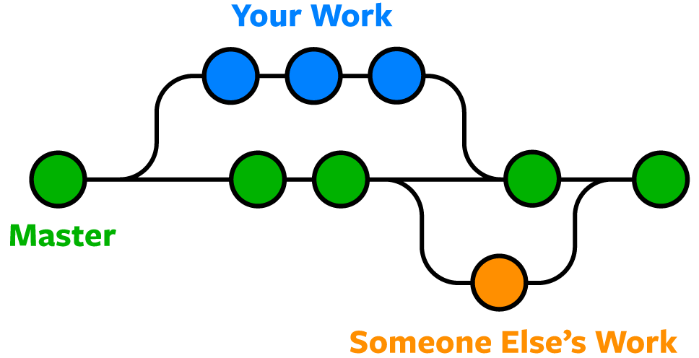
Version Control
You will be using Git for managing your source code
Why?
Organizes your code
Keeps track of features
Allows collaborators to work freely without messing up other existing code
Back-ups whenever something goes wrong

Slide 45
Basic Git Commands
Stage file for commit:
Commit files:
Push changes to remote (note: always pull before push!)
$ git add <file_name>
$ git commit -m ‘Add a description here’
$ git push [origin <branch_name>]

Slide 46
Basic Git Commands
Fetch changes from remote:
Check status
$ git pull
$ git status

Slide 47
Setup Git Access
You’ll need an SSH Key to get access to projects at git.cs.vt.edu
If you don’t already have a key…
Create a new key:
Add Key to https://git.cs.vt.edu/profile/keys
You will paste public key here ----------->
$ ssh-keygen -t rsa -b 4096 -C "email@vt.edu" \
-f ~/.ssh/id_rsa

Slide 48
Verify Git Access
Verify you have access
The first time you connect you will be asked to verify the host, just answer ‘Yes’ to continue
You can get in-depth explanations here:
Generate a key
Use an existing key
11 spencetk@linden ~ >ssh git@git.cs.vt.edu
PTY allocation request failed on channel 0
Welcome to GitLab, @spencetk! ← Your pid should be displayed here
Connection to git.cs.vt.edu closed.

Slide 49
GitLab Project Setup
One member will fork the base repository:
https://git.cs.vt.edu/cs3214-staff/cs3214-cush
Invite partner to collaborate
Go to Settings > Members to add them
Check partner role permissions too
Both members will clone the forked repository on their machines:
IMPORTANT: Set forked repository to private
Go to Settings > General > Visibility, project features, permissions
$ git clone <your git repo url>.git
cs3214-cush
*Your forked repository will have a navigation menu on the left side. Click under Settings to add members and set repo to private

Slide 50
The GNU Project Debugger

Slide 51
Starting GDB
Invoke GDB with a program and arguments:
Better alternative:
Must be compiled with debug symbols, -g
$ gdb --args program arg1 arg2
(gdb) run arg1 arg2

Slide 52
Breakpoints
Set a breakpoint
Set a conditional breakpoint:
Ignore breakpoint #1 100 times
Show # of times breakpoint was hit
(gdb) b <func_name> OR
(gdb) b <line_number>
(gdb) b <func_name> if <condition>
(gdb) ignore 1 100
(gdb) info b

Slide 53
Backtrace and Frames
Show backtrace:
Show frame:
After selecting frame, you can print all variables declared in that function call
(gdb) backtrace
(gdb) frame <num>

Slide 54
Follow-Fork-Mode
Which process to follow after a fork (parent / child):
‘parent’ = ignore child process and continue debugging the parent
‘child’ = begin debugging the child process when fork() is called
Retaining debugger control after fork:
After a fork, specify whether to freeze the child or allow it to run (this may make it difficult to find race conditions)
(gdb) set follow-fork-mode <mode>
(gdb) set detach-on-fork <mode>
Light reading: https://visualgdb.com/gdbreference/commands/set_follow-fork-mode

Slide 55
Layout Source
Show source code lines while debugging
Far superior alternative to ‘list’
Toggle with Ctrl-X+A
(gdb) layout src
Notes:
For asm nerds, you can do layout asm
If the layout messes up, you can type refresh or ctrl-L

Slide 56
Advice

Slide 57
How Can I Fail Systems?
Not utilize class resources
Mismanage your time
Not understand your tools
Fail to get along with your partner
Not break down the problem
Not understand the concepts

Slide 58
Advice
START EARLY
Create a roadmap before starting projects
Utilize TAs
Come with questions prepared, try to figure out what the problem is first
Be organized and have clean code - the cleaner it is, the faster we can help!
Run valgrind and try debugging with GDB before consulting us
Discord, Zoom, Class Forum
Understand the Exercises
Use valgrind! This can isolate many bugs
Become an expert at the debugger
Find what works best for communicating with your partner
Discord, Zoom, etc.

Slide 59
Sources
Referred to previous help session slides created by previous UTA’s Kent McDonough, Connor Shugg, Joe D’Anna, Chris Cerne, Justin Vita, Sam Lightfoot, and Michael Kyer since the Spring 2021 Semester
Spencer Keefer created the revised slides

Slide 60
Thanks for attending!
Questions?

