Slide 1
Cache Memory and Performance
Many of the following slides are taken with permission from
Complete Powerpoint Lecture Notes for Computer Systems: A Programmer's Perspective (CS:APP)
Randal E. Bryant and David R. O'Hallaron
http://csapp.cs.cmu.edu/public/lectures.html
The book is used explicitly in CS 2505 and CS 3214 and as a reference in CS 2506.

Slide 2
Cache Memories
Cache memories are small, fast SRAM-based memories managed automatically in hardware.
CPU looks first for data in caches (e.g., L1, L2, and L3), then in main memory.
Typical system structure:
CPU chip
Register file
ALU
Cache
memories
System bus
Memory bus
Main
memory
Bus interface
I/O
bridge

Slide 3
General Cache Organization (S, K, B)
K = 2^{k} lines (blocks) per set
0
1
2^{k}-1
0
set
1
line (block)
2
S = 2^{s} sets
3
2^{s}-1
v
tag
0
1
2
B-1
valid bit
B = 2^{b} bytes per cache block (the data)
Cache size:
C = S x K x B data bytes

Slide 4
Cache Defines View of DRAM
The "geometry" of the cache is defined by:
S = 2^{s} the number of sets in the cache
K = 2^{k} the number of lines (blocks) in a set
B = 2^{b} the number of bytes in a line (block)
These values define a related way to think about the organization of DRAM:
DRAM consists of a sequence of blocks of B bytes.
The bytes in a block (line) can be indexed by using b bits.
DRAM consists of a sequence of groups of S blocks (lines).
The blocks (lines) in a group can be indexed by using s bits.
Each group contains SxB bytes, which can be indexed by using s + b bits.

Slide 5
Cache (8, 2, 4) and 256-Byte DRAM
Cache size:
C = S x K x B = 64 data bytes
K = 2¹ blocks (lines) per set
0
1
DRAM
0
0
1
2
3
4
5
6
7
. . . | . .
252
253
254
255
0
1
2
S = 2³ sets
3
4
5
6
7
v
tag
0
1
2
3
valid bit
B = 2² bytes per cache block (the data)

Slide 6
Cache View of DRAM
So, to generalize, suppose a cache has:
S = 2^{s} sets
K = 2^{k} blocks (lines) per set
B = 2^{b} bytes per block (line)
And, suppose that DRAM uses N-bit addresses. then for any address:
a_{N-1} … a_{s+b} a_{s+b-1} … a_{b} a_{b-1} … a₀
Bits a_{b-1}:a₀ give the byte index within the block
Bits a_{b+s-1}:a_{b} give the set index
Bits a_{N-1}:a_{s+b} become the tag for the data
Note that these bits are only the same for blocks that are within the same DRAM group.

Slide 7
Cache Read
Locate set
Check if any line in set has matching tag
Yes + line valid: hit
Locate data starting at offset
Line
0
1
2^{k}-1
Set
0
1
Address of word:
1
K
t bits
s bits = K
b bits = J
set
index
block
offset
2^{s}-1
tag
2
K
data begins at this offset
4
3
v
tag
0
1
J
2^{b}-1

Slide 8
Example: Direct Mapped Cache (K = 1)
Direct mapped: One line per set
Assume: cache block size 8 bytes
Address of int:
v
tag
0
1
2
3
4
5
6
7
t bits
0…01
100
v
tag
0
1
2
3
4
5
6
7
find set
S = 2^{s} sets
v
tag
0
1
2
3
4
5
6
7
v
tag
0
1
2
3
4
5
6
7

Slide 9
Example: Direct Mapped Cache (K = 1)
Direct mapped: One line per set
Assume: cache block size 8 bytes
Address of int:
valid? +
matching tags → hit
t bits
0…01
100
v
tag
0
1
2
3
4
5
6
7
tag
block offset

Slide 10
Example: Direct Mapped Cache (K = 1)
Direct mapped: One line per set
Assume: cache block size 8 bytes
Address of int:
valid? +
matching tags → hit
t bits
0…01
100
v
tag
0
1
2
3
4
5
6
7
block offset
int (4 Bytes) is here
No match: old line (block) is evicted and replaced by requested block from DRAM

Slide 11
K-way Set Associative Cache (Here: K = 2)
K = 2: Two lines per set
Assume: cache block size 8 bytes
Address of short int:
t bits
0…01
100
v
tag
0
1
2
3
4
5
6
7
v
tag
0
1
2
3
4
5
6
7
v
tag
0
1
2
3
4
5
6
7
v
tag
0
1
2
3
4
5
6
7
find set
v
tag
0
1
2
3
4
5
6
7
v
tag
0
1
2
3
4
5
6
7
v
tag
0
1
2
3
4
5
6
7
v
tag
0
1
2
3
4
5
6
7

Slide 12
K-way Set Associative Cache (Here: K = 2)
K = 2: Two lines per set
Assume: cache block size 8 bytes
Address of short int:
compare both
t bits
0…01
100
valid? +
matching tags → hit
v
tag
0
1
2
3
4
5
6
7
tag
v
tag
0
1
2
3
4
5
6
7
block offset

Slide 13
K-way Set Associative Cache (Here: K = 2)
K = 2: Two lines per set
Assume: cache block size 8 bytes
Address of short int:
compare both
t bits
0…01
100
valid? +
matching tags → hit
v
tag
0
1
2
3
4
5
6
7
v
tag
0
1
2
3
4
5
6
7
block offset
short int (2 Bytes) is here
No match:
One line in set is selected for eviction and replacement
Replacement policies: random, least recently used (LRU), …

Slide 14
Cache Organization Types
The "geometry" of the cache is defined by:
S = 2^{s} the number of sets in the cache
K = 2^{k} the number of lines (blocks) in a set
B = 2^{b} the number of bytes in a line (block)
K = 1 (k = 0) direct-mapped cache
only one possible location in cache for each DRAM block
S > 1
K > 1 K-way associative cache
K possible locations (in same cache set) for each DRAM block
S = 1 (only one set) fully-associative cache
K = # of cache blocks each DRAM block can be at any location in the cache

Slide 15
Cache Example
5-bit addresses (32-word DRAM)
Direct-mapped, 8-blocks, 1 word/block
Index | Valid | Tag | Data
000 | 0
001 | 0
010 | 0
011 | 0
100 | 0
101 | 0
110 | 0
111 | 0

Slide 16
Cache Example
Memory access
address 10 110
hit? N
address / #sets
set to hold data
10 110
Index | Valid | Tag | Data
000 | 0
001 | 0
010 | 0
011 | 0
100 | 0
101 | 0
110 | 1 | 10 | Mem[10110]
111 | 0
address % #sets
set to hold data

Slide 17
Cache Example
Memory access
address 11 010
hit? N
address / #sets
set to hold data
11 010
Index | Valid | Tag | Data
000 | 0
001 | 0
010 | 1 | 11 | Mem[11010]
011 | 0
100 | 0
101 | 0
110 | 1 | 10 | Mem[10110]
111 | 0
address % #sets
set to hold data

Slide 18
Cache Example
Memory access
address 10 110
If valid bit is 1…
and tags match... hit!
Index | Valid | Tag | Data
000 | 0
001 | 0
010 | 1 | 11 | Mem[11010]
011 | 0
100 | 0
101 | 0
110 | 1 | 10 | Mem[10110]
111 | 0
Identify the cache slot

Slide 19
Cache Example
Memory accesses
address 10 000 miss
address 00 011 miss
address 10 000 hit
Index | Valid | Tag | Data
000 | 0 | 10 | Mem[10000]
001 | 0
010 | 1 | 11 | Mem[11010]
011 | 0 | 00 | Mem[00011]
100 | 0
101 | 0
110 | 1 | 10 | Mem[10110]
111 | 0

Slide 20
Cache Example
Memory access
address 10 010 miss (tags don't match)
Index | Valid | Tag | Data
. . .
010 | 1 | 11 | Mem[11010]
. . .
Index | Valid | Tag | Data
. . .
010 | 1 | 10 | Mem[10010]
. . .
replacement

Slide 21
Block Size Considerations
Larger blocks should reduce miss rate
- due to spatial locality (if present)
But in a fixed-sized cache
- larger blocks ⇒ fewer of them
more competition ⇒ increased miss rate
- larger blocks ⇒ pollution
Larger miss penalty
- can override benefit of reduced miss rate
- early restart and critical-word-first can help

Slide 22
Cache Misses
On cache hit, CPU proceeds normally
On cache miss:
- stall the CPU pipeline
- fetch block from next level of hierarchy
- instruction cache miss
restart instruction fetch
- data cache miss
complete data access

Slide 23
Write-Through
On data-write hit, could just update the block in cache
- but then cache and memory would be inconsistent
Write through: also update memory
But makes writes take longer
- e.g., if base CPI = 1, 10% of instructions are stores, write to memory takes 100 cycles
- effective CPI = 1 + 0.1×100 = 11
Solution: write buffer
- holds data waiting to be written to memory
CPU continues immediately
- only stalls on write if write buffer is already full

Slide 24
Write-Back
Alternative: On data-write hit, just update the block in cache
- keep track of whether each block is dirty
When a dirty block is replaced
- write it back to memory
- can use a write buffer to allow replacing block to be read first

Slide 25
Write-Allocation
What should happen on a write miss?
Alternatives for write-through
- allocate on miss: fetch the block
- write around: don’t fetch the block
since programs often write a whole block before reading it
(e.g., initialization)
For write-back
- usually fetch the block

Slide 26
DRAM Supporting Caches
Use DRAMs for main memory
- fixed width (e.g., 1 word)
- connected by fixed-width clocked bus
- bus clock is typically slower than CPU clock
Example cache block read
- 1 bus cycle for address transfer
- 15 bus cycles per DRAM access
- 1 bus cycle per data transfer
For 4-word block, 1-word-wide DRAM
- miss penalty = 1 + 4×15 + 4×1 = 65 bus cycles
- bandwidth = 16 bytes / 65 cycles = 0.25 B/cycle

Slide 27
Measuring Cache Performance
Components of CPU time
- program execution cycles
- includes cache hit time
- memory stall cycles
- mainly from cache misses
With simplifying assumptions:

Slide 28
Cache Performance Operation
Given
- I-cache miss rate = 2%
- D-cache miss rate = 4%
- miss penalty = 100 cycles
- base CPI (ideal cache) = 2
Miss cycles per instruction
- I-cache: 0.02 × 100 = 2
- D-cache: 0.36 × 0.04 × 100 = 1.44
Actual CPI = 2 + 2 + 1.44 = 5.44
- ideal CPU is 5.44/2 =2.72 times faster

Slide 29
Average Access Time
Hit time is also important for performance
Average memory access time (AMAT)
AMAT = Hit time + Miss rate × Miss penalty
Example
- CPU with 1ns clock,
hit time = 1 cycle,
miss penalty = 20 cycles,
I-cache miss rate = 5%
- AMAT = 1 + 0.05 × 20 = 2ns (2 cycles per instruction)

Slide 30
Performance Summary
When CPU performance increased
Miss penalty becomes more significant
Decreasing base CPI
Greater proportion of time spent on memory stalls
Increasing clock rate
Memory stalls account for more CPU cycles
Can’t neglect cache behavior when evaluating system performance

Slide 31
Associative Caches
Fully associative
- allow a given block to go in any cache entry
- requires all entries to be searched at once
- comparator per entry (expensive)
K-way set associative
- cach set contains K entries
- block number determines which set
(Block number) modulo (#Sets in cache)
- search all entries in a given set at once
- K comparators (less expensive)

Slide 32
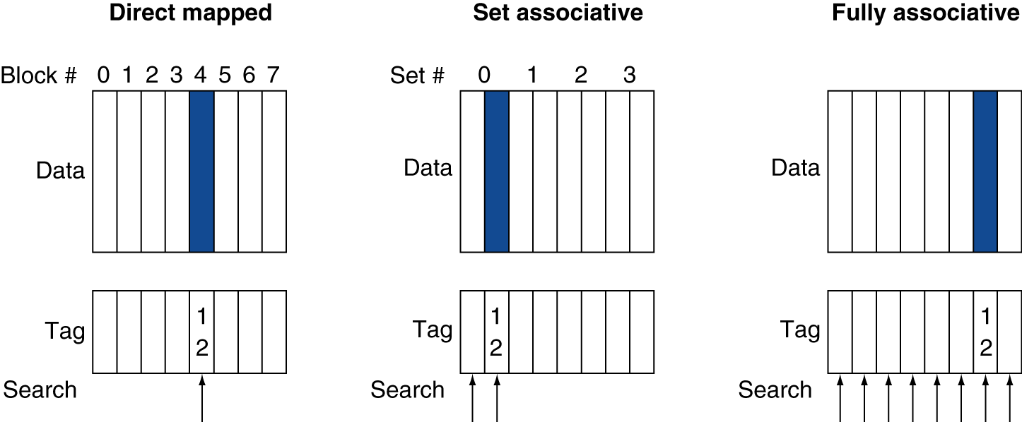
Associative Cache Example

Slide 33
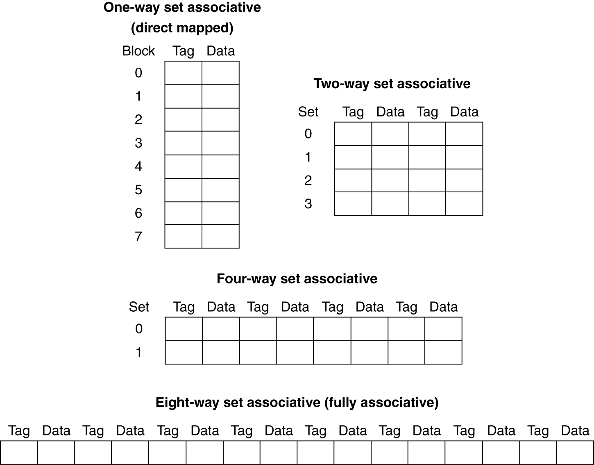
Spectrum of Associativity
Capacity: 8 blocks of user data

Slide 34
Associativity Example
Compare 4-block caches
- direct mapped vs 2-way set associative vs fully associative
- block access sequence: 0, 8, 0, 6, 8
Block address | Cache index | Hit/miss | Cache content after access
 |  |  | 0 | 1 | 2 | 3
0 | 0 | miss | Mem[0]
8 | 0 | miss | Mem[8]
0 | 0 | miss | Mem[0]
6 | 2 | miss | Mem[0] |  | Mem[6]
8 | 0 | miss | Mem[8] |  | Mem[6]
Direct mapped

Slide 35
Associativity Example
Block address | Cache index | Hit/miss | Cache content after access
 |  |  | Set 0 |  | Set 1
0 | 0 | miss | Mem[0]
8 | 0 | miss | Mem[0] | Mem[8]
0 | 0 | hit | Mem[0] | Mem[8]
6 | 0 | miss | Mem[0] | Mem[6]
8 | 0 | miss | Mem[8] | Mem[6]
2-way set associative
Block address |  | Hit/miss | Cache content after access
0 |  | miss | Mem[0]
8 |  | miss | Mem[0] | Mem[8]
0 |  | hit | Mem[0] | Mem[8]
6 |  | miss | Mem[0] | Mem[8] | Mem[6]
8 |  | hit | Mem[0] | Mem[8] | Mem[6]
Fully associative

Slide 36
How Much Associativity?
Increased associativity decreases miss rate
- but with diminishing returns
Simulation of a system with 64KB
D-cache, 16-word blocks, SPEC2000
- 1-way: 10.3%
- 2-way: 8.6%
- 4-way: 8.3%
- 8-way: 8.1%

Slide 37
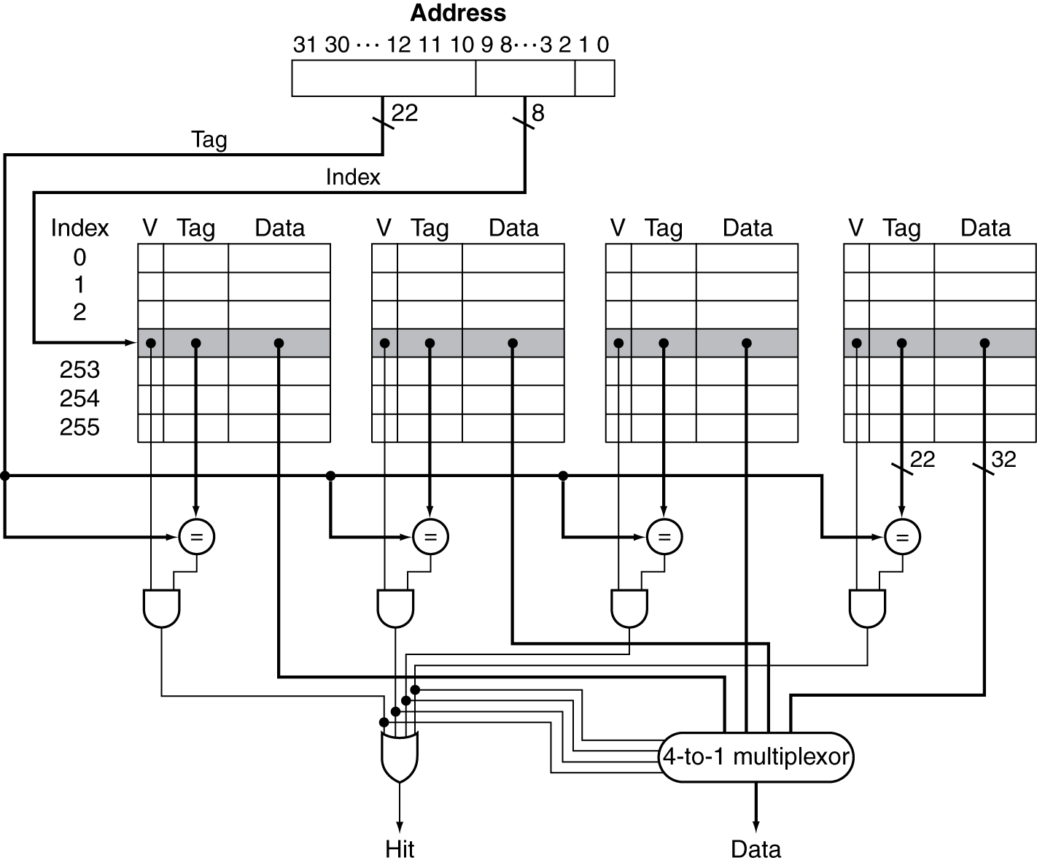
Set Associative Cache Organization
Compare the tag we’re trying to match to all of the tags for blocks in the relevant set at the same time!
Then factor in the valid bits, also in parallel.
And employ a MUX

Slide 38
Replacement Policy
Direct mapped: only one choice
Set associative
- prefer non-valid entry, if there is one
- otherwise, choose among entries in the set
Least-recently used (LRU)
- choose the one unused for the longest time
simple for 2-way, manageable for 4-way, too hard beyond that
Random
- gives approximately the same performance as LRU for high associativity

Slide 39
Multilevel Caches
Primary (L-1) cache attached to CPU
- small, but fast
Level-2 cache services misses from primary cache
- larger, slower, but still faster than main memory
Main memory services L-2 cache misses
Some high-end systems include L-3 cache

Slide 40
Multilevel Cache Example
Given
- CPU base CPI = 1, clock rate = 4GHz
- miss rate/instruction = 2%
- main memory access time = 100ns
With just primary cache
- miss penalty = 100ns / 0.25ns = 400 cycles
- effective CPI = 1 + 0.02 × 400 = 9

Slide 41
Multilevel Cache Example
Now add L-2 cache
- access time = 5ns
- global miss rate to main memory = 0.5%
Primary miss with L-2 hit
- penalty = 5ns / 0.25ns = 20 cycles
Primary miss with L-2 miss
- extra penalty = 500 cycles
CPI = 1 + 0.02 × 20 + 0.005 × 400 = 3.4
Performance ratio = 9/3.4 = 2.6

Slide 42
Multilevel Cache Considerations
Primary cache
- focus on minimal hit time
L-2 cache
- focus on low miss rate to avoid main memory access
- hit time has less overall impact
Results
- L-1 cache usually smaller than a single monolithic cache
- L-1 block size smaller than L-2 block size (then again…)

Slide 43
Example: Intel Core i7 Cache
Processor package
Core 0
Core 3
2700 Series
L1 i-cache and d-cache:
32 KB, 8-way,
Access: 4 cycles
L2 unified cache:
256 KB, 8-way,
Access: 11 cycles
L3 unified cache:
8 MB, 16-way,
Access: 25-40 cycles
Block size: 64 bytes for all caches.
Regs
Regs
L1
d-cache
L1
i-cache
L1
d-cache
L1
i-cache
…
L2 unified cache
L2 unified cache
L3 unified cache
(shared by all cores)
Main memory

