Slide 1
Branch Hazards
Consider executing this sequence of instructions in the pipeline:
address instruction
---------------------------------
36: sub $10, $4, $8 40: beq $1, $3, L1 44: and $12, $2, $5 48: or $13,$12,$13
52: add $14, $4, $2 56: slt $15, $6, $7 ... 72: L1: lw $4, 50($7)
When beq moves into the ID stage:
- should we fetch the instruction at address 44?
- it may or may not be executed next, depending on whether $1 == $3
- we don’t know the address of the branch target instruction yet anyway

Slide 2
Branch Hazards
When beq enters the ID stage, we don’t even know it is a conditional branch.
And… we won’t know if the branch should be taken until beq reaches the end of EX.
Hey!
It’s a branch!
??? beq sub
address instruction
---------------------------------
36: sub $10, $4, $8 40: beq $1, $3, L1 44: and $12, $2, $5
... 72: L1: lw $4, 50($7)

Slide 3
Branch Hazards
So… we will have already fetched the next (sequential) instruction.
Hey!
It’s a branch!
and beq sub
address instruction
---------------------------------
36: sub $10, $4, $8 40: beq $1, $3, L1 44: and $12, $2, $5
... 72: L1: lw $4, 50($7)

Slide 4
Stalling for Branch Hazards
Idea: insert stalls until we know if the branch will be taken.
We can’t act on that information before beq reaches the MEM stage.
Note:
the AND gate fires quickly enough that we can still fetch the branch target, on the same cycle, if the branch is taken.

Slide 5
Stalling Until Branch Decision
Idea: insert stalls until we know if the branch will be taken.
cycle action beq
----------------------------
0: fetch sub 1: fetch beq IF 2: fetch and ID 3: stall EX
4: stall MEM 5: fetch and/lw
That’s expensive.
If we don’t take the branch, we needlessly delayed the and instruction for 2 cycles.
Branch!
or
Don’t branch!
Hamlet
Hamlet
fetch stall stall beq sub

Slide 6
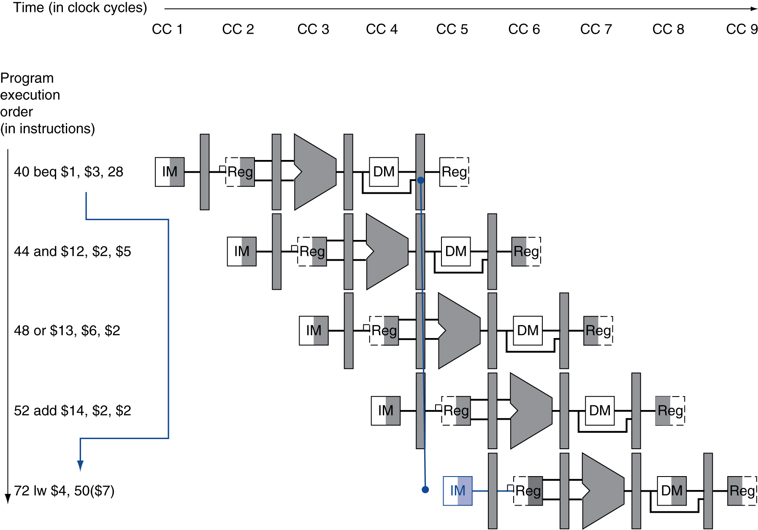
Rollback for Branch Hazards
Idea: proceed as if the branch will not be taken;
turn mis-fetched instructions into nops if wrong.
If branch is taken, flush* these instructions
(set control values to 0)
*QTP: will this be too late?

Slide 7
Questions
Could we rearrange the datapath so that the branch decision could be made earlier?
Questions to ponder:
- What about calculating the branch target address?
Can that be done in the ID stage?
- What about the register comparison?
Can that be done in the ID stage?
What about other kinds of conditional branches (e.g., bgez,)?

Slide 8
Making Branch Decisions Earlier
Stall if branch is taken, proceed normally otherwise:
or and beq
and beq
lw nop beq
Cost is now one stall if branch is taken, nothing if branch is not taken.

Slide 9
Making Branch Decisions Earlier
Ideas: simple hardware suffices to compare two registers
moving the branch adder is relatively simple
We can determine if the branch will be taken before beq reaches the EX stage.
But we also need to create a stall for one cycle…

Slide 10
Stall-on-Branch
Whenever we decode a beq instruction:
- we need to stall the instruction that follows the beq
- we have the ability to turn the instruction in the ID stage into a nop
- but we need to trigger that one cycle after decoding the beq
QTP
Does this design actually accomplish that?

Slide 11
The Big (but not quite final) Picture

Slide 12
Data Hazards for Branches
If a comparison register in beq is a destination of 2nd or 3rd preceding R-type instruction
Can resolve using forwarding, without any stalls
add $1, $2, $3
add
sub $4, $5, $6
sub
add $3, $1, $4
beq $1, $4, target
beq

Slide 13
Data Hazards for Branches
If a comparison register is a destination of the immediately-preceding type instruction or 2nd preceding load instruction
Need to stall beq for 1 cycle
lw $1, addr
lw
add $4, $5, $6
add
beq stalled
nop
nop
nop
beq $1, $4, target
beq

Slide 14
Data Hazards for Branches
If a comparison register is a destination of immediately preceding load instruction
Need to stall for 2 cycles
lw $1, addr
lw
beq stalled
nop
nop
nop
beq stalled
nop
nop
nop
beq $1, $0, target
beq

Slide 15
Data Hazards for Branches
So, the latest version of the datapath will require more modifications:
- these hazards must be detected in by new hardware in the ID stage
- the actual forwarding (substitution) operations also require new hardware in the ID stage
- handling these hazards requires stalling, as with lw, but…
- if the writing instruction is one cycle ahead of beq we need 2 stall cycles
- if the writing instruction is two cycles ahead of beq we need 1 stall cycle
These changes are similar to the earlier discussion of forwarding.
Details are left as an exercise.

