Slide 1
Pipelined Control Overview
This design has:
the correct logic for synchronizing control signals and instructions
no forwarding logic
no hazard detection.

Slide 2
Data Hazards in ALU Instructions
Consider this sequence:
sub $2, $1, $3 # value for $2 known end of EX stage;
# stored in $2 in WB stage
and $12, $2, $5 # enters ID stage when sub enters EX;
# and needs $s2 when enters EX stage;
# sub is in MEM stage by then;
# $2 has not been written yet
Tick 0: sub
Tick 1: and sub
Tick 2: and sub
Tick 3: and sub
Data hazard?

Slide 3
Data Hazards in ALU Instructions
So this sequence leads to a data hazard involving $2:
sub $2, $1, $3
and $12, $2, $5
Can we resolve the hazard simply by forwarding?
Tick 0: sub
Tick 1: and sub
Tick 2: and sub
Tick 3: and sub
Yes!
But we must deliver the computed value at the right time; the next tick.
And, that value will be sitting in the EX/MEM interstage buffer.

Slide 4
Detecting the Hazard
On the one hand, this is obvious. The first instruction writes a value into a register that is subsequently used as input by the second instruction:
sub $2, $1, $3 and $12, $2, $5
We must know the register numbers for both instructions in order to detect the hazard.
More precisely, we must know rd for the first instruction and both rs and rt for the second instruction.
So, we must save those register numbers, via the interstage buffers.
Some notation will help us speak precisely about what's going on:
B.RegisterRX = register number for RX sitting in interstage pipeline buffer B

Slide 5
A Glance Ahead
Passing the register numbers:
Logic “box” that manages forwarding of operands
rs (left operand) register number
rt (right operand) register number
rd (destination) register number

Slide 6
A Glance Ahead
Passing the register numbers:
1
2
3
1: rd for instruction currently in EX stage
2: rd for instruction currently in MEM stage
3: rd for instruction currently in WB stage
They may all be different!

Slide 7
Detecting the Hazard
Now, for this sequence of instructions:
sub $2, $1, $3 and $12, $2, $5
So, we detect the hazard because we see that:
EX/MEM.RegisterRd == ID/EX.RegisterRs
Hence, we must forward the ALU output value from the EX/MEM interstage buffer to the rs input to the ALU.
Apparently, we'll need to:
- pass (at least some) register numbers forward via the interstage buffers
- add a logic unit to compare those register numbers to detect hazards
- add data connections to support transferring data values being forwarded
- add some more selection logic (multiplexors)

Slide 8
Data Hazards in ALU Instructions
Now, consider this sequence:
sub $2, $1, $3 # value for $2 known in EX stage and $12, $2, $5 # enters ID stage when sub enters EX
or $13, $6, $2 # enters ID stage when sub enters MEM;
# $2 has not been written yet
Tick 0: sub
Tick 1: and sub
Tick 2: or and sub
Tick 3: or and sub
Tick 4: or and sub
Data hazard?

Slide 9
Data Hazards in ALU Instructions
Again, we have a data hazard:
sub $2, $1, $3 # value for $2 known in EX stage and $12, $2, $5 # enters ID stage when sub enters EX
or $13, $6, $2 # enters ID stage when sub enters MEM;
Tick 0: sub
Tick 1: and sub
Tick 2: or and sub
Tick 3: or and sub
Tick 4: or and sub
Yes!
Now, we must deliver the computed value after a delay of one tick, from MEM/WB.

Slide 10
Detecting the Hazard
Again, we have a data hazard:
sub $2, $1, $3 and $12, $2, $5
or $13, $6, $2
So, we detect the hazard because we see that:
MEM/WB.RegisterRd == ID/EX.RegisterRt
Hence, we must forward the ALU output value from the MEM/WB interstage buffer to the rt* input to the ALU.
So… detecting data hazards is a multi-stage affair.
* QTP: why does this one go to the rt input?

Slide 11
Data Hazards in ALU Instructions
Now, consider this sequence:
sub $2, $1, $3 # value for $2 known in EX stage;
and $12, $2, $5 # enters ID stage when sub enters EX;
or $13, $6, $2 # enters ID stage when sub enters MEM;
add $14, $2, $2 # enters ID stage when sub enters WB;
# $2 has not been written yet, but. . .
Tick 0: sub
Tick 1: and sub
Tick 2: or and sub
Tick 3: add or and sub
Tick 4: add or and sub
Data hazard?

Slide 12
Data Hazards in ALU Instructions
Now, there's almost a hazard… but not quite…
sub $2, $1, $3 # value for $2 known in EX stage;
and $12, $2, $5 # enters ID stage when sub enters EX;
or $13, $6, $2 # enters ID stage when sub enters MEM;
add $14, $2, $2 # enters ID stage when sub enters WB;
Tick 0: sub
Tick 1: and sub
Tick 2: or and sub
Tick 3: add or and sub
Tick 4: add or and sub
Tick 5: add or and sub
Now, we deliver the computed value to the register file in the first half of tick 4, and it's not read until the second half of that tick!

Slide 13
Data Hazards in ALU Instructions
Now, consider this sequence:
sub $2, $1, $3 # value for $2 known in EX stage;
and $12, $2, $5 # enters ID stage when sub enters EX;
or $13, $6, $2 # enters ID stage when sub enters MEM;
add $14, $2, $2 # enters ID stage when sub enters WB
sw $15, 100($2) # enters ID stage after sub is done
Tick 0: sub
Tick 1: and sub
Tick 2: or and sub
Tick 3: add or and sub
Tick 4: sw add or and sub
Tick 5: sw add or and
Data hazard?

Slide 14
Detecting the Need to Forward
Here's what we (seem to) know so far:
ALU-related data hazards occur when
EX/MEM.RegisterRd = ID/EX.RegisterRs
EX/MEM.RegisterRd = ID/EX.RegisterRt
MEM/WB.RegisterRd = ID/EX.RegisterRs
MEM/WB.RegisterRd = ID/EX.RegisterRt
However, we have overlooked (at least) one thing…
Fwd from EX/MEM pipeline reg
Fwd from MEM/WB pipeline reg

Slide 15
Detecting the Need to Forward
We don't need to forward unless the forwarding (earlier) instruction does actually write a value to a register:
EX/MEM.RegWrite == 1
MEM/WB.RegWrite == 1
And we only forward if Rd for that instruction is not $zero:
EX/MEM.RegisterRd != 0 MEM/WB.RegisterRd != 0

Slide 16
Datapath Change: ALU Operand Selection
Value from register fetch in ID stage
Value from WB stage
Value from ALU execution
Forwarding unit selects among three candidates for the register operands.

Slide 17
Datapath Change: ALU Operand Selection

Slide 18
Forwarding Paths
Select source for left operand rs
Select source for right operand rt
Possible rd numbers
rs and rt for the instruction in the EX stage,
ID/EX.RegisterRs
ID/EX.RegisterRt
Select correct rd number
rd # from WB stage,
MEM/WB.RegisterRd
rd # from MEM stage,
EX/MEM.RegisterRd

Slide 19
Conditions for EX Hazard
If ( EX/MEM.RegWrite and
EX/MEM.RegisterRd != 0 and
EX/MEM.RegisterRd == ID/EX.RegisterRs ) then
ForwardA = 10
If ( EX/MEM.RegWrite and
EX/MEM.RegisterRd != 0 and EX/MEM.RegisterRd == ID/EX.RegisterRt )
then ForwardB = 10
QTP: could BOTH occur with respect to the same instruction?
Notes:
NB: prior to the 5th edition, the P&H book stated some of these incorrectly, with mismatched parentheses.

Slide 20
Conditions for MEM Hazard
If ( MEM/WB.RegWrite and
MEM/WB.RegisterRd != 0 and MEM/WB.RegisterRd == ID/EX.RegisterRs )
then ForwardA = 01
If ( MEM/WB.RegWrite and
MEM/WB.RegisterRd != 0 and MEM/WB.RegisterRd == ID/EX.RegisterRt )
then ForwardB = 01
QTP: could BOTH an EX hazard and a MEM hazard occur with respect to the same instruction?

Slide 21
Double Data Hazard
Consider the sequence:
add $1,$1,$2
sub $1,$1,$3
or $1,$1,$4
Both hazards occur… which value do we want to forward?
Tick 2: or sub add
Tick 3: ... or sub add

Slide 22
Double Data Hazard
Consider the sequence:
add $1,$1,$2
add $1,$1,$3
add $1,$1,$4
Revise MEM hazard condition:
Only forward if EX hazard condition is not true

Slide 23
Revised Conditions for MEM Hazard
If ( MEM/WB.RegWrite and
MEM/WB.RegisterRd != 0 and not ( EX/MEM.RegWrite and
EX/MEM.RegisterRd != 0 and EX/MEM.RegisterRd == ID/EX.RegisterRs ) and MEM/WB.RegisterRd == ID/EX.RegisterRs )
then ForwardA = 01
If ( MEM/WB.RegWrite and
MEM/WB.RegisterRd != 0 and not ( EX/MEM.RegWrite and
EX/MEM.RegisterRd != 0 and EX/MEM.RegisterRd == ID/EX.RegisterRt ) and MEM/WB.RegisterRd == ID/EX.RegisterRt )
then ForwardB = 01

Slide 24
MEM Hazard Breakdown
If ( ( MEM/WB.RegWrite and
MEM/WB.RegisterRd != 0 )
and
not ( EX/MEM.RegWrite and
EX/MEM.RegisterRd != 0 and EX/MEM.RegisterRd == ID/EX.RegisterRs )
and
MEM/WB.RegisterRd == ID/EX.RegisterRs )
then ForwardA = 01
Instruction leaving MEM stage DOES write a value
Instruction leaving EX stage DOES NOT write a value
OR
it doesn’t write to Rs register of instruction leaving ID stage
Instruction leaving MEM stage DOES write a value to the Rs register of instruction leaving ID stage

Slide 25
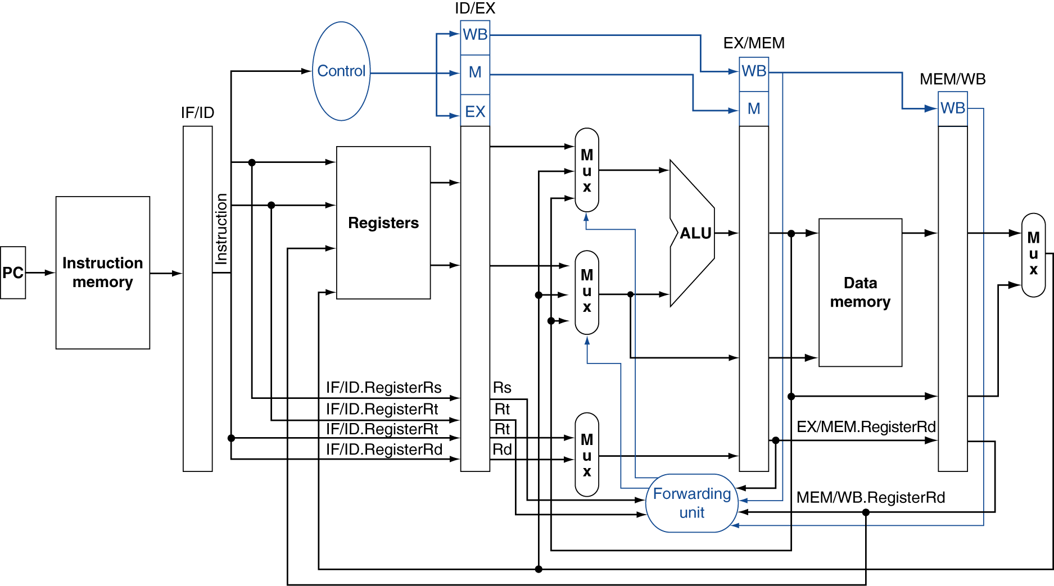
Simplified Datapath with Forwarding

Slide 26
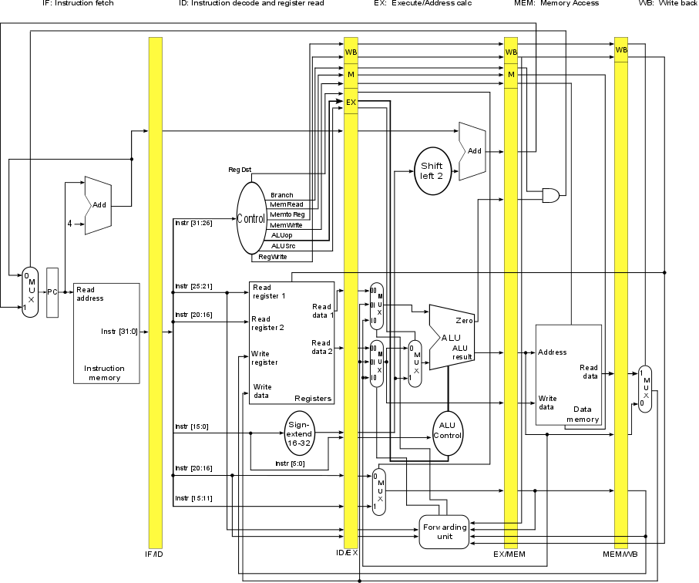
Unsimplified Datapath with Forwarding
Yes:
add
sub
and
or
slt
sw
No:
lw
beq
j
This design has:
logic for synchronizing control signals and instructions
forwarding logic
no hazard detection.

