Slide 1
Recap: the Basic Idea
We have 5 stages, which will mean that on any given cycle up to 5 different instructions will be in various points of execution.
Can we operate the stages independently, using an earlier one to begin the next instruction before the previous instruction has completed?
Notes:
1

Slide 2
Hazards
Situations that prevent starting the next instruction in the next cycle
Structural hazards
A required resource is busy
Data hazard
Need to wait for previous instruction to complete its data read/write
Control hazard
Deciding on control action depends on previous instruction

Slide 3
Structural Hazards
Conflict for use of a resource
For example:
In MIPS pipeline with a single memory
Load/store both require memory access
So does instruction fetch
Instruction fetch would have to stall for that cycle
Hence, MIPS pipeline require separate instruction/data memories
Or separate instruction/data caches
Or dual-ported memories

Slide 4
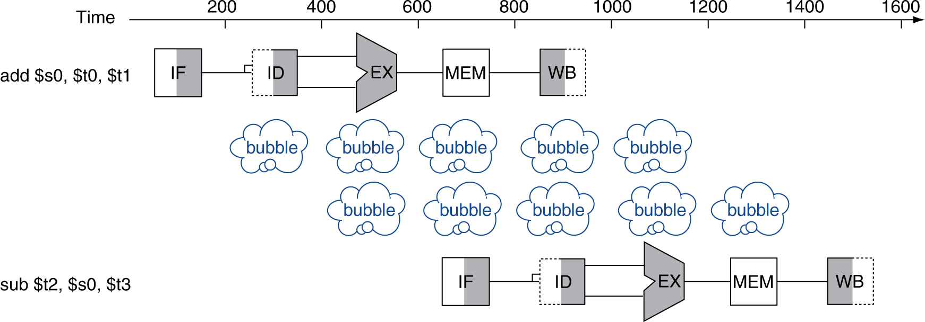
Data Hazards
An instruction depends on completion of a write to a register by a previous instruction
add $s0, $t0, $t1 // writes $s0 from WB stage sub $t2, $s0, $t3 // needs value in ID stage
2-stage stall

Slide 5
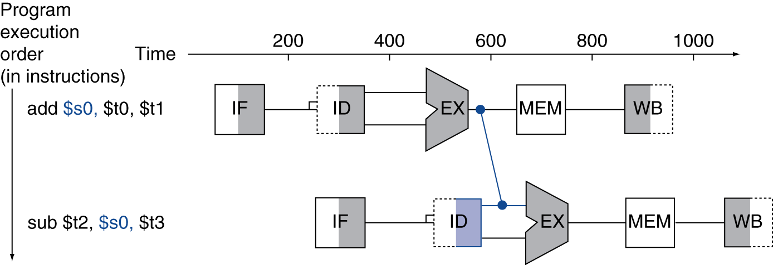
Forwarding (aka Bypassing)
Use result when it is computed
Don’t wait for it to be stored in a register
Requires extra connections in the datapath (& more control logic?)
no stall

Slide 6
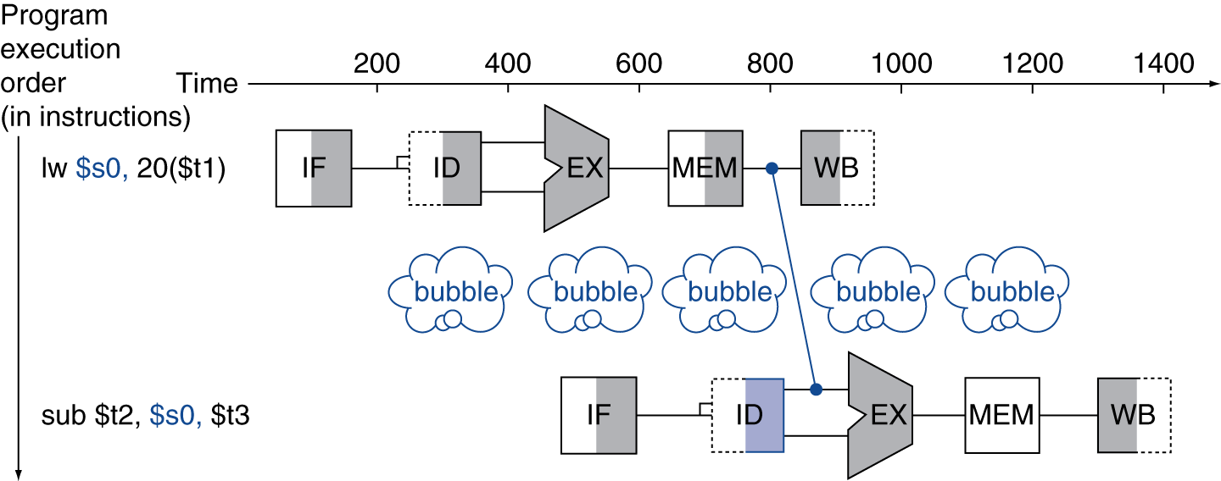
Load-Use Data Hazard
Can’t always avoid stalls by forwarding
If value not computed when needed, can’t forward backward in time!
1-stage stall

Slide 7
Code Scheduling to Avoid Stalls
Reorder code to avoid use of load result in the next instruction
C code for A = B + E; C = B + F;
lw $t1, 0($t0)
lw $t2, 4($t0)
add $t3, $t1, $t2
sw $t3, 12($t0)
lw $t4, 8($t0)
add $t5, $t1, $t4
sw $t5, 16($t0)
lw $t1, 0($t0)
lw $t2, 4($t0)
lw $t4, 8($t0)
add $t3, $t1, $t2
sw $t3, 12($t0)
add $t5, $t1, $t4
sw $t5, 16($t0)
stall
stall
13 cycles
11 cycles
Who reorders the code?

Slide 8
Control Hazards: beq
Branch determines flow of control
Fetching next instruction depends on branch outcome
Register comparison done in EX stage
Branch target address computed in EX stage
MUX selection done in MEM stage
What instruction do we fetch when BEQ is in ID stage?

Slide 9
Control Hazards: beq
How can we deal with BEQ?
Stall until we know whether (& where) to branch?
Make the decision and calculate the address earlier?
Guess whether the branch will be taken?

Slide 10
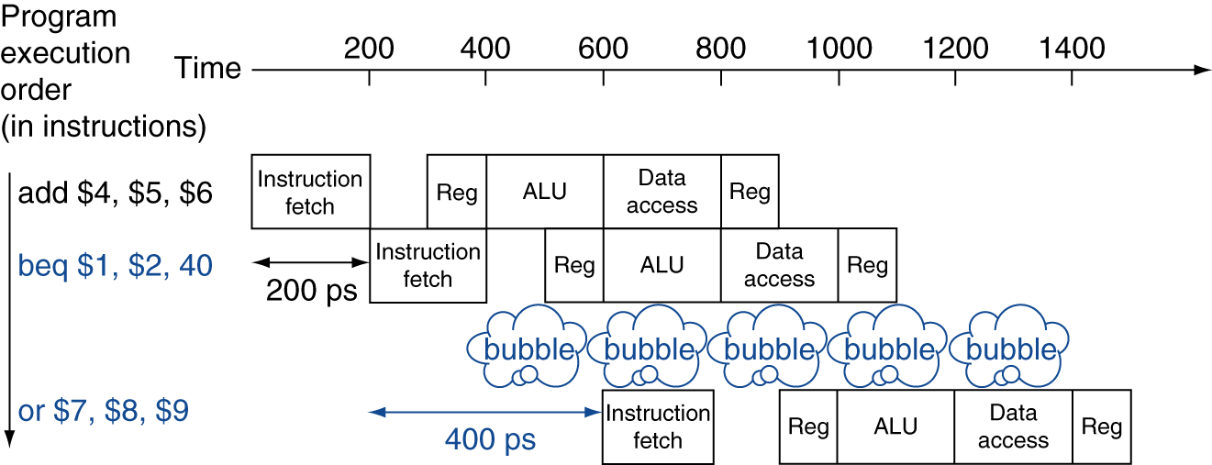
Stall on Branch
Wait until branch outcome determined before fetching next instruction
How many cycles does this cost?

Slide 11
Early Decision
What new hardware would be needed to decide earlier?
Must compare the registers before the EX stage
Must compute the branch target address before the EX stage
Can we know what to do by the time BEQ enters the ID stage?

Slide 12
Branch Prediction
Longer pipelines can’t readily determine branch outcome early
Stall penalty becomes unacceptable
Predict outcome of branch
Only stall if prediction is wrong
In MIPS pipeline
Can predict branches will not be taken
Fetch sequential instruction after branch, with no delay

Slide 13
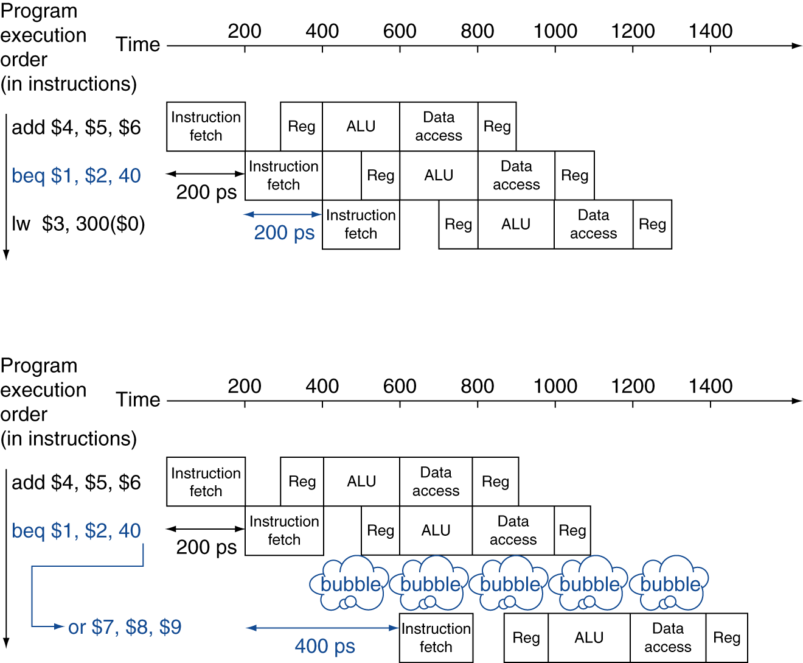
MIPS with Predict-Not-Taken
Prediction correct
Prediction incorrect

Slide 14
Pipeline Summary
Pipelining improves performance by increasing instruction throughput
Executes multiple instructions in parallel
Each instruction has the same latency
Subject to hazards
Structure, data, control
Instruction set design affects complexity of pipeline implementation

