Slide 1
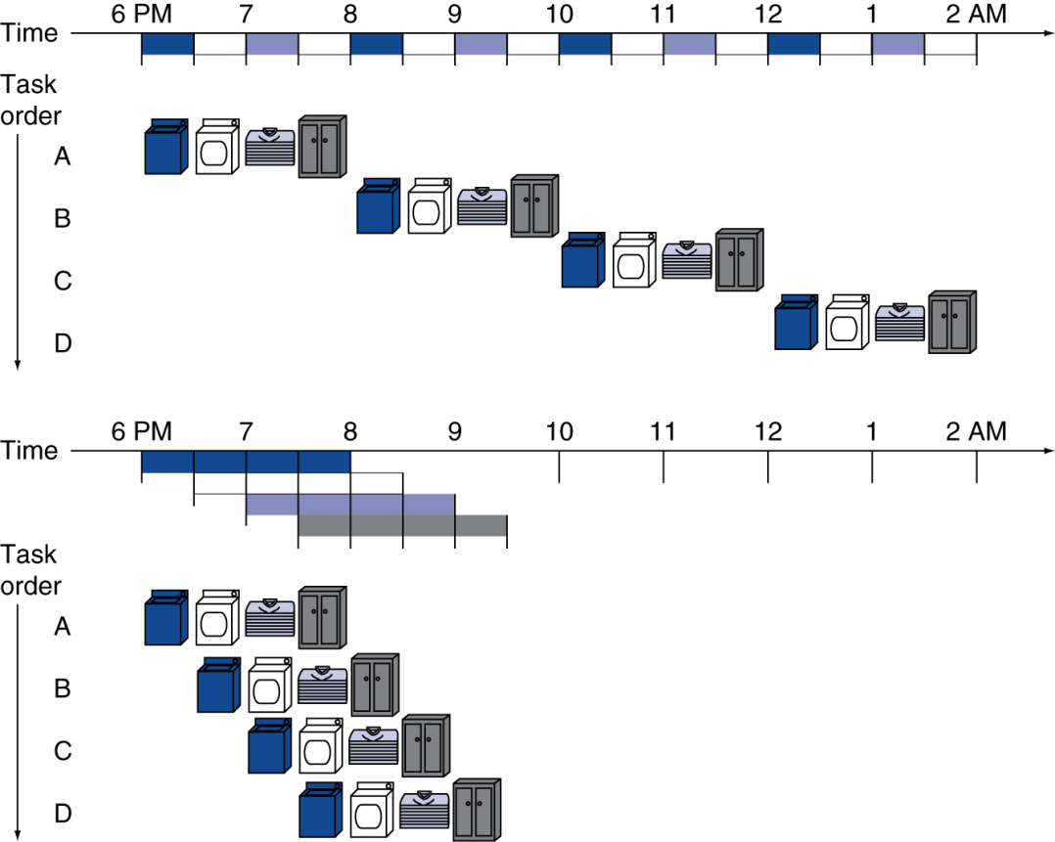
Pipelining Analogy
Pipelined laundry: overlapping execution
Parallelism improves performance
Four loads:
- serial throughput:
0.5 load/hr
- pipelined throughput:
1.14 load/hr
- speedup:
8/3.5 ≈ 2.3
Non-stop speedup:
2n/(0.5n + 1.5) ≈ 4
Notes:
QTP: for the pipelined version, calculate the throughput if we ran continuously until 2 am.
Soln: By 9:30 pm we have completed 4 jobs.
Thereafter, we complete another job every half hour.
There are 9 half-hour steps from 9:30 pm until 2 am.
So, by 2 am, we will have completed 13 jobs in 8 hours,
giving us a throughput value of 13/8 or 1.625.

Slide 2
Basic Idea
What if we think of the simple datapath as a linear sequence of stages?
We have 5 stages, which will mean that on any given cycle up to 5 different instructions will be in various points of execution.
Can we operate the stages independently, using an earlier one to begin the next instruction before the previous instruction has completed?
Notes:
2

Slide 3
MIPS 5-stage Pipeline
Stage Actions For
IF Instruction fetch from memory all
ID Instruction decode & register read decode for all;
read for all but j
EX Execute operation or calculate address all but j
MEM Access memory operand lw, sw
WB Write result back to register lw, R-type

Slide 4
Timing Assumptions
Assume time for stages is
100ps for register read or write
200ps for other stages
Instruction | Instruction fetch | Register read | ALU operation | Memory access | Register write | Total time
lw | 200ps | 100 ps | 200ps | 200ps | 100 ps | 800ps
sw | 200ps | 100 ps | 200ps | 200ps |  | 700ps
R-format | 200ps | 100 ps | 200ps |  | 100 ps | 600ps
beq | 200ps | 100 ps | 200ps |  |  | 500ps
j | ?? | ?? | ?? | ?? | ?? | ??
QTP: how does j fit in here?

Slide 5
Pipeline Timing Details
Each stage is allotted 200ps, and so that is the cycle time.
That leads to "gaps" in stages 2 and 5:
We stipulate that register writes take place in the first half of a cycle and that register reads take place in the second half of a cycle.
QTP: why?

Slide 6
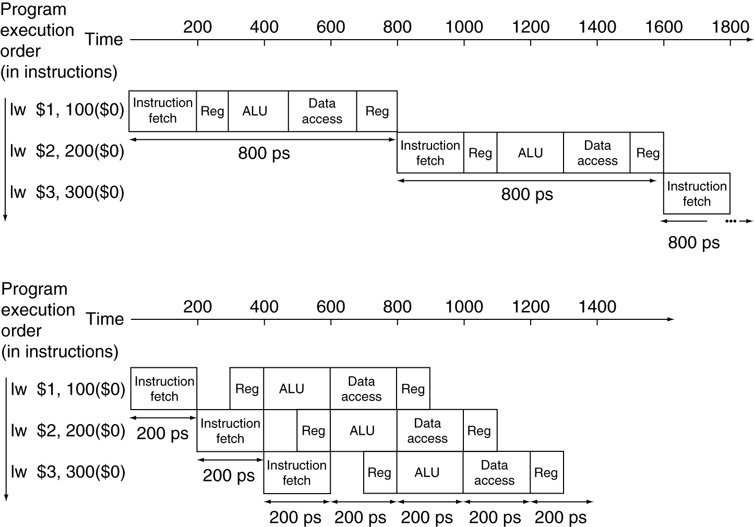
Non-pipelined Performance
Single-cycle (T_{c}= 800ps)
Total time to execute 3 instructions would be 2400 ps.
Total time to execute N instructions would be 800N ps.

Slide 7
Pipelined Performance
Pipelined (T_{c}= 200ps)
Total time to execute these 3 instructions would be 1400 ps.
Speedup would be 2400/1400 or about 1.7.
Total time to execute N (similar) instructions would be 800 + 200N ps.
Speedup would be 800N/(800+200N) or about 4 for large N.

Slide 8
Pipeline Speedup
If all stages are balanced (i.e., all take the same time):
If not balanced, speedup is less
Speedup is due to increased throughput
Latency (time for each instruction) does not decrease
In fact…
Note: the goal here is to improve overall performance, which is often not the same as optimizing the performance of any particular operation.

Slide 9
Pipelining and ISA Design
MIPS32 ISA was designed for pipelining:
32-bit machine instructions (uniformity)
- easier to fetch and decode in one cycle
- vs x86: machine instructions vary from 1 to 17 bytes
Few, regular instruction formats
- can decode opcode and read registers in same clock cycle
Load/store addressing
- can calculate address in one pipeline stage…
- … and access data memory in the next pipeline stage
Alignment requirements for memory operands
- 4-byte accesses must be at “word” addresses
- memory access takes only one clock cycle
QTP: what if we had to support:
add 4($t0), 12($t1), -8($t2)

Slide 10
Issues
But… is there anything wrong with our thinking?
Notes:
10

Slide 11
Issues
What about handling:
beq $s0, $s1, exit
j exit
lw $s0, 12($s1)
add $s3, $s0, $s1
add $s4, $s0, $s5
Are there any other issues…?

