Slide 1
Course Outline
I. Introduction
II. Digital Logic Design
- Boolean algebra (review)
- logic gates and fundamental components
- combinational and sequential logic
- integer addition
- counters
III. Datapath Design and Analysis
- single-cycle MIPS32 datapath
- defining and measuring performance
- basic pipelined MIPS32 datapath
- exceptions
IV. Memory Hierarchy
- SRAM vs DRAM
- cache memory
- virtual memory
- secondary storage

Slide 2
The Computer Revolution
Progress in computer technology
  Underpinned by Moore’s Law
The complexity for minimum component costs has increased at a rate of roughly a factor of two per year. Certainly over the short term this rate can be expected to continue, if not to increase. Over the longer term, the rate of increase is a bit more uncertain, although there is no reason to believe it will not remain nearly constant for at least 10 years.
Gordon Moore (1965)
Makes novel applications feasible
  Computers in automobiles
  Cell phones
  Human genome project
  World Wide Web
  Search Engines
Computers are pervasive

Slide 3
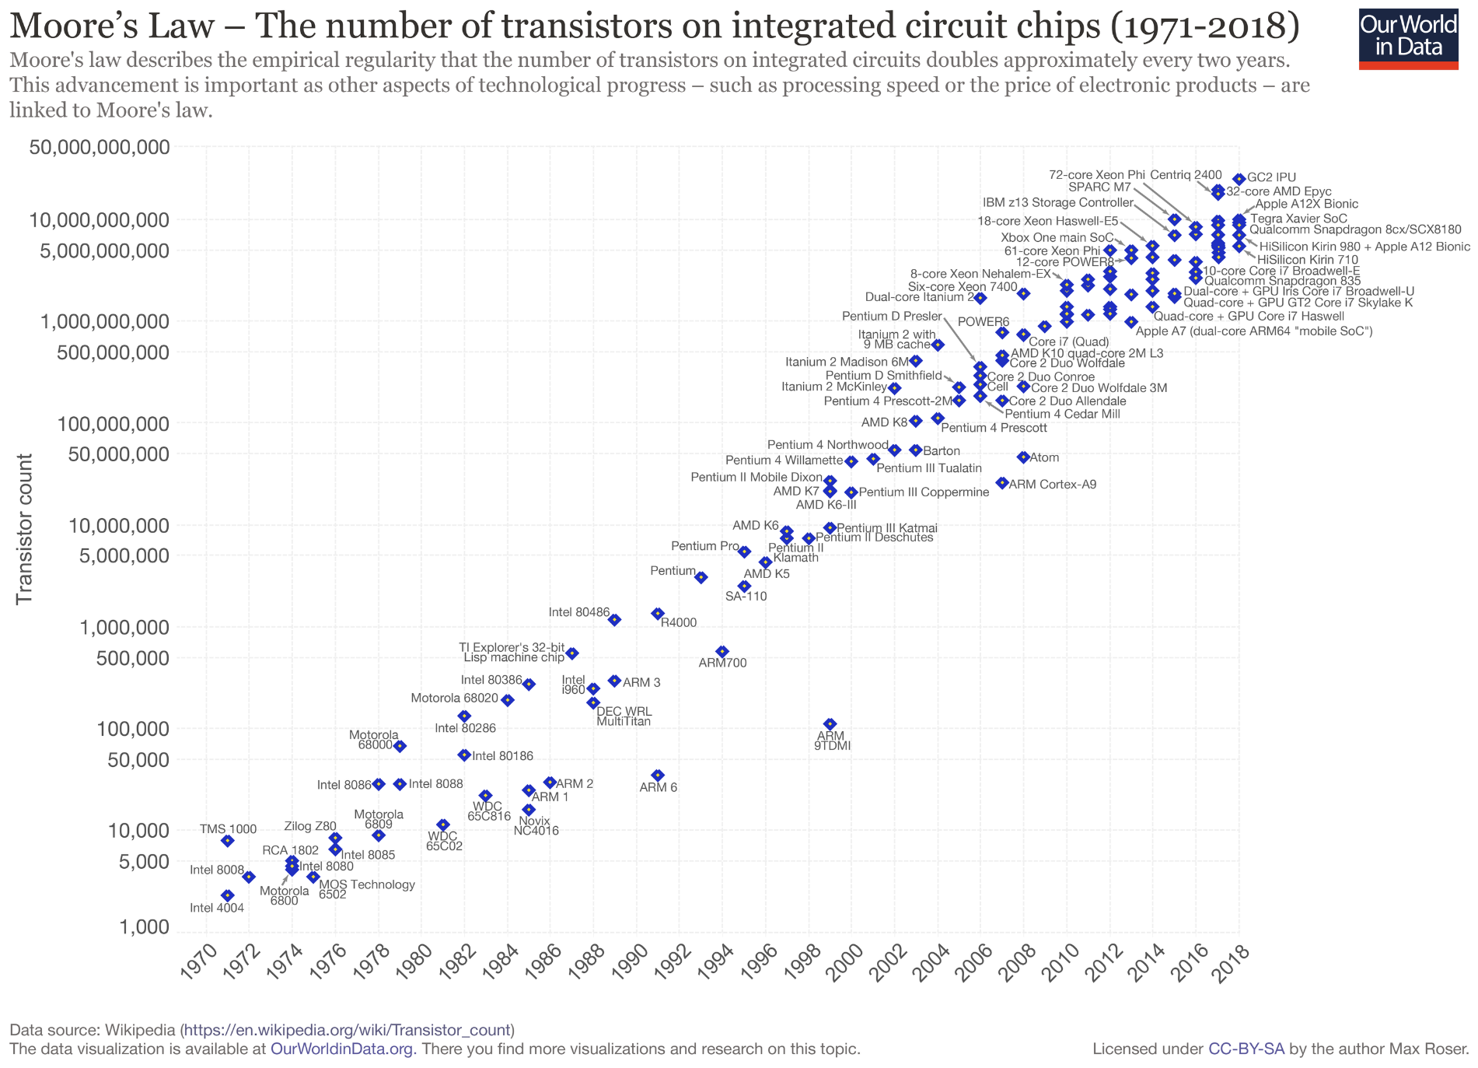
The Computer Revolution

Slide 4
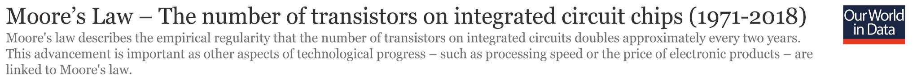

The Computer Revolution

Slide 5


The Computer Revolution

Slide 6








8 Great Ideas in Computing
Design for Moore’s Law
Use abstraction to simplify design
Make the common case fast
Performance via parallelism
Performance via pipelining
Performance via prediction
Hierarchy of memories
Dependability via redundancy

Slide 7
Introduction
This course is all about how computers work
But what do we mean by a computer?
- Different types: desktop, servers, embedded devices
- Different uses: automobiles, graphics, structural analysis, finance, genomics…
- Different manufacturers: Intel, Apple, IBM, Microsoft, Sun…
- Different underlying technologies and different costs!

Slide 8
Classes of Computers
Personal computers
  General purpose, variety of software
  Subject to cost/performance tradeoff
Server computers
  Network based
  High capacity, performance, reliability
  Range from small servers to building sized
Supercomputers
  High-end scientific and engineering calculations
  Highest capability but represent a small fraction of the overall computer market
Embedded computers
  Hidden as components of systems
  Stringent power/performance/cost constraints

Slide 9
Pedagogy
Analogy: Consider a course on “automotive vehicles”
- Many similarities from vehicle to vehicle (e.g., wheels)
- Huge differences from vehicle to vehicle (e.g., gas vs. electric)
Best way to learn:
- Focus on a specific instance and learn how it works
- While learning general principles and historical perspectives

Slide 10
Why learn this stuff?
You want to call yourself a “computer scientist”
You want to build software people use (need performance)
You need to make a purchasing decision or offer “expert” advice
Debugging skills often benefit from understanding architecture
- better understand system error messages
- better understand translators (compilers and interpreters)
Both hardware and software affect performance:
- Algorithm determines number of source-level statements
- Language/Compiler/Architecture determine machine instructions
- Processor/Memory determine how fast instructions are executed
Assessing and Understanding Performance in Chapter 4

Slide 11
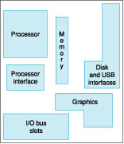
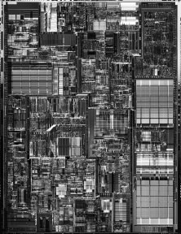
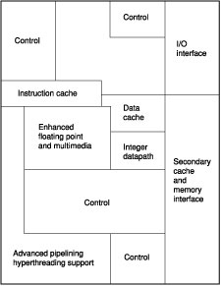
Focus: the Processor

Slide 12
Focus: the Memory Hierarchy
Processor
Fastest
Cache
Smallest
$$$$$
SRAM
Primary memory
DRAM
Secondary storage
Slowest
Largest
$
SSD
Magnetic disk

Slide 13
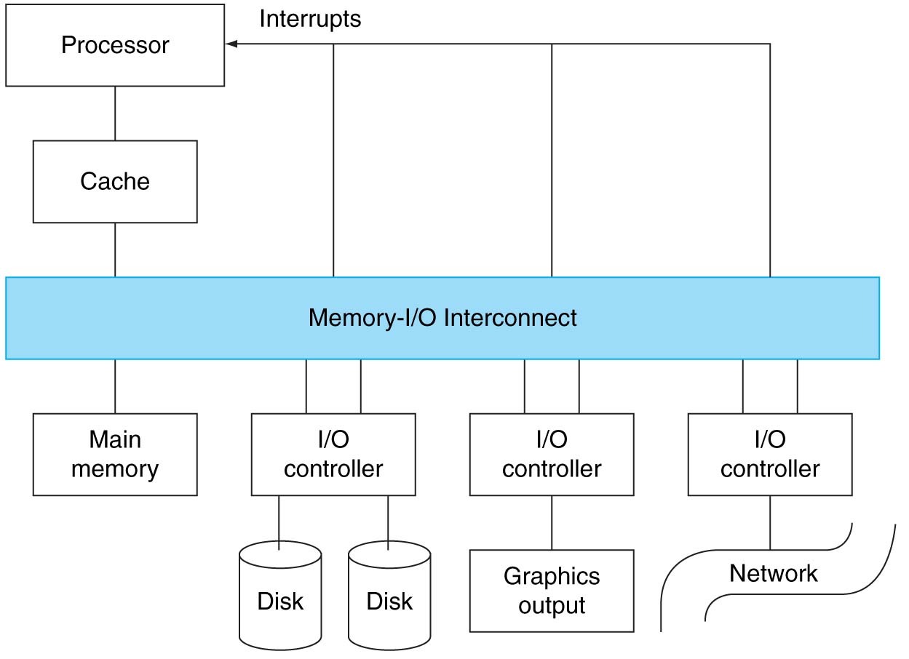
Focus: I/O

Slide 14
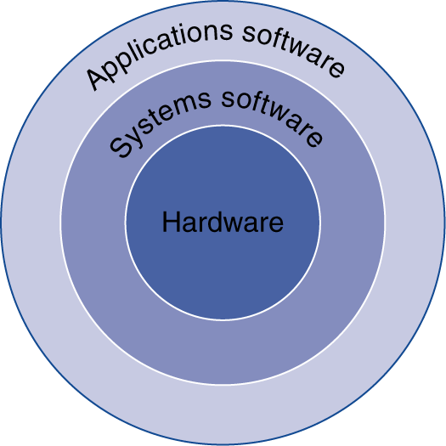
Below Your Program
Application software
  Written in high-level language
System software
  Compiler/Assembler/Linker:
  translates HLL code to machine code
  Operating System: service code
    Handling input/output
    Managing memory and storage
    Scheduling tasks & sharing resources
Hardware
  Processor, memory, I/O controllers

Slide 15
Language Abstractions
Delving into the depths
reveals more information
An abstraction omits unneeded detail, helps us cope with complexity
What are some of the details that appear in these familiar abstractions?
swap(int v[], int k) {
int temp;
temp = v[k];
v[k] = v[k+1];
v[k+1] = temp;
}
High-level language (C)
compiler
Assembly language (MIPS)
swap:
muli $2, $5, 4
add $2, $4, $2
lw $15, 0($2)
lw $16, 4($2)
sw $16, 0($2)
sw $16, 4($2)
jr $31
00000000101000010000000000011000
00000000000110000001100000100001
10001100011000100000000000000000
10001100111100100000000000000100
10101100111100100000000000000000
10101100011000100000000000000100
00000011111000000000000000001000
assembler
Binary machine language (for MIPS)

Slide 16
How do computers work?
Need to understand abstractions such as:
- Applications software
- Systems software
- Assembly Language
- Machine Language
- Architectural Issues: i.e., Caches, Virtual Memory, Pipelining
- Sequential logic, finite state machines
- Combinational logic, arithmetic circuits
- Boolean logic, 1s and 0s
- Transistors used to build logic gates (CMOS)
- Semiconductors/Silicon used to build transistors
- Properties of atoms, electrons, and quantum dynamics
So much to learn!

Slide 17
50 Years of Progress

Slide 18
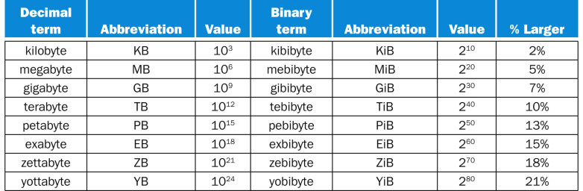
Units of Measurement
Spatial units:
Time units:
picosecond (ps) one-trillionth (10⁻¹²) of a second
nanosecond (ns) one-billionth (10⁻⁹) of a second
microsecond (ms) one-millionth (10⁻⁶) of a second
millisecond (ms) one-thousandth (10⁻³) of a second
Light in vacuum travels 1 foot in 1.016703362164 nanoseconds…

