Slide 1
Buffer Overflows
Many of the following slides are based on those from
Complete Powerpoint Lecture Notes for Computer Systems: A Programmer's Perspective (CS:APP)
Randal E. Bryant and David R. O'Hallaron
http://www.cs.cmu.edu/afs/cs/academic/class/15213-f15/www/schedule.html
The book is used explicitly in CS 2505 and CS 3214 and as a reference in CS 2506.
Notes:
This presentation is based on my old notes for the buffer lab project and CMU's notes for Recitation 5, CS 15213 Fall 2015.

Slide 2
Agenda
Stack review
Attack lab overview
Phases 1-3: Buffer overflow attacks
Phases 4-5: ROP attacks

Slide 3
x86-64 Registers
Return
%rax
%r8
Arg 5
%eax
%r8d
%rbx
%r9
Arg 6
%ebx
%r9d
Arg 4
%rcx
%r10
%ecx
%r10d
Arg 3
%rdx
%r11
%edx
%r11d
Arg 2
%rsi
%r12
%esi
%r12d
Arg 1
%rdi
%r13
%edi
%r13d
Stack ptr
%rsp
%r14
%esp
%r14d
%rbp
%r15
%ebp
%r15d
Notes:
It's important to note the roles played by %rax, %rsp, and the argument registers.
AMD's documentation says the following about the frame pointer (rbp):
The conventional use of %rbp as a frame pointer for the stack frame may be avoided by using %rsp
(the stack pointer) to index into the stack frame. This technique saves two instructions in the prologue
and epilogue and makes one additional general-purpose register (%rbp) available.
It's not really necessary to mention this, but it does explain some differences between the behavior of 32-bit
and 64-bit code... see Notes page for slide 13.

Slide 4
x86-64: Register Conventions
Arguments are passed in registers (default):
%rdi, %rsi, %rdx, %rcx, %r8, %r9
Return value: %rax
Callee-saved: %rbx, %r12, %r13, %r14, %rbp, %rsp
Caller-saved:
%rdi, %rsi, %rdx, %rcx, %r8, %r9, %rax, %r10, %r11
Stack pointer: %rsp
Instruction pointer: %rip

Slide 5
x86-64: The Stack
Grows downward towards lower memory addresses
%rsp points to top of stack
Bottom
0x7fffffffffff
push %reg
subtract 8 from %rsp,
put val in %reg at (%rsp)
pop %reg
put val at (%rsp) in %reg,
add 8 to %rsp
%rsp
Top
Notes:
All of my stack diagrams follow the following conventions:
- each "row" represents 8 bytes of data
- if I show individual bytes, addresses within a "row" increase from left to right

Slide 6
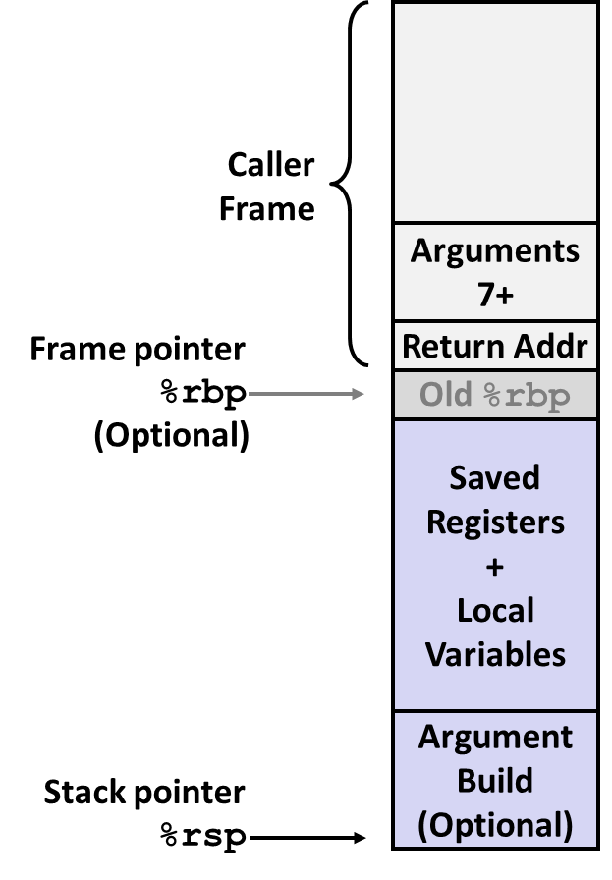
x86-64: Stack Frames
Every function call has its own stack frame.
Think of a frame as a workspace for each call.
- local variables
- callee & caller-saved registers
- optional arguments for a function call
Notes:
I put minor emphasis on the issues of saved registers and the argument build... I doubt either arises in this assignment.
I do make the observation that storing the return address on the stack makes it potentially vulnerable.

Slide 7
x86-64: Function Call Setup
Caller:
- allocates stack frame large enough for saved registers, optional arguments
- save any caller-saved registers in frame
- save any optional arguments (in reverse order) in frame
- call foo: push %rip to stack, jump to label foo
Callee:
- push any callee-saved registers, decrease %rsp to make room for new frame

Slide 8
x86-64: Function Call Return
Callee:
- increase %rsp
- pop any callee-saved registers (in reverse order)
- execute ret: pop %rip

Slide 9
Attack Lab Overview: Phases 1-3
Overview
Exploit x86-64 by overwriting the stack
Overflow a buffer, overwrite return address
Execute injected code
Key Advice
Brush up on your x86-64 conventions!
Use objdump –d to determine relevant offsets
Use GDB to determine stack addresses

Slide 10
Buffer Overflows
Exploit C String library vulneratilities to overwrite important info on stack
When this function returns, where will it begin executing?
Recall
ret:pop %rip
What if we want to inject new code to execute?
0xAABBCCDDEEFFGGHH
0xFFFFFFFFFFFFFFFF 0xFFFFFFFFFFFFFFFF 0xFFFFFFFFFFFFFFFF 0xFFFFFFFFFFFFFFFF 0xFFFFFFFFFFFFFFFF 0xFFFFFFFFFFFFFFFF 0xFFFFFFFFFFFFFFFF 0xFFFFFFFFFFFFFFFF 0xFFFFFFFFFFFFFFFF 0xFFFFFFFFFFFFFFFF 0xFFFFFFFFFFFFFFFF
old return address
buf

Slide 11
String Library Code
Implementation of Unix function gets
No way to specify limit on number of characters to read
// Get string from stdin
char *gets(char *dest) { int c = getc();
char *p = dest;
while (c != EOF && c != '\n') {
*p++ = c;
c = getc();
}
*p = '\0';
return dest;
}
So bad it's officially deprecated, but it has been used widely, is still used, and gcc still supports it.
Notes:
One might be tempted to say that gets() is no longer relevant, but it's still available and it was widely used in legacy code that has not been rewritten to fix the issue.

Slide 12
Vulnerable Buffer Code
int main() { printf("Type a string:"); echo(); return 0; }
// Echo Line void echo() { char buf[4]; // Dangerously small!
// Stored on the stack!!
gets(buf); // Call to oblivious fn
puts(buf); }

Slide 13
Buffer Overflow Executions
CentOS > ./bufdemo
Type a string:abcd
abcd
CentOS > ./bufdemo
Type a string:abcdefghijklmnopqrst
abcdefghijklmnopqrst
CentOS > ./bufdemo
Type a string:abcdefghijklmnopqrstuvwx
abcdefghijklmnopqrstuvwx
Segmentation fault (core dumped)
Notes:
When compiled to 32-bit code, I get a segfault with a string of length 5 (not counting the terminator).
That is partly due to the difference in frame layouts, and partly due to the fact that the saved frame pointer ebp is more critical in that context.

Slide 14
Buffer Overflow Stack
// Echo Line void echo() { char buf[4]; // Way too small! gets(buf); puts(buf); }
echo:
pushq %rbp # setup stack frame
movq %rsp, %rbp
subq $16, %rsp
leaq -16(%rbp), %rax # calculate buf
movq %rax, %rdi # set param for buf
movl $0, %eax
call gets # call gets
. . .
Stack
Frame
for main
Stack
frame
for main
Saved %rip
%rbp
Saved %rbp
Stack
frame
for echo
buf
Notes:
The next slide explains just how I know the layout of the frame for echo().
Remind them that %rip is the program counter; so the backup of it stores the address of the instruction to which we want to return when echo() is finished.

Slide 15
Buffer Overflow Stack
00007fffffffdff0
Stack
Frame
for main
00007fffffffdfe8
Saved %rip
%rbp:
00007fffffffdfe0
Saved %rbp
buf:
00007fffffffdfd0
(gdb) info f
Stack level 0, frame at 0x7fffffffdff0:
rip = 0x4005ec in echo (echo.c:4); saved rip 0x4005dd
called by frame at 0x7fffffffe000
source language c.
Arglist at 0x7fffffffdfe0, args:
Locals at 0x7fffffffdfe0, Previous frame's sp is 0x7fffffffdff0
Saved registers:
rbp at 0x7fffffffdfe0, rip at 0x7fffffffdfe8
(gdb) p/a $rbp
$6 = 0x7fffffffdfe0
(gdb) p/a &buf[0]
$7 = 0x7fffffffdfd0
Notes:
I used gdb, with a breakpoint set at echo() and the command "info f" to examine the stack layout.
I also printed the value of rbp to verify the beginning of echo()'s frame, and the address of buf[0] to determine just where buf begins on the stack.

Slide 16
Buffer Overflow Example #1
00007fffffffdff0
Stack
Frame
for main
Before call to gets()
00007fffffffdfe8
Saved %rip
Entered string was "abc"
%rbp:
00007fffffffdfe0
Saved %rbp
buf:
00007fffffffdfd0
00007fffffffdff0
Stack
Frame
for main
After call to gets()
00007fffffffdfe8
Saved %rip
%rbp:
00007fffffffdfe0
Saved %rbp
buf:
00007fffffffdfd0
'a'
'b'
'c'
'\0'
No problem
Notes:
Nothing was corrupted... no issues can arise.

Slide 17
Buffer Overflow Example #2
00007fffffffdff0
Stack
Frame
for main
Before call to gets()
00007fffffffdfe8
Saved %rip
Entered string was "abcd...qrst"
%rbp:
00007fffffffdfe0
Saved %rbp
buf:
00007fffffffdfd0
00007fffffffdff0
Stack
Frame
for main
After call to gets()
00007fffffffdfe8
Saved %rip
%rbp:
00007fffffffdfe0
'q'
'r'
's'
't'
'\0'
No problem??
'i'
'j'
'k'
'l'
'm'
'n'
'o'
'p'
buf:
00007fffffffdfd0
'a'
'b'
'c'
'd'
'e'
'f'
'g'
'h'
Notes:
Here, the saved value of rbp is corrupted, but no runtime error occurs since the stack manipulations, when echo() returns, do not depend on that.

Slide 18
Buffer Overflow Example #3
00007fffffffdff0
Stack
Frame
for main
Before call to gets()
00007fffffffdfe8
Saved %rip
Entered string was "abcd...qrstuvwx"
%rbp:
00007fffffffdfe0
Saved %rbp
buf:
00007fffffffdfd0
00007fffffffdff0
Stack
Frame
for main
After call to gets()
00007fffffffdfe8
'\0'
%rbp:
00007fffffffdfe0
'q'
'r'
's'
't'
'u'
'v'
'w'
'x'
'i'
'j'
'k'
'l'
'm'
'n'
'o'
'p'
Problem!!
buf:
00007fffffffdfd0
'a'
'b'
'c'
'd'
'e'
'f'
'g'
'h'
Notes:
Now, the return address has been corrupted... in this case, that results in a segfault when echo() returns.
QTP: Which byte of the return address was overwritten, the high byte or the low byte? Why?
Hint: how are multi-byte values stored? (little-endian)

Slide 19
Demonstration: Generating Byte Codes
Use gcc and objdump to generate machine code bytes for assembly instruction sequences:
CentOS > cat exploit.s
movq %rbx, %rdx
addq $5, %rdx
movq %rdx, %rax
retq
CentOS > gcc -c exploit.s
CentOS > objdump -d exploit.o
exploit.o: file format elf64-x86-64
Disassembly of section .text:
0000000000000000 <.text>:
0: 48 89 da mov %rbx,%rdx
3: 48 83 c2 05 add $0x5,%rdx
7: 48 89 d0 mov %rdx,%rax
a: c3 retq
Notes:
One could also write the exploit in C (perhaps)...
The code used here serves no particular logical purpose.

Slide 20
Demonstration: Trying the Exploit
Edit the objdump output as shown.
hex2raw will generate an appropriate binary version of that for input to ctarget:
CentOS > cat exploit.hex
48 89 da /* mov %rbx,%rdx */
48 83 c2 05 /* add $0x5,%rdx */
48 89 d0 /* mov %rdx,%rax */
c3 /* retq */
CentOS > hex2raw -i exploit.hex
H??H??H???
CentOS > hex2raw -i exploit.hex | rtarget -q
Cookie: 0x754e7ddd
Type string:No exploit. Getbuf returned 0x1
Normal return
(The strange output from hex2raw is due to the presence of bytes in the machine code that correspond to unprintable ASCII characters.)
Notes:
exploit.hex is an edited version of the objdump output shown on the previous slide.
See the assignment specification for the requirements.
hex2raw is necessary because we need to put the actual binary values of the machine code bytes into the buffer, not the characters shown here.
FWIW, 0x48 is the code for "H" and none of the other bytes correspond to printable characters.
The students should use the –q switch (after rtarget) if they want to avoid contacting the server; it's necessary in any case if they want to run this on their own CentOS machines.
Since my exploit string was essentially crap, it fails to solve the problem.

Slide 21
Attack Lab Overview: Phases 4-5
Overview
Utilize return-oriented programming to execute arbitrary code
- Useful when stack is non-executable or randomized
Find gadgets, string together to form injected code
Key Advice
- Use mixture of pop & mov instructions + constants to perform specific task

Slide 22
ROP Example
Draw a stack diagram and ROP exploit to:
- pop the value 0xBBBBBBBB into %rbx, and
- move it into %rax
void foo(char *input){
char buf[32];
...
strcpy (buf, input);
return;
}
Gadgets:
address₁: pop %rbx; ret
address₂: mov %rbx, %rax; ret
Inspired by content created by Professor David Brumley

Slide 23
ROP Example: Solution
Gadgets:
Address 1: pop %rbx; ret
Address 2: mov %rbx, %rax; ret
More ROP entries...
Address 2
0x00000000BBBBBBBB
Address 1
0xFFFFFFFFFFFFFFFF 0xFFFFFFFFFFFFFFFF 0xFFFFFFFFFFFFFFFF 0xFFFFFFFFFFFFFFFF 0xFFFFFFFFFFFFFFFF 0xFFFFFFFFFFFFFFFF 0xFFFFFFFFFFFFFFFF 0xFFFFFFFFFFFFFFFF 0xFFFFFFFFFFFFFFFF 0xFFFFFFFFFFFFFFFF
old return address was here
void foo(char *input){
char buf[32];
...
strcpy (buf, input);
return;
}
buf
Notes:
Consider what happens when echo() completes:
- rsp winds up pointing to the location of the old return address
- ret pops the stack, putting Address 1 into rip, and leaving rsp at the location of the constant
- the first gadget is "called", pops the constant into rbx, and leaves rsp pointing at Address 2
- the first gadget executes ret, which pops the stack, putting Address 2 into rip
- the second gadget is "called", copying rbx into rax
- the second gadget executes ret, therefore we must be concerned about what's
above Address 2...

Slide 24
ROP Demonstration: Looking for Gadgets
How to identify useful gadgets in your code:
- a gadget must come from the supplied gadget "farm"
- a gadget must end with the byte c3 (corresponding to retq)
- pop and mov instructions are useful
- so are carefully-chosen constants
You must use objdump to examine farm.o for candidate gadgets.
Then, you must determine the correct virtual addresses for those gadgets within rtarget.
Use objdump to examine rtarget...
Notes:
See the beginning of my gadget farm on the following slide.
Make the point that one can "subset" part(s) of longer machine instructions when forming a gadget.
Show the students the encoding tables in the assignment specification.

Slide 25
ROP Demonstration: Looking for Gadgets
Creative "subsetting" of the machine code bytes may be useful:
0000000000000000 <start_farm>:
0: b8 01 00 00 00 mov $0x1,%eax
5: c3 retq
0000000000000006 <getval_168>:
6: b8 48 89 c7 94 mov $0x94c78948,%eax
b: c3 retq
000000000000000c <getval_448>:
c: b8 7e 58 89 c7 mov $0xc789587e,%eax
11: c3 retq
0000000000000012 <getval_387>:
12: b8 48 89 c7 c3 mov $0xc3c78948,%eax
17: c3 retq
0000000000000018 <getval_247>:
18: b8 18 90 90 90 mov $0x90909018,%eax
1d: c3 retq
000000000000001e <addval_452>:
1e: 8d 87 48 89 c7 c3 lea -0x3c3876b8(%rdi),%eax
24: c3 retq

Slide 26
Tools
objdump –d
View byte code and assembly instructions, determine stack offsets
./hex2raw
Pass raw ASCII strings to targets
gdb
Step through execution, determine stack addresses
gcc –c
Generate object file from assembly language file

Slide 27
More Tips
Draw stack diagrams
Be careful of byte ordering (little endian)
READ the assignment specification!
A video presentation of CMU's version is available as Recitation 5 at the link below:
http://scs.hosted.panopto.com/Panopto/Podcast/Podcast.ashx?courseid=b96d90ae-9871-4fae-91e2-b1627b43e25e&type=mp4
Notes:
The video may be useful, so be sure to mention it.
But... most of the lecture videos there correspond to our CS 3214, not CS 2506.

