Slide 1

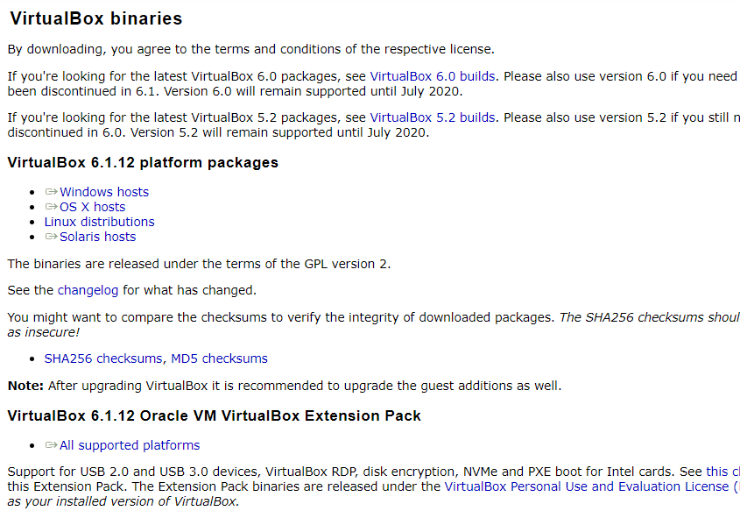
Get VirtualBox
Go to www.virtualbox.org and select:
Note:
- the OS on which you will install VirtualBox is called the host OS.
- the OS you will install on VirtualBox (later) is called the guest OS.
* These notes are based on VirtualBox 6.1.12.

Slide 2
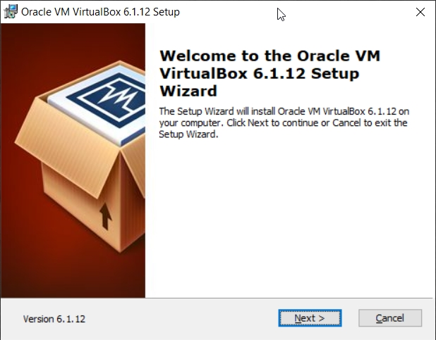
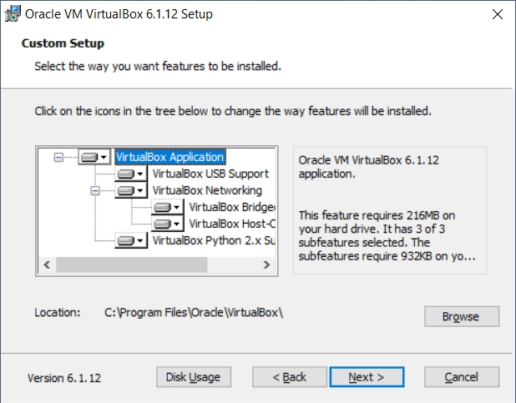
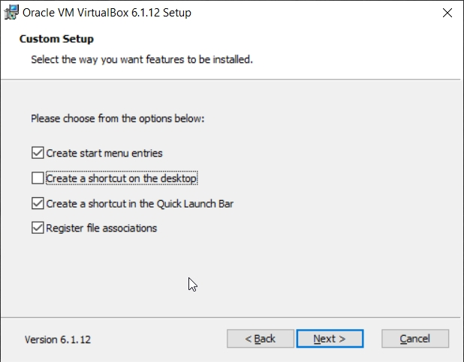
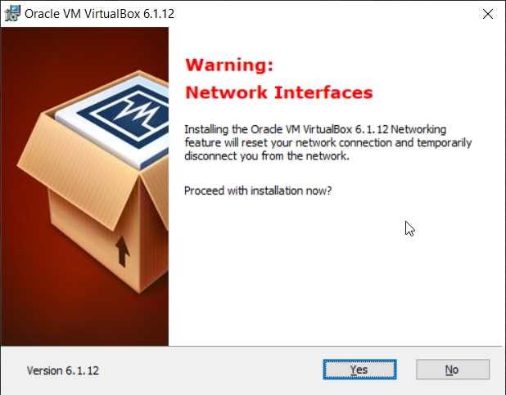
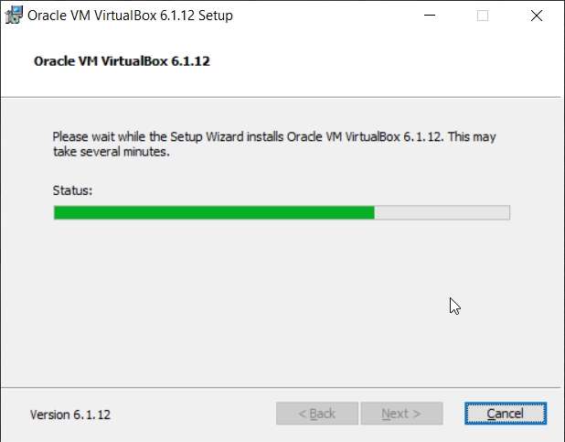
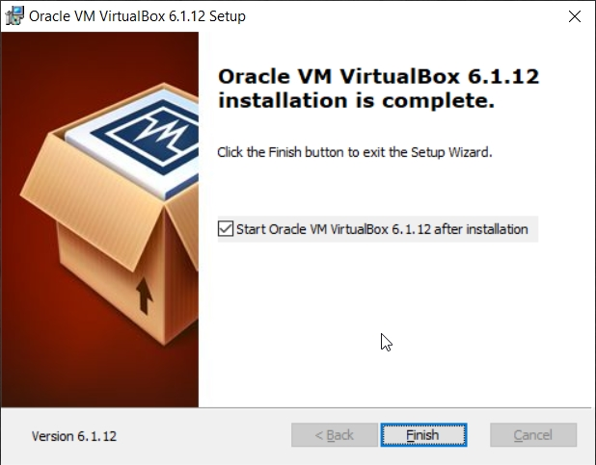
Begin the VirtualBox Installation
Run the VirtualBox installer. The first few screens are typical and probably do not require you to make any changes to the default options:

Slide 3
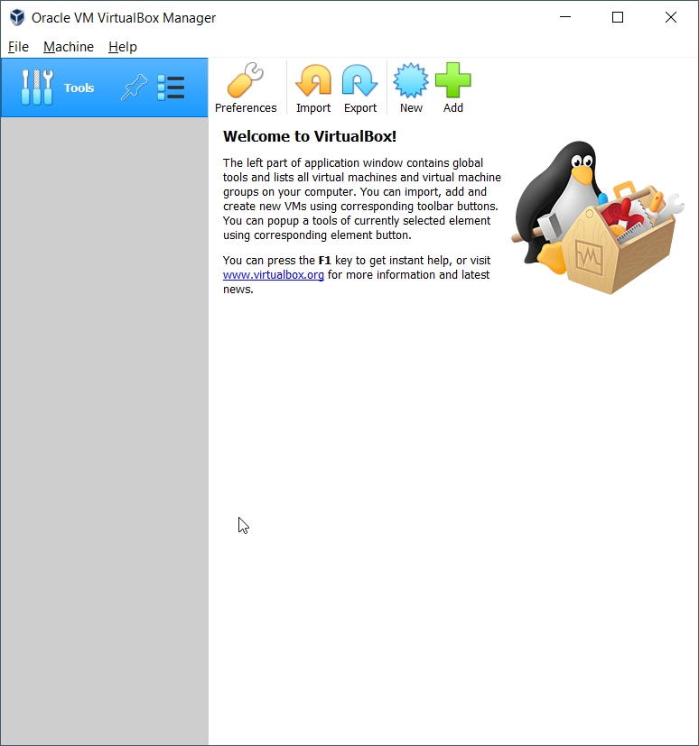
Start VirtualBox
Once the base installation is complete, start the VirtualBox Manager:
Find the file you downloaded for the VirtualBox Extension Pack and double-click it…

Slide 4
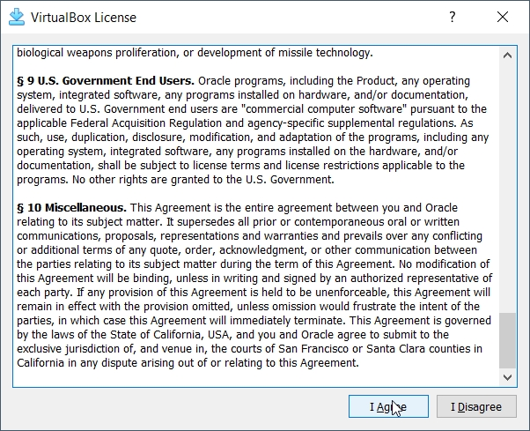
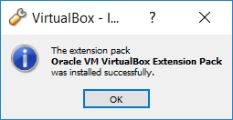
Install the VirtualBox Extensions
Authorize the installation…
… accept the license …
... and wait for …

Slide 5
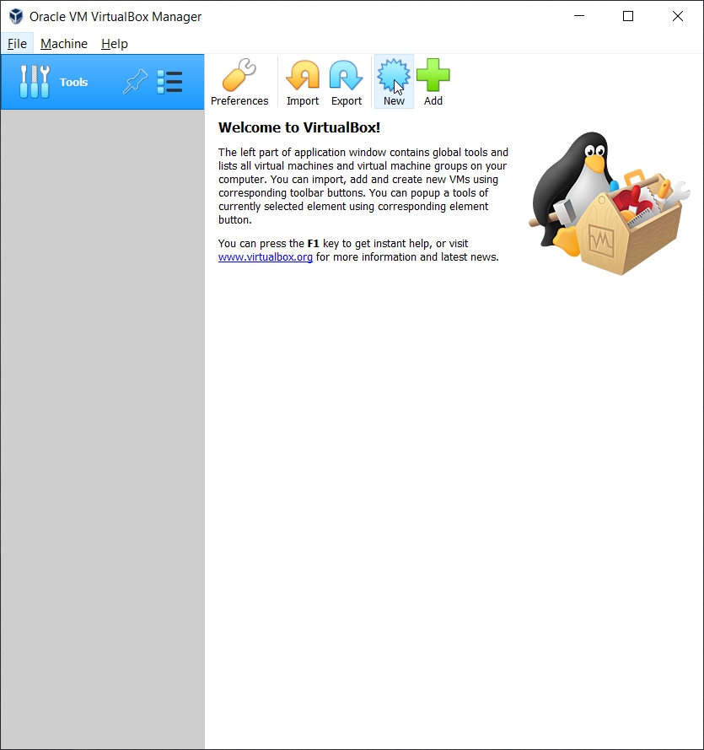
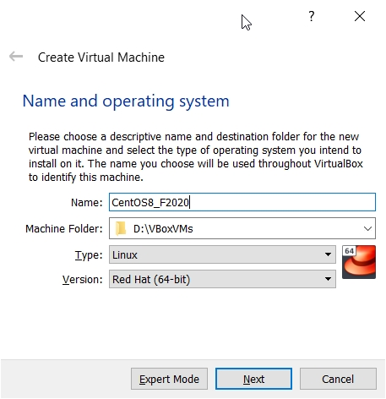
Creating a Virtual Machine
Restart the VirtualBox Manager.
Select New to create your virtual machine:
Enter a Name:
If you use a descriptive name for the VM, VirtualBox should auto-detect the proper OS type and version.

Slide 6
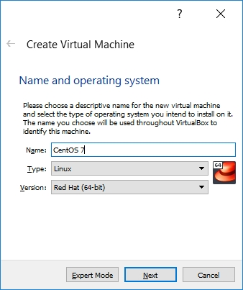
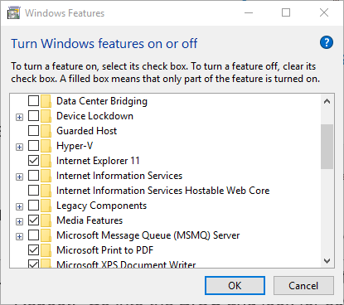
No 64-bit Options?
What if you only have 32-bit options listed?
There are two likely possibilities:
Hardware virtualization support is not enabled on your system.
Reboot. Go into the BIOS and look for something like VT-X and turn it on.
You are running Win8 or Win10 Pro or Enterprise and Hyper-V is turned on:
Follow the instructions at:
https://www.petri.com/how-to-disable-hyper-v-completely-in-windows-10

Slide 7
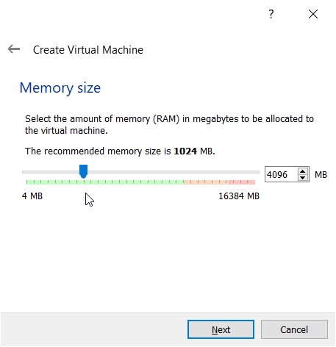
Configuring Memory for the VM
Specify the amount of memory you'll give the VM.
In this example, I'm installing on a host machine with 8GB of RAM; with less, I'd probably given the VM 2GB (the minimum for CentOS 8 is 2GB).
On my current working laptop, I have 16GB of RAM and gave my VM 8GB.

Slide 8
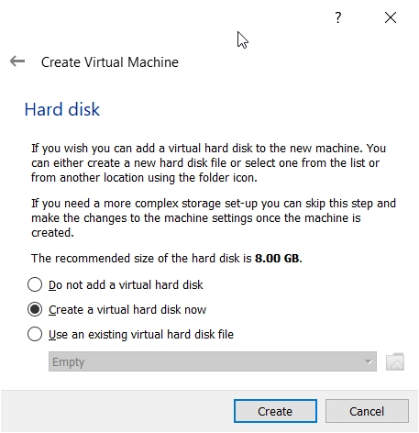
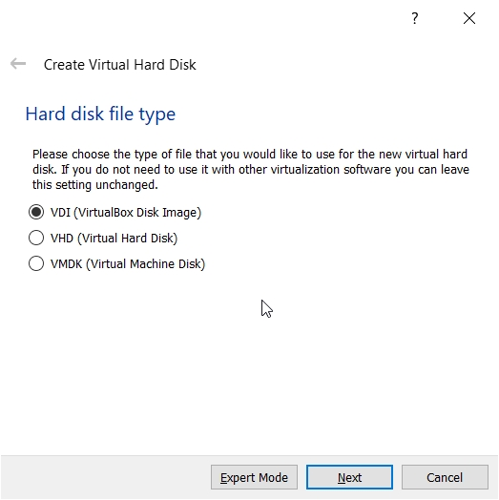
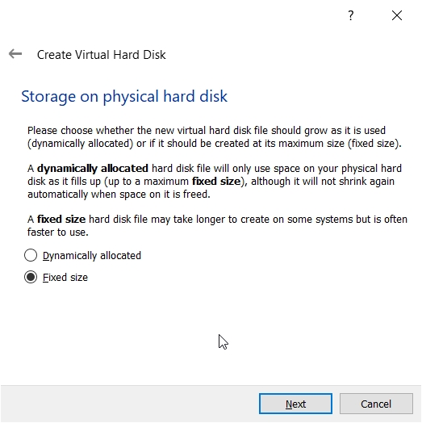
Configuring a Virtual Hard Disk
In the next dialog, select the option to create a new virtual hard drive now.
Take the default hard drive file type in the next dialog unless you're concerned about being compatible with some other virtualization tool like VMWare.
Next, I strongly recommend choosing a fixed-size hard disk.

Slide 9
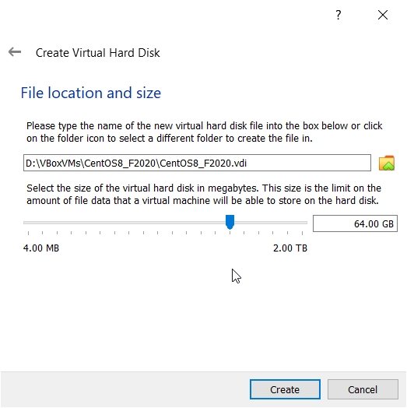
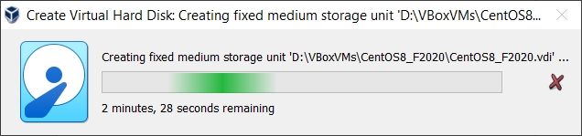
Configuring a Virtual Hard Disk
I generally make this 32GB, but make it smaller if you're short on space.
That said, CentOS 8 requires a virtual HD that's 20GB or more.

Slide 10
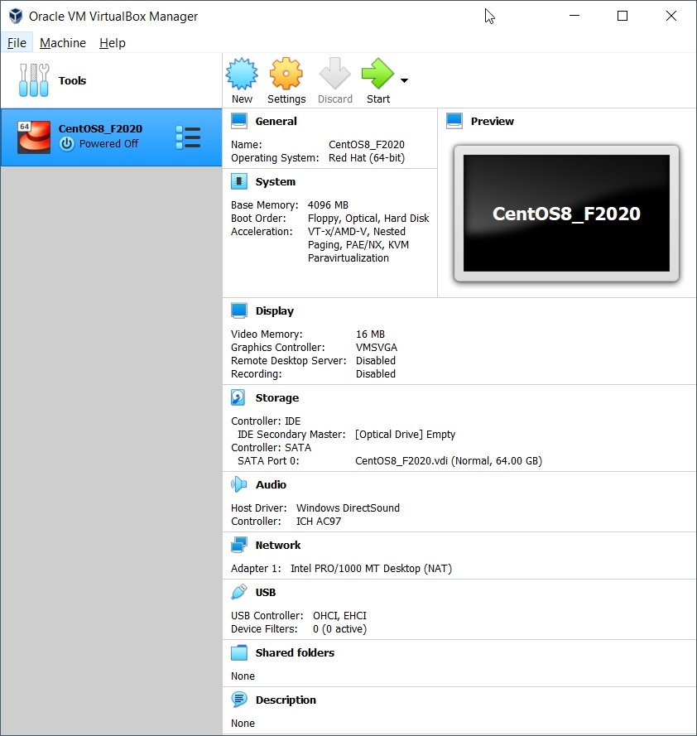
An Empty VM
Now, you have an empty virtual machine.
That is, a formatted (virtual) hard disk and no OS installation on it.

Slide 11
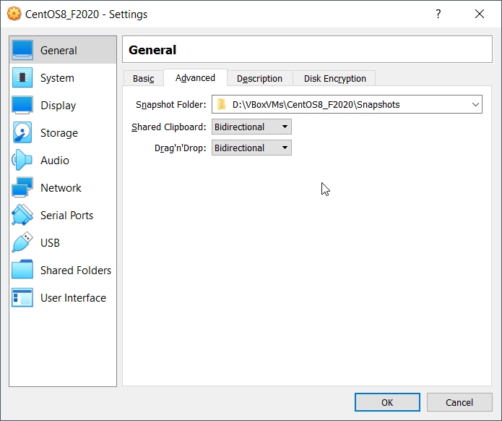
An Empty VM
Click on Settings to bring up a more information about your empty VM:
Under General/Advanced, make the shared clipboard and Drag'n Drop Bidirectional.

Slide 12
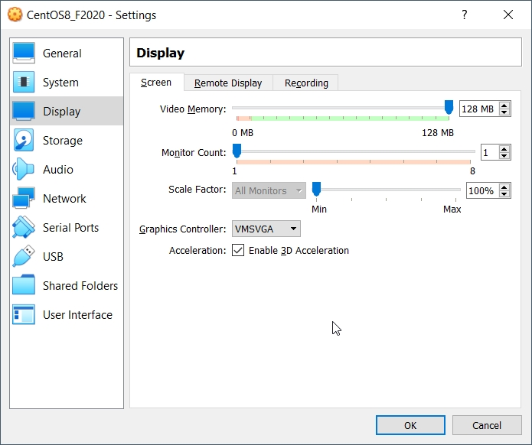
VM Settings
On the Processor tab, you can increase the number of cores your VM can use.
Under Display, enabling 3D Acceleration may improve performance (or not).
I also pump Video Memory up to 128MB, but it probably doesn't matter.

Slide 13
Halfway There…
So…
You've got an empty VM, but sensibly configured.
Now you need to install a CentOS into your empty VM…

