Slide 1
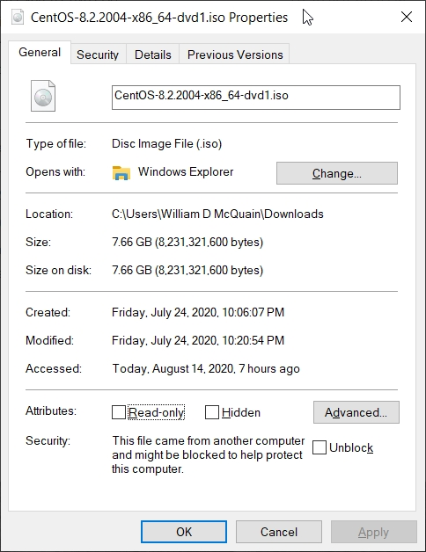
Get CentOS 8
CentOS 8 matches the department’s servers, including the rlogin cluster, so that is what you should install.
That's where we will evaluate all of your assignments.
When downloading an ISO for CentOS, be aware that the file is fairly large…
Be sure you've gotten all of it…
Disclaimer: the following notes illustrate one session installing CentOS 8 on VirtualBox 6.1.12, running on Windows 10 Enterprise, on a particular underlying hardware system.
YMMV. Mine certainly has…

Slide 2
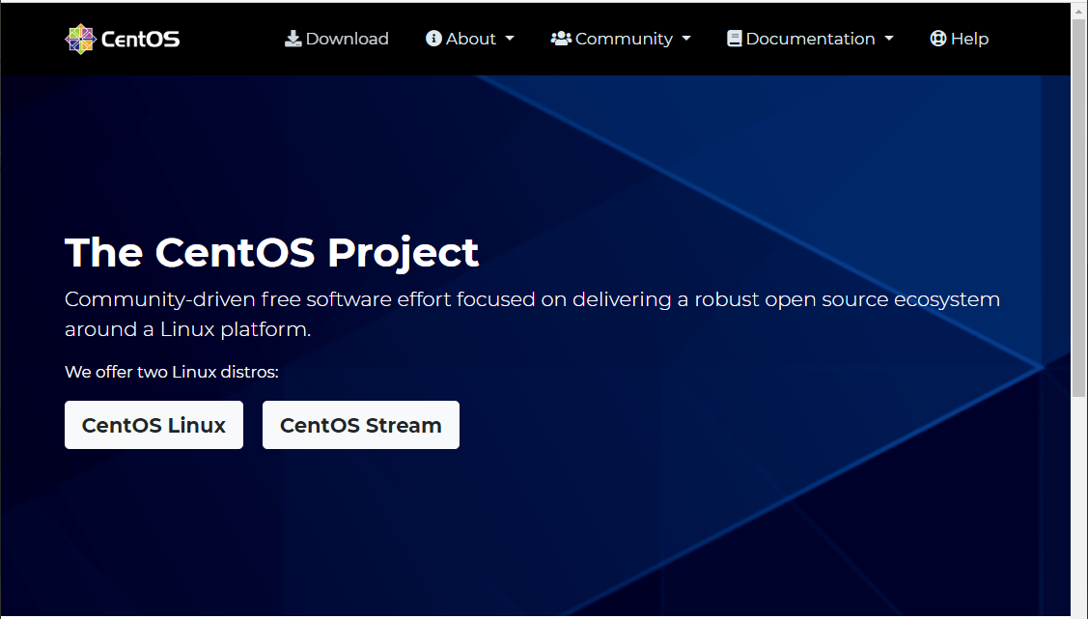
Get CentOS
Go to centos.org, and use the Download link.

Slide 3
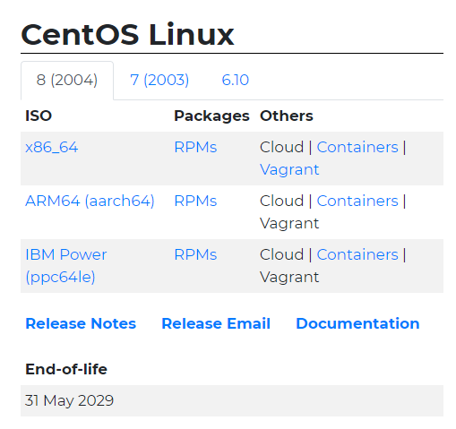
Get CentOS 8
Select the ISO distribution

Slide 4
Installing CentOS 8
The following notes assume that you have:
- installed VirtualBox
- created an empty VM
If you are preparing a USB flash drive for a dual-boot approach instead, you need to:
- prepare a bootable installation flash drive (or DVD) from the CentOS 8 ISO
- boot your computer from that installation medium
- very carefully choose your second flash drive for the installation*
- follow the remaining slides to perform the installation
- skip the VirtualBox-specific slides
* If you choose your primary hard drive instead, you will destroy your host OS!

Slide 5
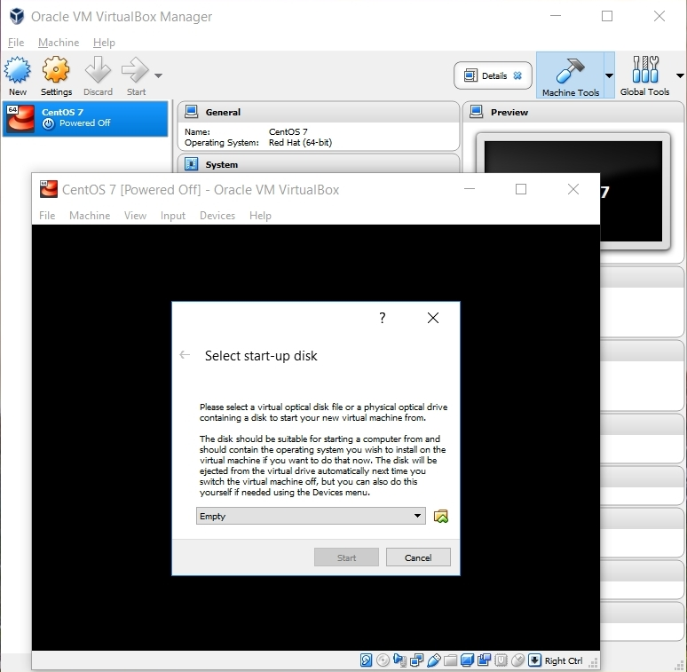
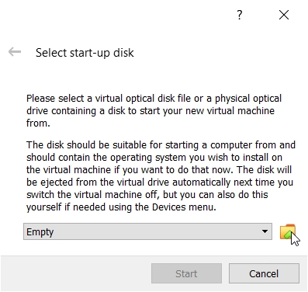
Beginning the CentOS Installation
Select the VM and click Start.
VirtualBox will recognize the empty system and prompt you to select an installation disk.
Click the folder icon…

Slide 6
Working with the VM
If you click your mouse within the window where CentOS is being installed:
- VirtualBox will capture your mouse and keyboard
- you can release them by pressing the Host key
- on Windows systems, that's the right-hand Control key (right-Ctrl)
- on Mac systems, that's the left Command key
The mouse and keyboard might auto-release on modern systems.
Once you've installed the Guest Additions in your CentOS VM, they will.

Slide 7
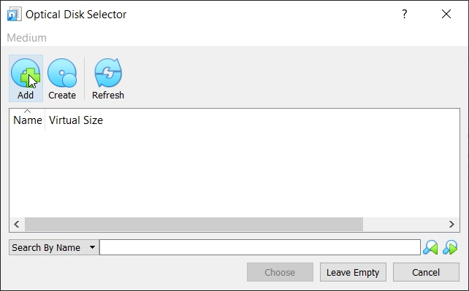
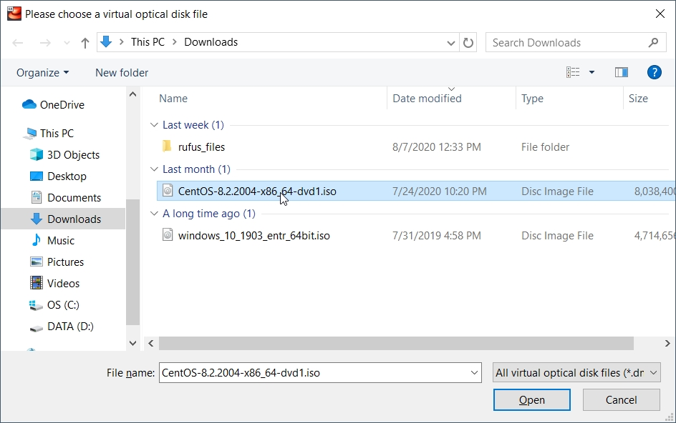
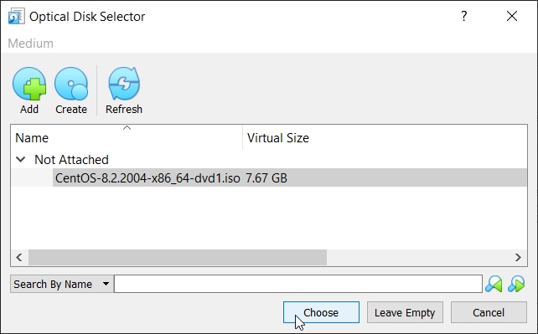
Beginning the CentOS Installation
Select Add
Find the CentOS 8 ISO
Click Open

Slide 8
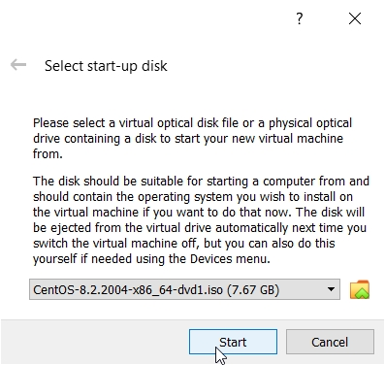
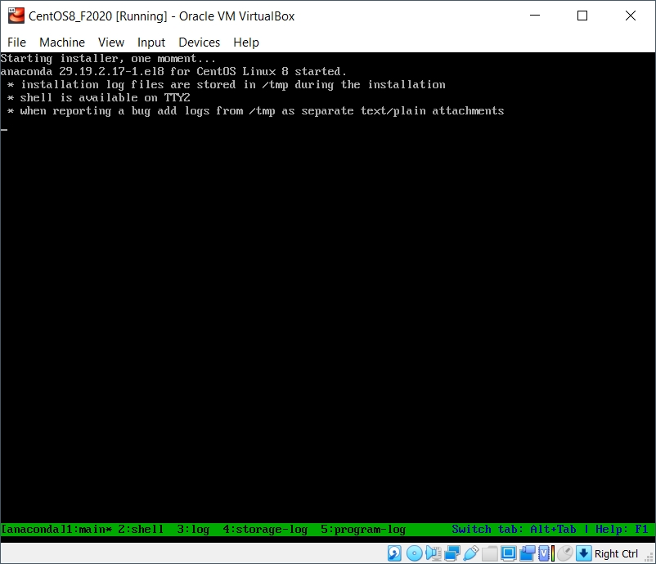
Running the Installation Code
Click Start
Select Install CentOS 8...
… and it grinds away awhile…

Slide 9
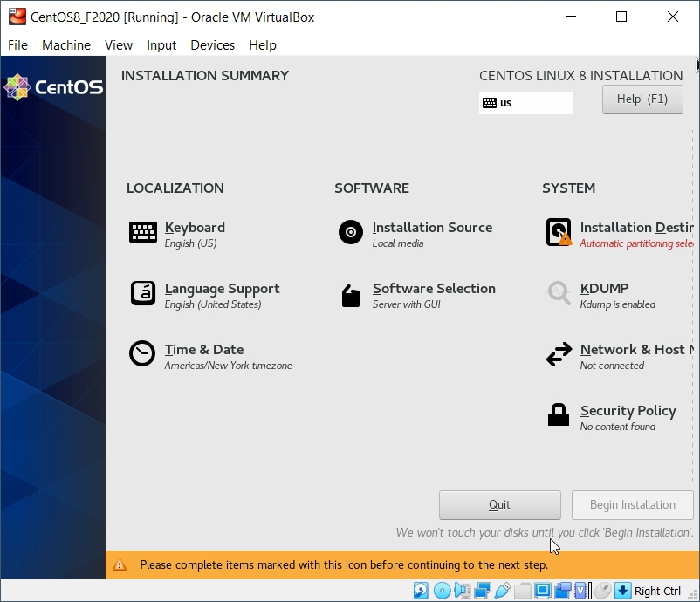
Running the Installation Code
Some basic settings need to be established.
After confirming Language and Keyboard…
Installation Destination
Software Selection

Slide 10
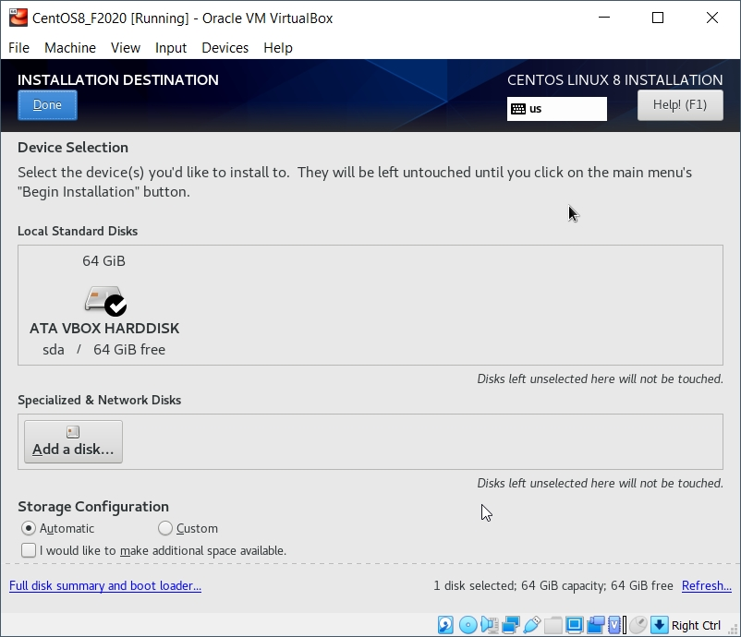
Installation Destination
This will be the virtual harddrive you just created... take the defaults.

Slide 11
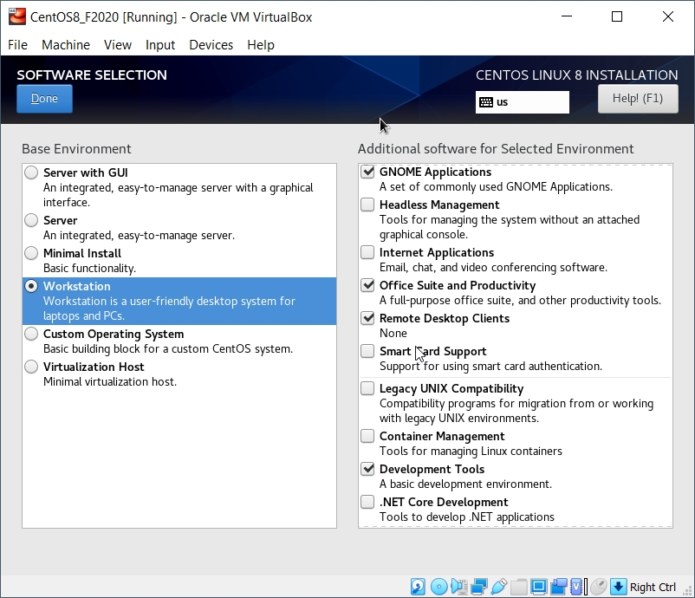
Software Selection
Be sure to choose Workstation and to install the Development Tools.
I also chose:
GNOME desktop
Office Suite
Remote Desktop
Make other choices as you like... more packages can be installed later.

Slide 12
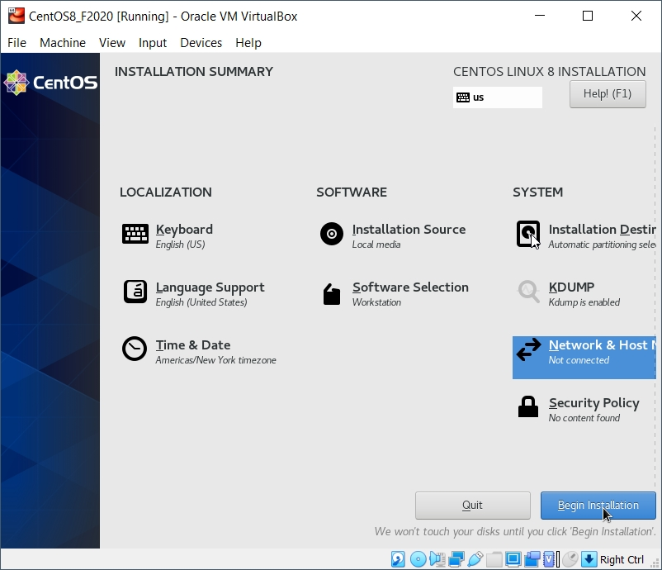
Initiate Installation
Fire up the installation routine...

Slide 13
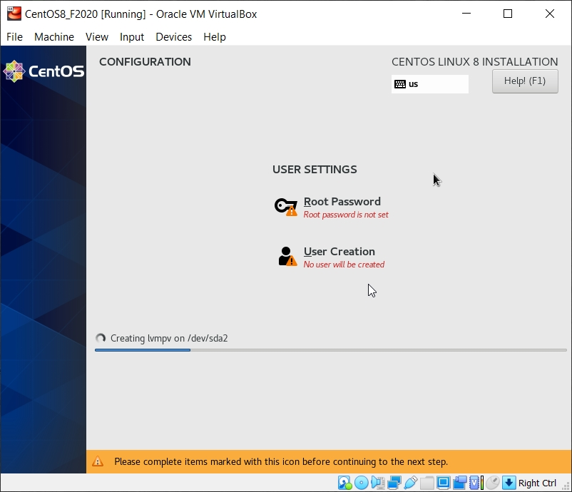
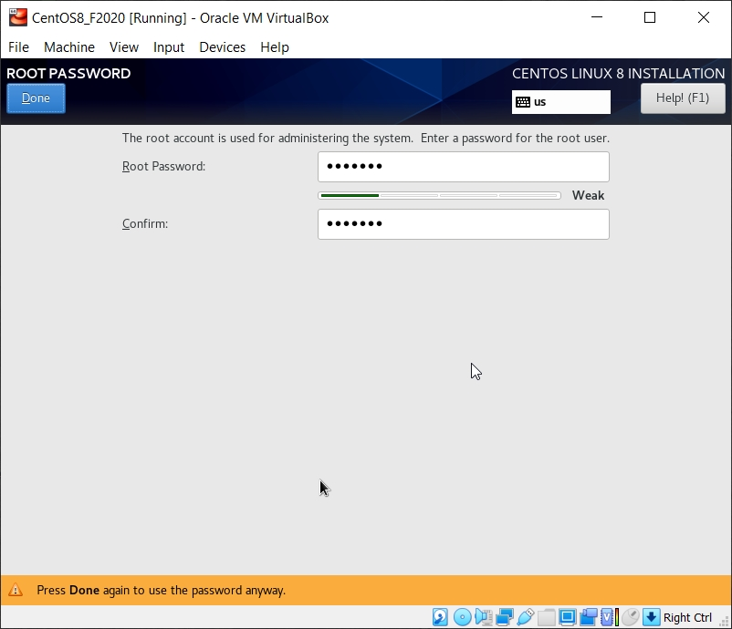
root Account Setup
While the installation is running, set the password for the root (superuser) account.
root is the administrative account.
You will use that for most software installs and some other activities.
Do not forget this password!

Slide 14
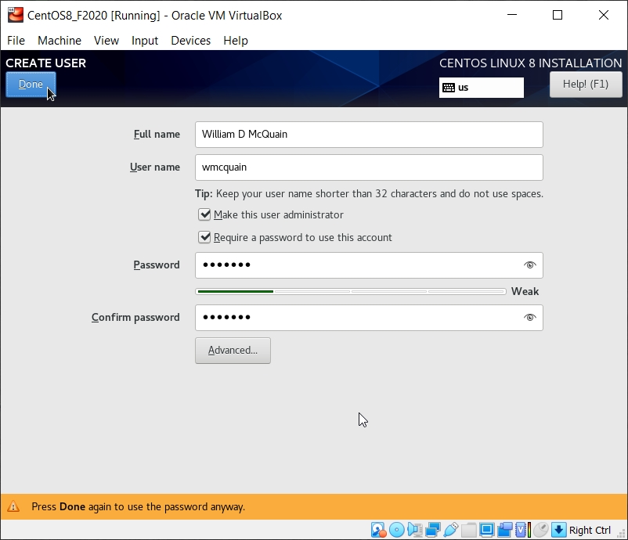
User Account Setup
I also set up a user account for my personal use.
I recommend using your PID for your User name… helps with rlogin later on.
Security advice notwithstanding, I prefer to run as an admin… this is NOT the same as being root.

Slide 15
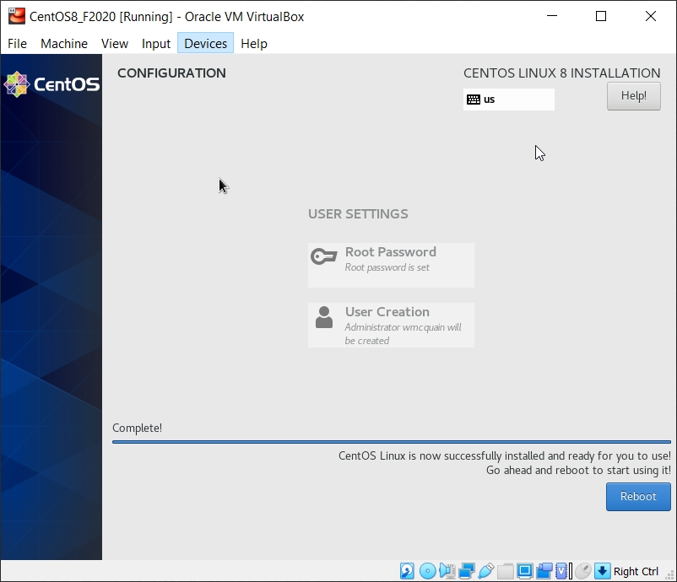
Prepare to Reboot
Eventually you should see the completion screen (it takes awhile, depending on how many software packages you chose, the speed of your machine, etc).
BEFORE you restart the virtual machine...

Slide 16
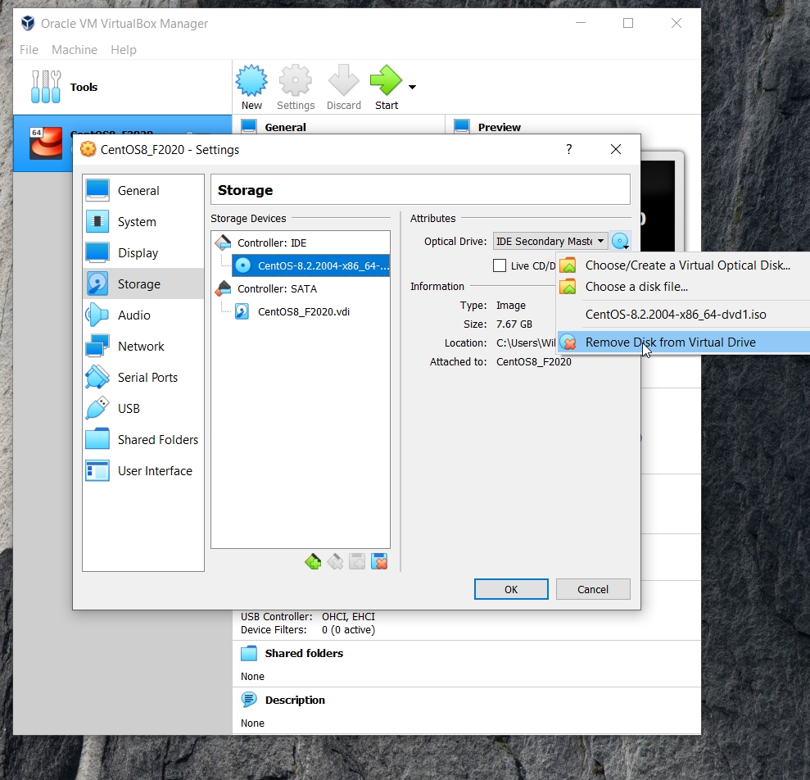
Prepare to Reboot
Before restarting the VM, you need to eject the CentOS 8 ISO:
Don't close the VM…
In VirtualBox Manager:
goto Settings
goto Storage
select the optical drive
click as shown
Remove Disk from Virtual Drive

Slide 17
Reboot
Now, choose Reboot…

Slide 18
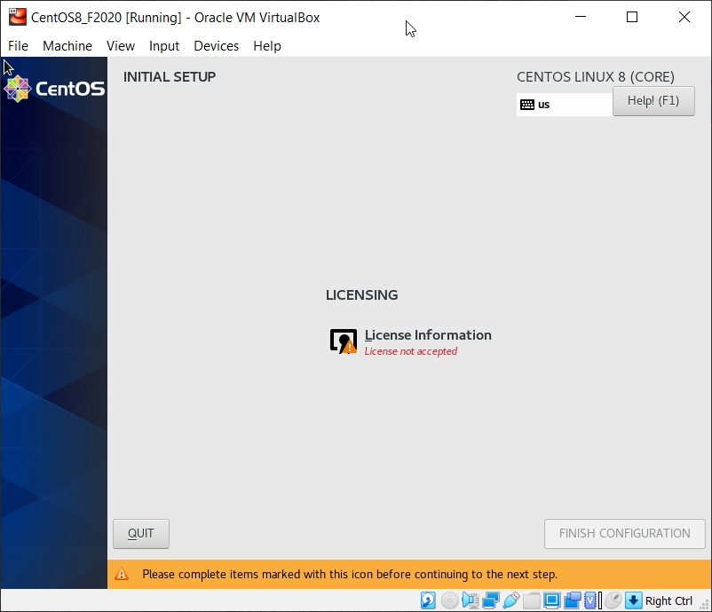
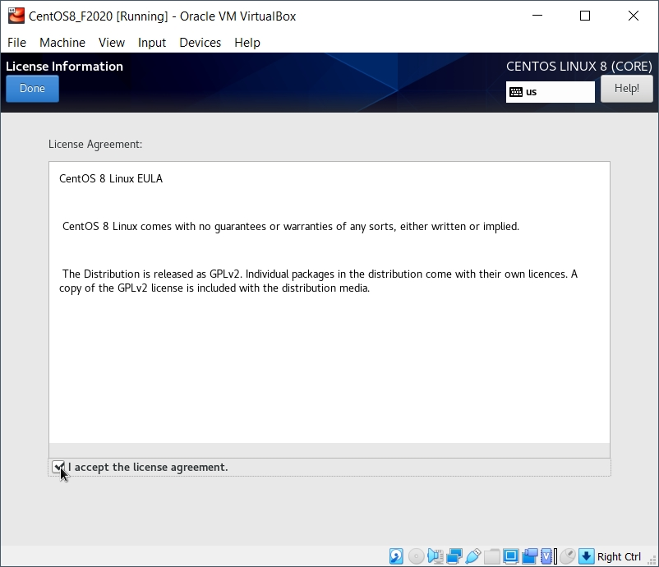
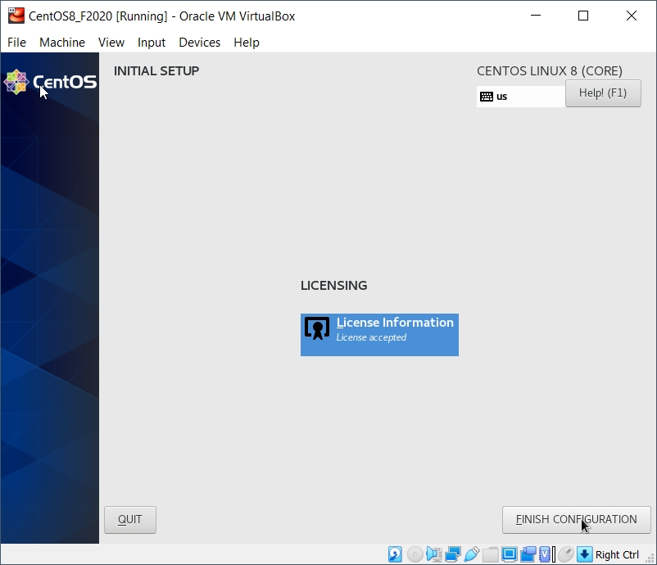
License Screen
The restart will bring you to the license screens:

Slide 19
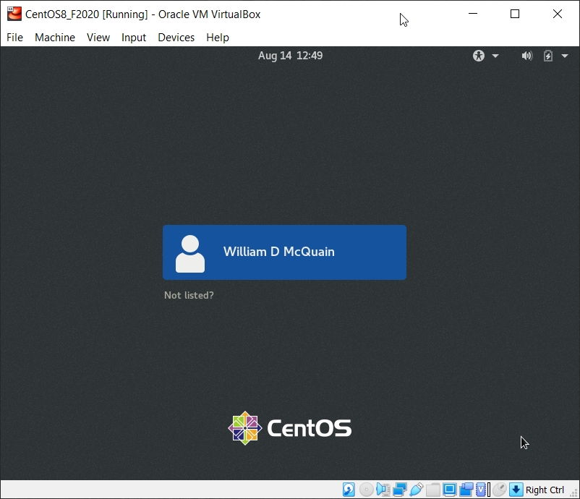
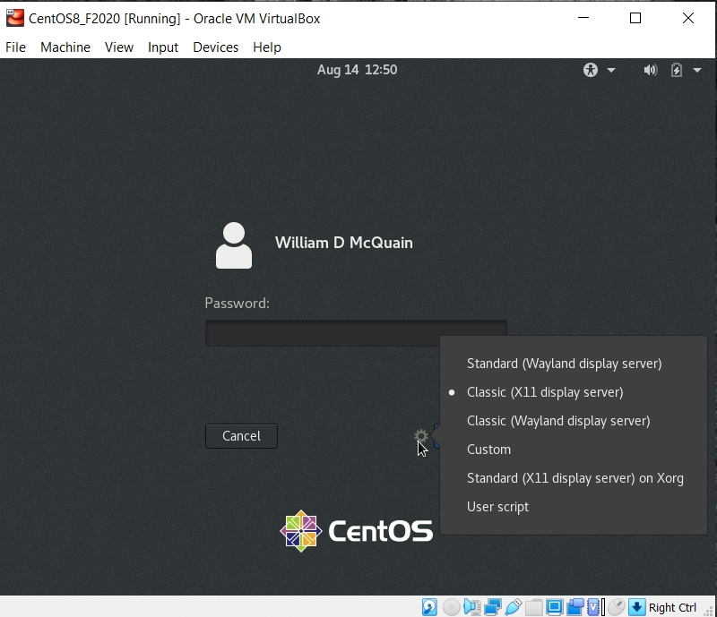
Login Screen
The restart will now bring you to the login screen:
I prefer the Gnome Classic desktop… the slides that follow assume that.

Slide 20
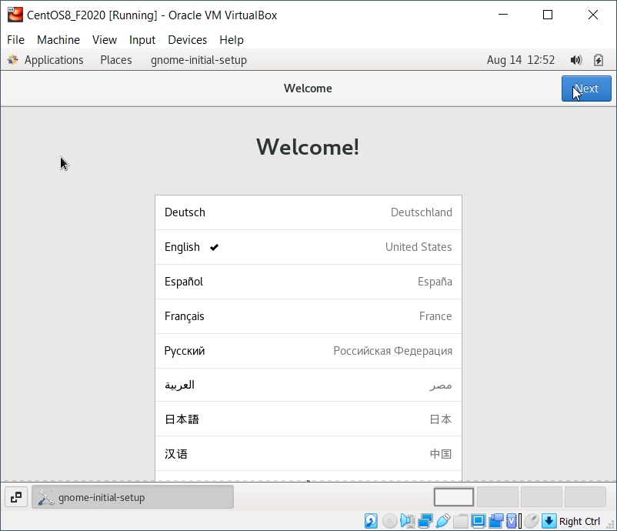
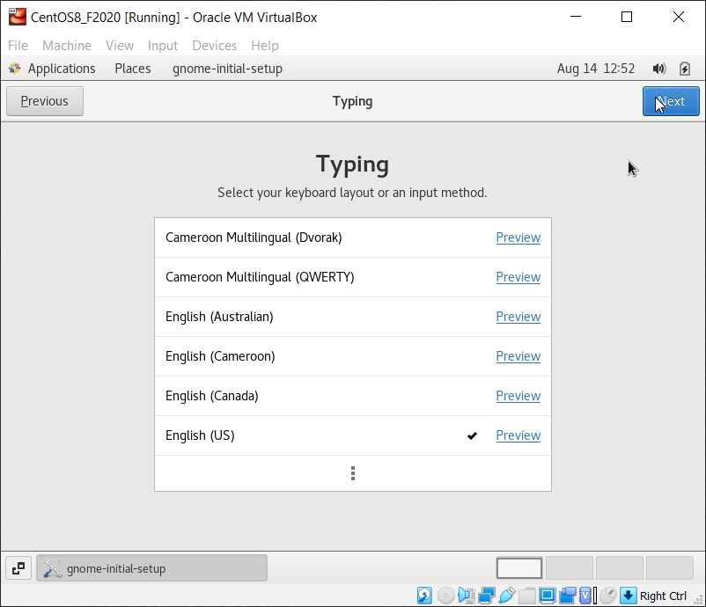
Initial Options
CentOS starts with some basic language and keyboard configuration:

Slide 21
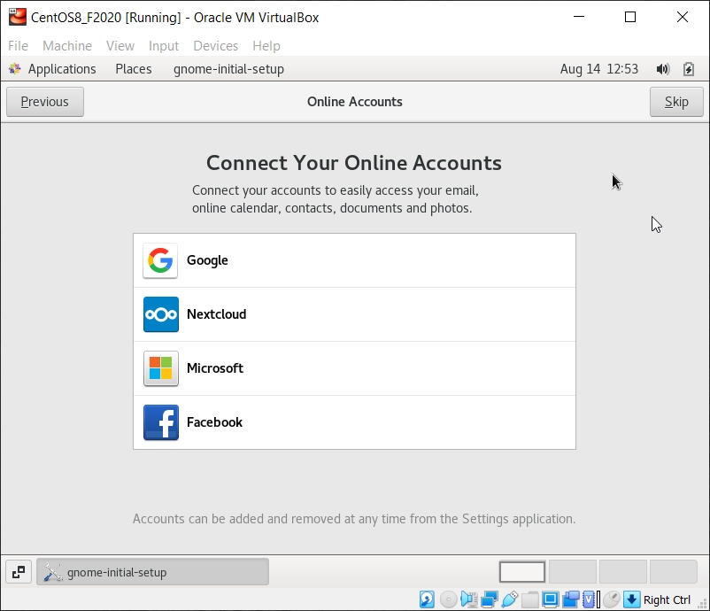
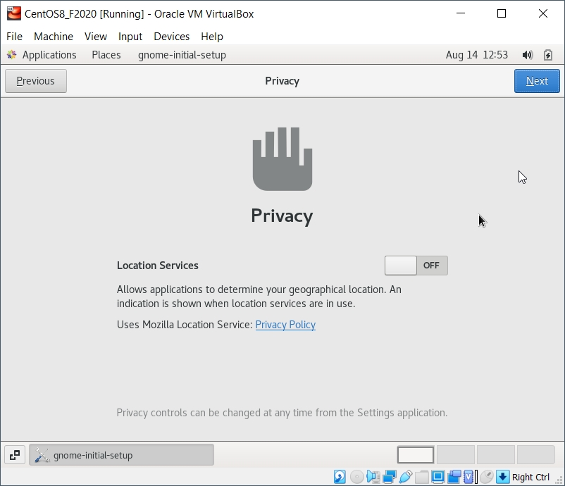
Initial Options
You may setup access to online accounts… or not…
You may configure some privacy settings …

Slide 22
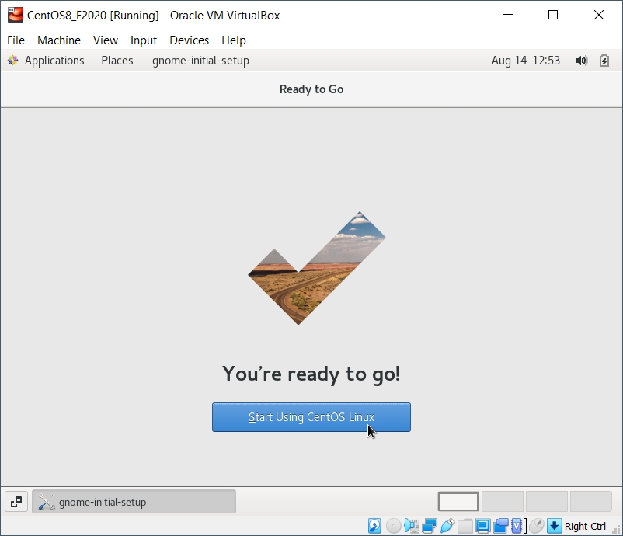
Completing Basic Setup
Eventually you will reach completion:

Slide 23
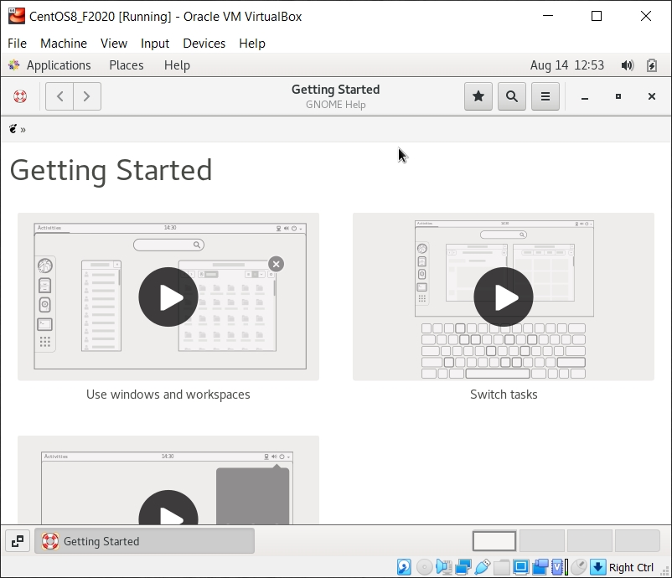
GNOME Help
On first startup, you'll be offered help for the Linux environment:
Ignore this or explore it, as you like... it's all available at any time.

Slide 24
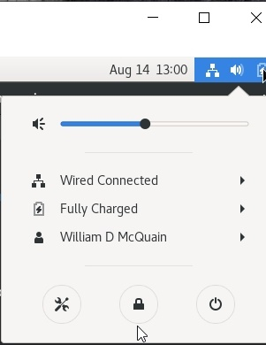
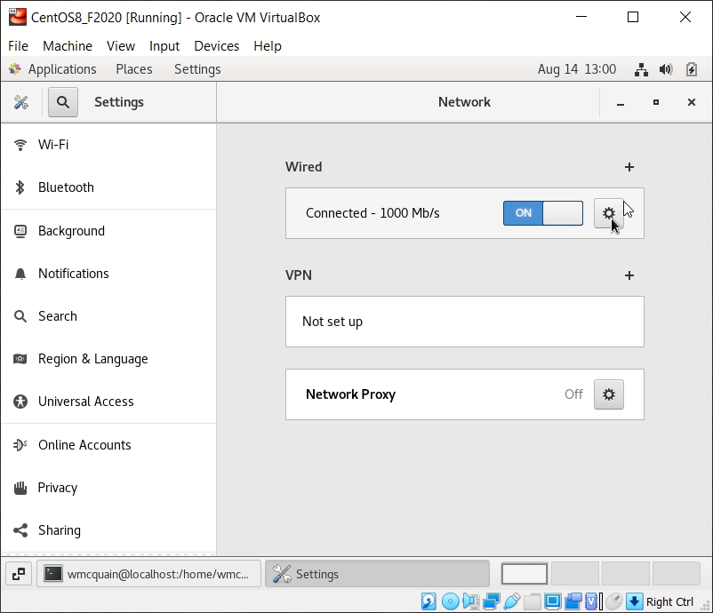
Starting the Network
Click the Network icon and turn on the network...

Slide 25
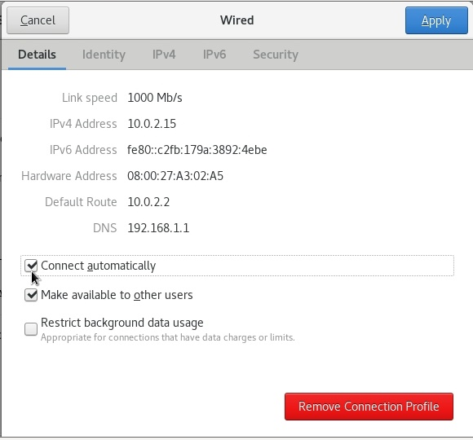
Make the Network Automatic
Click the gear icon for settings, and enable the network to be on automatically.

Slide 26
VirtualBox Guest Additions
The VirtualBox Guest Additions provide additional functionality for your VM.
Guest Additions (should) enable the following features:
- auto-capture and auto-release for the mouse and keyboard
- the ability to rescale the VM display by just resizing its window
- the ability to create a directory on the host OS that is accessible to the VM
- drag and drop between host and VM
- shared clipboard between host and VM
Another note: if you run the system updater or install other software on your VM, you may have to reinstall the Guest Additions.

Slide 27
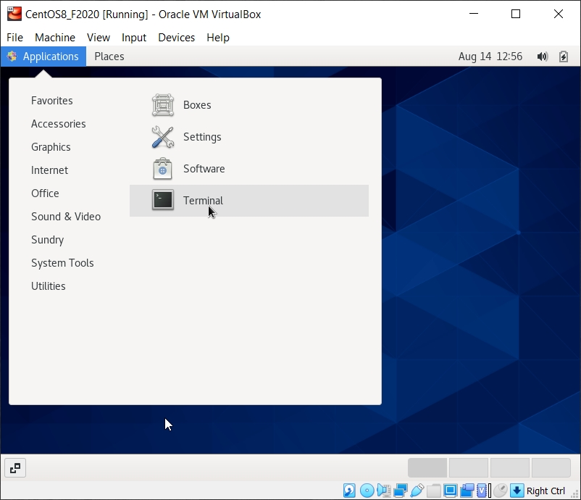
Install the Guest Additions
Note: many important CentOS features will not be available until this is done!
Unfortunately, I needed to install some additional software first…
Go to Applications/System Tools (or possibly Favorites), and start a Terminal session:

Slide 28
Install the Missing Libraries
#782 wmcquain: ~> su
Password:
[root@centos8 ~]# yum install elfutils-libelf-devel
Last metadata expiration check: 0:01:03 ago on Fri 14 Aug 2020 01:01:43 PM EDT.
Dependencies resolved.
=================================================================
Package Architecture Version Repository Size
=================================================================
Installing:
elfutils-libelf-devel x86_64 0.178-7.el8 BaseOS 58 k
Installing dependencies:
zlib-devel x86_64 1.2.11-13.el8 BaseOS 57 k
. . .
Total download size: 115 k
Installed size: 171 k
Is this ok [y/N]: y
Downloading Packages:
(1/2): elfutils-libelf-devel-0.178-7.el8.x86_64.rpm 193 kB/s | 58 kB 00:00
(2/2): zlib-devel-1.2.11-13.el8.x86_64.rpm 189 kB/s | 57 kB 00:00
…
Installed:
elfutils-libelf-devel-0.178-7.el8.x86_64 zlib-devel-1.2.11-13.el8.x86_64
Complete!
[root@localhost wmcquain]# exit
You need to be root to install or update a package
Execute this command

Slide 29
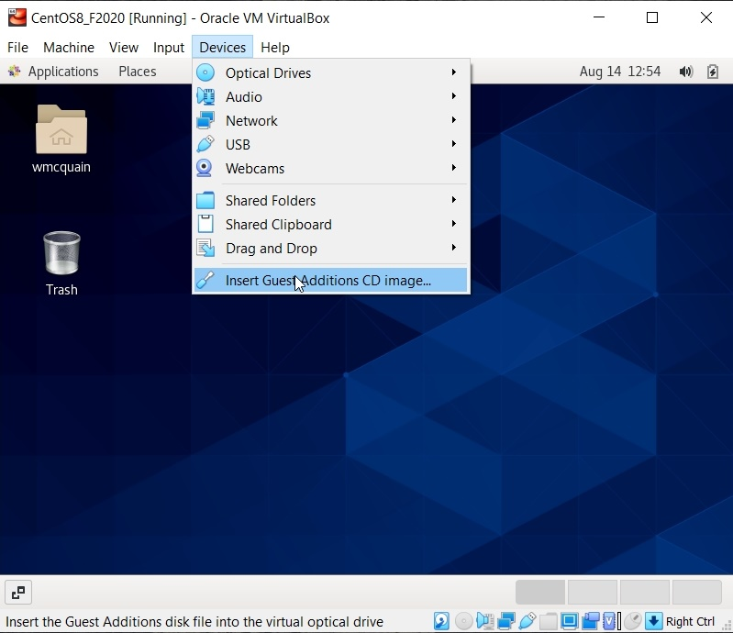
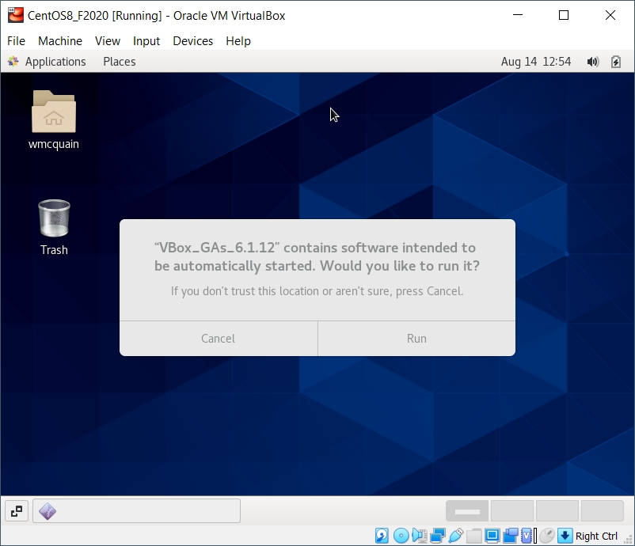
Install the Missing Libraries
From the Devices menu in the VirtualBox Manage, insert the Guest Additions CD:
Choose Run
You'll need to become root…

Slide 30
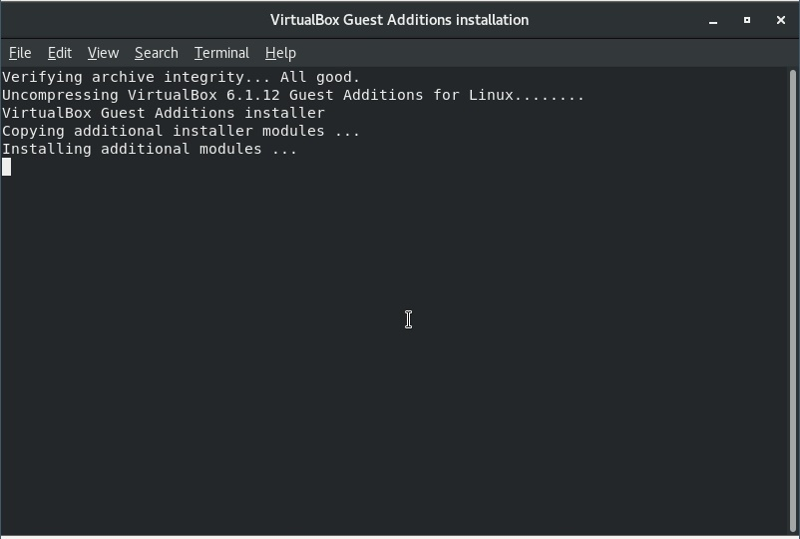
Install the Guest Additions
The installation will start, and may take awhile…
…do not close the window until you get a message that it's done.
This WILL fail if you haven't installed the libraries described earlier.

Slide 31
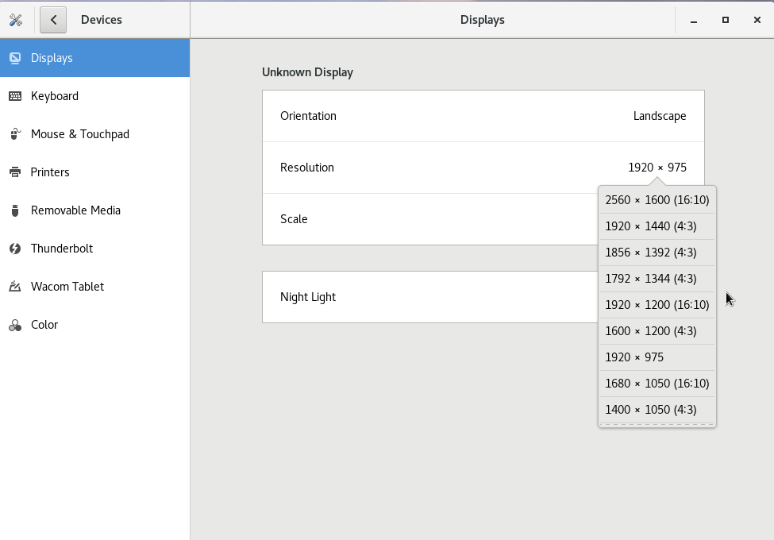
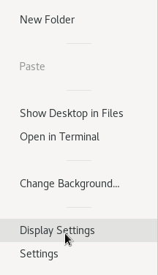
New Options
You can now resize the VirtualBox window and the display should adjust.
This may be a good time to adjust your display resolution.
Right-click on the display background
At this point, I sometimes encounter problems… which are often resolved by performing several restarts of the VM… however, the vast number of different video cards makes this a bit twitchy…

Slide 32
New Options
The mouse and keyboard capture feature should now be automatic.
No more Right-Crtl to release them (in most cases).
You now have the ability to create a shared folder with your host OS.
That will be described shortly…

Slide 33
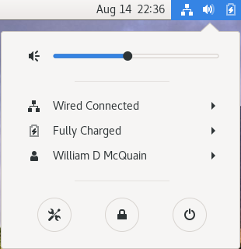
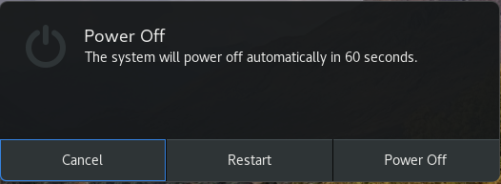
Shutdown CentOS
At this point, shut CentOS down properly.
Click the battery icon
Click Power Off
It is VITAL to always shutdown correctly… improper shutdowns may render the VM unbootable!

Slide 34
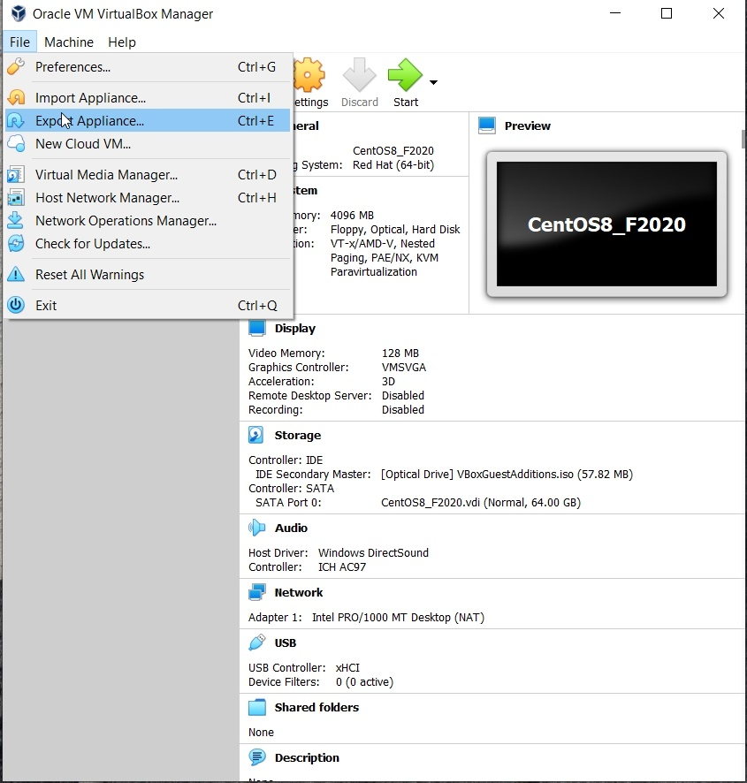
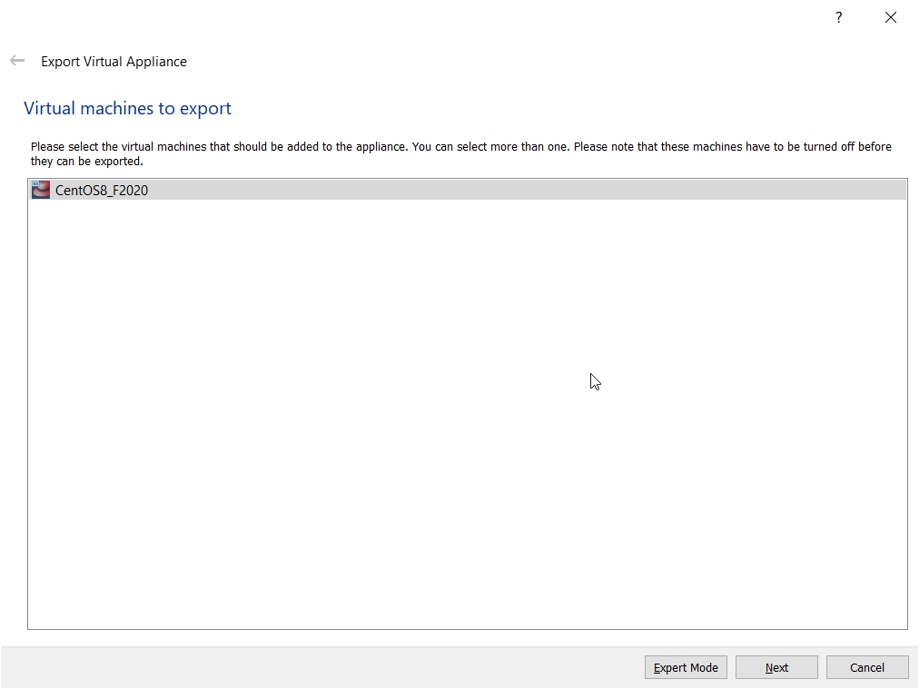
Back it Up!!
I recommend making a total backup of your virtual machine right now!
This gives you an emergency, pristine VM when things go wrong…
Do this with the VM shut down!
Do it frequently!

Slide 35
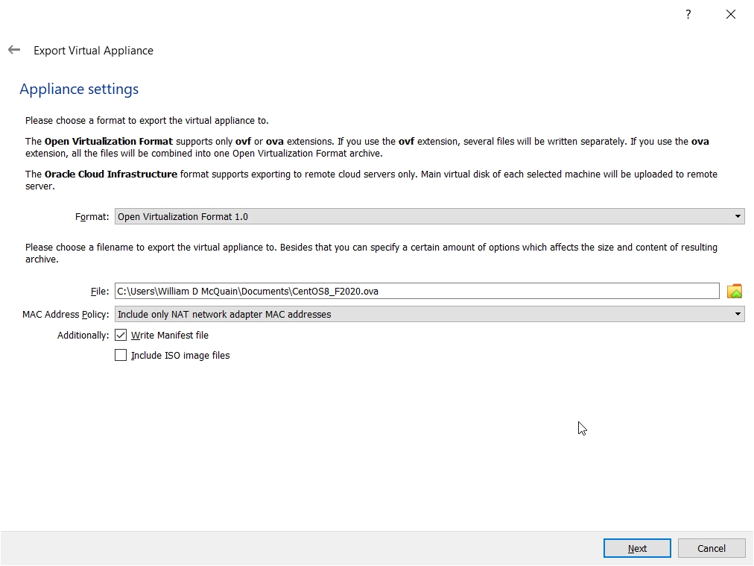
Exporting a Virtual Machine
The process creates a single file backup of your entire VM.
I suggest tagging the name with the date you made the backup… and keeping more than one backup around.
I suggest copying the backup file to another device for safe keeping.
You can:
use Import Appliance to reload this if your VM is damaged later
copy this to another computer and import it to a VirtualBox installation there

Slide 36
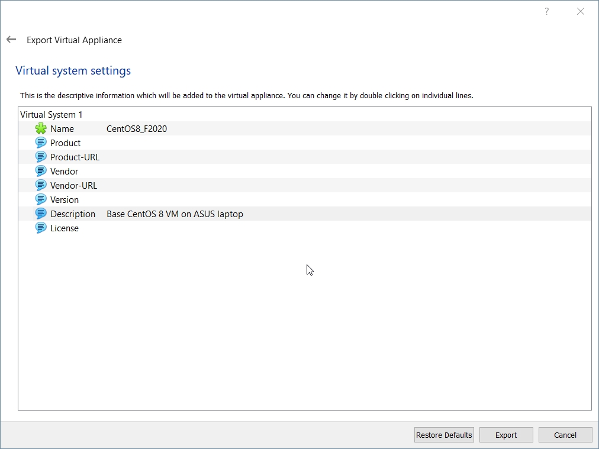
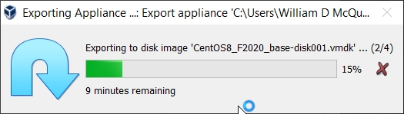
Exporting a Virtual Machine
The default settings will suffice, but I usually add a Description.
Back It Up!!

Slide 37
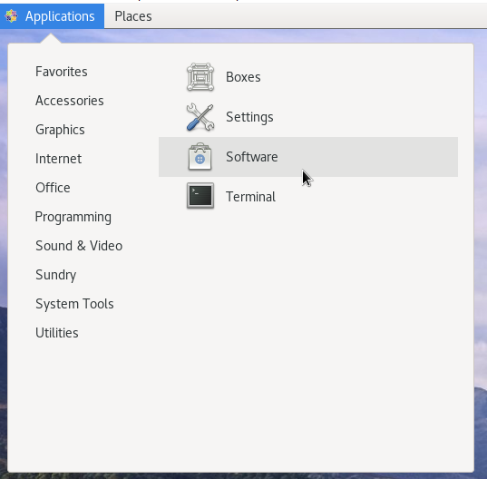
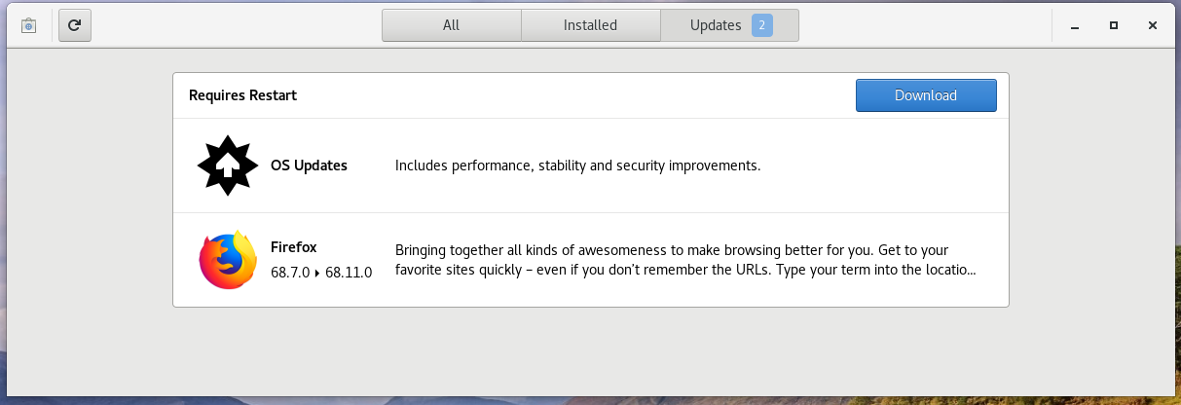
Software Updates
I recommend running a general software update at this point.
Go to the Application/System Tools menu and pick Software...

Slide 38
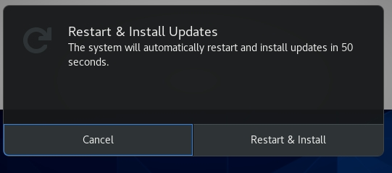
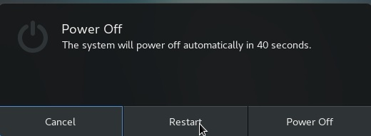
Software Updates
Restart after the updates complete…
And… I recommend making another full backup of your VM at this point.
This is a better starting option if things go wrong later.
If everything seems to still work:
Back It Up Again!!

Slide 39


Shared Folders
The most efficient way to transfer files between your VM and the host OS is to set up a shared folder that both OSes can see.
Pick the folder you want to share; I'll use D:\vm_share on my Windows 10 host.
In the VirtualBox Manager, click on Shared Folders and select the Add Folder button, then enter the path to the shared folder and make it permanent:
For the mount point, specify it's in the directory /media…

Slide 40

Shared Folders
Back in your CentOS VM, you need to add yourself to a Linux group.
Become root and do this (with YOUR username):
If the auto-mount feature doesn't seem to be working, become root execute:
mount.vboxsf share /media/vm_share
Of course, substitute the folder name you chose for vm_share.

Slide 41

Accessing Files
The Gnome desktop has a file manager, that is similar to those in Windows and OS X. Go to Places/Home:

Slide 42

Accessing Remote Hosts
The Gnome File tool provides drag-and-drop file transfers with remote hosts:
Note how I am including the path to my rlogin home directory.
Use pwd on rlogin to determine yours.

Slide 43


Accessing Remote Hosts
After logging in to the remote host…
… now I have access to my home directory on rlogin.

Slide 44

Additional Stuff: yum
As you use your CentOS system, you'll probably discover new tools you'd like that are not included by default.
In most cases, if you know the name of the software package you'd like to install, you can do so by running the yum tool. yum has many options and you should skim its man page.
For instance, we can use yum to determine what version of a package is installed:

Slide 45
Additional Stuff: yum
We can use yum to install or update a package:
[wdm@Centos65 ~]$ yum install tree
. . .
You need to be root to perform this command.
[wdm@Centos65 ~]$ su
Password:
[wmcquain@localhost ~]$ su
Password:
[root@localhost wmcquain]# yum install tree
. . .
Resolving Dependencies
. . .
Dependencies Resolved
. . .
Transaction Summary
====================================================
Install 1 Package
Total download size: 46 k
Installed size: 87 k
Is this ok [y/d/N]: y
You need to be root to install or update a package:
Now I am root ... bwa ha ha!
yum has determined what needs to be installed, shown me that info, and now wants confirmation...

Slide 46
Additional Stuff: yum
We can use yum to install or update a package:
. . .
Downloading packages:
tree-1.6.0-10.el7.x86_64.rpm | 46 kB 00:00:00
Running transaction check
Running transaction test
Transaction test succeeded
Running transaction
Installing : tree-1.6.0-10.el7.x86_64 1/1
Verifying : tree-1.6.0-10.el7.x86_64 1/1
Installed:
tree.x86_64 0:1.6.0-10.el7
Complete!
[root@localhost wmcquain]# exit
yum triggers the installation..
Now I will cease to be root ... that much privilege can be dangerous.
I've noticed that CentOS 8 actually includes the tree command by default.

Slide 47
Additional Stuff: yum
Sometimes yum cannot find a package:
root@localhost wmcquain]# yum install geany
Loaded plugins: fastestmirror, langpacks
Loading mirror speeds from cached hostfile
* base: mirror.es.its.nyu.edu
* extras: mirror.team-cymru.com
* updates: mirror.math.princeton.edu
No package geany available.
Error: Nothing to do
yum queries a collection of online repositories... in this case it doesn't find the package I wanted.
It's possible to direct yum to search additional repositories…

Slide 48
Adding a Repository
[root@localhost wmcquain]# yum install epel-release
. . .
Resolving Dependencies
. . .
Dependencies Resolved
=============================================================
Package Arch Version Repository Size
=============================================================
Installing:
epel-release noarch 7-11 extras 15 k
Transaction Summary
=============================================================
Install 1 Package
Total download size: 15 k
Installed size: 24 k
Is this ok [y/d/N]: y
Downloading packages:
. . .
Here, I'm adding another common repository to those yum queries by default.

Slide 49
Installing Geany
root@localhost wmcquain]# yum install geany
. . .
Dependencies Resolved
==========================================================================
Package Arch Version Repository Size
==========================================================================
Installing:
geany x86_64 1.31-3.el7 epel 2.5 M
Installing for dependencies:
geany-libgeany
x86_64 1.31-3.el7 epel 1.0 M
vte3 x86_64 0.36.5-1.el7 base 337 k
Transaction Summary
===========================================================================
Install 1 Package (+2 Dependent packages)
Total download size: 3.8 M
Installed size: 13 M
Is this ok [y/d/N]: y
...
Here, I'm installing a programmer's editor, geany.

Slide 50

Additional Stuff: Geany
geany is a programmer-oriented editor:
It's my (current) favorite text editor for programming on Linux.
It's also available for Windows.

Slide 51
Useful Libraries
By default, 64-bit Linux distros do not install some libraries that are needed in order to compile 32-bit binaries.
We may want that capability later on. The following worked for me:
root@localhost wmcquain]# yum install glibc-devel.i686 libgcc.i686
. . .
Others have reported success with:
root@localhost wmcquain]# yum install glibc-devel.i686 libgcc.i686 libstdc++-devel.i686 ncurses-devel.i686
. . .

Slide 52


Configuring the Terminal
The Terminal application provides some options for customization:
Here, I'm renaming the default Terminal Profile…

Slide 53

Configuring the Terminal
As you may have noticed, I prefer to reset the Terminal colors:
I also reset the default number of rows and columns… feel free to experiment.

Slide 54

Configuring the Terminal
Go to the Command tab and enable "Run command as a login shell":
This makes sure that configuration changes in .bashrc and .bash_profile take effect when you open a new terminal session.

